Slide 1
Education in GCC Countries: Access and Innovation
Marina TOLMACHЁVA
Washington State University
tolmache@wsu.edu

Slide 2
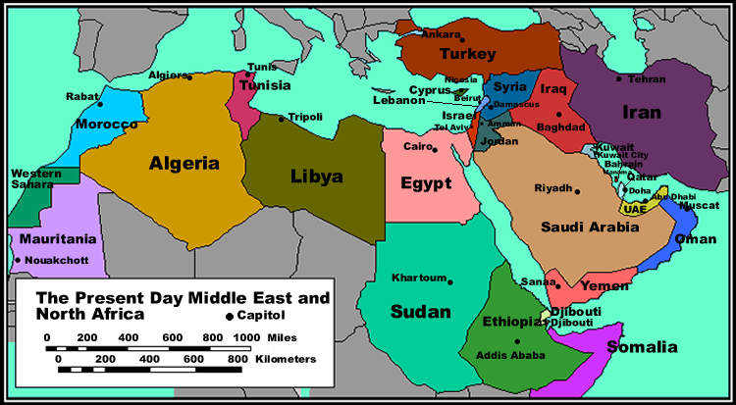
The Middle East & North Africa

Slide 3
Youth of the Gulf
The Business of Education
Education Goals – Whose Goals?
Women in Education
Education, religion and tradition
International factors
Concerns for Students
Concerns for Educators

Slide 4
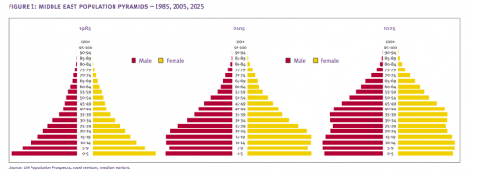
Prospects and Problems:
“Youth Tsunami” or
“From Oil Boom to Youth Boon”?

Slide 5
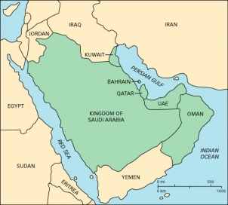
Gulf Cooperation Council countries

Slide 6
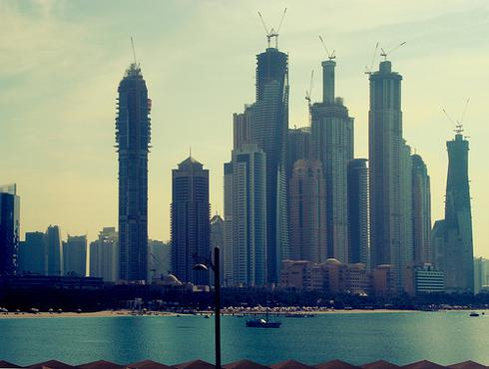
At first glance:
Investment, Innovation, Competition

Slide 7

Nearly half of Saudi Arabia’s own 2011 population consists of youths under age 20
Nearly one in five people living in the Middle East and North Africa (MENA) region is between the ages of 15 and 24—the age group defined as "youth." The current number of youth in the region is unprecedented: nearly 95 million in 2005.

Slide 8
Gulf Population Estimates 2013
Saudi Arabia 28.16 mln
UAE 7.89
Kuwait 3.85
Oman 2.95
Qatar 1.94
Bahrain 1.55

Slide 9
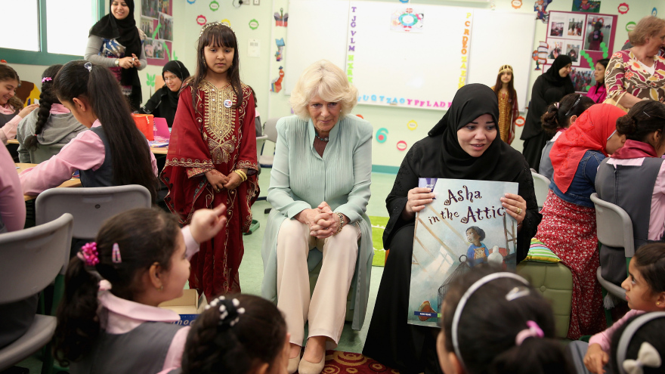
Education is for them…

Slide 10
Middle East Higher Ed Background:
Middle East and North African higher education historically dominated by European university models.
British college model emulated by national universities after independence
Formerly few American universities, originally missionary colleges

Slide 11
Education trends in the Middle East and the Gulf
Population growth
Oil wealth
National universities cannot cope
Middle class can afford tuition
Demand for
  Higher education
  Higher education in home country
  New type of higher education
  Higher education for women
  Higher education for expatriates

Slide 12
Current picture
U.S., British, Australian, Canadian, and Indian universities & colleges now offer post-secondary English-language instruction in the region.
German & Malaysian universities are coming.
American-style community colleges coming.

Slide 13
GCC goals:
Develop “knowledge economies”
Become “education destinations”
Reduce dependence on expatriate labor
Reduce state financing of higher education

Slide 14
Motivation for inviting US schools:
Observed success of American higher education in producing
Employable graduates
Successful businessmen & entrepreneurs
Competent professionals
Research, publications, creative works

Slide 15
American U Model: major types
1 Branches of American Universities (public & private)
  financed by government/state institutions
2 Private local universities with American partners
  financed by investors & tuition
3 “American” universities chartered in US
  financed by tuition, eligible for US support

Slide 16
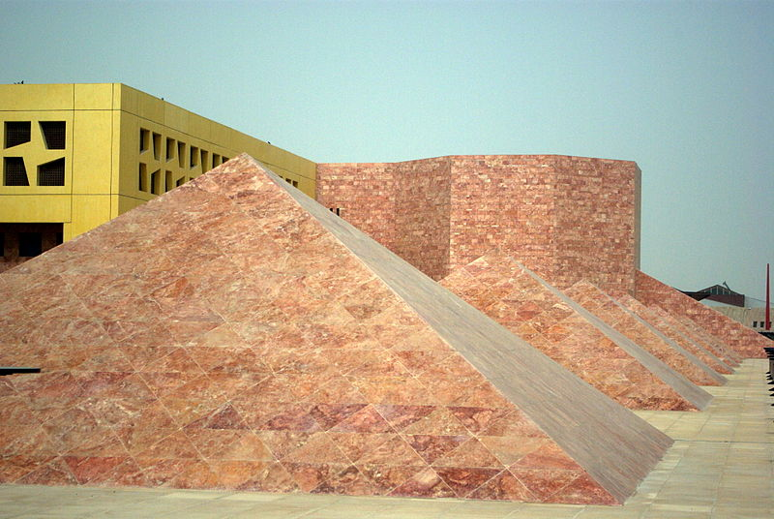
Education City — Doha, Qatar

Slide 17
Six American universities, one British university and one French university – branch campuses
Virginia Commonwealth U. in Qatar , est. 1998 - School of the Arts (VCUQ).
Weill Cornell Medical College in Qatar (WCMC-Q). Est. 2001.
Texas A&M University at Qatar (TAMUQ). Est. 2003 . Degrees in chemical, electrical, mechanical and petroleum engineering.
Carnegie Mellon University in Qatar (CMU-Q). From 2004: Business, computer science ; as of 2007 information systems. From 2011, joint program with Weill Cornell Medical College in Biological Sciences and Computational Biology.
Georgetown University School of Foreign Service in Qatar SFS-Qatar). Est. 2005. Bachelor's degree in foreign service.
Northwestern University in Qatar (NU-Q). Est. 2008: journalism and communication.
HEC Paris, est. 2011 graduate executive education program.
UCL Qatar, est. 2011 and offers postgraduate degree programmes in the areas of archaeology, conservation, cultural heritage and museum studies.
ALSO: Qatar Faculty of Islamic Studies (QFIS). Est. 2007.

Slide 18
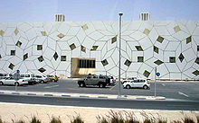

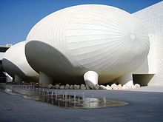


Liberal Arts and Science classroom buildings
Lecture halls at the Weill Cornell Medical College campus in Education City

Slide 19
Education City is an initiative of Qatar Foundation for Education, Science and Community Development
RAND-Qatar Policy Institute (RQPI), which complex policy problems and helps implement enduring solutions for clients across the Middle East, North Africa and South Asia.
Qatar Science & Technology Park (QSTP), a state-of-the-art facility comprising Doha Debates, a public forum for dialogue modeled on the Oxford Union debates and broadcast on the BBC.
Al Jazeera Children's Channel (JCC), a pan-Arab youth television channel which aims to strike a balance between education and entertainment.

Slide 20
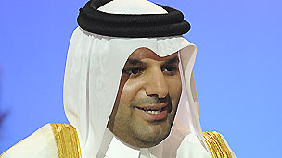
WISE Chairman H.E.
Dr Abdulla bin Ali Al-Thani
Why is Qatar investing so much in education?
Strategic decision to spend oil income on education
Knowledge economy
Freedom of inquiry
“Nobel for education”

Slide 21
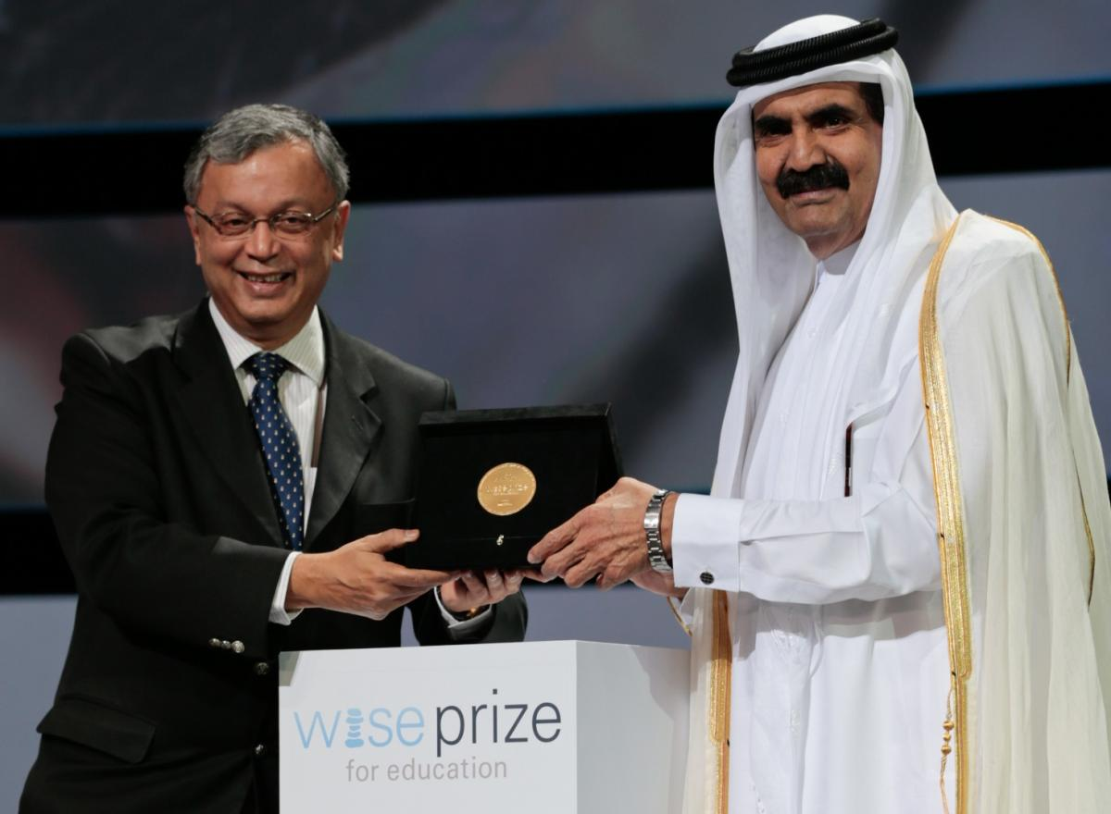
The World Innovation Summit for Education (WISE)
WISE Prize (est. 2009)

Slide 22
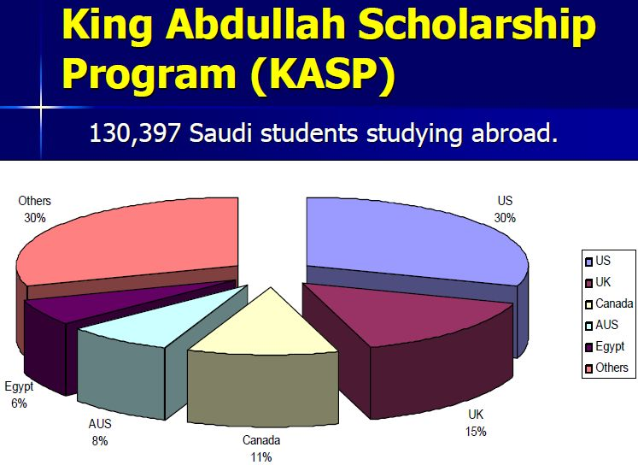
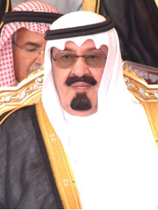
King Abdullah University of Science and Technology (KAUST, 2009)
The Custodian of the Two Holy Mosques King Abdullah Bin Abdulaziz Al Saud

Slide 23

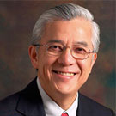
Technocrat leadership
President Choon Fong Shih 2008-2013 (ex NUS)
Jean-Lou Chameau 2013-
(ex-CalTech)

Slide 24

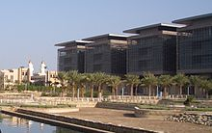
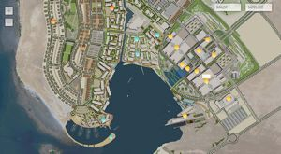
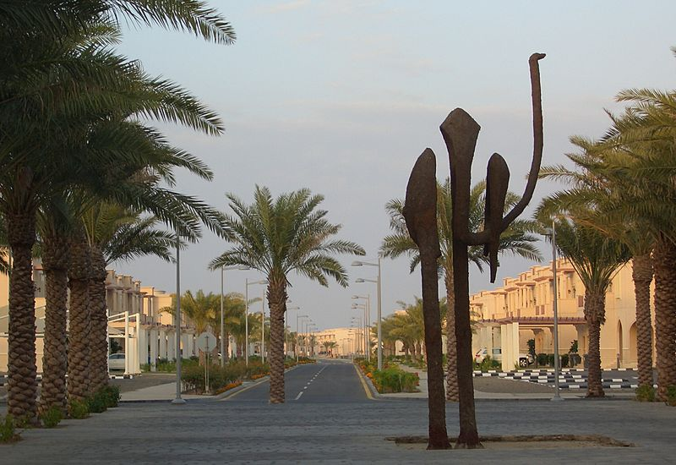

KAUST facilities and students

Slide 25
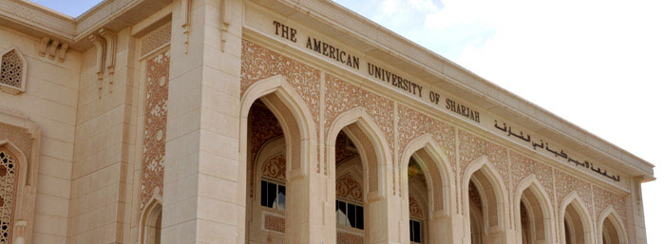
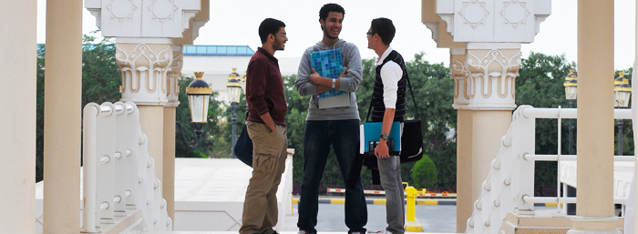
AU Sharjah

Slide 26

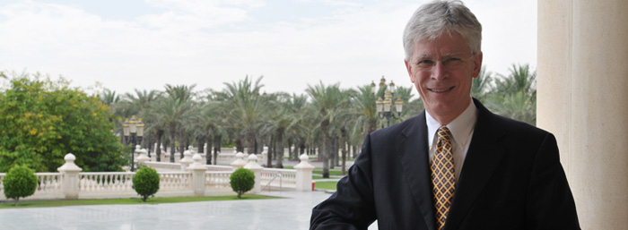
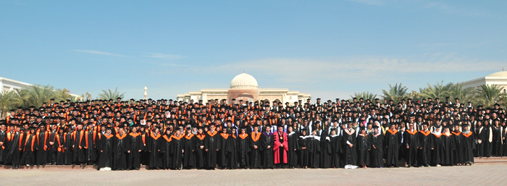
President Heath, Provost Hochstettler
AUS Commencement 2012

Slide 27
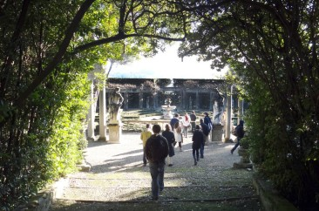
NYUAD: “The World's Honors College“

Slide 28
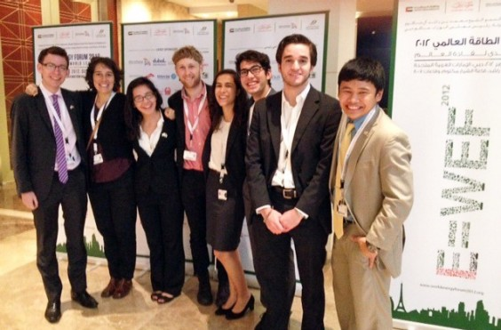
NYUAD Students Head to Dubai for World Energy Forum

Slide 29
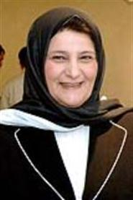
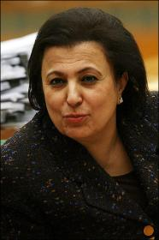
KUWAIT EDUCATORS
Nuriya Sabeeh, former Kuwait Education Minister
Faiza Kharafi,
former president,
Kuwait University

Slide 30
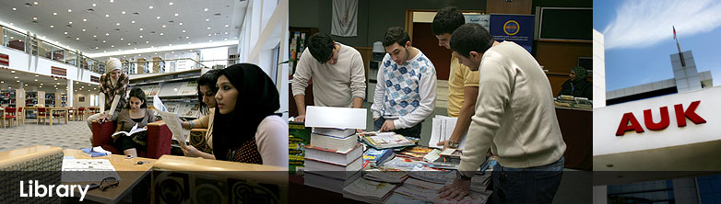
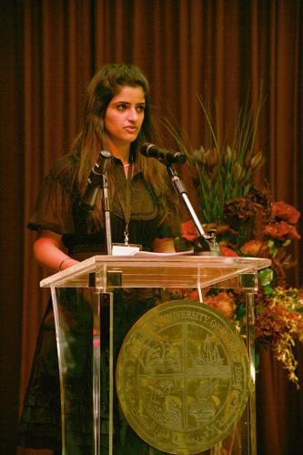
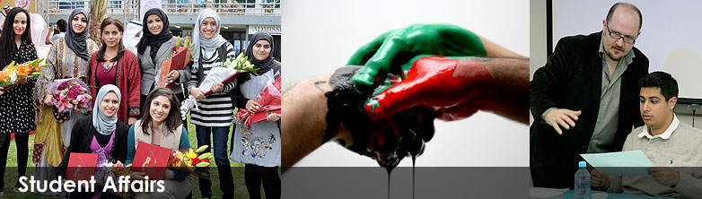
Kuwaiti students
American University of Kuwait
Sarah Budai, AUK alumna

Slide 31
Secondary Ed Background
English-language secondary education
  mostly follows British model
  Mostly private
  Elite schools with links to UK
  Indian & Pakistani schools
  Bilingual schools (English-Arabic)
  International faculty
“American” schools for the elite

Slide 32

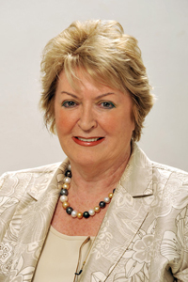
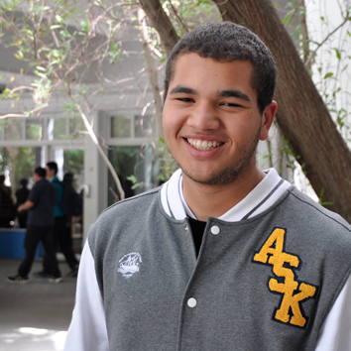
“Feeder” schools for elite colleges
Vera Mutawwa, founder of the British School of Kuwait
Students of the American School of Kuwait

Slide 33
The Business of Education
UAE Population: 2005=4.1 mln; 2012=7.5+
Abu Dhabi – 11 universities, including
NYUAD
INSEAD
Paris-Sorbonne AD
Dubai – 18 universities, including
Cass Business School
U. of Wollongong
London Business School
Rochester Institute of Technology

Slide 34
Bahrain: Population 1.3 mln with non-nationals
4 public & 16 private universities
Bentley U (Mass.) own faculty
DePaul “flying faculty”
New York Institute of Technology – Bahrain
University of Wales, Bangor (2 years in Bahrain, 3rd in UK)
Birla Institute of Technology (India, also branches in Oman and UAE)
Arab Open University
Royal University for Women

Slide 35
GCC Higher Education: whose rules?
Qatar:
Education City
UAE, Bahrain
Kuwait
(AUK, GUST, AUME)
Saudi Arabia
Exempt from local HE regulations
Foreign branches exempt from some regulations.
Local private American- or British-style not exempt.
Local control
No foreign universities

Slide 36

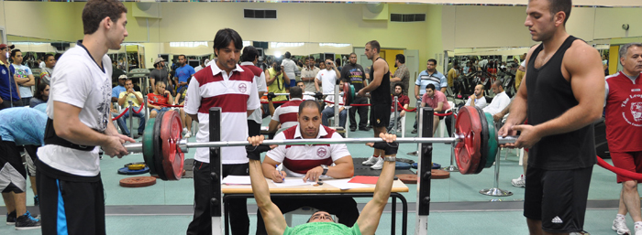
Sports and wellness are promoted

Slide 37
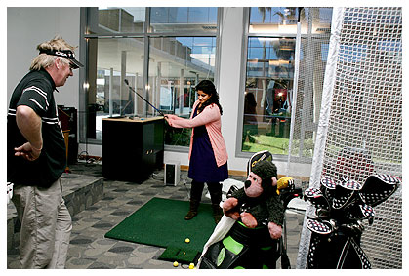
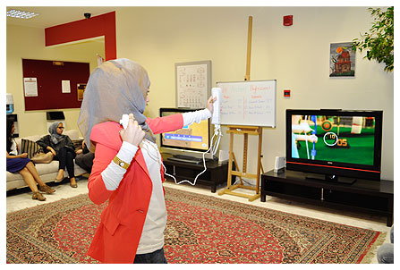
Sports are gender-segregated

Slide 38
GCC challenges:
GCC colleges are young and changing
Certain freedoms may be limited
GCC regulations may require
  Gender segregation
  Adherence to Islamic values
  For-profit status for private colleges
  Legally mandated differences between citizens and expatriates

Slide 39
GCC challenges:
GCC investors hesitant re
  US incorporation
  Faculty governance
  Cooperation with local private institutions

Slide 40
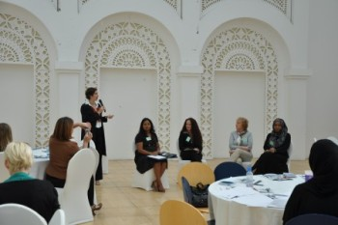
Helping Women Hurdle Employment Barrier A discussion at "How Women Work," part of an Arcata program in Qatar.
“Every year, thousands of students graduate from Arab universities and find there are no jobs”
Swelling Number of Students
Fighting Sexual Harassment on Campus

Slide 41
Education vs. Security
CHE, February 25, 2013
Canceled Conference Revives Concerns About Academic Freedom in the Persian Gulf
The London School of Economics and Political Science abruptly canceled an academic conference on the Arab Spring at the American University of Sharjah, in the United Arab Emirates, citing "restrictions imposed on the intellectual content of the event that threatened academic freedom."
Does U.S. Accreditation Mean American-Style Academic Freedom? U.S. accreditation, a sought-after prize for some Arab universities, might get pulled when American values clash with those of countries where security concerns can override academic ones.

Slide 42
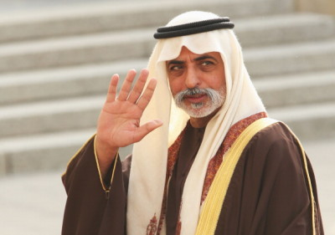
Longtime Emirati Education Minister
Moves Aside
Al Fanar 19 March 2013
Sheikh
Nahyan
Bin Mubarak
Al Nahyan

Slide 43

http://www.al-fanar.org/ http://alexandriatrust.org/our-projects/public-voice-al-fanar

Slide 44

Concerns and hopes…
“The thinker”: Barcelona's shirt sponsor is the Qatar Foundation, which funds education projects
Liberal Education –
A Model for Reversing Brain Drain?
Can Liberal Arts Curb Extremism?

Slide 45




Thank you. Questions?

