Slide 1
Women in the Arab Countries of the Gulf Region: the Ordinary and the Extraordinary
Marina TOLMACHЁVA
Washington State University
tolmache@wsu.edu

Slide 2
Women of the Gulf
Women in the Gulf
Women young and old, old and new
Women, religion and tradition
Women in public life
  Gender in politics
  Personalities and Faces

Slide 3
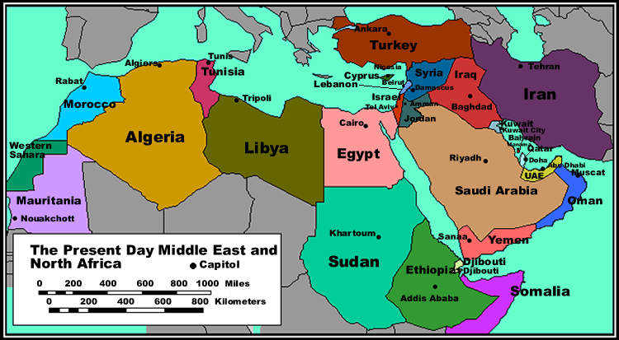
The Middle East & North Africa

Slide 4
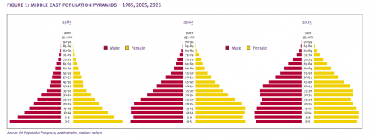
Prospects and Problems:
“Youth Tsunami” or
“From Oil Boom to Youth Boon”?

Slide 5
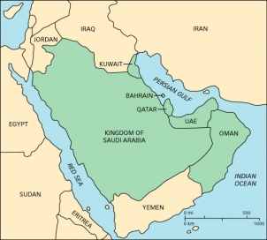
Gulf Cooperation Council countries

Slide 6
Gulf Population Estimates 2013
Saudi Arabia 28.16 mln
UAE 7.89
Kuwait 3.85
Oman 2.95
Qatar 1.94
Bahrain 1.55

Slide 7


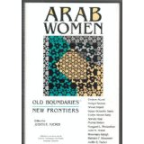

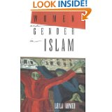
We have learned a great deal about Arab women…

Slide 8
“...mass-market publishing has brought us a sordid genre of pulp non-fiction about Muslim woman’s bondage and oppression.”
Lila Abu-Lughod (Columbia U)

Slide 9
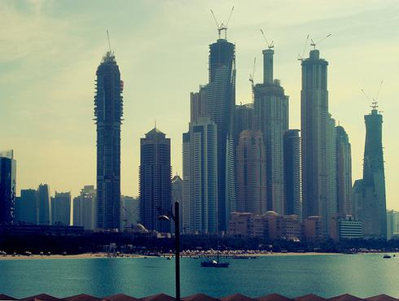
The Gulf at first glance:
Investment, Innovation, Competition

Slide 10


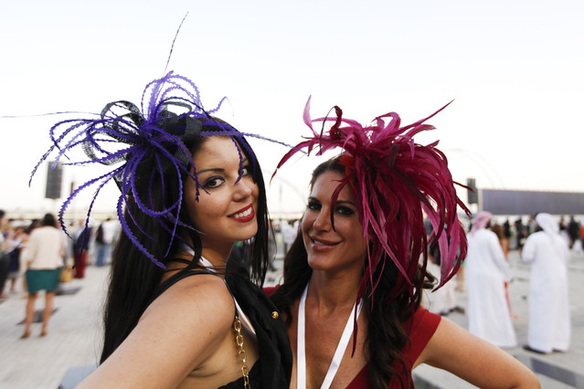
Global Outreach:
Dubai World Cup 2013 fashions

Slide 11
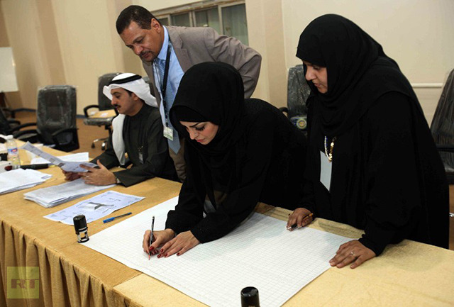
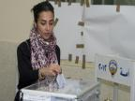

DEMOCRACY IN THE GULF?
Kuwait, 2005: women gained the right to vote and be elected to Parliament

Slide 12
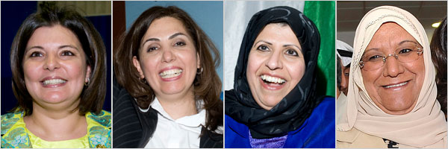
Kuwait, 2009: four women elected to Parliament
June 1, 2009: “Women arrive in Kuwait's parliament, and some male MPs walk out”
L-R: Dr. Aseel al-Awadhi, Dr. Rula Dashti (#56 in the 100 most powerful Arab women list), Dr.Salwa al-Jassar, Dr. Massouma al-Mubarak

Slide 13
Democracy in Saudi Arabia?
Women’s and Girls’ Rights
On September 25, 2011 King Abdullah announced that women will be able to vote in municipal elections in 2015. The king also promised to appoint women as full members of the Shura Council.
Saudi Arabia is the only country in the world to prohibit women from driving.
The Saudi guardianship system continues to treat women as minors. Under this discriminatory system, girls and women of all ages are forbidden from traveling, studying, or working without permission from their male guardians. In 2009 the Ministry of Commerce, though not other ministries, stopped requiring women to conduct ministerial business through a male representative.
http://www.hrw.org/world-report-2012/world-report-2012-saudi-arabia

Slide 14
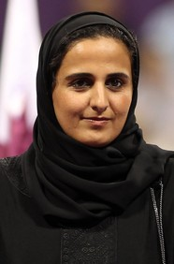
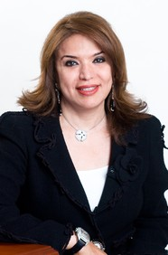
The FORBES list of 100 “Power Women” http://www.forbes.com/power-women/list/
#85 Sheikha Al-Bahar,
National Bank of Kuwait
Also #8 on Arab Women list
#100 Sheikha Mayassa Al Thani, Qatar Museums Authority

Slide 15
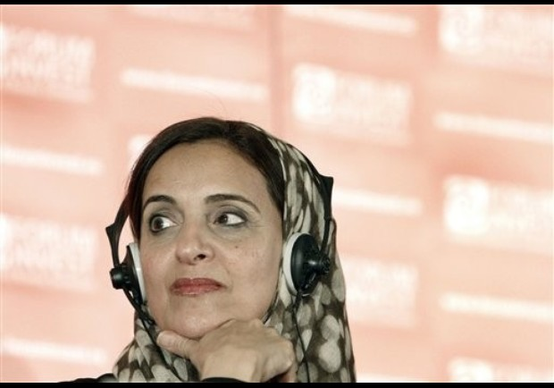
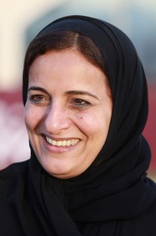
Sheikha Lubna Al Qasimi of UAE
#92 on World Power Women list
#1 on Arab Women list

Slide 16
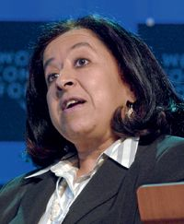

Saudi women on the
100 Arab Power Women list
#3 Lubna Olayan, Finance
#4 Princess Ameerah Al Taweel , Philanthropist

Slide 17
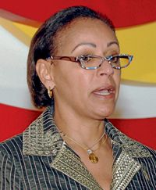
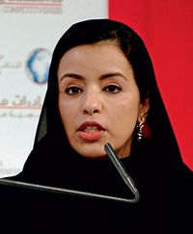
Kuwait businesswomen on the list of 100 most powerful Arab women
#18 Sheikha Hessa Al Sabah
#43 Maha Ghunaim

Slide 18
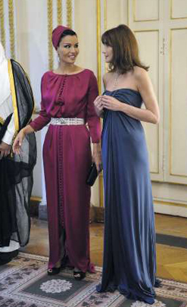
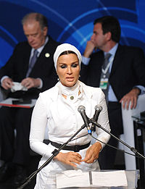
Sheikha Mozah bint Nasser Al Missned, Qatar Foundation

Slide 19
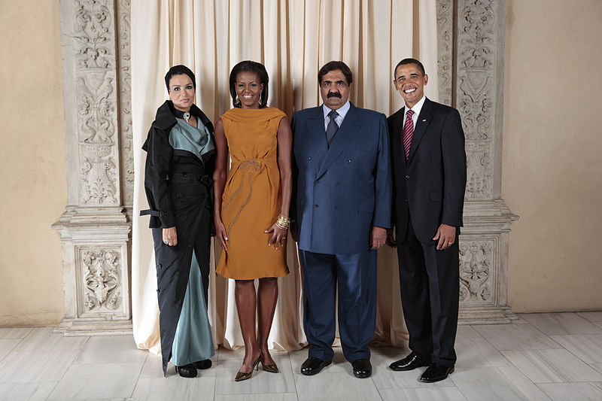
Sheikha Mozah with her husband at the White House

Slide 20
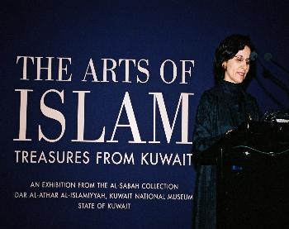
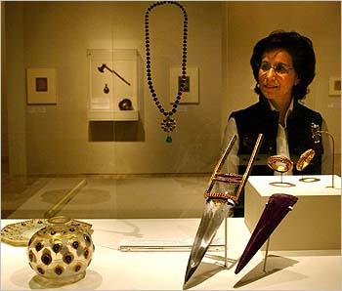
Sheikha Hussa Al Sabah
Kuwait cultural leader
Dar al-Athar al-Islamiya cultural center and curated collection

Slide 21
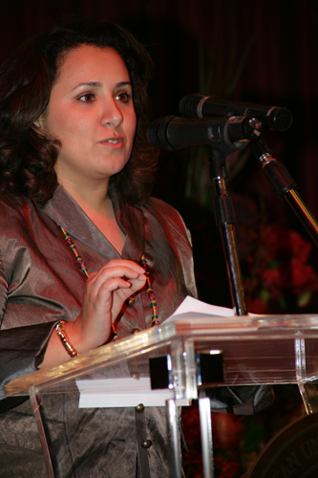
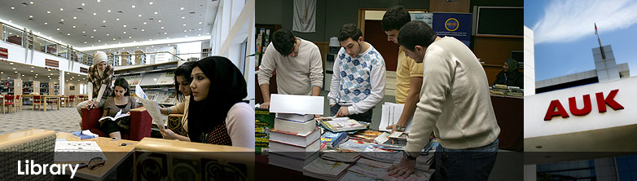
Sheikha Dana Sabah, Kuwait
Businesswoman and education patron

Slide 22
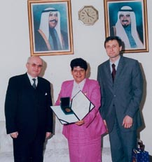
Sheikha Dr. Rasha Al Sabah
Kuwait politician and educator
Degrees from University of Birmingham and Yale
1985-91 Vice Rector, Kuwait University
1989-2008 Under Secretary, Ministry of Higher Education
Named International Woman of the Year for 1996-1997 by the International Biographical Center (IBC) in Cambridge

Slide 23
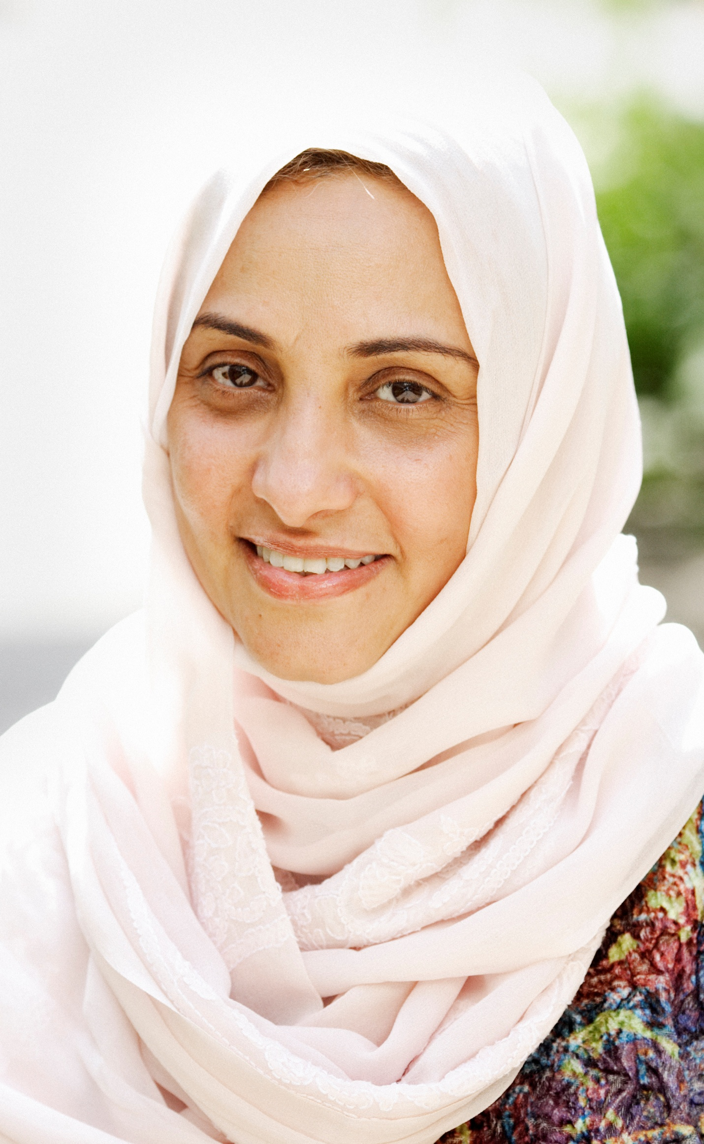
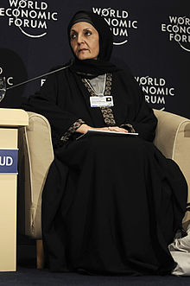
Dr. Haifa Jamal Al-Lail
President of Effat University, Saudi Arabia
Ph.D. in Public Policy, University of Southern California, 1991
Princess Loulwa bint Faisal, daughter of Queen Effat

Slide 24
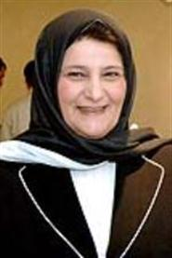
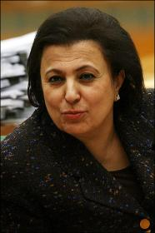
KUWAIT EDUCATORS
Faiza Kharafi,
former president,
Kuwait University
Nuriya Sabeeh, former Kuwait Education Minister

Slide 25
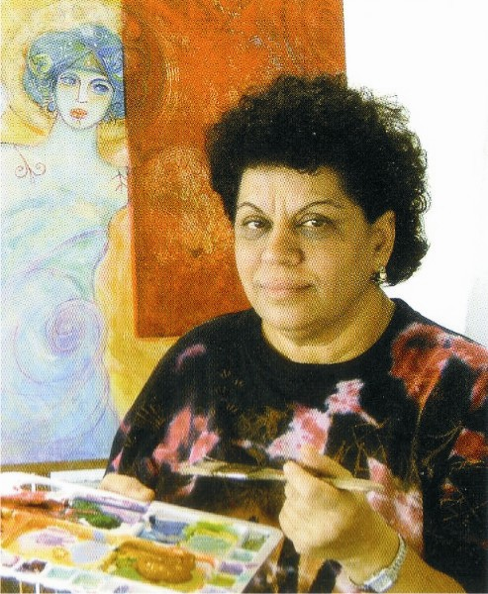
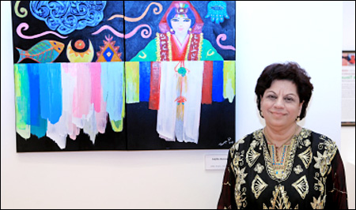
Thuraya Al-Baqsami , Kuwait artist. Member, Kuwait Art Society. Academic training in Cairo, Egypt and Moscow, Russia.
Golden Palm Leaf award, the GCC Biennale in Riyadh (1989) and in Doha (1992).

Slide 26

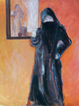


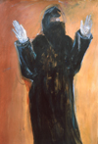
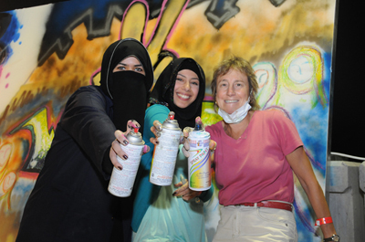
Yvonne Wakefield,
Suitcase Filled with Nails:
Lessons Learned from Teaching Art in Kuwait

Slide 27
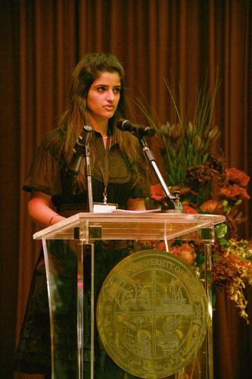
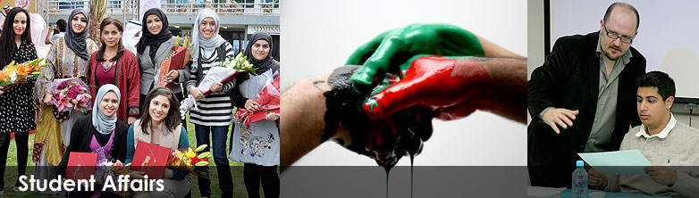
Kuwaiti students
American University of Kuwait
Sarah Budai, AUK alumna

Slide 28
Working women in the
Gulf Cooperation Council
  Over half of university students in the Gulf Cooperation Council are women, yet female participation in the workforce stands at less than 20%......Why?
  http://www.cassknowledge.com/inbusiness/feature/working-women-gulf-cooperation-council
  Cass Knowledge: Research for Business, issue 16, 2012

Slide 29
Gulf Population Estimates 2013
Saudi Arabia 28.16 mln
UAE 7.89
Kuwait 3.85
Oman 2.95
Qatar 1.94
Bahrain 1.55

Slide 30
UAE Population 2012
Age structure
0-14 years: 20.5% (male 557,603/female 532,303)
15-24 years: 14% (male 440,556/female 301,147)
25-54 years: 61.6% (male 2,497,606/female 774,318)
55-64 years: 3% (male 122,356/female 38,402)
65 years and over: 0.9% (male 31,942/female 18,084)
Median age
total: 30.2 years
male: 32.1 years
female: 25 years

Slide 31

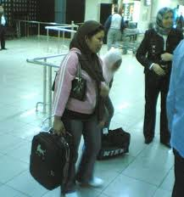
Migration of Women Workers from South Asia to the Gulf
UN Women ISBN: 978-81-924272-0-1
Healthcare and Nursing Jobs in Saudi Arabia
Filipino nanny job jobs in Qatar
20,000 jobs await Filipino nurses in Middle East | ABS-CBN News

Slide 32
Labor Trafficking as the Modern-day Slave Trade
Indian Maids Tortured, Denied Food, Treated Worse Than Dogs…
Abuse of Indian maids in Kuwait on rise
India to ban maid emigration to Gulf states and Africa
Migrant Nightmares: Ethiopian Domestic Workers in the Gulf
Nepal bans women under 30 from working in Gulf states
Burmese migrant workers dream of returning home
Minimum wage for Filipino maids in Saudi a model for Gulf countries
UAE recruiters warned to pay minimum wage for Filipino domestic workers...
Saudi Arabia, 70% of Filipino domestic workers suffer physical and psychological violence
■ Philippines aims to halt migration of domestic workers
■ Manila delays ban on citizens working as UAE domestics

Slide 33
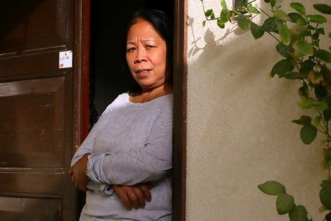

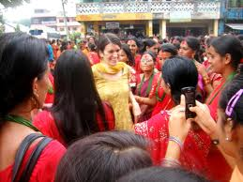

Asian migrants in the Gulf

Slide 34
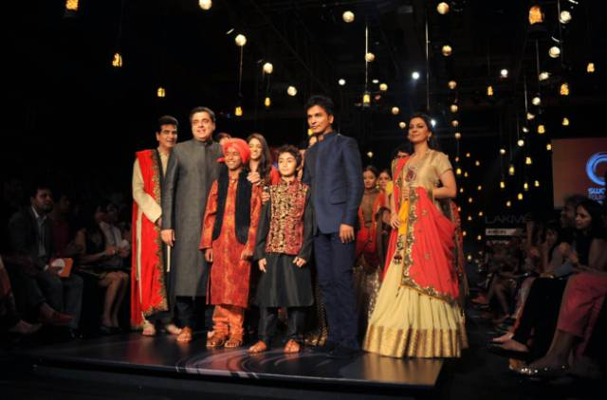
Bollywood in the Gulf
Lakme Fashion Week 2013

Slide 35
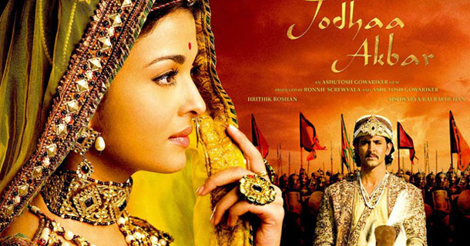
Indian TV channel aims to link diaspora to homeland

Slide 36

Emirates produces Bollywood TV show » Gulf News Dubai ...

Slide 37
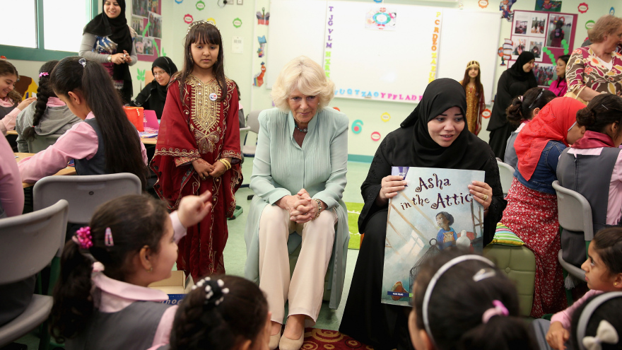
It is about their future…

Slide 38
Questions?
RECENT GAINS AND NEW OPPORTUNITIES FOR WOMEN’S RIGHTS IN THE GULF ARAB STATES. By Sanja Kelly, 2009 http://www.freedomhouse.org/sites/default/files/Women's%20Rights%20in%20the%20Middle%20East%20and%20Noth%20Africa,%20Gulf%20Edition.pdf
WOMEN IN GULF POLITICS: A PROGRESS REPORT.
By Simon Henderson, 2005 http://www.washingtoninstitute.org/policy-analysis/view/women-in-gulf-politics-a-progress-report

