Slide 1
Playboy Magazine and the Politics of Popular Culture in Indonesia
*
Jim Hoesterey
Department of Religion
Emory University

Slide 2
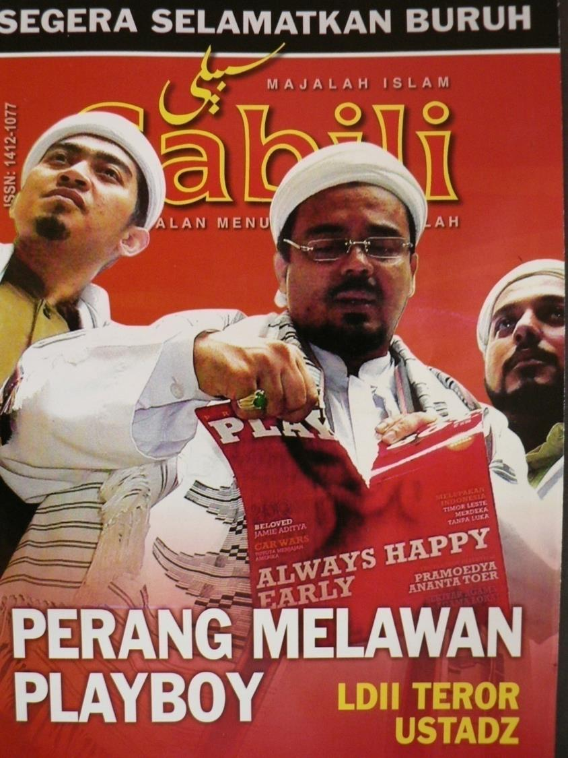

Slide 3
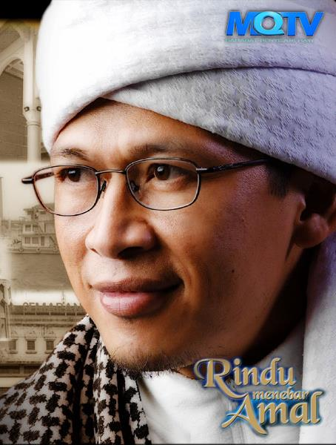

Slide 4
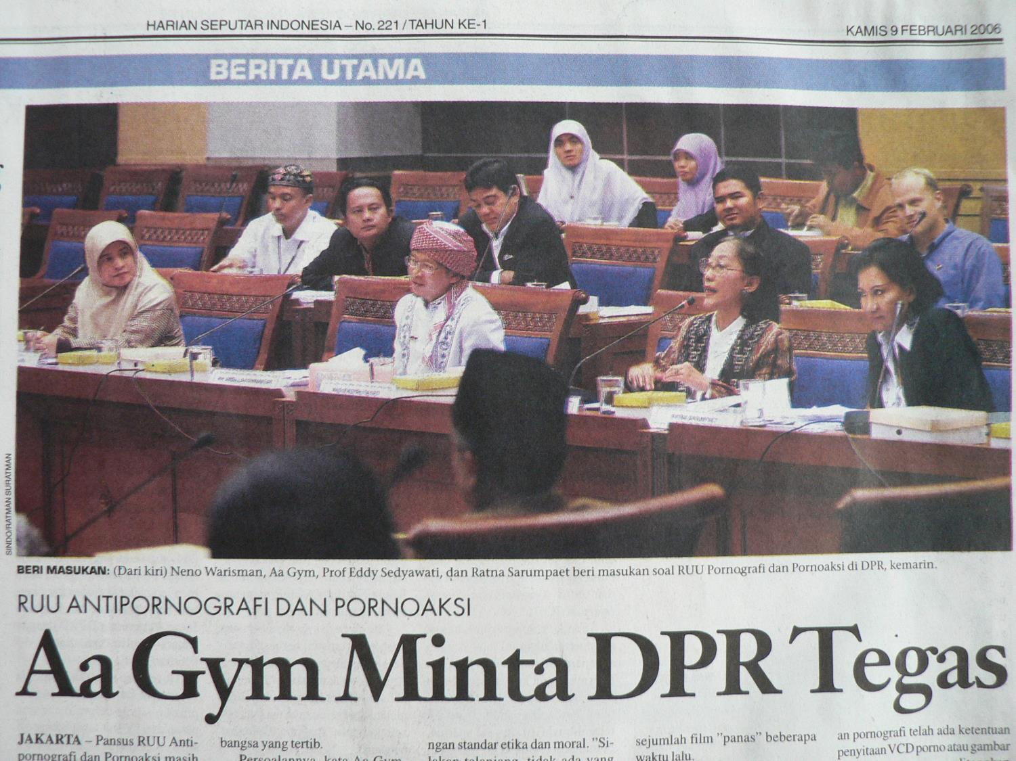

Slide 5
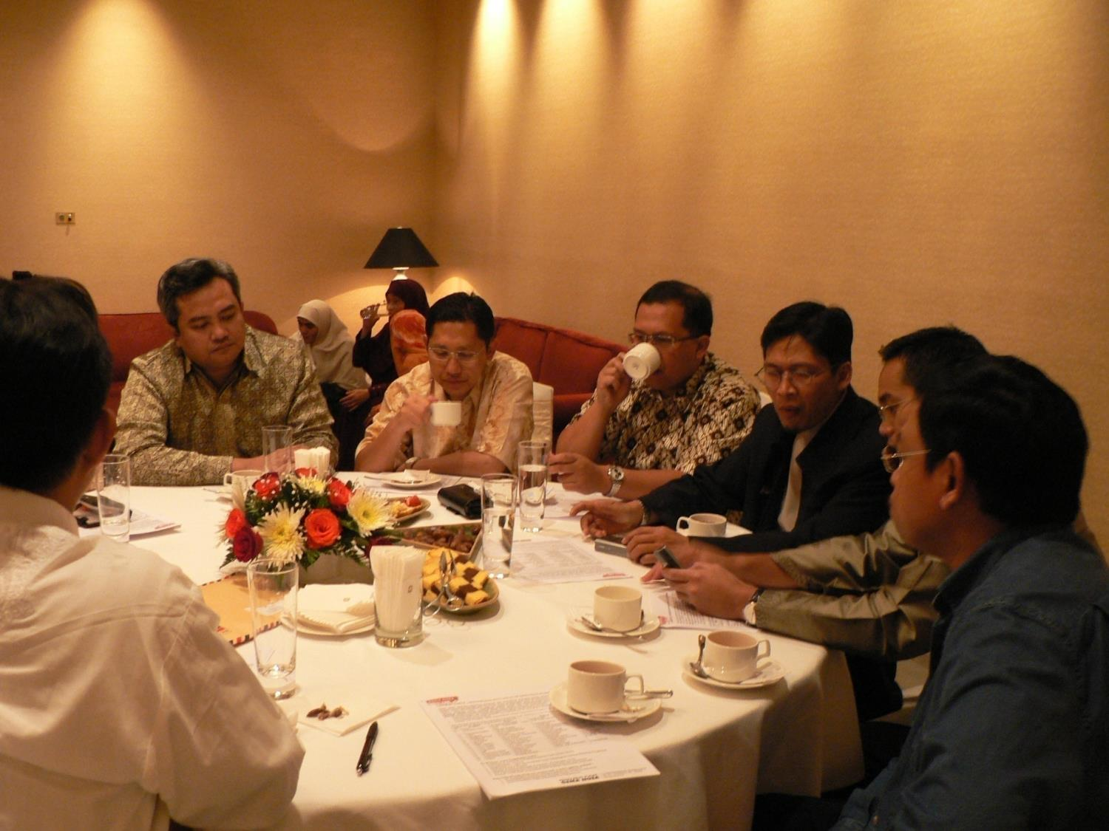

Slide 6
Dan ketahuilah !
Bahwa di dalam tubuh itu ada
segumpal daging, yang apabila
bersih maka bersihlah
tubuh semuanya;
dan apabila rusak, maka
rusaklah
tubuh semuanya.
Dan ketahuilah !
Dia adalah Qolbu
( HR. Muttafaqun ‘alaihi )

Slide 7
“Time” Magazine Oct. 2008
Translation:
“Urban Sufism in Search of God”
“Previously Sufism lived in desolate places. Nowadays it has become a new spiritual alternative for the urban upper middle class.”

Slide 8
Muslim Televangelists
“Hip Preachers:
The New Generation”
“Celebrity Ustadz, Moral Business, and Online Fatwas”

Slide 12
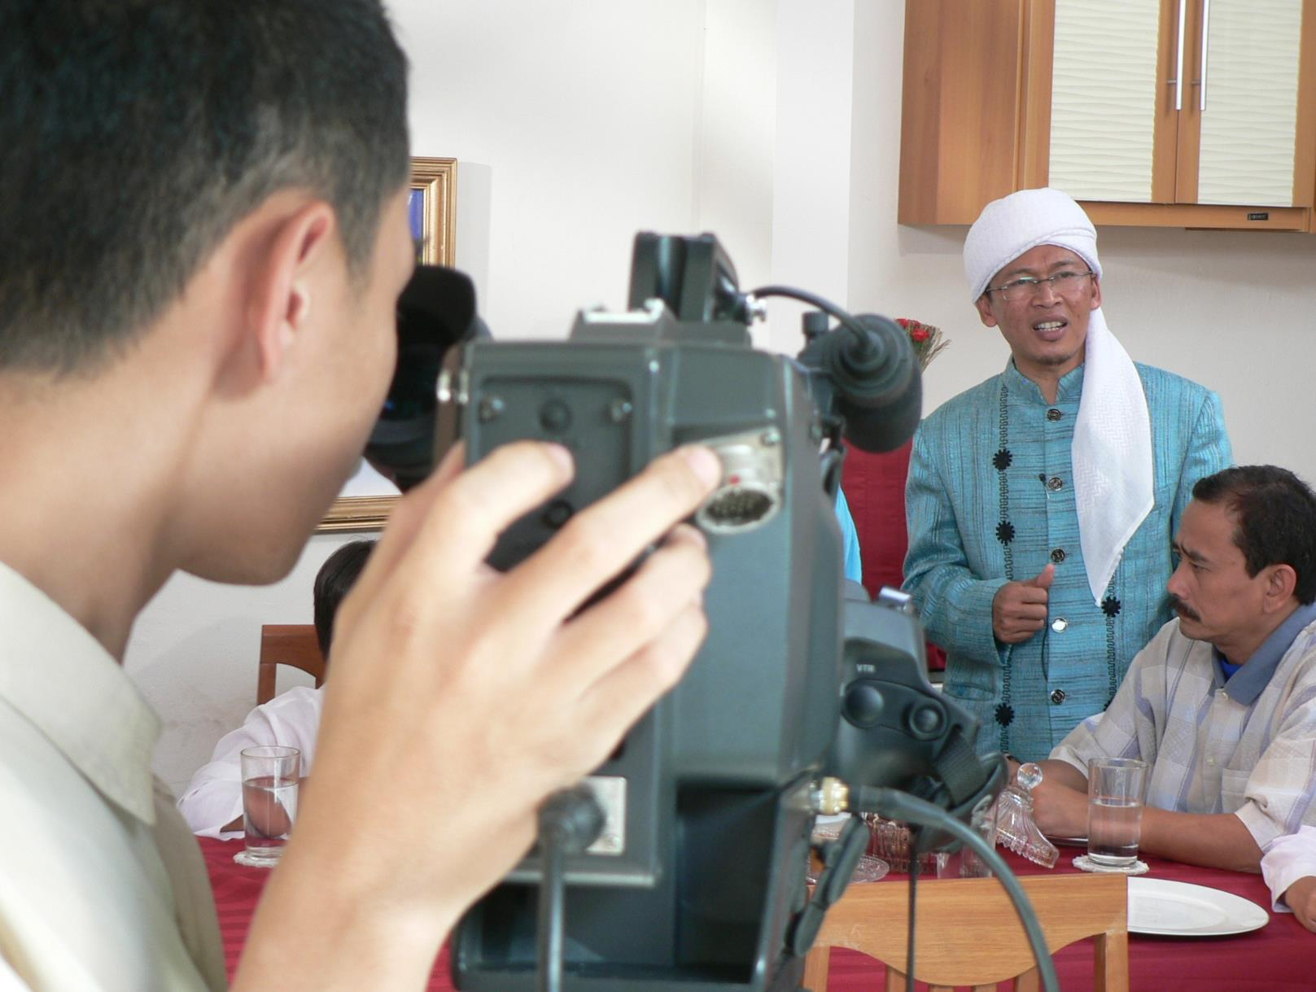

Slide 13
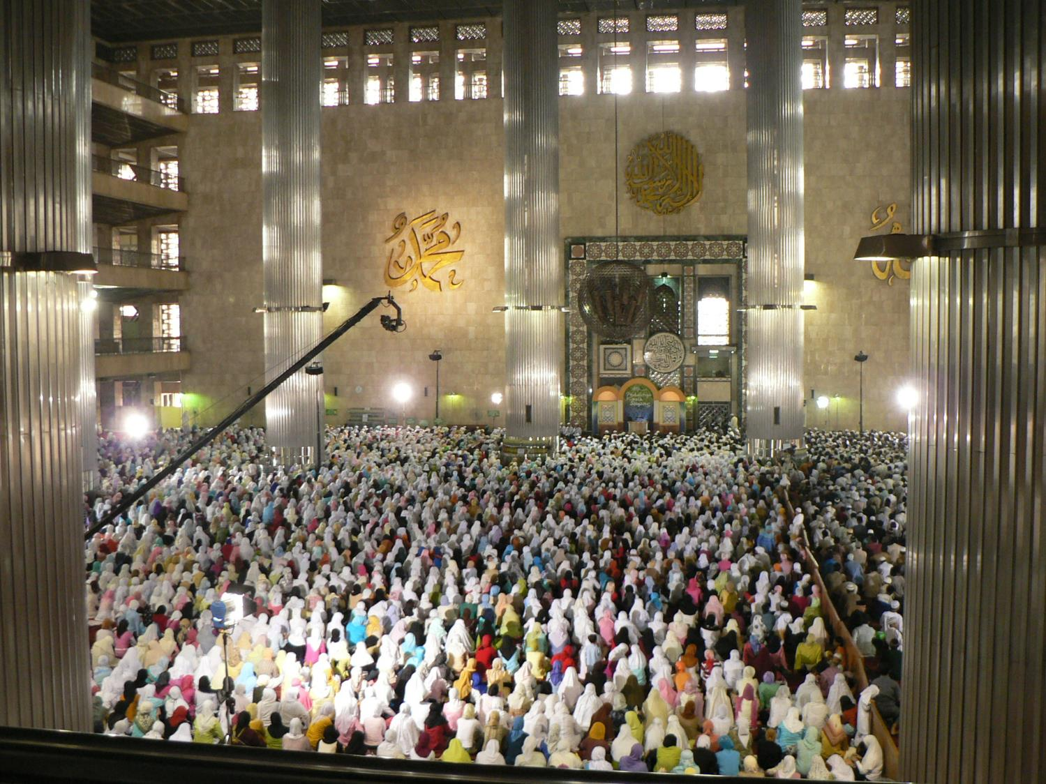

Slide 14
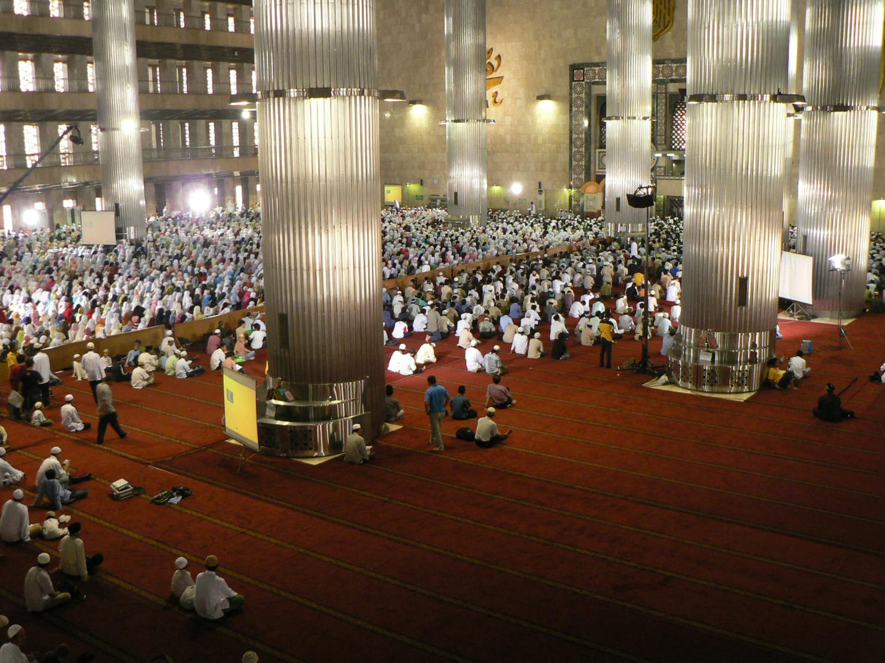

Slide 15
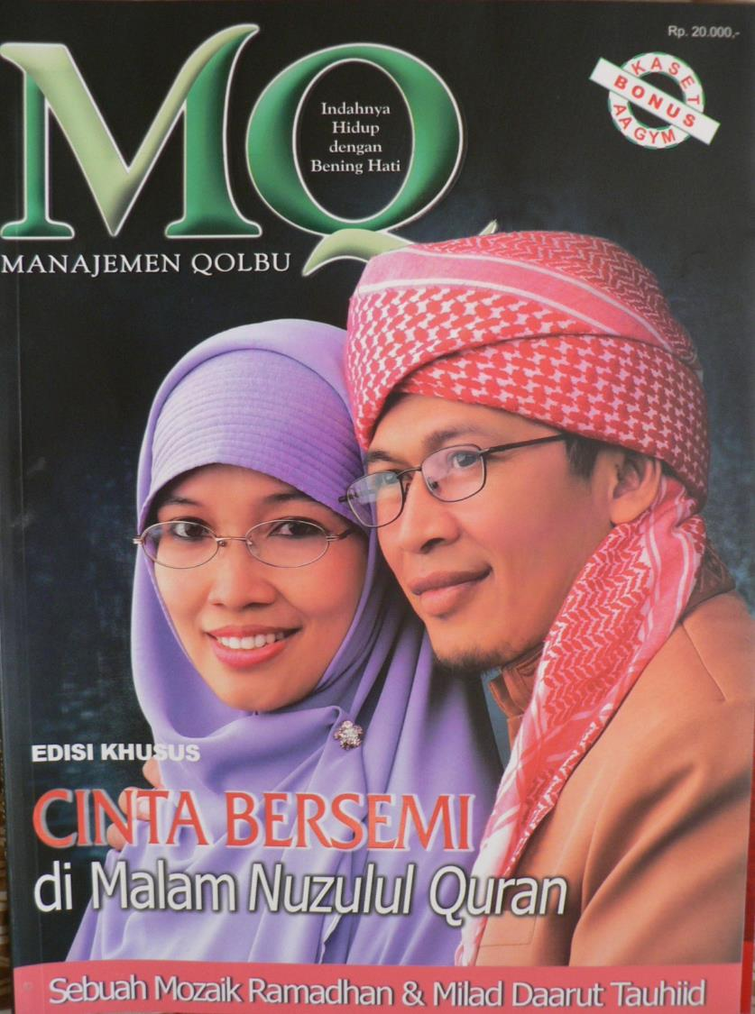

Slide 16
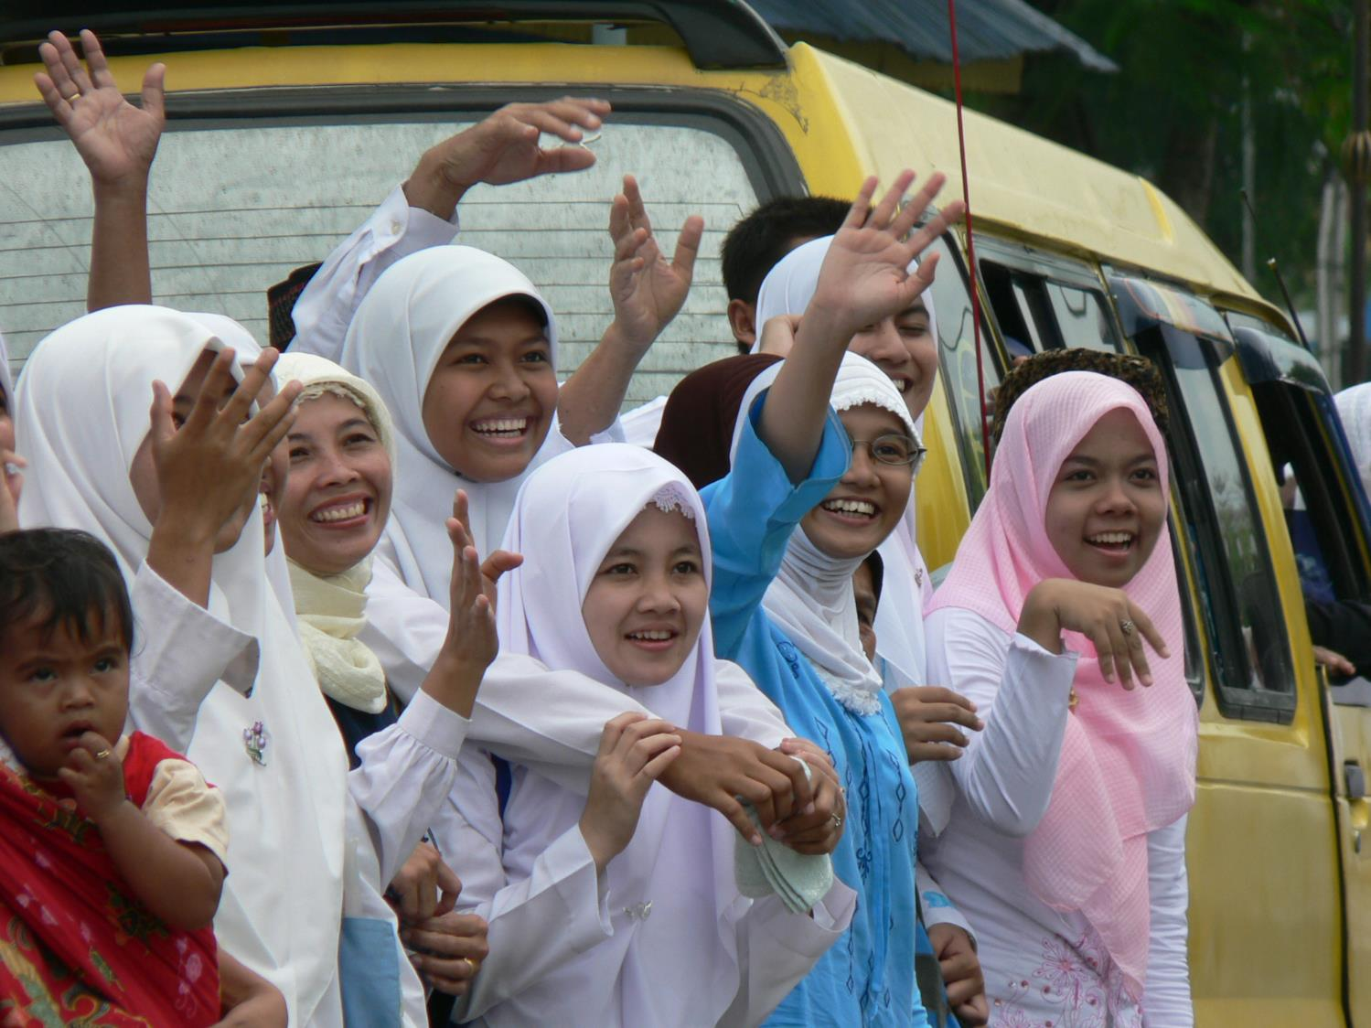

Slide 17
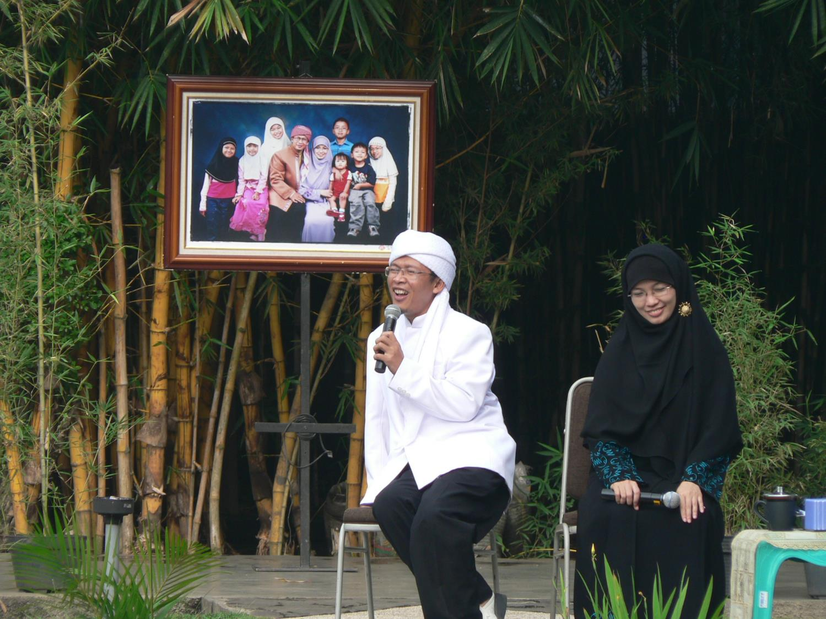

Slide 18
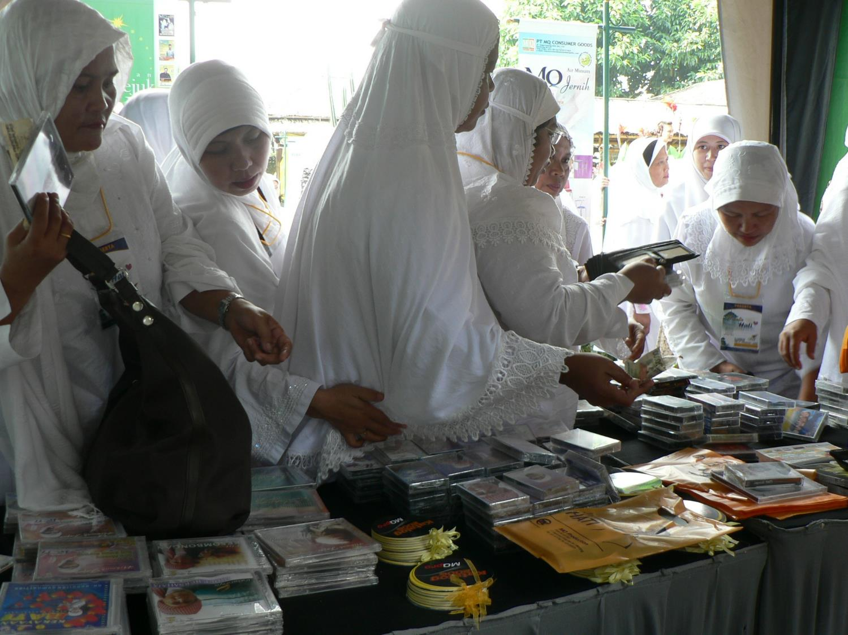

Slide 19
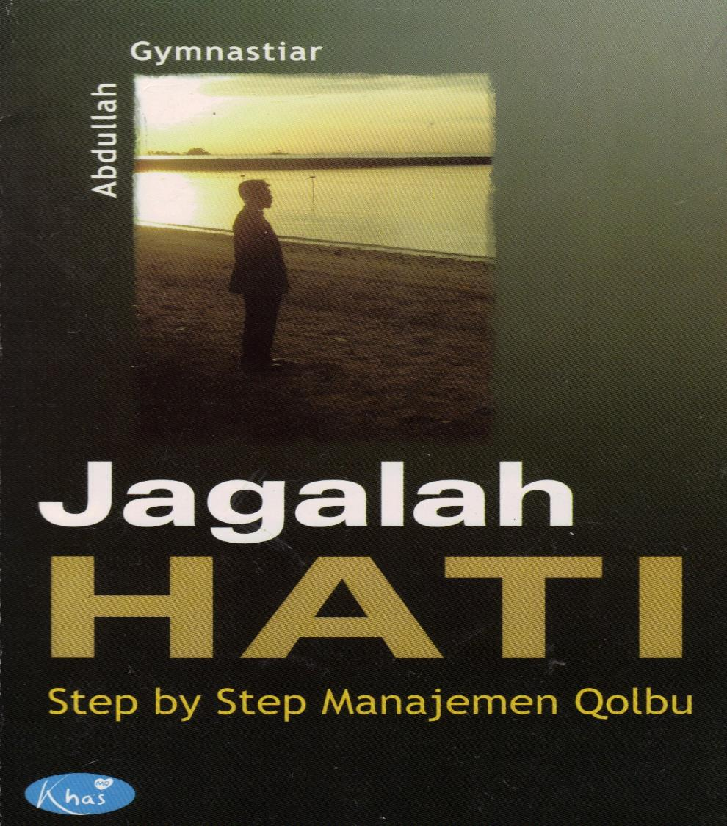

Slide 20
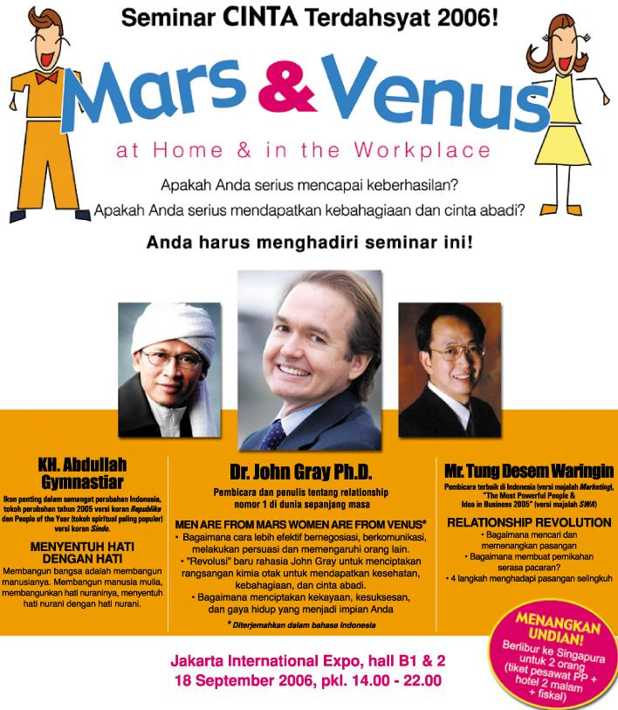

Slide 21
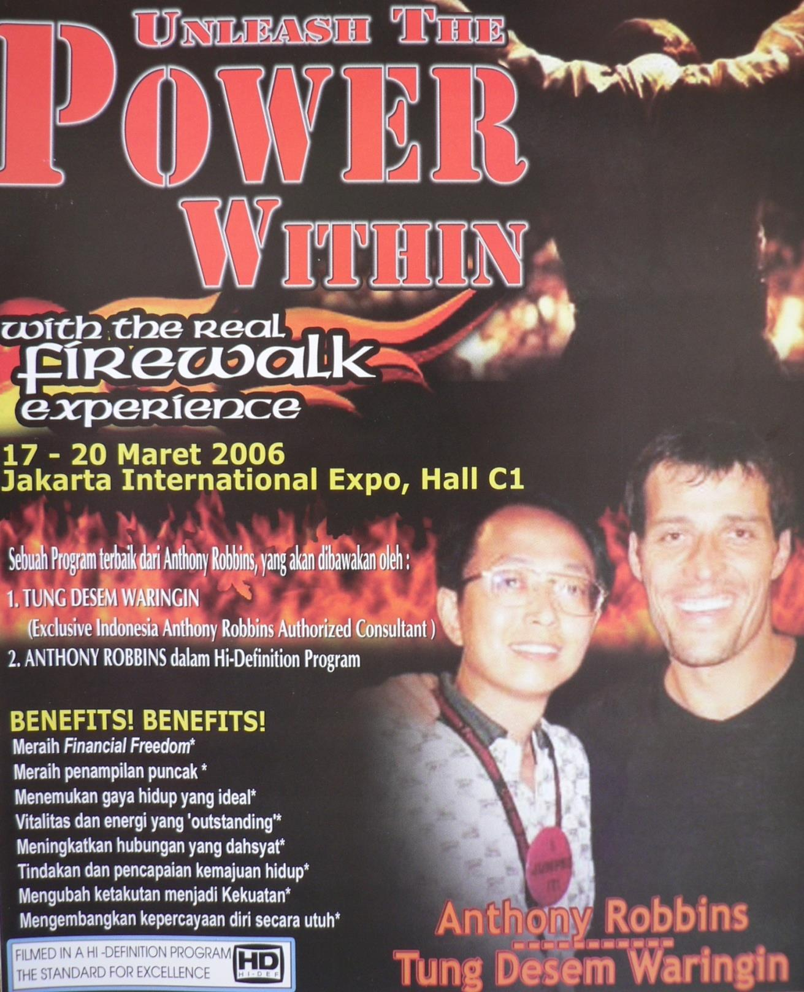

Slide 22
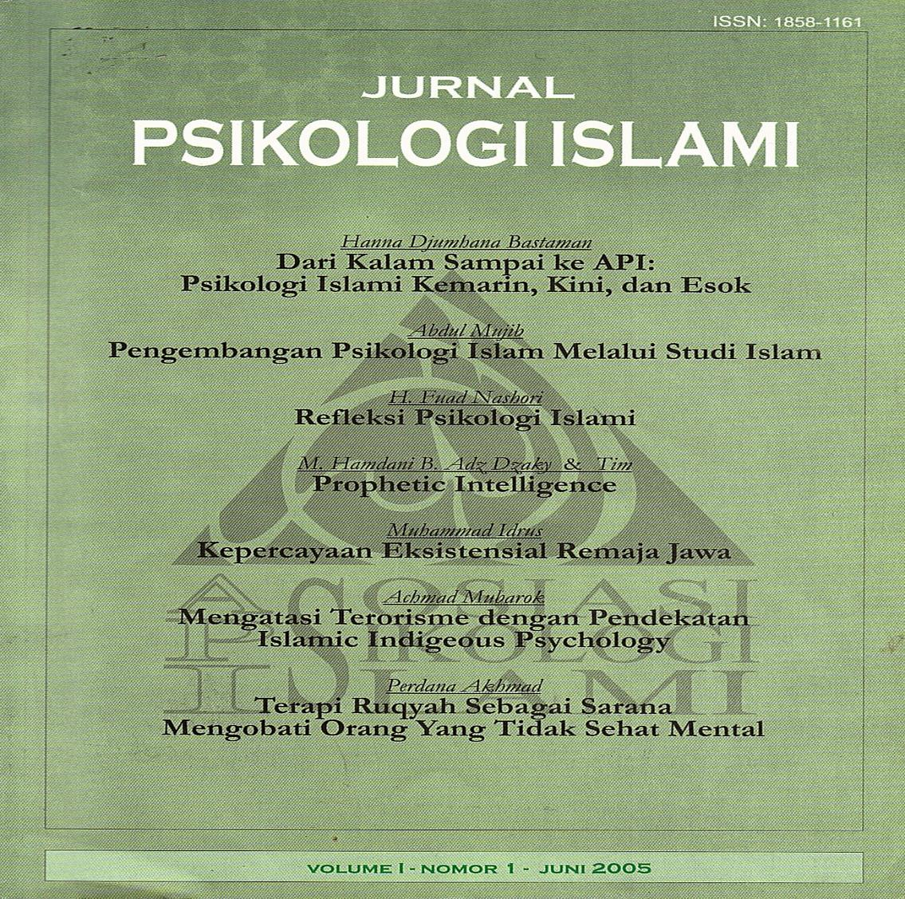

Slide 23
Prophetic Cosmopolitanism

Slide 24
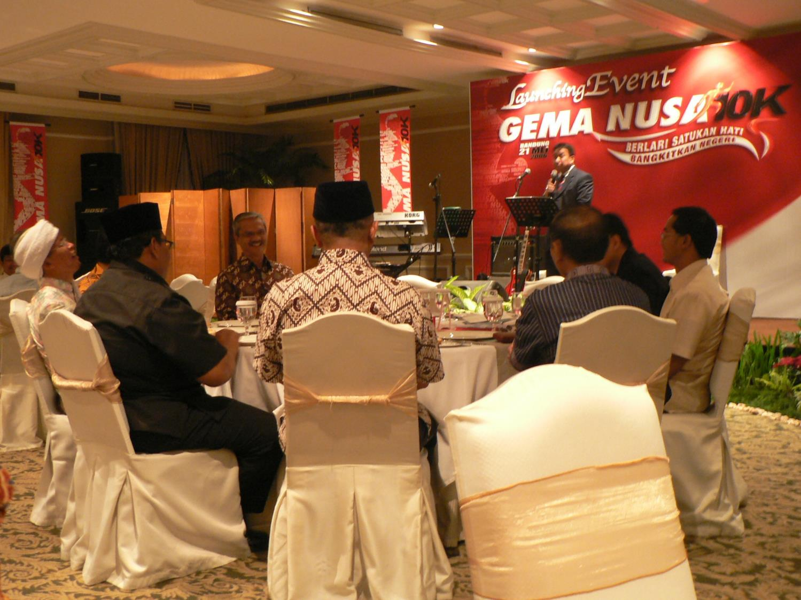

Slide 25
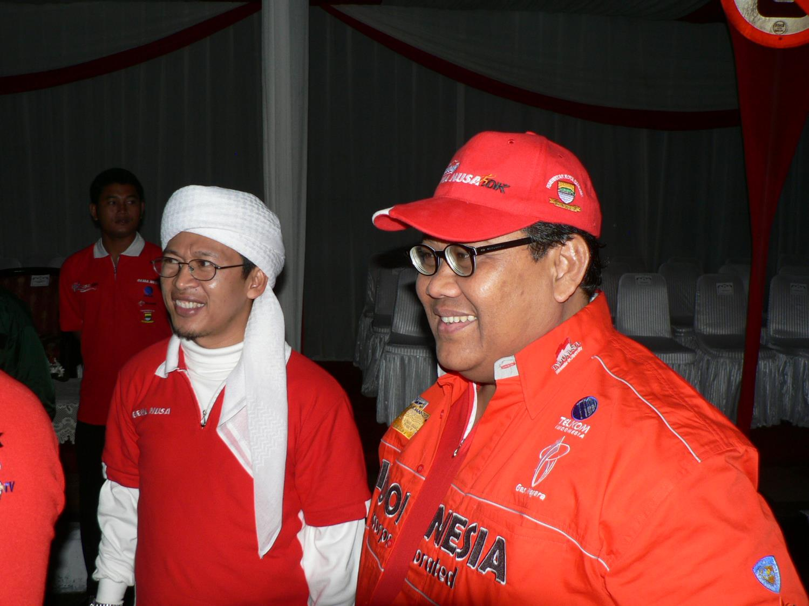

Slide 26
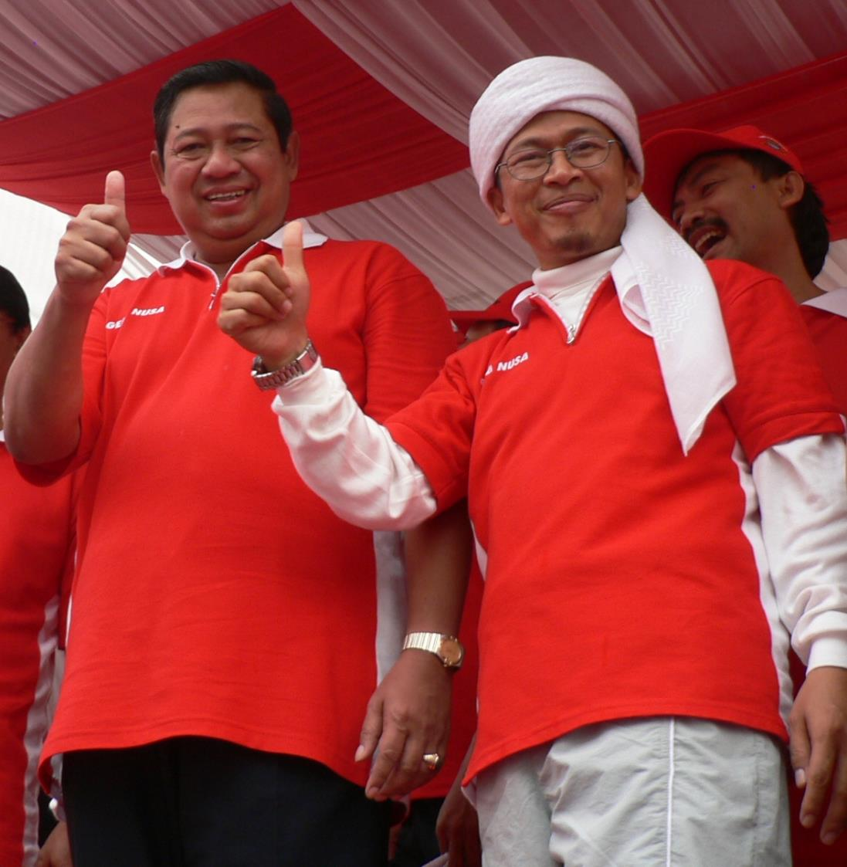

Slide 29
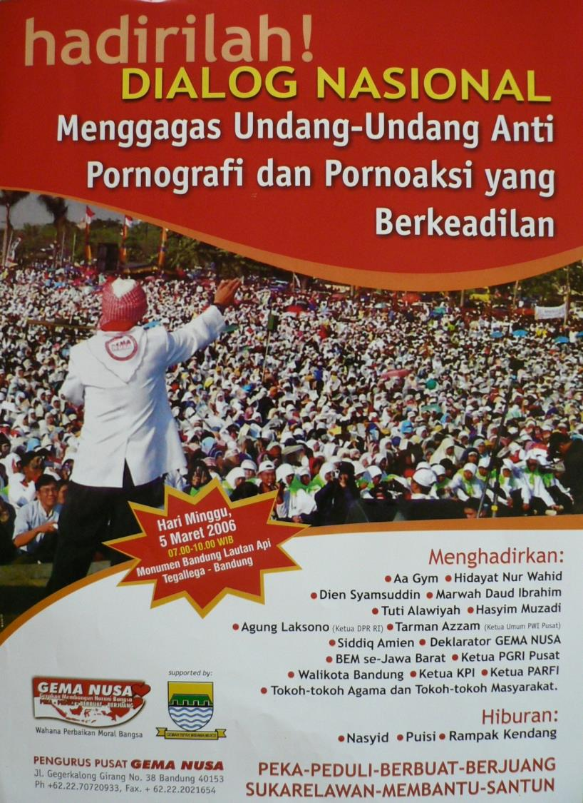

Slide 30
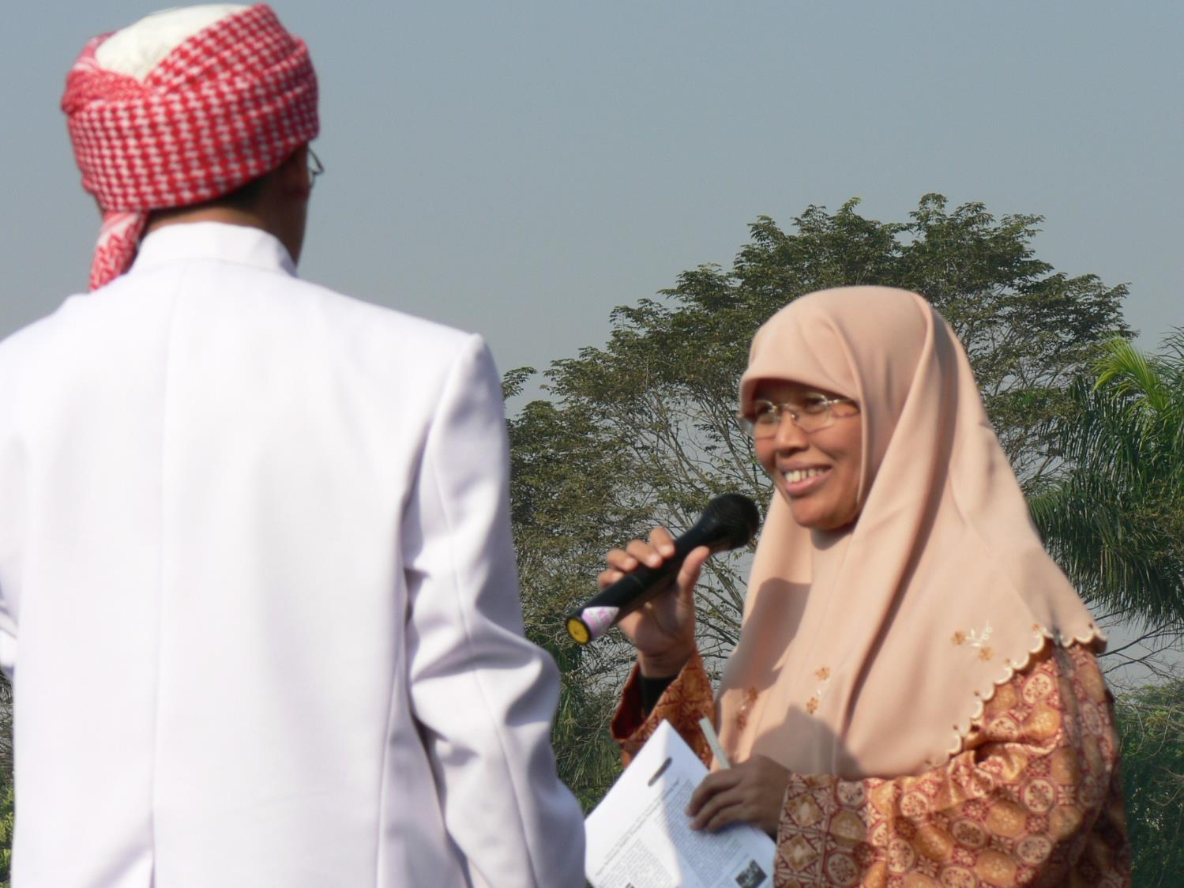

Slide 31
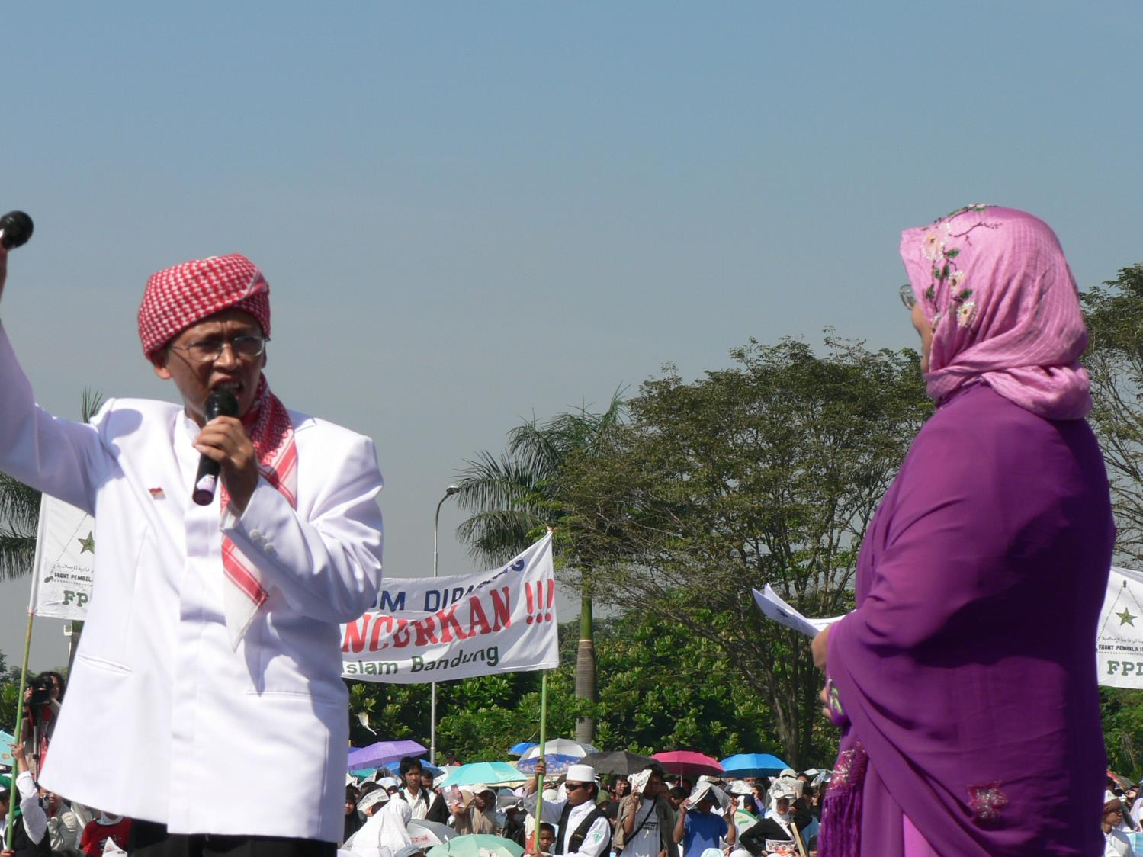

Slide 32
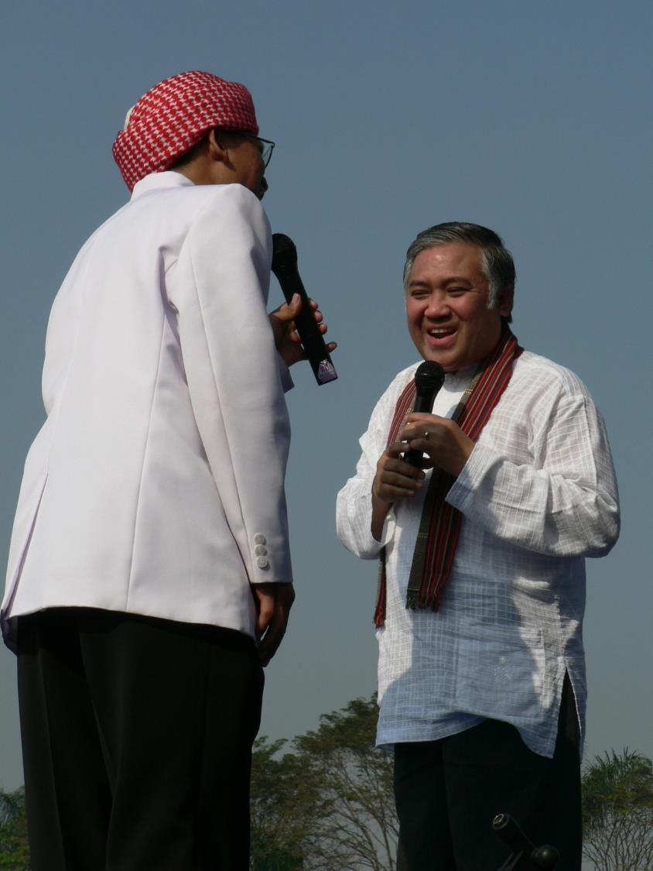

Slide 33
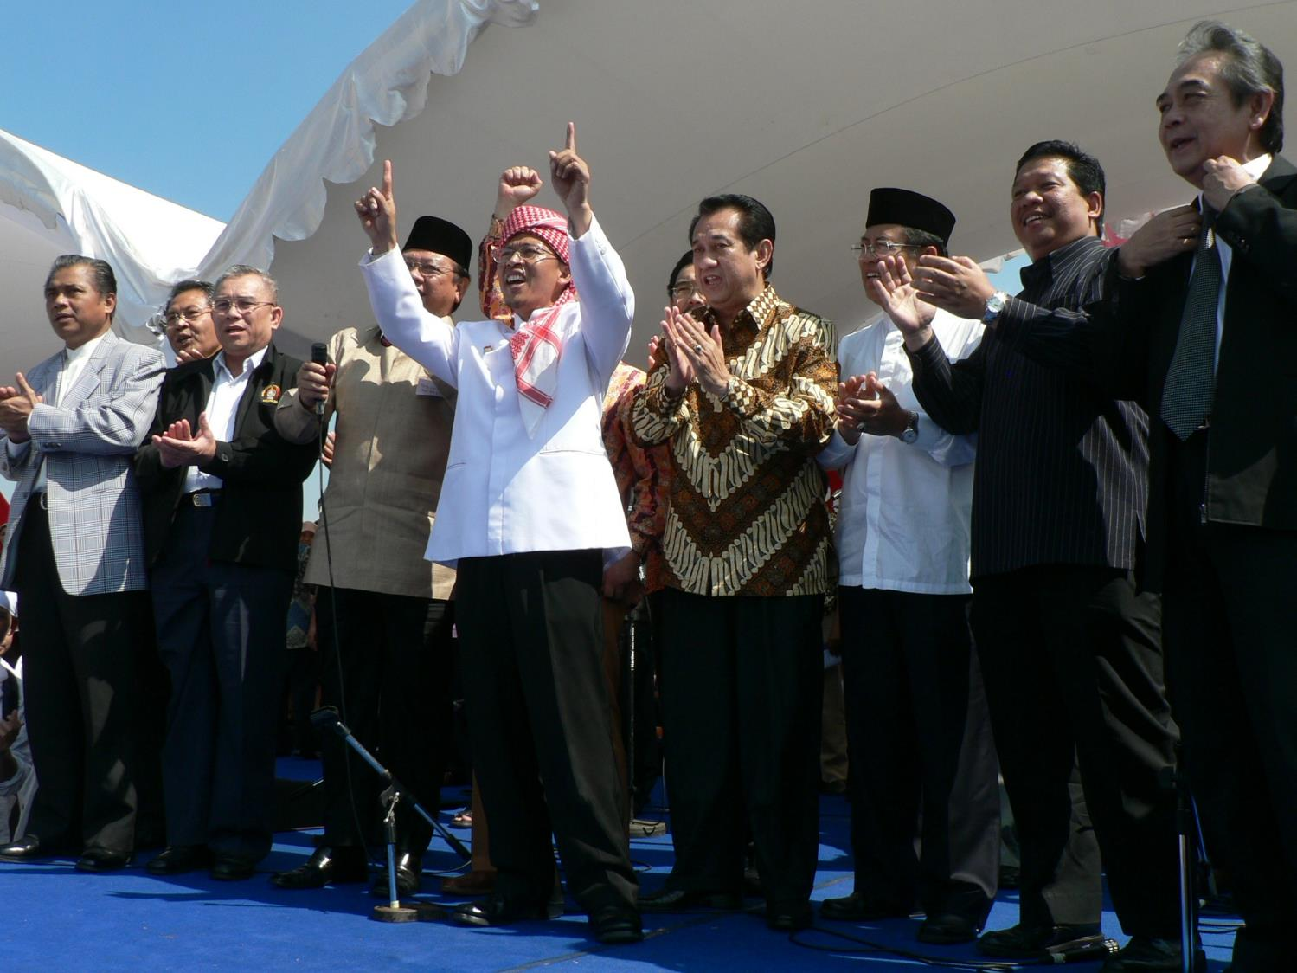

Slide 35
