Slide 1
Youth and Digital Media in Central Asia
Sarah Kendzior, PhD

Slide 2
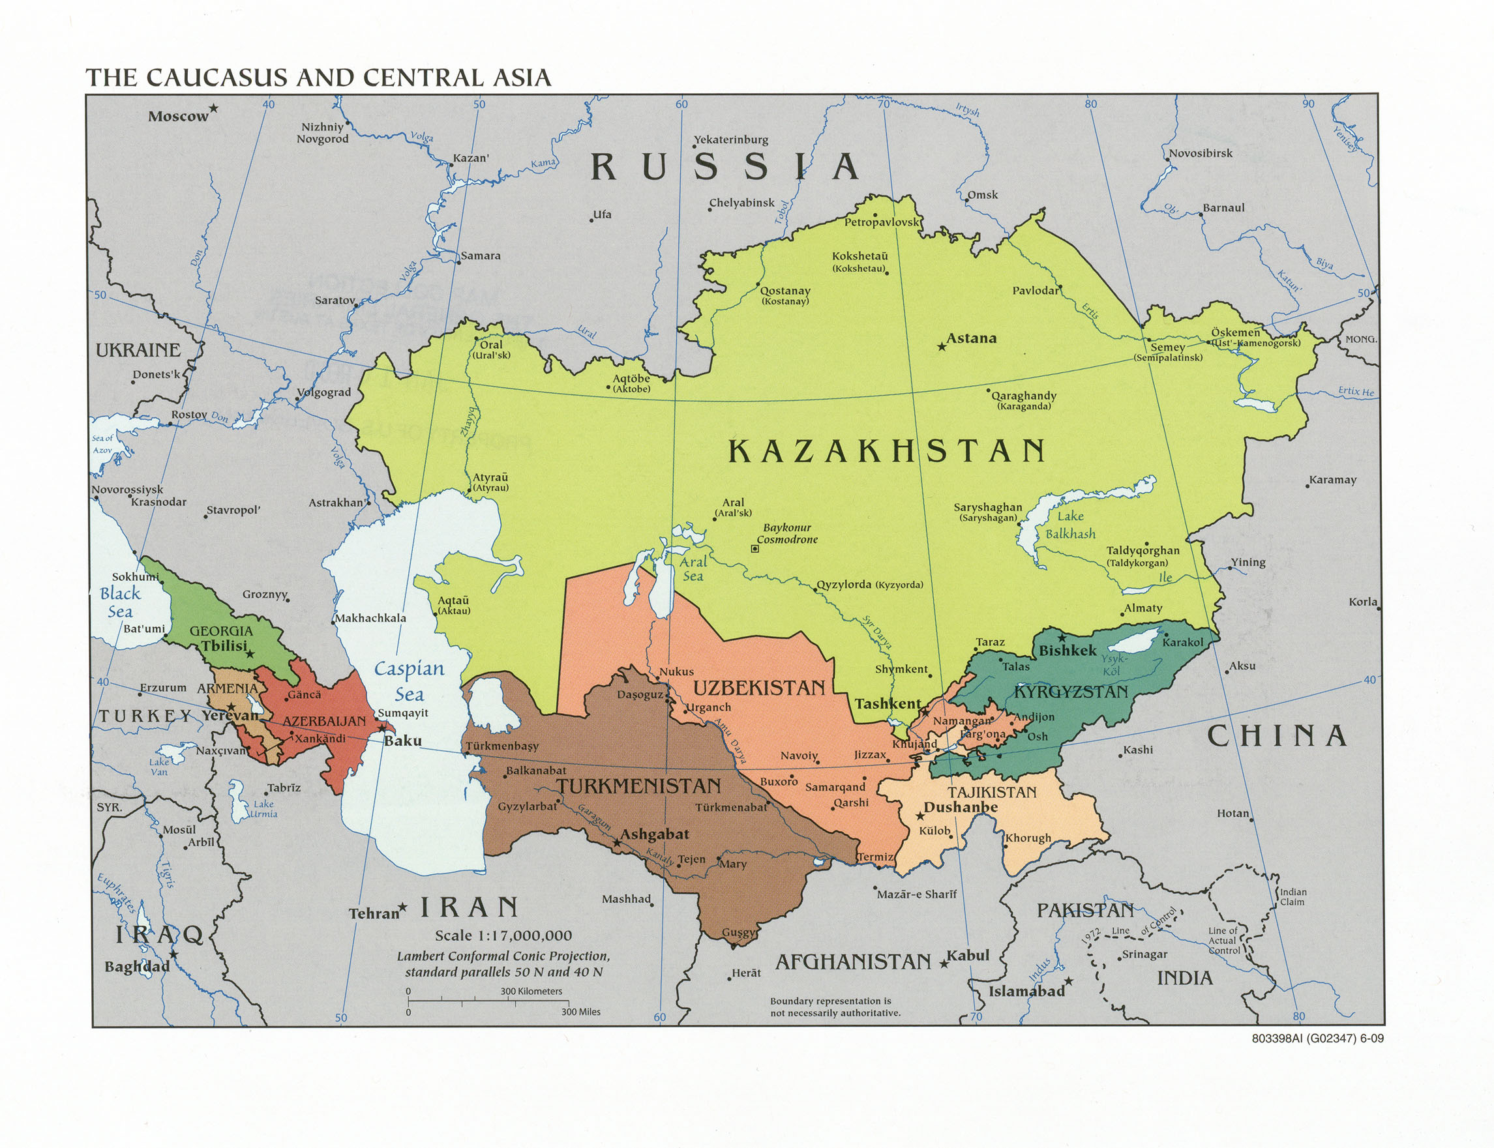
1991: End of the Soviet Union

Slide 3
1991: Birth of the Internet
“The World Wide Web project aims to allow all links to be made to any information anywhere. [...] The WWW project was started to allow [people] to share data, news, and documentation.
“We are very interested in spreading the web to other areas, and having gateway servers for other data. Collaborators welcome!”
--Tim Berners-Lee

Slide 4
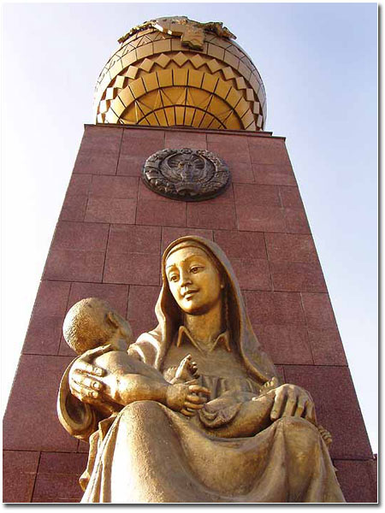
In 1991, the “Monument of Independence and Humanism” replaced a statue of Lenin in Tashkent,
Uzbekistan.

Slide 5
Declaration of Cyberspace
“Governments of the Industrial World, you weary giants of flesh and steel, I come from Cyberspace, the new home of Mind. On behalf of the future, I ask you of the past to leave us alone. You are not welcome among us. You have no sovereignty where we gather.
“…I declare the global social space we are building to be naturally independent of the tyrannies you seek to impose on us. You have no moral right to rule us nor do you possess any methods of enforcement we have true reason to fear.”
--John Perry Barlow, 1995

Slide 6
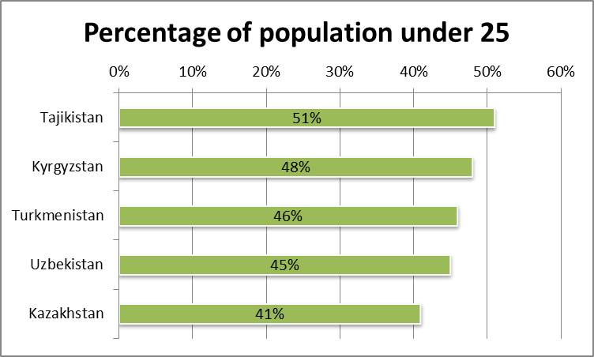

Slide 7
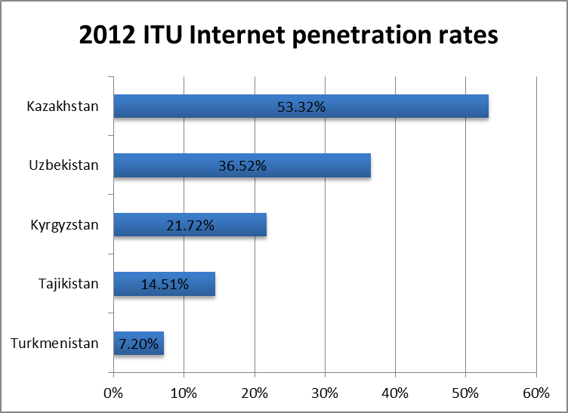

Slide 8
Beware Central Asian statistics!
They have been skewed by governments
They are not up-to-date
People lie for their own safety
They are not validated empircally
When it comes to tech, states argue that quantity compensates for quality

Slide 9
A Few Questions
Is independence the same thing as freedom?
What happens when independence creates state borders – and then a technological medium appears that allows borders to be crossed?
How does digital media affect citizens of authoritarian states? Does it transform their politics? Does it reify or reflect them?

Slide 10
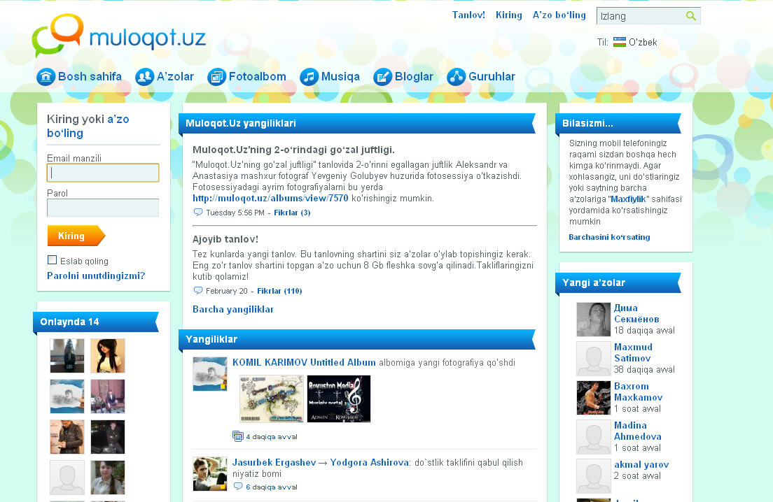

Slide 11
Uzbeks constitute 14.5% of Kyrgyzstan, 15% of Tajikistan, and 2.9% of Kazakhstan
Uzbek exiles, immigrants and refugees are widely scattered throughout Europe, Russia, and North America

Slide 12
Sign posted in Uzbek internet café: “Viewing political sites such as ferghana.ru, centrasia.ru and the like is categorically forbidden! Fine 10,000 so’m!” (Photo credit: Ferghana.ru)

Slide 13
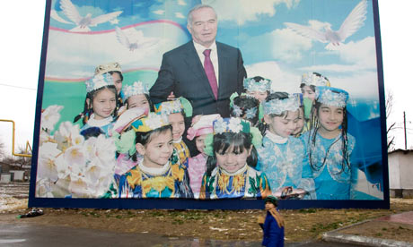
“We fully support the desire of our fellow citizens to freely use the internet. We absolutely do not accept the establishment of any walls or restrictions in the information world that lead to isolation… At the same time, we must not ignore the fact that destructive forces seeking to mislead young people with immature minds and naive views on life seek to exploit the possibilities of
the internet for their own selfish purposes, leading to dire consequences.”

Slide 14
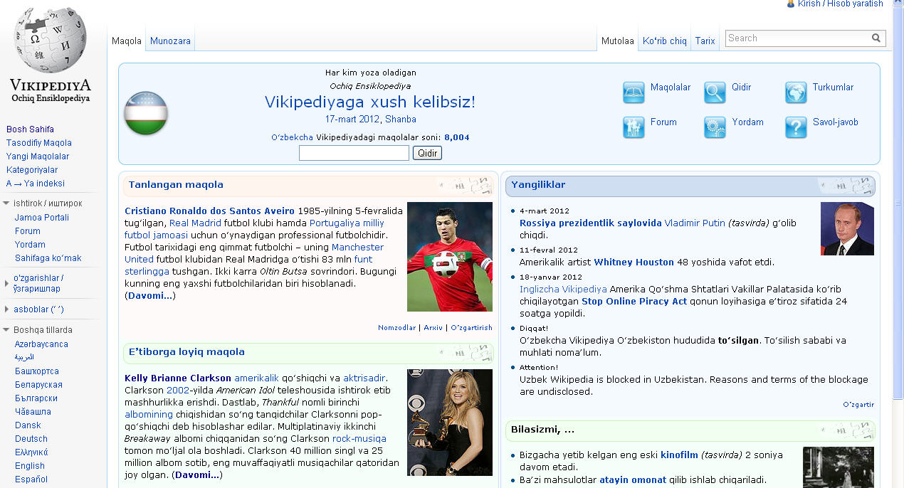

Slide 17
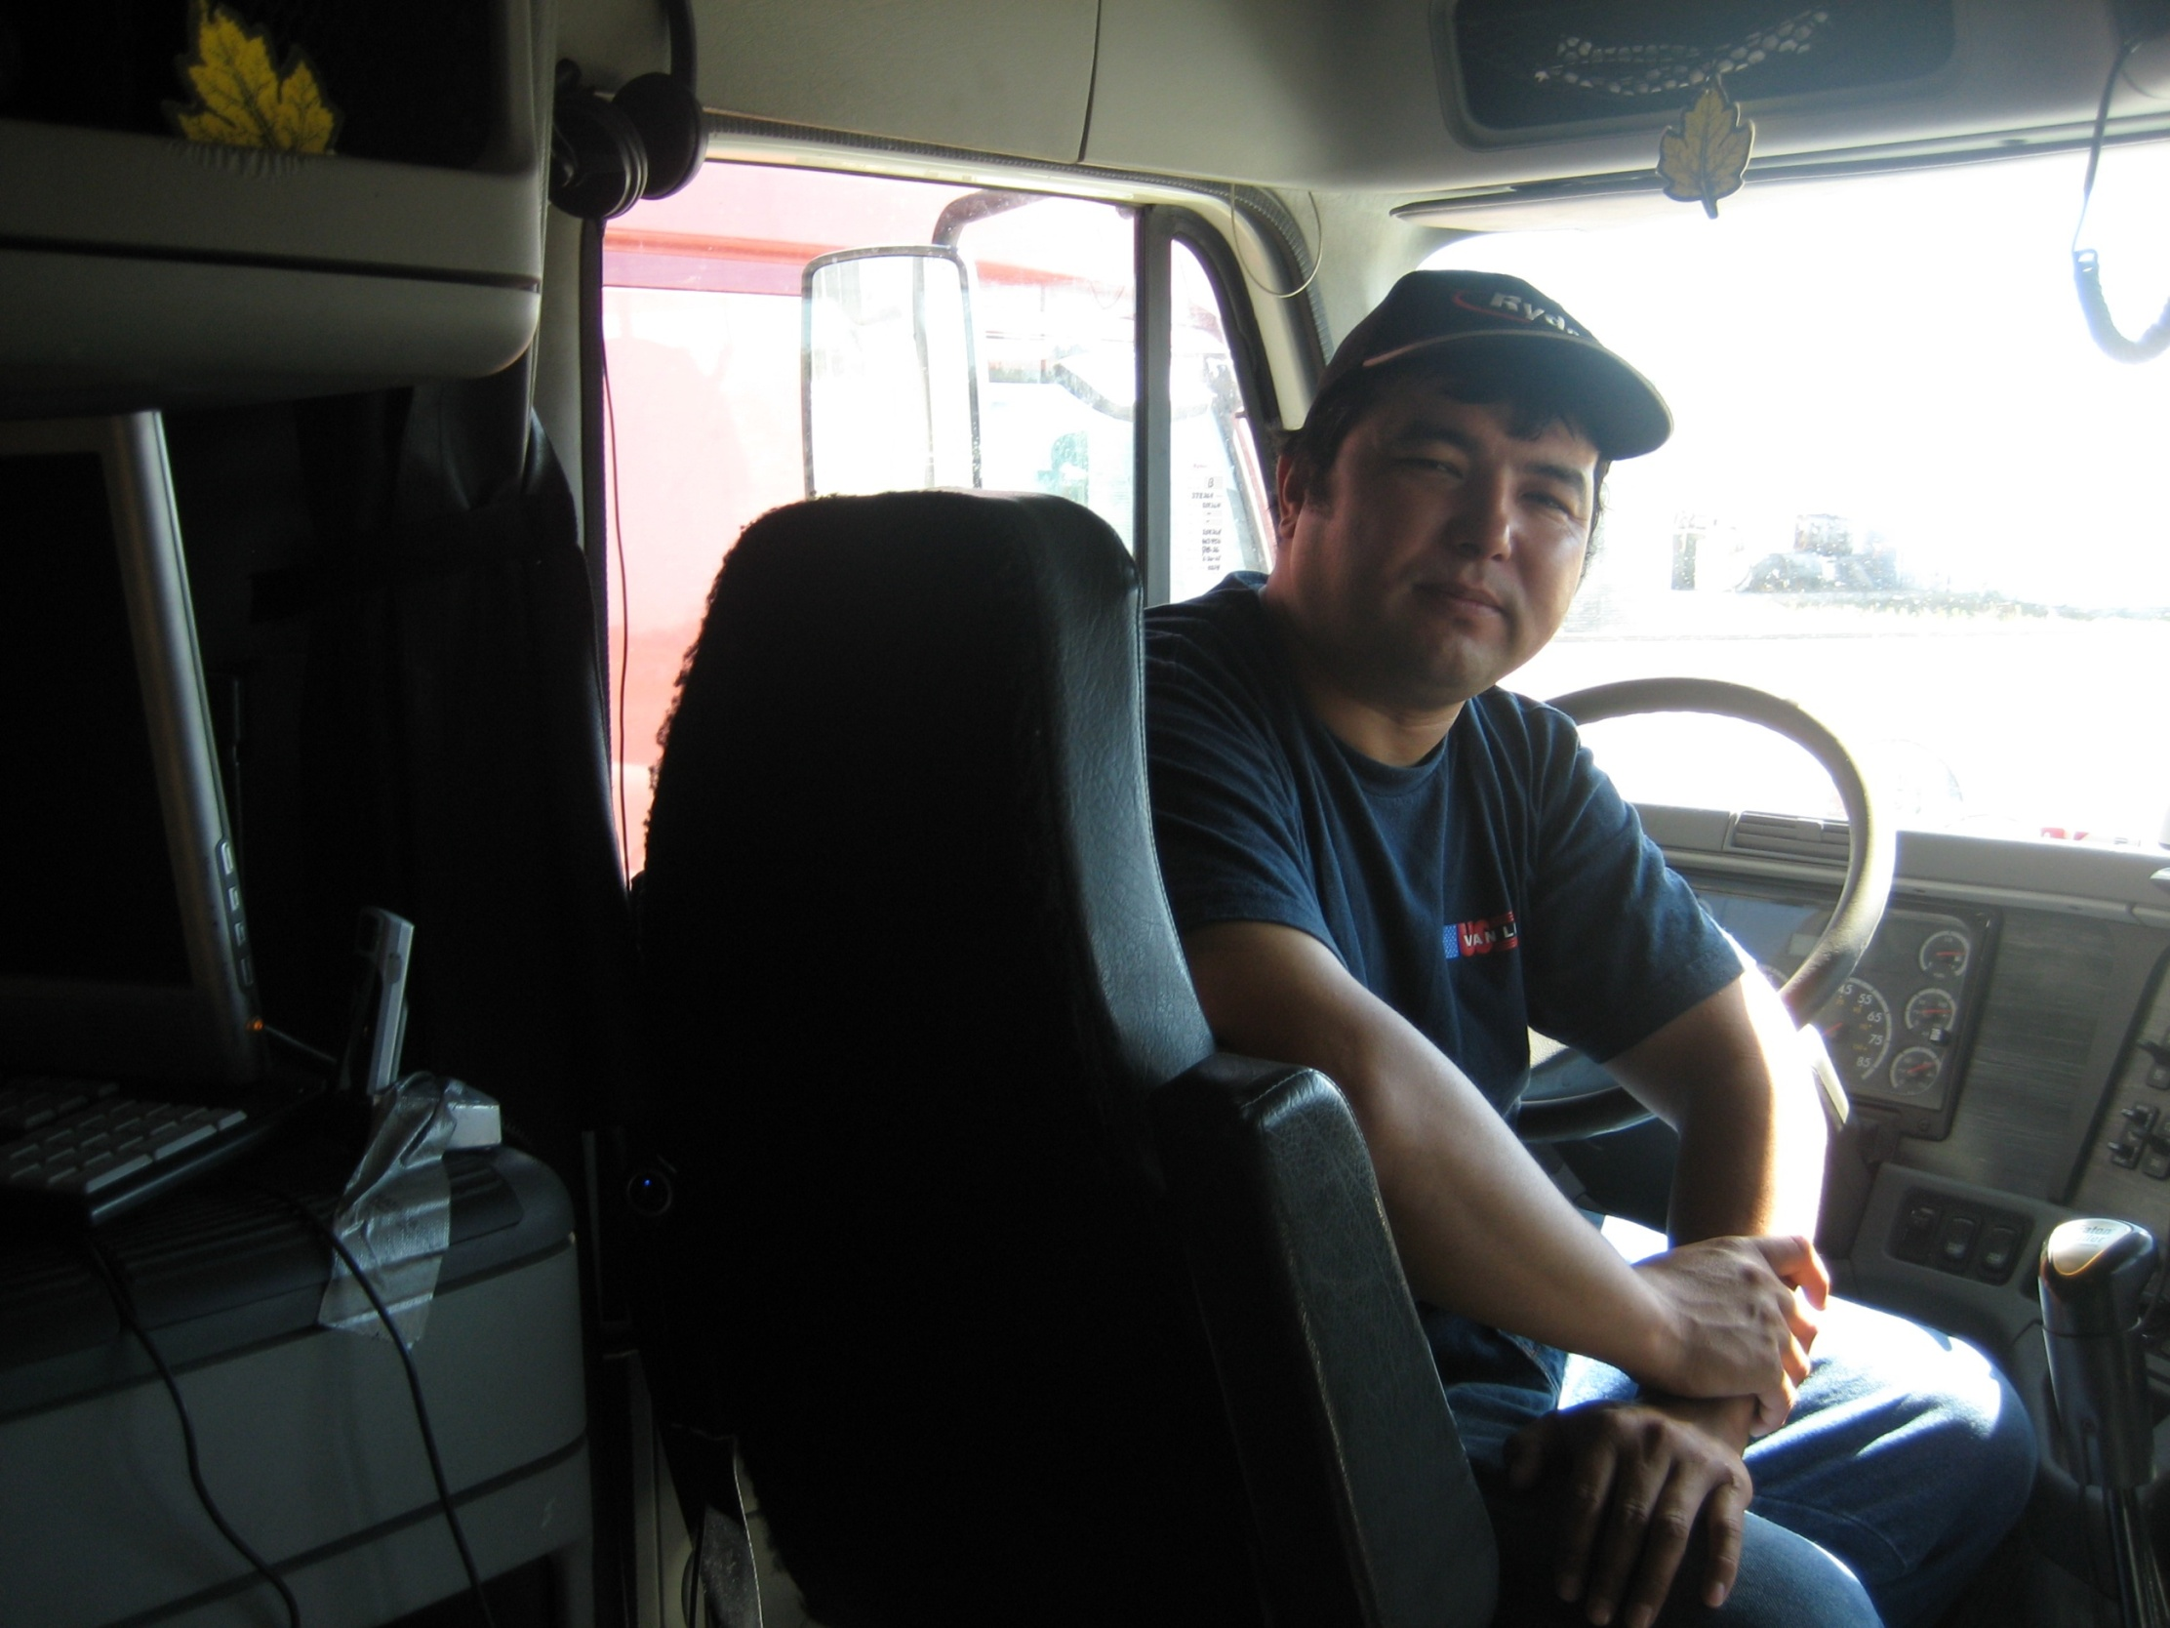
Bahodir Choriyev, b. 1969, Shahrisabz, Uzbekistan
Saint Louis truck driver;
Leader of the Birdamlik People’s Movement

Slide 18
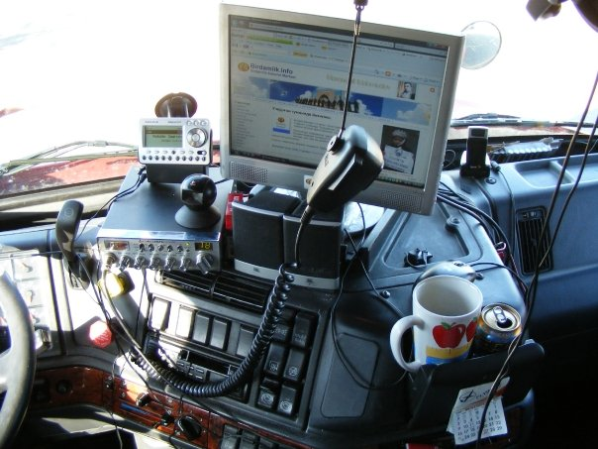
Bahodir’s “mobile office” in 2008

Slide 19
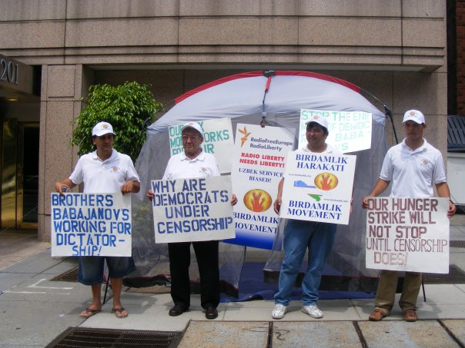
Birdamlik protest against Radio Free Europe, Washington DC, 2009

Slide 20
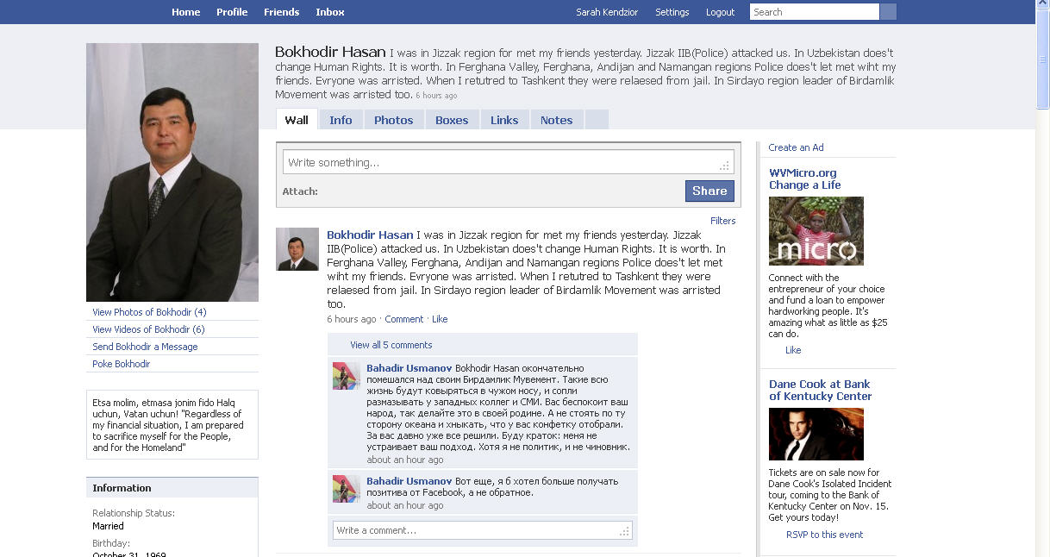

Slide 21
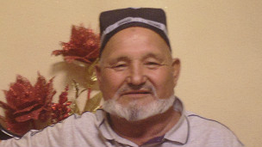
Hasan Choriyev

Slide 22
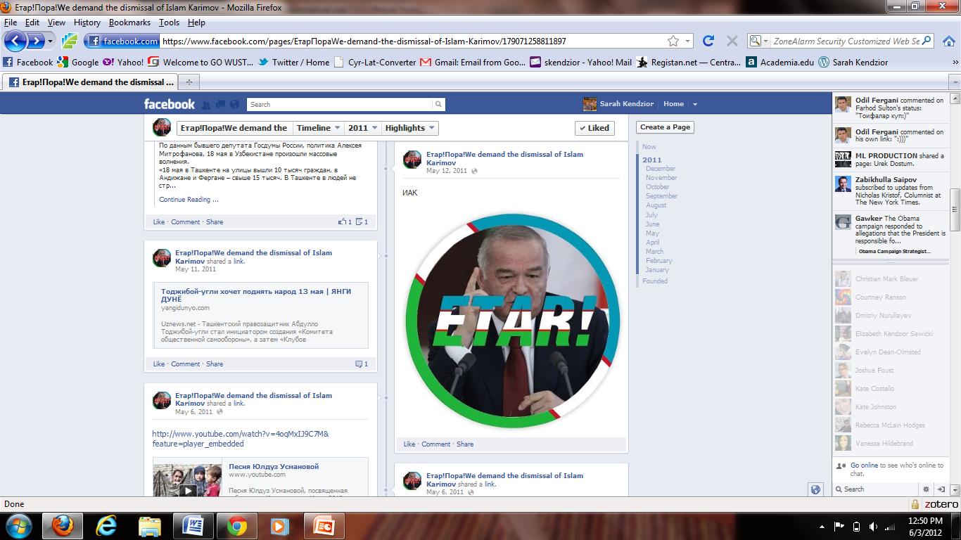

Slide 23
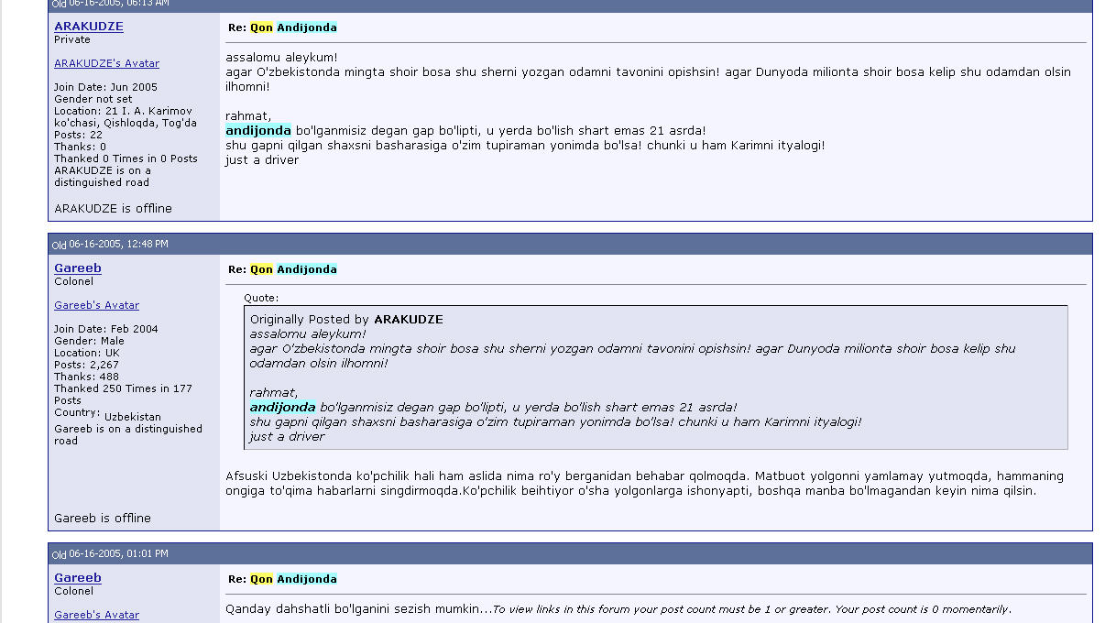
Screenshot of Arbuz web forum, June 2005
“Unfortunately most in Uzbekistan still have no idea what has transpired [in Andijon]. The lies just keep coming and these fabrications are being absorbed into everyone’s consciousness. The majority of people automatically believe these lies, let’s see what happens after there are no other topics. “

Slide 24
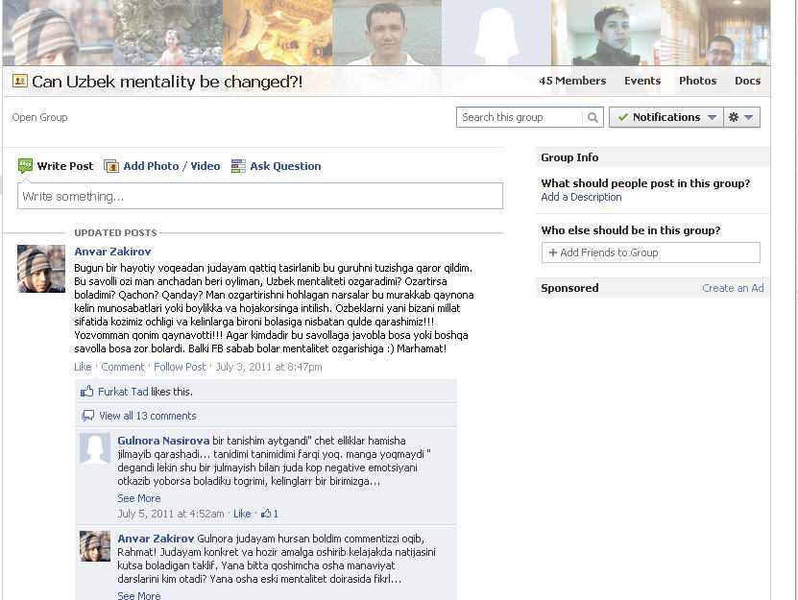
“Today I decided to form this group after some difficult events in life. The question I keep asking myself is, will the Uzbek mentality change? Can it change? When? How?...If someone seeks to answer these questions or other questions, that would be great. Maybe the mentality will change through Facebook. Welcome!”

Slide 25
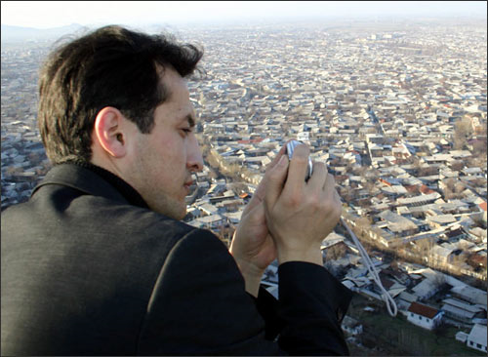
Alisher Saipov, 1981-2007

Slide 26
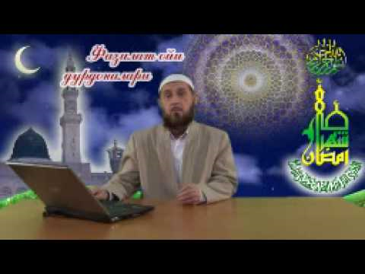
Screenshot from YouTube broadcast of Imam Obidxon Qori Nazarov

