Slide 1
The Effects of the Gulf States on the Arab Spring
By: Sami Hermez
Visiting Professor of Contemporary International Issues
University of Pittsburgh
April 7, 2013

Slide 2
Outline
Summary of the Arab Spring
Rise of the Gulf Cooperation Council and formation of its member states
Understanding GCC relation to the Arab Spring – 3 prisms
Inside-Outside
Monarchy-Republic
Sunni-Shi’a

Slide 3
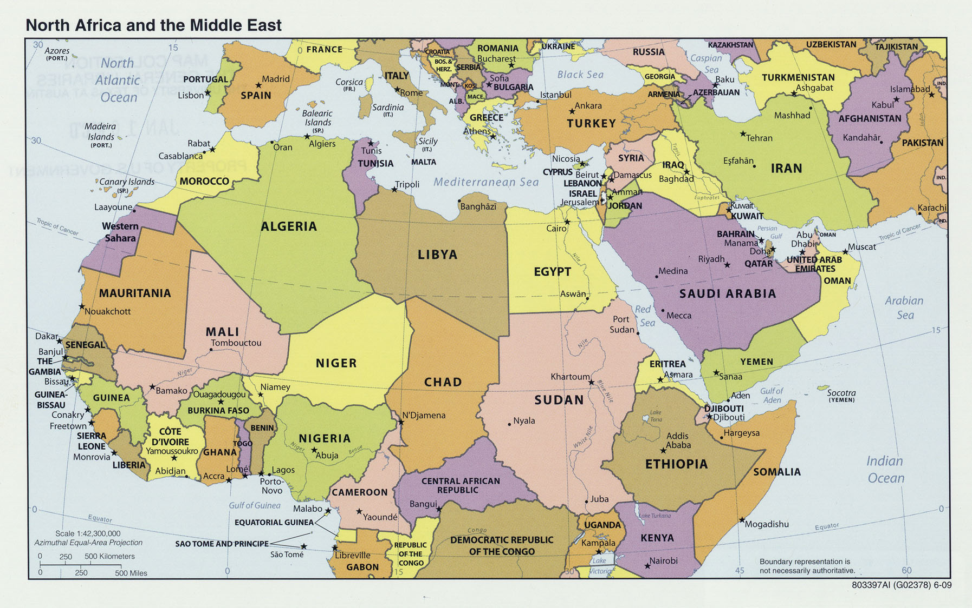
The Arab Spring
See Guardian Arab Spring Timeline for first year events:
http://www.guardian.co.uk/world/interactive/2011/mar/22/middle-east-protest-interactive-timeline
Mar 19
Dec 19, 2010
Feb 14
Jan 25
Feb 16
Jan 27

Slide 4
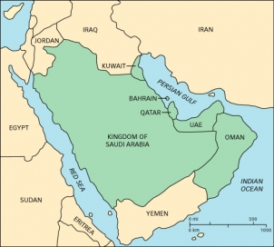
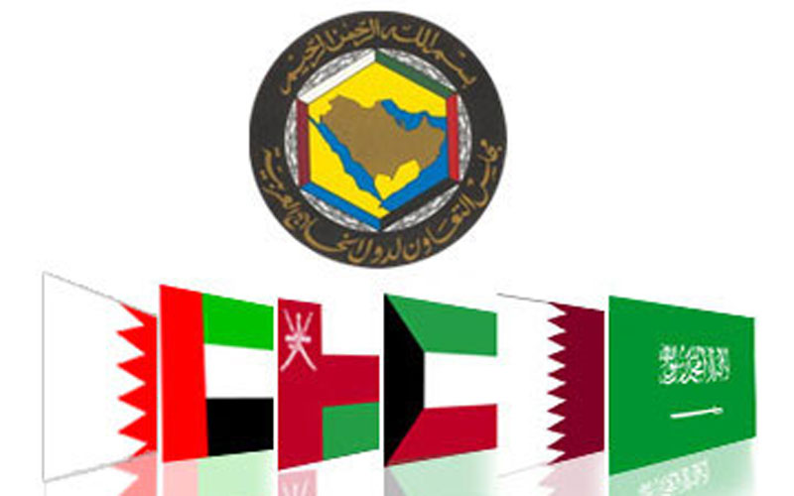
Gulf Cooperation Council (GCC)
Bahrain
Kuwait
Oman
Qatar
Saudi Arabia
UAE
Formed:
May 1981

Slide 5
Colonial Era
Gulf countries were protectorates with exception of present day Saudi Arabia (except for a treaty between 1915-1927)
British rule by encouraging concentration of power in the hands of individual rulers
British chose divide and rule strategy breaking region into little sheikhdoms
Many of the current border disputes are a result of this old policy
(Source: Capitalism and Class in the Gulf Arab States. Adam Hanieh. 2010)

Slide 6
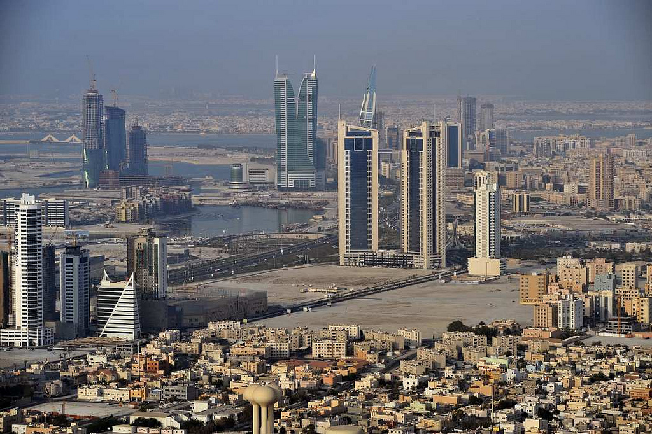
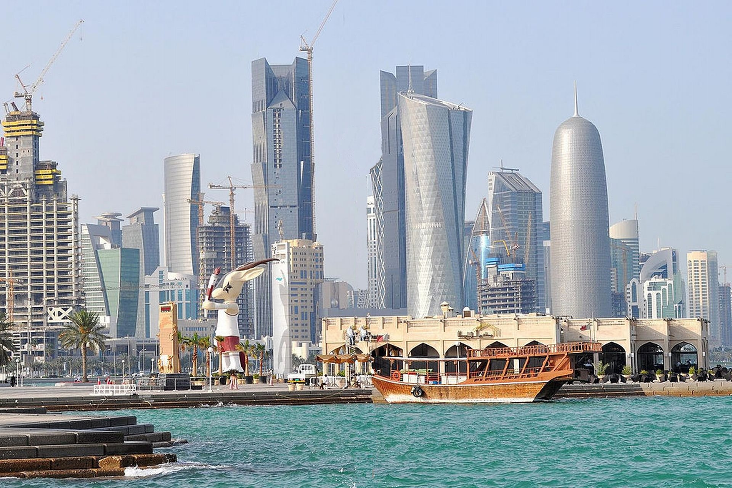
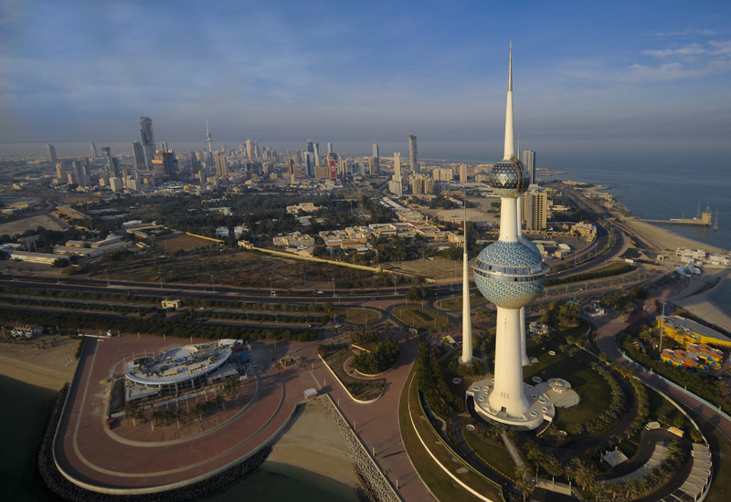
Background on Gulf States
Kuwait
Sabah family rule through merchant taxation
Population aprox 3 million (1.5 million citizens)
Qatar
Ruled by Al-Thani family
Population aprox. 2 million (250,000 citizens)
Bahrain
Ruled by Arab tribe owing fealty to Iran
Conquered by Al-Khalifa who rule today

Slide 7
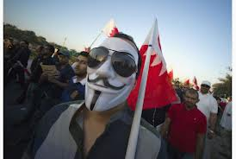
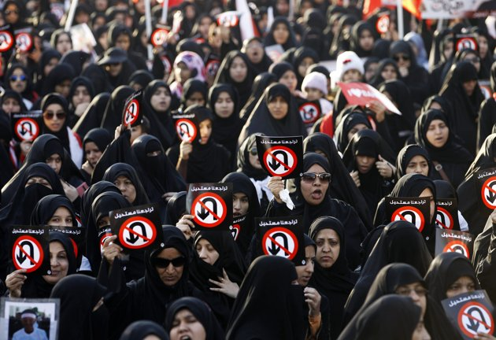
Bahrain

Slide 8
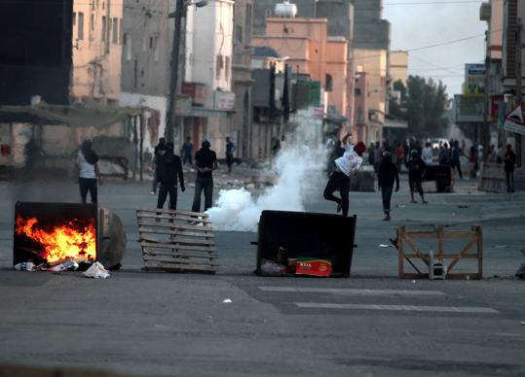
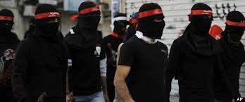
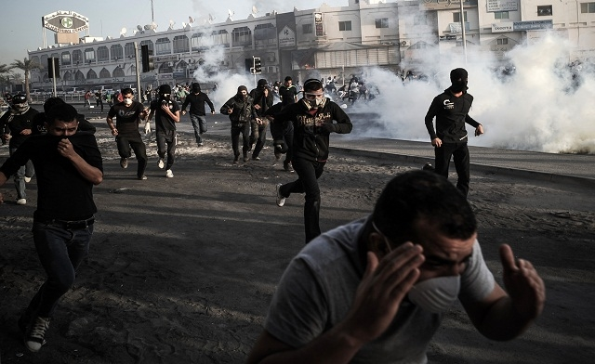

Slide 9
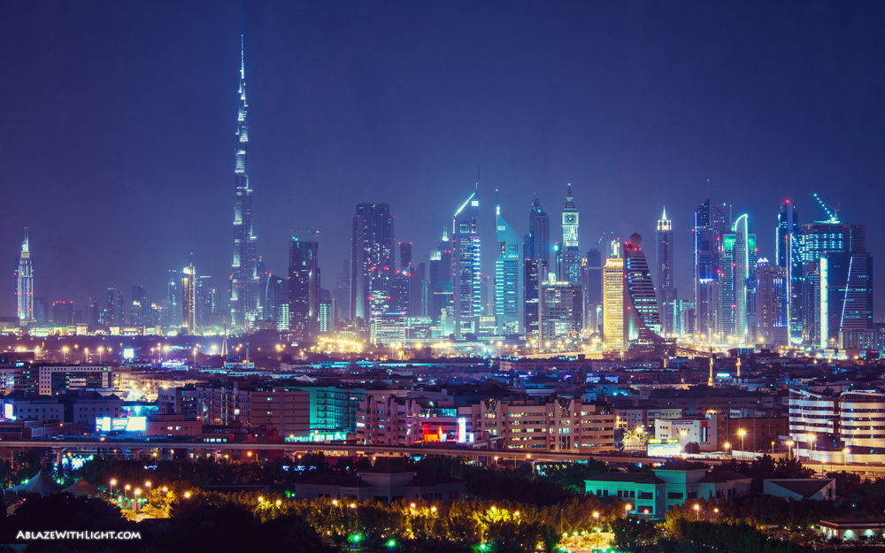
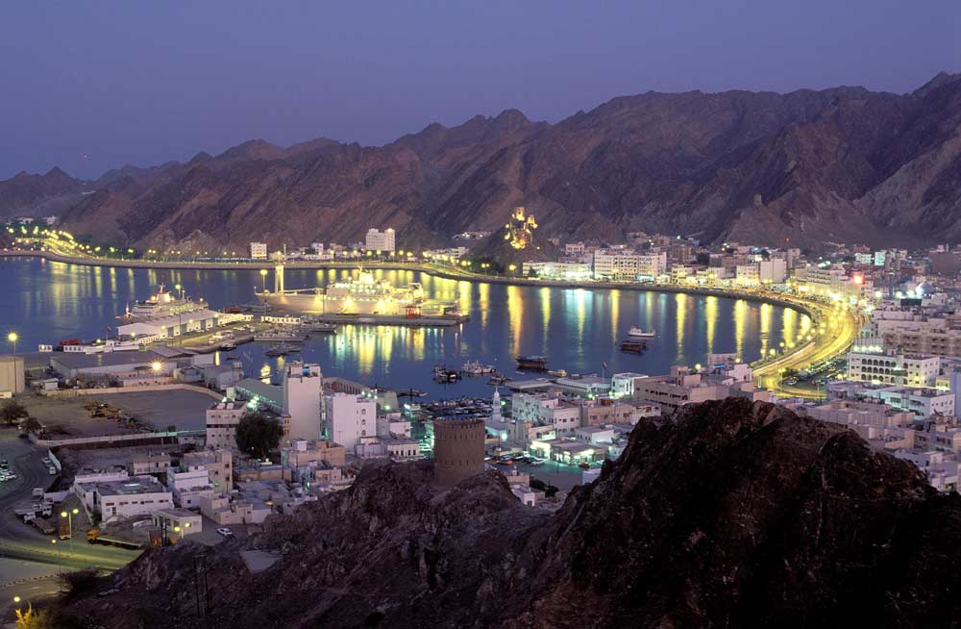
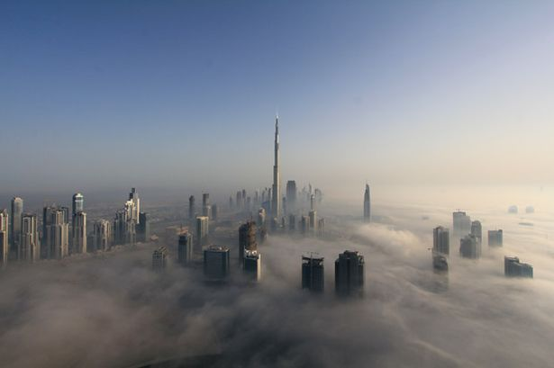
Background on Gulf States (cont.)
Oman
Was an Empire with control of Zanzibar and connected to interior Africa
Fought and defeated by British to control Strait of Hormuz
British brought in Baluchi Muslims from Pakistan to control military – still make up significant part of population (12%)
UAE
British sponsored 7 individual ruling Sheikhs
Forbid entry into negotiations with any other foreign powers
Dubai was key among them in trading route for British India
Joined together after British withdrawal in 1971

Slide 10
Background on Gulf States (cont.)
Saudi Arabia
Around 1/5 total conventional oil reserves
2/3 of GCC total population
Nearly 1/2 the region’s GDP
Aside from brief British treaty it was never under full control of British or the Ottomans
Rulers gained power from feudal tribute from nomadic tribes and not through taxes on merchants like coastal rulers

Slide 11
Protests in Al-Qatif (Eastern Province)
https://www.youtube.com/watch?feature=player_embedded&v=c2Q3VYWWkz8
https://www.youtube.com/watch?feature=player_embedded&v=MwG1FiFWJDc
https://www.youtube.com/watch?feature=player_embedded&v=1D2dUoEWpII

Slide 12
Integration of Gulf States in Global System
Think of the relation of oil to the world system
Not oil as a “thing” but as a commodity embedded in a set of (globally determined) social relations (Hanieh)
US desire to protect system of scarcity
Saudi Arabia key player
Rise of McJihad
Notion that capitalism is not self sufficient, dependent on other forces like Muwahhidun
(Source: Timothy Mitchell. McJihad: Islam in the US Global Order)

Slide 13
GCC Reactions to Arab Spring
Economic handouts
Political and economic reforms
Military intervention
Outreach to and support for the protestors.

Slide 14
Gulf States vs. the Region: Political Prisms
Inside – Outside
Suppression of protest at home vs. promotion of revolutionaries abroad
Monarchy – Republic
Can get rid of Parliament with ease to bolster legitimacy
Pluralism has created competition between social groups rather than vertical confrontation between society and regime
Sunni – Shi’a
Sectarianism is modern; exists alongside nationalism
Myth of Shi’a crescent
Saudi role

Slide 15
Saudi Managing Internal Protest
Two contradictory discourses both sponsored by the state:
a religious one in support of Sunni unity against Shia heretics
a so-called liberal discourse denouncing religious scholars and their sectarianism
Objective:
Suppress Shi’a areas – Al-Qatif predominantly Shi’a
Invoke discourse of Iranian backed Shi’a regional revolt
Methods for deploying this strategy:
Wahhabi preach that protests are illegal and issue fatwa
Iranian plot directed by Shi’a and exiled Sunni
Protestors become the ones sowing sectarianism that the gov’t is protecting against

