Slide 1
Political Islam and internal politics in Central Asia
Dr John Heathershaw, University of Exeter, UK
A presentation at the University of Pittsburgh
22 March, 2014

Slide 2
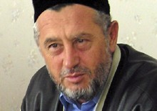
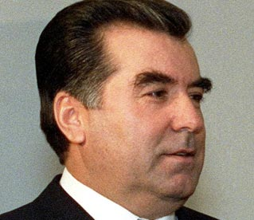
Islamic-Secular dialogue…?
Or… national Islamic secularism?

Slide 3
Political Islam, Islamism, etc..
Some terminology:
Political Islam
Islamism
‘Radical Islam’
Islamic violent extremist organizations

Slide 4
Part One: Post-Soviet Muslim radicalization
Myth or reality?

Slide 5
Six claims about Political Islam in Central Asia
The post-Soviet Islamic Revival
To Islamize is to radicalize
Authoritarianism and poverty cause radicalism
Underground Muslim groups are radical
Underground Muslim groups are globally networked
Political Islam opposes the secular state

Slide 6
1. The post-Soviet Islamic Revival
International Crisis Group: ‘many have responded to 70 years of atheism by embracing religion’ (2009, pp. i)
One survey: 43 percent pray more than they did prior to independence?
BUT….
Revival began from the 1950s as secularised Islam
Political Islam at least from the 1970s

Slide 7
2. To Islamize is to radicalize
ICG: ‘the growth of interest in more strictly observant, and sometimes radical, Islam’ (2012, p.12)
BUT…
This slippage is political, e.g. Akromiya
Survey: of those who claim religion influences their behavior “a lot”, 30 percent either never pray or pray only on special occasions

Slide 8
3. Authoritarianism and poverty cause radicalism
The following claimed as causes of radicalism:
‘disappearance of basic services’
‘poor living conditions, corruption and abuse of office’
‘economic crisis and rigged elections’
‘declining demand for labour migrants’
‘woeful social and economic conditions’
‘a venal and corrupt political elite’
BUT…
No evidence
Kazakhstan not Kyrgyzstan?
Turkmenistan and Uzbekistan: effective suppression

Slide 9
4. Underground Muslim groups are radical
When groups are driven underground they ‘radicalise’?
BUT…
Again, little or no evidence
Islamic Revival Party of Tajikistan?

Slide 10
5. Underground Muslim groups are globally networked
ICG: ‘Links between Islamic militants in Central Asia, Afghanistan and the former Soviet Union […] supplemented by an informal web of contacts at multiple levels across the internet.’
20 Central Asianists amongst 759 Gtmo detainees listed by US DoD in 2006
BUT…
Islamic Movement of Uzbekistan: external?
Hizb ut-Tahrir: local?

Slide 11
6. Political Islam opposes the secular state
ICG: ‘The term Islamist in this report is used to refer to political activists with an agenda of applying Islamic law, through peaceful democratic means, through missionary work, through non-violent advocacy or through violent jihad.’
BUT…
Islamic Revival Party of Tajikistan
Survey: the majority (62%) of those who claim that religion influences behavior a lot also believe that religion should concern itself only with the spiritual

Slide 12
Post-Soviet Muslim radicalization?
Myth or reality?
Political violence: 11 casualties and 3 terror attacks in CA since 2001?
A break from the past, or…
Central Asian Islamic secularism?

Slide 13
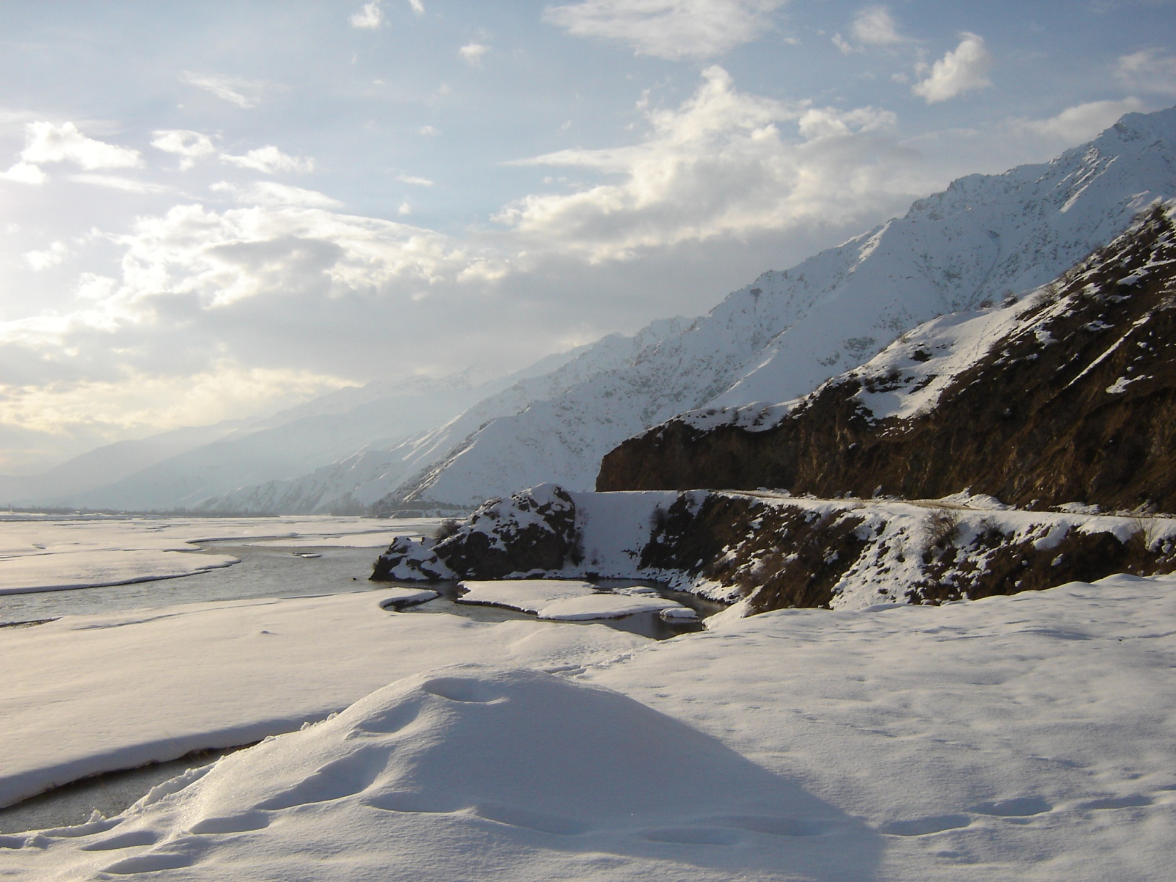
Tajikistan
Part Two: Case study – Rasht valley, Tajikistan

Slide 14
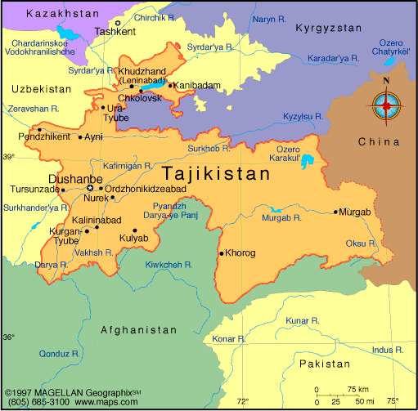
Tajikistan
Rasht valley
The main town is called Garm

Slide 15
Rasht and the Tajik civil war
From 1950s: forced migrations to south from Garm region of Rasht valley
1950s-90s: emergence of ‘Garmi’ identity and land conflicts in South
From 1992: civil war between regional factions including ‘Garmis’ allied to the military formation of the Islamic Revival Party of Tajikistan
From 1993: ‘Garmi’ groups, having been forced into Afghanistan, return to the Rasht valley to continue the war
1996: Garm Protocol signed
27 June 1997: General Peace Agreement involving incorporation of Garmi commanders into state

Slide 16
Post-war conflicts
1997-2007: gradual exclusion of Garmi commanders by firing, exile, imprisonment and/or murder
Various incidents of violence in Rasht valley related to these political struggles
2008: killing of Dushanbe commander Oleg Zakarchenko by the men of Garmi commander Mirzokhuja Ahmadov
2009: killing of former Minister Mirzo Ziyoev

Slide 17
Kamarob Gorge, 2010-11
Early-September 2010: prison break
15 September: high-level delegation in Rasht Valley region to meet ex-commanders
19 September: attack on convoy in Kamarob gorge of Rasht Valley – 25 government soldiers killed
Sept. 2010-Jan.2011: military operations – over 100 killed including more than 60 government troops
4 Jan. 2011: announcement of the killing of the commander Ali Bedaki and his group

Slide 18
What’s it all about?
Layers of the onion…
Islamic radicalism? Secondarily. Local (Ali Bedak) not regional (IMU) or global (al-Qaeda).
Post-war context? Continuation of a pattern; peripheral region; personal rivalries.
State weakness? Fighting within the state. All main protagonists have held government posts.
Business? Turf war over the Rasht valley route; control of coal mine?

Slide 19
Conclusions
Political Islam is weak in Central Asia
Non-violent Islamism is marginal and difficult to assess
‘Radical Islam’ is a bogeyman deployed casually by secular states (and occasionally foreign experts)
Islamic violent extremist organizations have largely been excluded from Central Asia
Rather than a crime-terror nexus it is better to think of a crime-state nexus

Slide 20
Prompt
Why is Political Islam weak in Tajikistan?
Why is it so often conflated and exaggerated?

