Slide 1
“He who hasn’t been a foreigner, hasn’t been a Muslim”: Debating Labor, Migration, and the Ethical Life in Rural Central Asia
Dr. Madeleine Reeves, University of Manchester
Notes:
These 2 photos together: thinking about migration and social change in sending communties at the same time
Migration a huge part of life across Central Asia, for different reasons. Kg, Taj, Uzb as sending communities; Kaz as a receiving community
We don’t know how many people are on the move at any one time – why?
Russian federal migration service estimates 2.5 million citizens of Uzb (out of pop of 30 million), 1.1 million from Taj (out of 8 million), 600,000 from Kg in 2013 (out of population of 5.5 million).
In rural areas, unusual to find a family that doesn’t have at least one family member working in Russia or Kazakhstan for work.
Enormous impacts for how we think about social and political change in rural Central Asia, and yet when I started researching this,
Most of the research tended to be focused on highly normative questions: should we be worried about migration? Are people sending their remittances the right way?

Slide 2
Framing the migration debate
Policy-led questions
Is migration economically beneficial to sending communities? Should out-migration be encouraged, facilitated, managed by the state?
How are remittances being transferred, and who is benefitting?
How should receiving states regulate migration for work (through visas? Through employment quotas?)
Governments “escape from the pressures for urgently needed structural reforms,” while “most remittance-taking families experience moral hazard problems, some entirely forgo productive activities, and tend to live lucrative and lazy lives. (Aslan, “Labor migration and its potential consequences for Central Asia” 2008)
Notes:
Often the language normative, sometimes alarmist
Tended to be dominated by questions of concern for the state – is migration a good thing or a bad thing?
Russia – are migrants adapting properly? Should we introduce a visa regime?
Central Asian states – should migration be encouraged?
Karimov – migrants are lazy to go there for a piece of bread? They are too lazy to work at home!

Slide 4
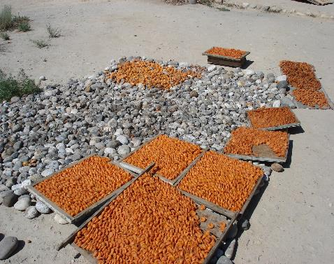
Notes:
Borders – problems getting apricots out to market, need to sell them quick
Labour migration – building on older networks of trading apricots

Slide 5
Debate about migration in Central Asia has tended to sideline questions of meaning:
What kinds of theoretical tools do we need to understand migration decisions?
What is the significance of migration for debates about citizenship and belonging two decades after the end of the Soviet Union?
How is migration being incorporated into considerations about family life, intimacy, inter-generational care, gender relations, and future well-being?
→ Anthropological perspectives
Notes:
By anthropological perspective – not just ‘ground up’ but attuned to the meaning of everyday practices
Not only, how is Karimov thinking about migrant workers, but how are families themselves dealing with protracted absence of family members.
Who should leave, where to, for how long? Is it worth the expense of getting there?

Slide 6
The questions we’ll explore
Who is on the move from Central Asia today, and why?
Moving beyond economic determinism
What are some of the consequences of labor migration…
…for economic and social change in sending communities?
…for gender identities, roles and relationships?
…for debates about citizenship and political membership in the receiving community?
How is migration inserted into moral frameworks? How might it be transforming them?
…. But first some context….

Slide 7
Central Asia as a region of in- and out-migration
20th Century histories of migration, voluntary (e.g. for work, for study) and coerced: Soviet Union as a state that drastically shaped human mobility.
Perestroika and post-perestroika “unmixing of peoples” (Brubaker) → out-migration of ethnic Russians and Russian-speaking minorities to their (putative) “historical homeland”. Typically:
Permanent rather than seasonal (though exceptions and reversals)
Involving networks of kin straddling sending/receiving communities
Naturalization facilitated, discourse of “return”
Whole family (often 2 or 3 generations)
Complex economic, political, linguistic reasons, concerns about children’s future as ethnic minorities
From urban and peri-urban areas

Slide 8
Post-soviet labor migration
From early/mid-2000s: migration of the non-Russian populations for work, predominantly to Russia and Kazakhstan. Typically
Seasonal rather than permanent (at least initially)
From rural, land-poor regions (though changing)
Economically driven: remittances as a primary source of domestic incomes
Gendered (though differently so in different sending states)
Largely unskilled work (chernaya rabota)
Unregulated and extremely precarious
Encountered in the receiving society as “outsiders” (priezzhie)

Slide 9
I. A story of economic migration?

Slide 10
Economic differentials between post-Soviet states (2010)
Notes:
So – an economic story – “we go because there is no choice” (aila jok barabyz)

Slide 11
Remittance corridors as % of recipient state’s GDP

Slide 12
Emergent economic differentials
Civil war (in Tajikistan)
Collapse in central subsidies for industry
Impact of new border controls on exports
Lack of rural employment
E.g. work as an unskilled laborer in Moscow greatly exceeds skilled work in rural Kyrgyzstan
Notes:
“I can’t speak for the whole of Kyrgyzstan, but here in Ak-Sai Russia is the only source of employment. Although there are Turks building in Bishkek now, the pay is lower because of the relationship of the som to the rouble. Say in Russia the average pay on a building site is 10,000 roubles—so about 14,500 som, right [c. $320] ?—in Kyrgyzstan they’ll pay 10,000 som. So where’s the benefit? There or here? Well I don’t know, but that’s how I see the situation” (Abdullo, Ak-Sai, January 2010)
Teacher with a double teaching load in 2005, $56; in Moscow $200

Slide 13
II. The political economy of migration (mis-)management

Slide 14
The administrative and social organization of migration
No visa regime: entry easy, but remaining legally legible very difficult. Challenges:
1) Work permits and quotas
2) Long-term residence registrations
3) Safe, affordable accommodation
Notes:
But we need to attend to the political economy of migration management (or of migration mis-management)

Slide 15
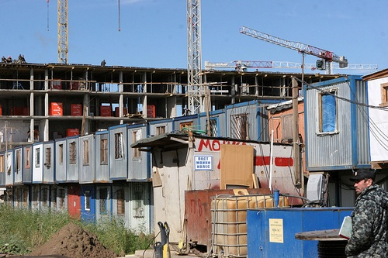

Slide 16
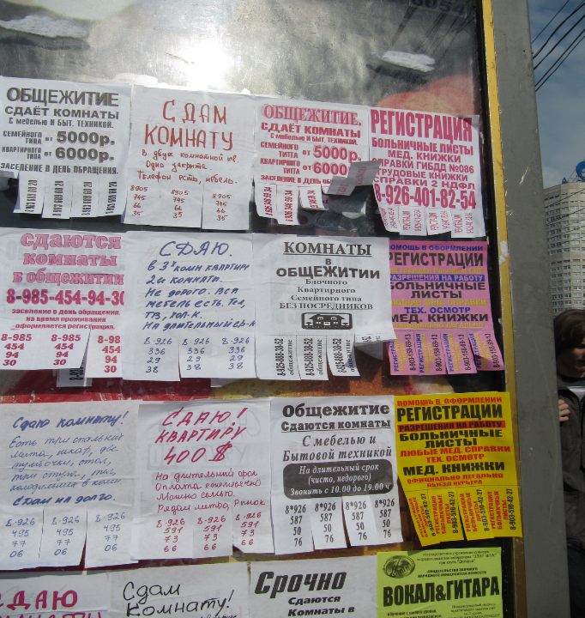
Notes:
16

Slide 18
www.kojko-mesto.ru (until March this year)
“We don’t have racial prejudices, but the situation has arisen today that the greatest demand for a place to stay in Moscow is among citizens of Russia, Belarus’ and Ukraine. In accordance with the existing demand for inexpensive dormitory accommodation in Moscow, we aim to only house people of Slavic appearance (tol’ko lits slavianskoi vneshnosti), for the comfortable living conditions of all residents, thereby also avoiding any conflictual situations (tem samym zaranee izbegaia konfliktnykh situatsii).”

Slide 19
Anxieties about “illegal” immigration
Photo: Ilya Varlamov

Slide 20
Political economy of migration management
Story of “economic migration” should be understood in context of a distinctive political economy:
the demand in Russia for cheap, tractable, deportable labor
+ few labor controls
+ widespread public antipathy to migrant presence– discrimination in the housing market, pay differentials
→ Implications for the social organization of migration (who goes, who stays, whom you trust)

Slide 21
A fieldwork example: labor migration from the Isfara valley

Slide 22
Migration as a mode of life..
At the time of research (Jan-Feb 2010), 35.6 % of all households in the villages surveyed currently had at least one family member working in Russia.
85.8 % of all households had had at least one family member working in Russia at some point during the preceding 5 years (since Jan 2005)
Historical patterns of seasonal migration for trade (apricots to Nizhnii Novgorod (Gorky)), but large-scale labour migration a phenomenon of the last few years.
Migration still predominantly undertaken by young men, though increasing proportion of young married couples travelling together, typically leaving their children with grandparents.

Slide 23
An economic story….
Notes:
Main reasons:
No work here
To cover everyday living expenses
To cover significant one off purchases
Other reasons:
To acquiare a skill
To learn Russian
To escape domestic problems

Slide 24
…That should be socially embedded. (1) pioneers and odnoklass networks (“snowball effect”)
Notes:
You go because you know someone. Major period of take-off
One person brings over 10 more – the “brigade”
Migration can’t be understood without understanding these social networks of support

Slide 25
(2) Networks trump economics in choice of city
Reasons in order of popularity:
1. Relatives working in that city
2. Friends/acquaintances in that city
3. Had already had a workplace in that city
4. Ease of registration
5. Wages higher in that city

Slide 26
III. Migration as site of social and economic transformation

Slide 27
The social life of remittances
Majority of remittances are spent on meeting everyday living expenses (food, clothes, coal, school books)
Investment in house and barn-building, livestock, land.
Affording to marry: the “toi economy” and ritual inflation.
“It’s not enough just to have nice food at your toi now, you have to have done nice repairs on your house, have a DVD player”
University education as a route out of the village
Investing in transnational livelihoods: Russian citizenship and an apartment in Osh

Slide 28
Economic and social remittances…
Notes:
28

Slide 29
Innovations in ritual life

Slide 30
IV. Migration as a gendered field

Slide 31
Gender, generation, sibling hierarchy
Numerical dominance of male migration (though differing by country)
Ambivalence surrounding unmarried female migrants (“buzulgan kyzdar”)
Increase in “family migration” – husband and wife migrating together, children left in care of grandparents or other children
Particular pressures on youngest sons and their wives: to stay or go?

Slide 32
Growth in grand-parent and child-headed households

Slide 33
New experiences of paid employment as source of self-realization

Slide 35
Implications?
Shifting domains of work
Autonomy and freedom?
But male absence can also lead to new restrictions on female mobility
Policing female behavior as index of national pride

Slide 36
“Patriotic” violence and divorce by SMS
Notes:
Normalization of violence?
Nationalism Anxieties about transformation of gender hierarchies, breaking of national boundaries
Kyrgyz MP – suggested that women younger than 22 should not be able to travel to Russia without Father’s permission or permission of older male relative
Organized groups of violent men are the consequence of social mythmaking by politicians in the post-April 2010 interim government who created a symbolic aura around participants in the violent seizure of power which they called a “revolution”, and of the political nationalism project visible in the interethnic conflict in June 2010 in the south of Kyrgyzstan.
• ?Groups of young men who have received this symbolic status but who have been forced into labour migration have found a way to enhance their “patriotic” status in criminal activity in Russia. In essence, this is a political collective unconsciousness driven by nationalistic imagination.

Slide 37
Conclusions
Migration should be understood as much more than a response to economic need;
A key dynamic of social and political transformation in sending and receiving societies
A site of ethical debate concerning
The organization and distribution of labor
The possibilities and limits of female emancipation
The reconfiguring of inter-state relations after end of Soviet Union
How and where to situate imagined futures: here or away?

Slide 38
And so, the prompt…
“The large-scale out-migration for work from Central Asia is serving as much to reinforce traditional gender hierarchies as to challenge them”. Discuss.

