Slide 1
Views from the East and West
Muslims in a Global Context
Indonesia, Malaysia, Myanmar, the Philippines
Siddharth Chandra
Professor and Director, Asian Studies Center
Michigan State University

Slide 2
Objectives
Part I: Focus on Indonesia
  Historical and political context
Part II: Views from the East
  The Pew Research Forum on the World’s Muslims
Synthesis

Slide 3
Relevant features of Indonesia
4th most populous country in the world
Most populous country in Southeast Asia
  About 250 million people
Archipelago
As wide from west to east as the northern USA
  Three time zones

Slide 4
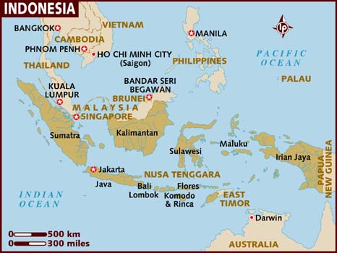
Indonesia
Source: Lonely Planet, http://www.lonelyplanet.com/maps/asia/indonesia/

Slide 5
Muslims in Indonesia
Largest Muslim country in the world
  205 million Muslim Indonesians in 2010
  In 2010, 88% of Indonesia’s population was Muslim
  12.7% of the world’s Muslims live in Indonesia
  Source: Pew Research Forum

Slide 6
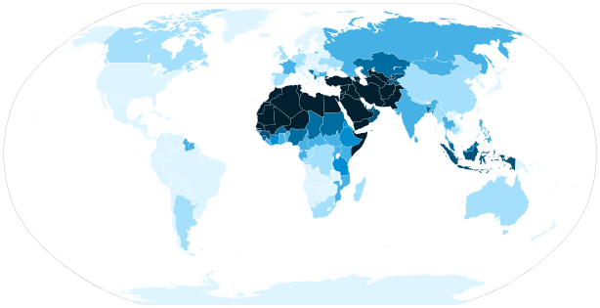
Indonesia’s location in the (Muslim) world

Slide 7
Indonesia’s location in the (Muslim) world
Easternmost majority-Muslim country
Farthest from the birthplace of Islam (Saudi Arabia)

Slide 8
Arrival of Islam in Indonesia
Islam arrives in Indonesia by sea early in the second millennium C.E.
Development of various Sultanates across the western part of the archipelago (Sumatra and Java) between 1200 and 1700 C.E.
Animist, Hindu, and Buddhist traditions are overlaid with new Islamic traditions
Especially evident in Java

Slide 9
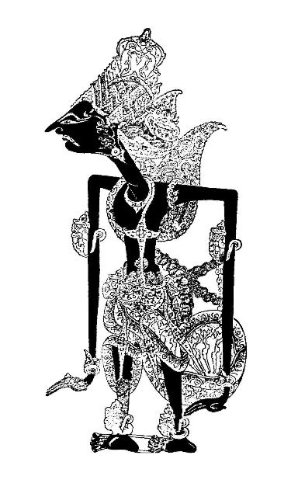
Multi-layered Religious Traditions
Cerita wayang
Prabu Kresna
Prabu means “Lord”
Krishna is a Hindu deity
Pesantren vs abangan
approach to faith

Slide 10
Arrival of Europeans
Portuguese 1500+
Dutch 1600+
  First as the VOC (Dutch East India Company)
  Then as a formal Dutch Colony (Dutch East Indies)
The rise of Dutch power coincides with the fall of sultanates in Indonesia
  Loss of Islamic head(s) of state
Dutch policy: freedom of religion so long as it does not interfere with governance/law and order

Slide 11
Independent Indonesia
Sukarno
  Parliamentary democracy
  Nasakom/Guided Democracy
    Nas-nationalism (army)
    A-religion (Islamic groups)
    Kom-Communism (Communists)
  Explicit role for religion (Islam)
  Rise of the Communist Party of Indonesia
  Coup and transition, 1965

Slide 12
Independent Indonesia
Suharto
Comes into power after the 1965 coup
Military vs. communists
  Killings of 1965-1966
Period of transition to 1967
Elimination of the Communist Party of Indonesia
“Pancasila Democracy” to control Islamic opposition

Slide 13
Pancasila (Five Principles)
Belief in the divinity of God
Just and civilized humanity
The unity of Indonesia
Democracy guided by the inner wisdom in the unanimity arising out of deliberations amongst representatives
Social justice for all of the people of Indonesia

Slide 14
Democratic Indonesia
Asian financial crisis of 1998
Fall of Suharto
Emergence of democratic politics
The new Indonesian democracy is only 15 years old!
Emergence of long-suppressed political forces
Including political Islam

Slide 15
Pew Research Forum
World’s Muslims
Favor Sharia
  Indonesia - 72%
  Malaysia - 86%
Religious leaders should have political influence
  Southeast Asia – 79% (higher than all other regions)
Other issues
  Gender – Indonesia – favor freedom for women, but within the context of submission

Slide 16
Conclusions
Indonesia (and Southeast Asia) is a major world region for Muslim studies
Islam is a relatively recent phenomenon in the region
Islam in Indonesia is a very diverse and complex phenomenon
In Indonesia, political Islam has had little time to assert itself
In the newly democratic system, these forces will finally be able to play out
A system in disequilibrium, moving toward a (long-thwarted) equilibrium

