Slide 1

ADAM MASAVA
Introduction

Slide 2
SEE
THINK
WONDER

Slide 3

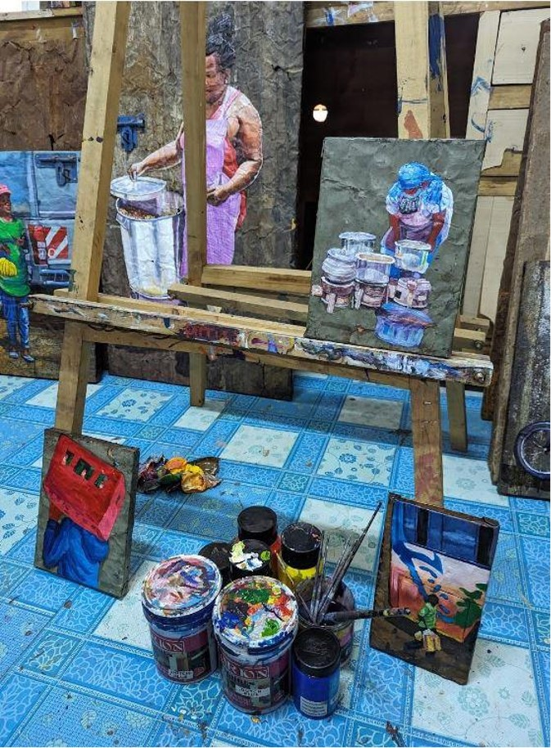

Slide 4

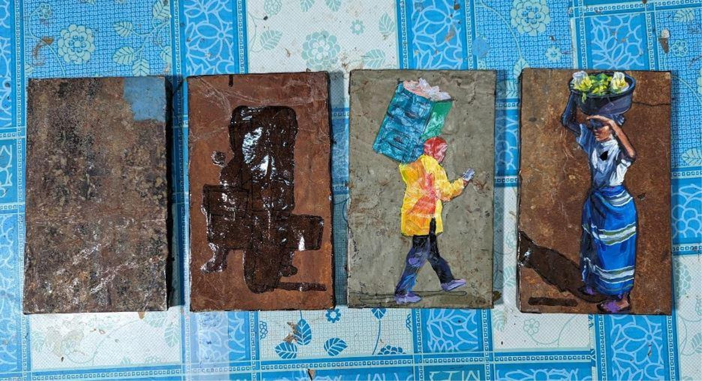
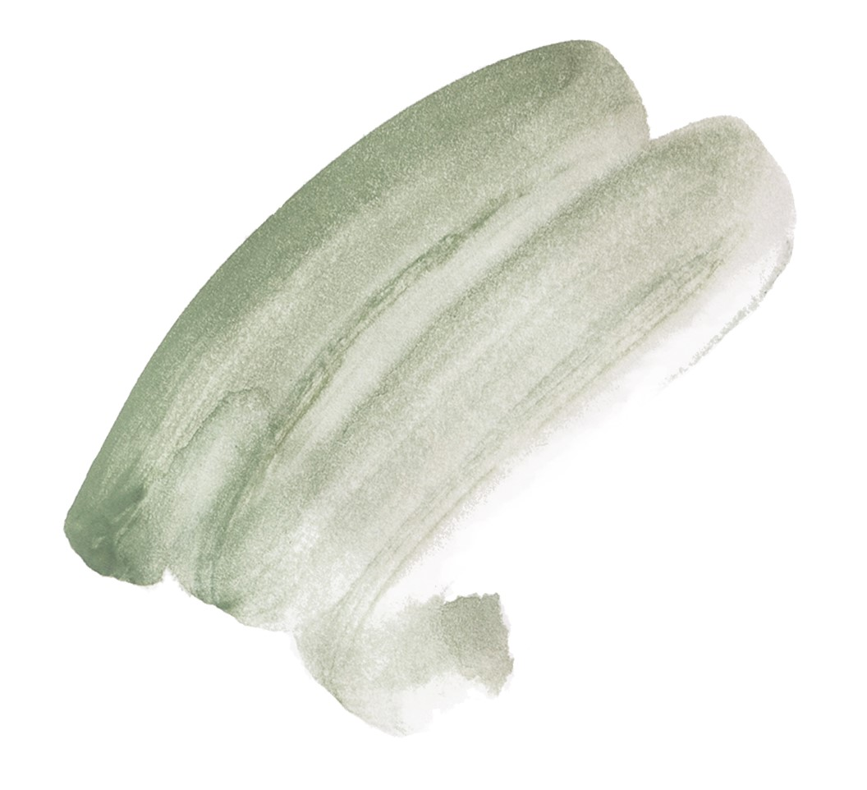

Slide 5
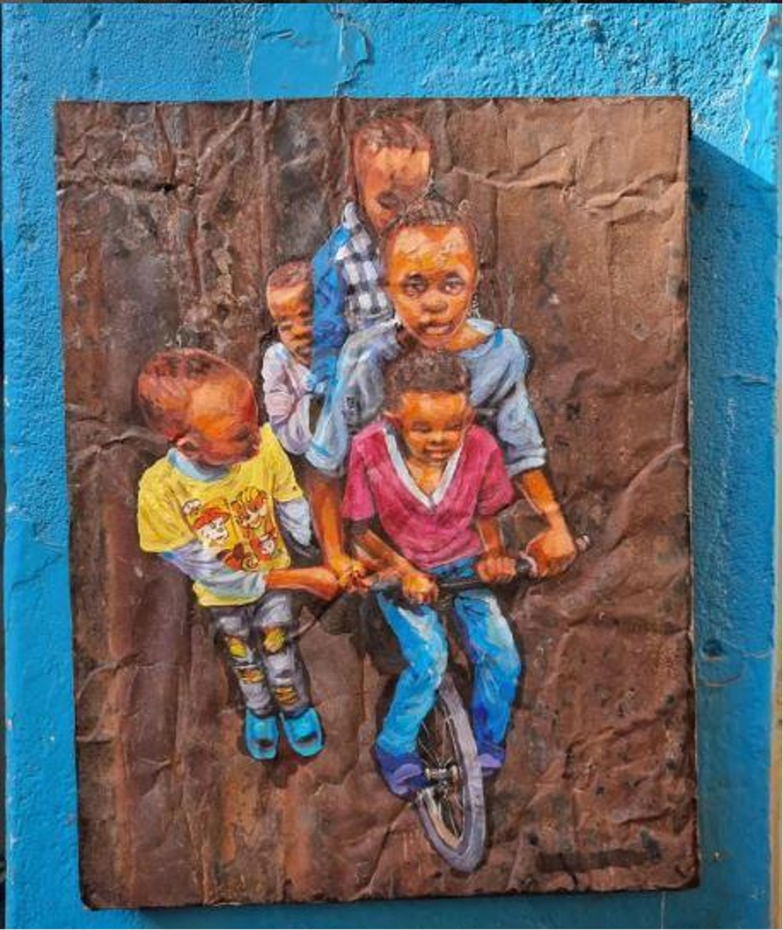

Slide 6

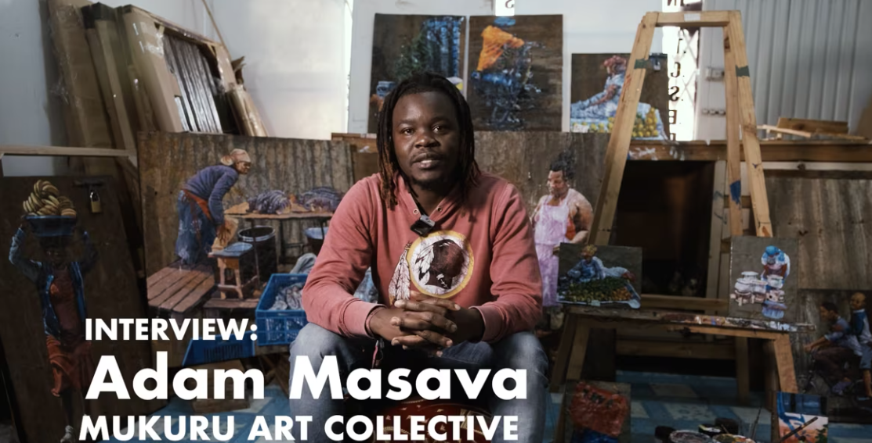

Slide 7

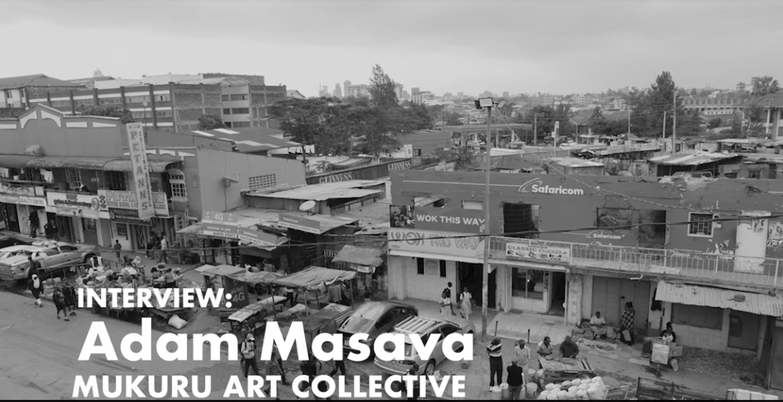

Slide 8
Let’s Create!
Use the connections you made as inspiration for sketches of your everyday experiences

Slide 9

CONNECT

