Slide 1

Comparative Study of Agricultural Practices: Kenya and Southwestern PA

Slide 2

Welcome to Agricultural Insights
Today we will explore agricultural practices and their environmental impacts.
We'll compare sustainable methods and degradation issues in Kenya and Southwestern PA.
Think about how agriculture shapes the environment and communities where you live.

Slide 3

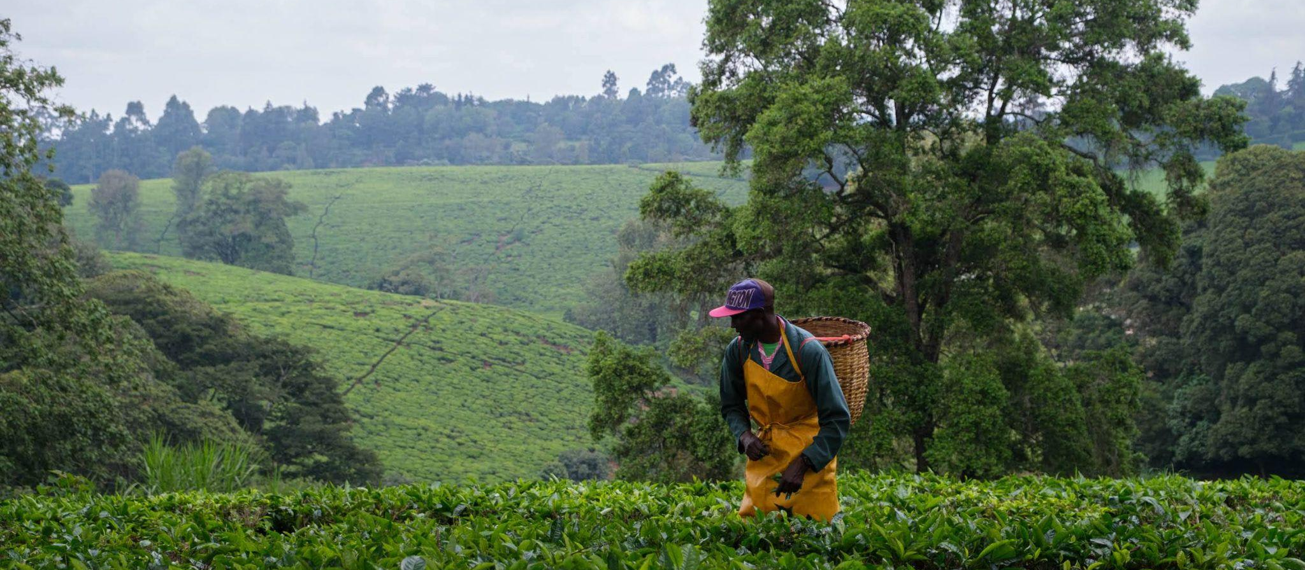
Agriculture in Kenya: An Overview
Agriculture is a key sector in Kenya, contributing to the economy and food security.
Diverse climates allow for a variety of crops and livestock.
Challenges include climate change, land degradation, and water scarcity.
How might these challenges affect food production and local communities?

Slide 4
Sustainable Agriculture in Kenya
Conservation agriculture: minimal soil disturbance, crop rotation, and cover crops.
Agroforestry: integrating trees into farming systems for better soil and water conservation.
Organic farming: reducing man-made chemical inputs to preserve soil health and biodiversity.
Can you think of other benefits of sustainable agriculture?

Slide 5

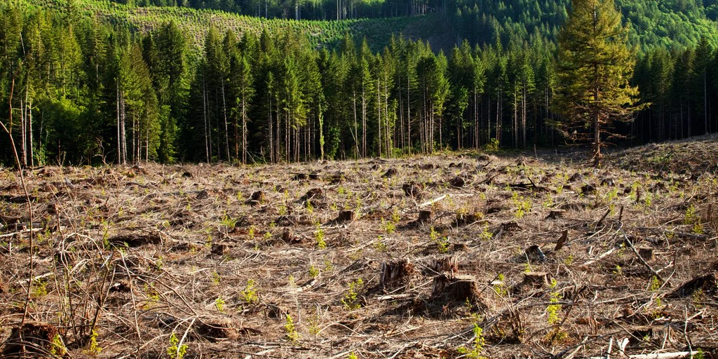
Environmental Damage
in Kenya
Deforestation for agriculture leads to habitat loss and reduced rainfall.
Overgrazing by livestock causes soil erosion and destruction.
Chemical runoff from farms pollutes water sources and harms wildlife.
In what ways can these issues be lessened?
“Deforestation in Kenya.” Deforestation in Kenya: Causes and Factors, Effects of Deforestation, Statistics, www.ecohubmap.com/hot-spot/deforestation-in-kenya/3zerb1klk4ct6i3. Accessed 5 June 2024.

Slide 6
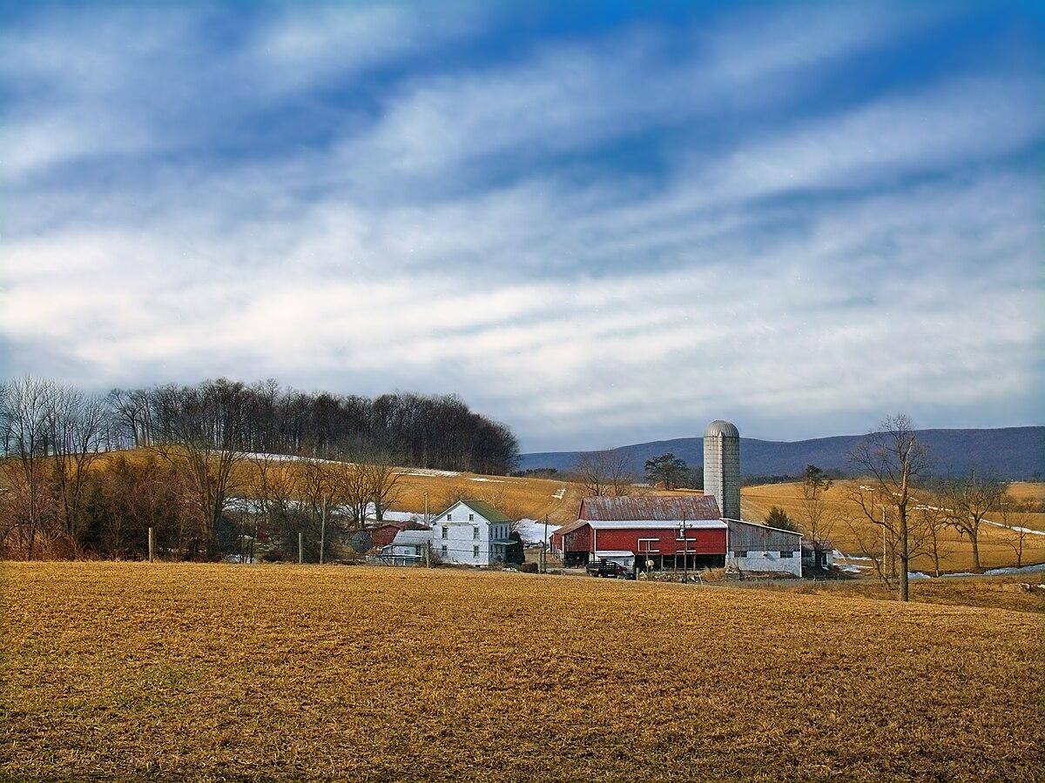
Agriculture in Southwestern PA: An Overview
Agriculture in Southwestern PA includes dairy, corn, and soybean production.
The region's temperate climate and rolling hills shape its farming practices.
Urbanization and economic shifts impact the agricultural landscape.
How do these factors influence farming choices in Southwestern PA?

Slide 7
Sustainable Agriculture in Southwestern PA
Community Supported Agriculture (CSA) programs promote local, seasonal food.
Integrated Pest Management (IPM) reduces the need for chemical pesticides.
No-till farming preserves soil structure and reduces erosion.
What are some local foods you've encountered that are grown sustainably?

Slide 8
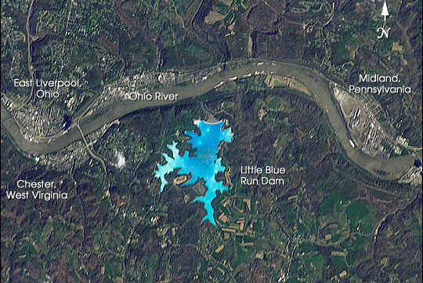
Environmental Damage in Southwestern PA
Historical coal mining has left a legacy of soil and water contamination.
Conventional farming can lead to nutrient runoff and waterway eutrophication.
Loss of farmland to development disrupts ecosystems and reduces green space.
How can communities work together to address these environmental challenges?
LIttle Blue Run Lake in Beaver County, PA is a man made lake that covers approximately 1,900 acres and forms the largest coal ash impound in the United states. (Image Science and Analysis Laboratory, “Gateway to Astronaut Photography of Earth.” NASA, NASA, eol.jsc.nasa.gov/. Accessed 5 June 2024.

Slide 9
Comparing Sustainable Practices
Both Kenya and Southwestern PA use crop rotation and organic farming to enhance sustainability.
Agroforestry in Kenya and CSA in Southwestern PA both promote biodiversity.
How do these practices reflect the unique environments of each region?

Slide 10
Comparing Environmental Challenges
Kenya faces deforestation, while Southwestern PA deals with post-industrial pollution.
Overgrazing in Kenya and nutrient runoff in Southwestern PA both affect soil and water quality.
How can lessons from one region inform practices in the other?

Slide 11
Global Impact of Local Agriculture
Agriculture's environmental impact extends beyond local borders.
Climate change is a global issue influenced by agricultural practices.
Sustainable methods can contribute to global environmental health.
In what ways can we support sustainable agriculture locally and globally?

Slide 12
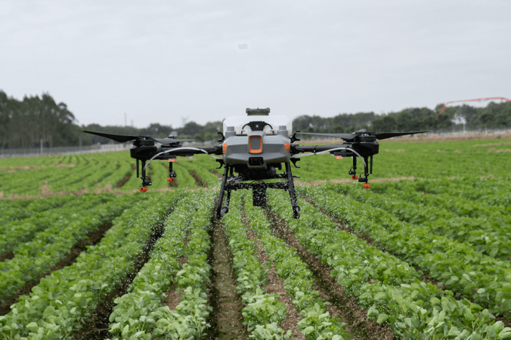
Technology in Sustainable Agriculture
Precision farming uses technology to optimize field-level management.
Drones and satellite imagery help monitor crop health and resource use.
How might technology further improve sustainability in agriculture?
https://www.nifa.usda.gov/about-nifa/impacts/using-drones-agriculture-natural-resources

Slide 13
Policy and Agriculture
Government policies can incentivize sustainable practices or contribute to degradation.
In Kenya, policies aim to increase forest cover and manage water resources.
In Southwestern PA, conservation programs support soil and water quality.
What role should governments play in shaping agricultural practices?

Slide 14
Community Involvement in Agriculture
Community gardens and urban farms bring sustainable practices to cities.
Educational programs raise awareness about the impacts of agriculture.
Farmer's markets in Southwestern PA and local cooperatives in Kenya support small-scale farmers.
How can you participate in your local agricultural community?

Slide 15
Future of Farming: Adapting to Change
Crop diversification and water conservation are key to resilience.
Sustainable agriculture can help ensure food security for future generations.
What changes do you think are necessary for a sustainable agricultural future?

Slide 16
Conclusion: Our Role in Sustainable Agriculture
Our choices as consumers can support sustainable practices.
Educating ourselves and others about the impacts of agriculture is crucial.
Advocating for policies that protect the environment ensures a healthier planet.
What actions will you take to promote sustainable agriculture in your community?

