Slide 1

Everyday American Objects
Fulbright Ethiopia: Indigenous Wisdom and Culture
Created by: Geraldine Truog and Kate Van Haren

Slide 2
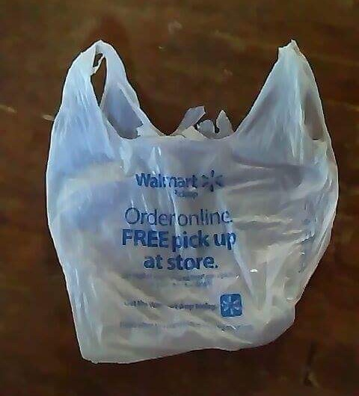
#1
1. What is it?
2. What is it made of?
3. What is it used for?
4. How is it used?
5. What does Ethiopia have that compares to it?
6. How is it made?
7. Do men, women, both, or neither make it?

Slide 3
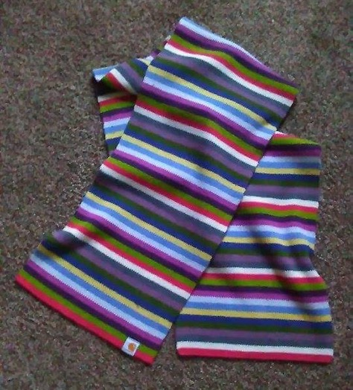
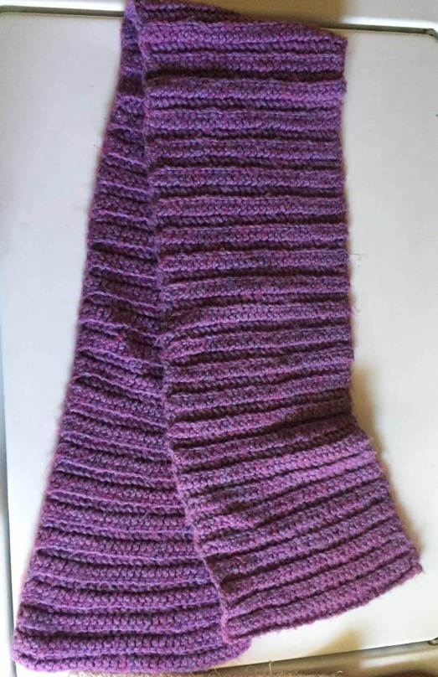
#2
1. What is it? 2. What is it made of?
3. What is it used for? 4. How is it used?
5. What does Ethiopia have that compares to it?
6. How is it made?
7. Do men, women, both, or neither make it?

Slide 4
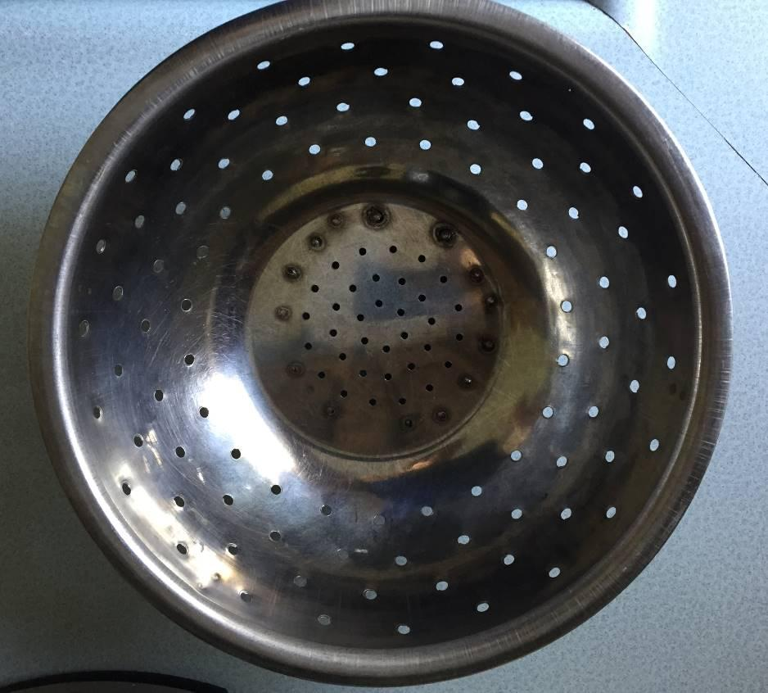
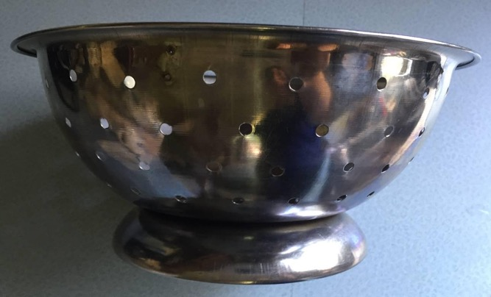
1. What is it?
2. What is it made of?
3. What is it used for?
4. How is it used?
5. What does Ethiopia have that compares to it?
6. How is it made?
7. Do men, women, both, or neither make it?
#3

Slide 5
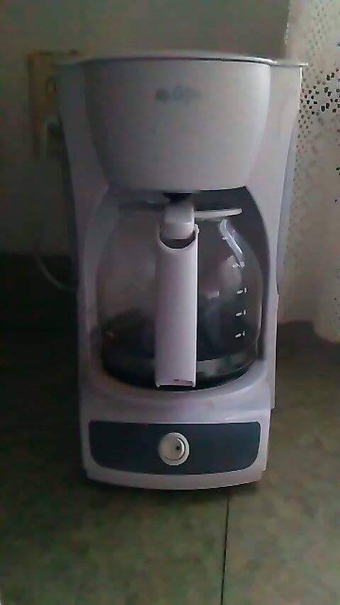
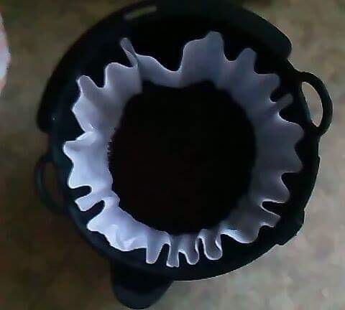
#4
1. What is it?
2. What is it made of?
3. What is it used for?
4. How is it used?
5. What does Ethiopia have that compares to it?
6. How is it made?
7. Do men, women, both, or neither make it?

Slide 6
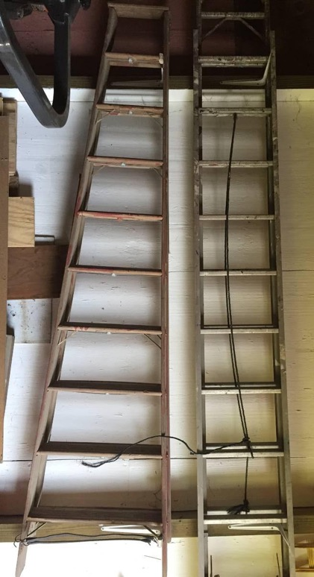
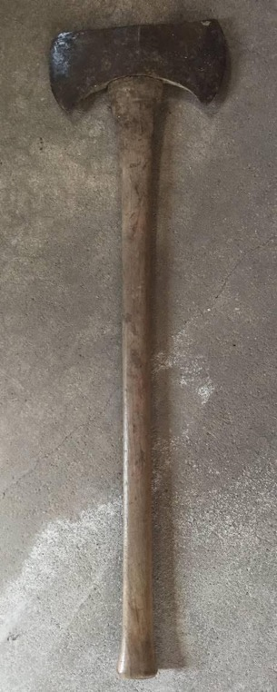
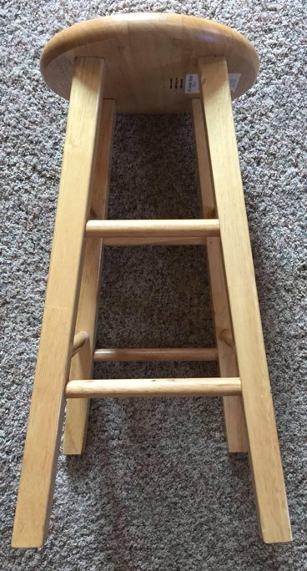
#5
A
B
C

Slide 7
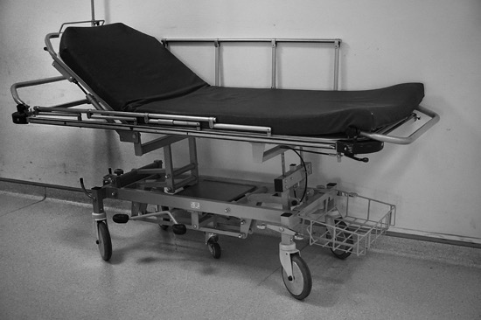
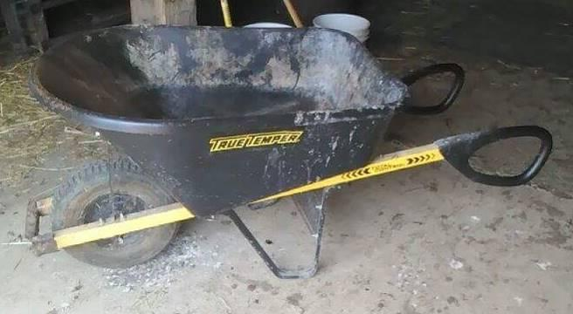
#5 Cont.
D
E
1. What is each item?
2. What is it made of?
3. What is it used for?
4. How is it used?
5. What does Ethiopia have that compares to it?
6. How is it made?
7. Do men, women, both, or neither make it?
Notes:
http://maxpixel.freegreatpicture.com/Stretcher-Emergency-Hospital-Medicine-Relief-1872166 - Stretcher/Gurney image source

Slide 8
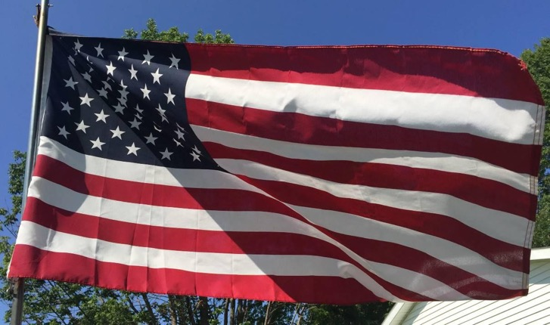
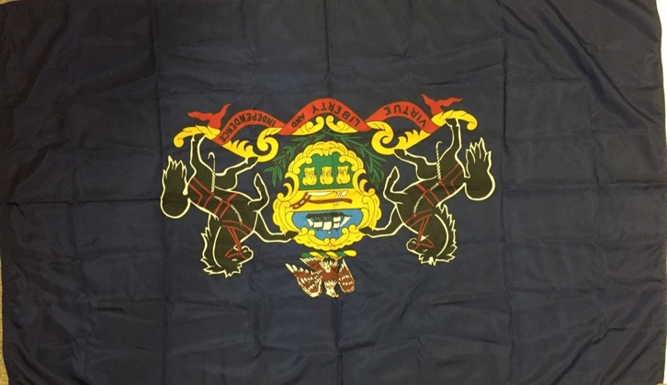
A
#6
1. What is it?
2. What is it made of?
3. What is it used for?
4. How is it used?
B
5. What does Ethiopia have that compares to it?
6. How is it made?
7. Do men, women, both, or neither make it?

Slide 9
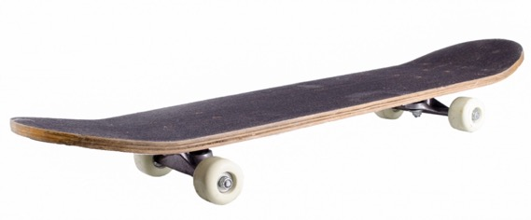
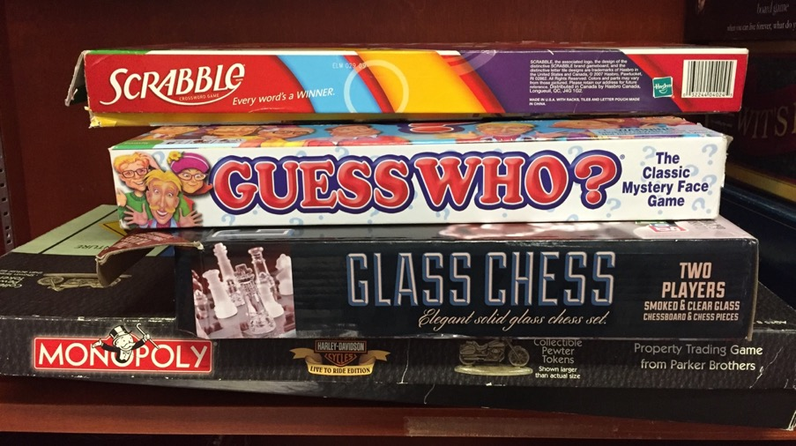
#7
1. What is it?
2. What is it made of?
3. What is it used for?
4. How is it used?
5. What does Ethiopia have that compares to it?
6. How is it made?
7. Do men, women, both, or neither make it?
Notes:
Skateboard source: http://www.publicdomainpictures.net/view-image.php?image=68200&picture=skateboard

Slide 10
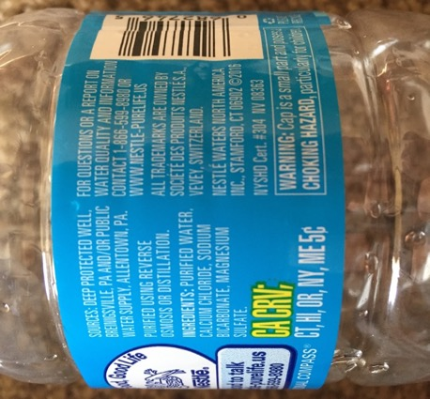
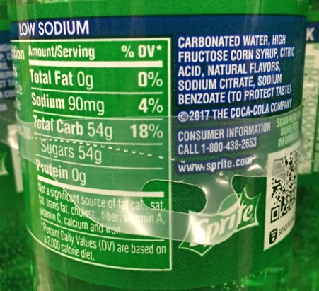
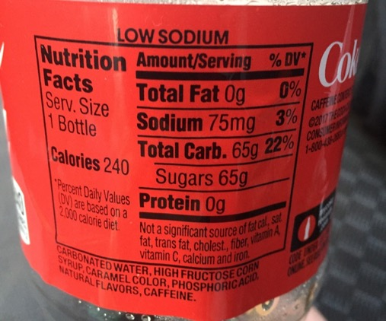
1. What is it?
2. What is it made of?
3. What is it used for?
4. How is it used?
5. What does Ethiopia have that compares to it?
6. How is it made?
7. Do men, women, both, or neither make it?
#8

Slide 11
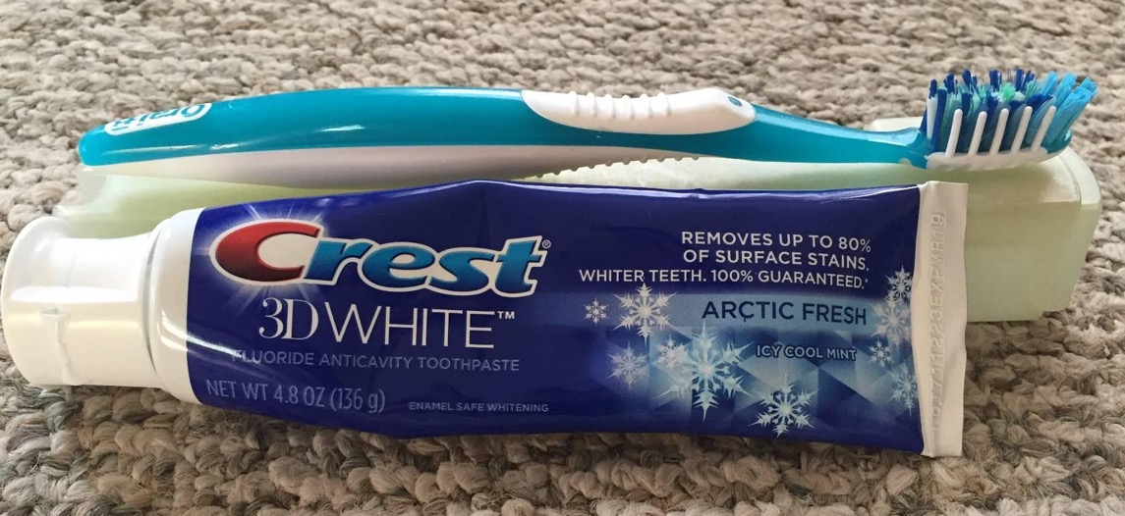
#9
1. What is it? 2. What is it made of?
3. What is it used for? 4. How is it used?
5. What does Ethiopia have that compares to it? 6. How is it made?
7. Do men, women, both, or neither make it?

Slide 12
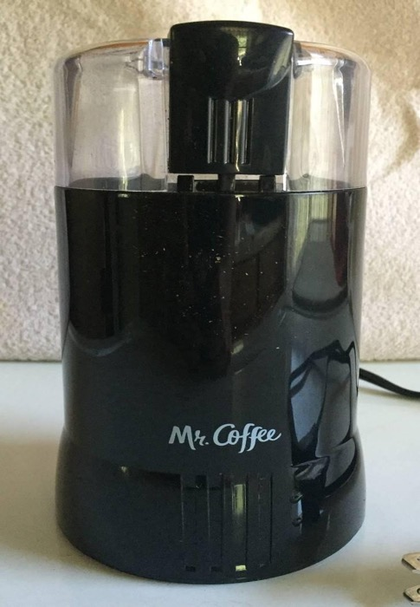
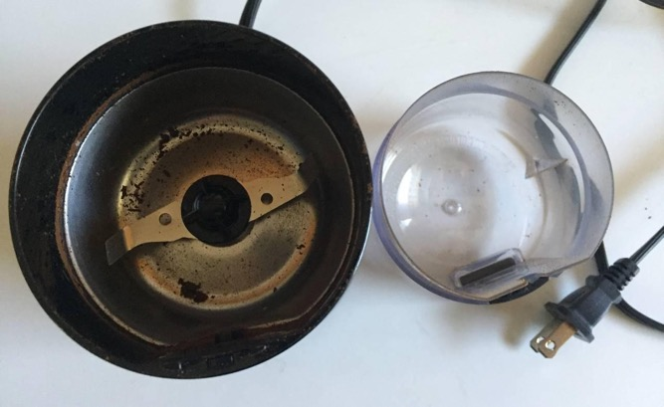
1. What is it?
2. What is it made of?
3. What is it used for?
4. How is it used?
5. What does Ethiopia have that compares to it?
6. How is it made?
7. Do men, women, both, or neither make it?
#10

Slide 13
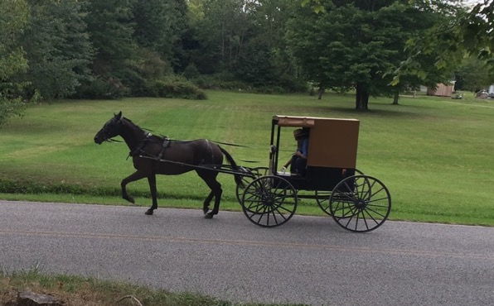
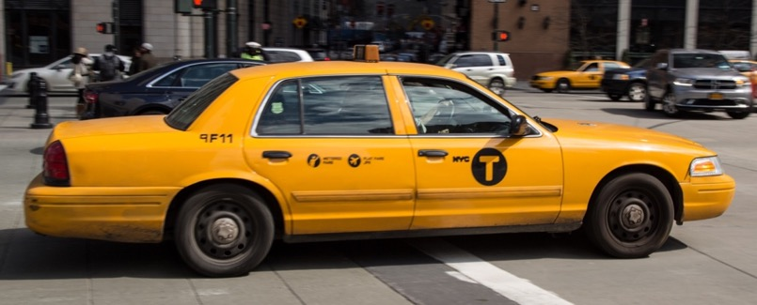
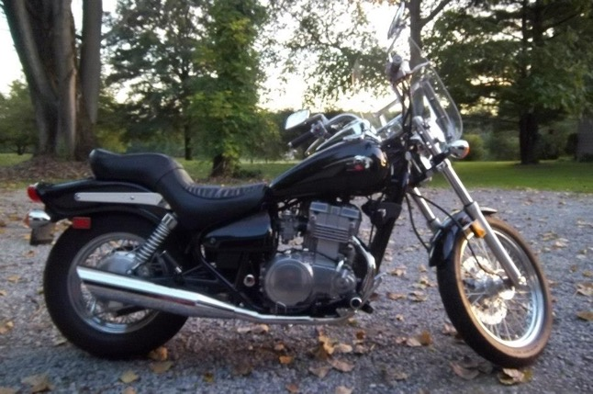
#11
B
A
C
Notes:
Source for taxi: http://www.publicdomainpictures.net/view-image.php?image=178756&picture=nyc-yellow-taxi

Slide 14
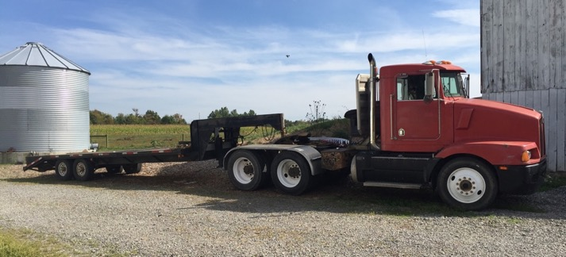
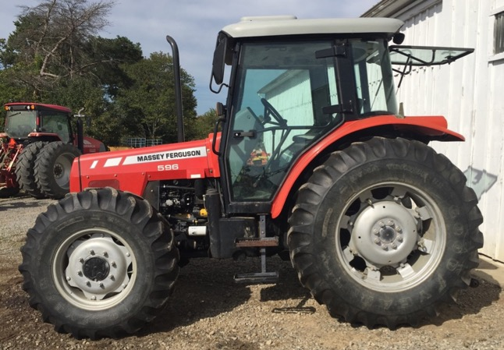
#11 Cont.
D
1. What is it?
2. What is it made of?
3. What is it used for?
4. How is it used?
5. What does Ethiopia have that compares to it?
6. How is it made?
7. Do men, women, both, or neither make it?
E

Slide 15
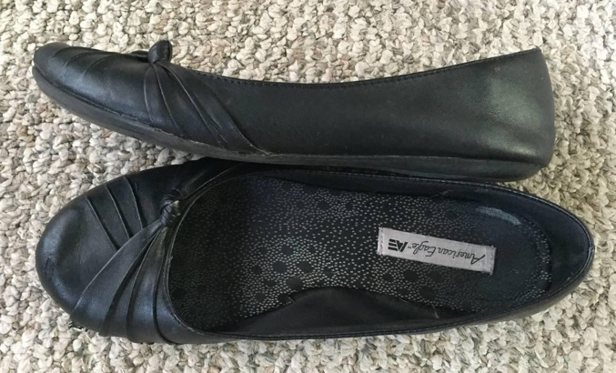
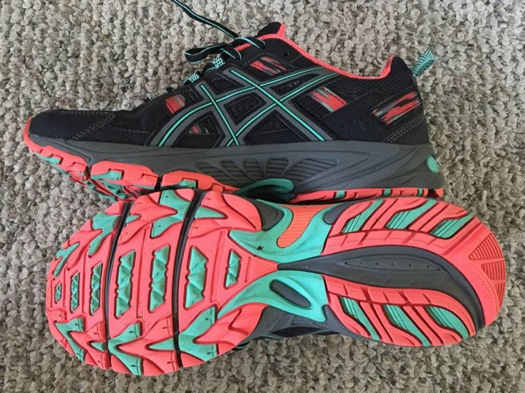
#12
1. What is it?
2. What is it made of?
3. What is it used for?
4. How is it used?
5. What does Ethiopia have that compares to it?
6. How is it made?
7. Do men, women, both, or neither make it?

Slide 16
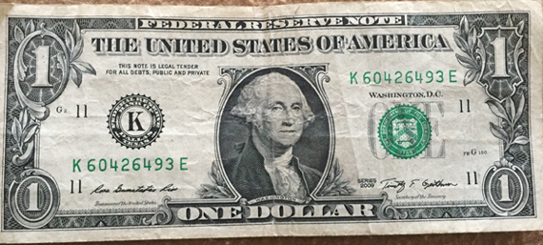
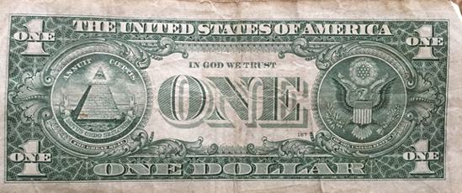
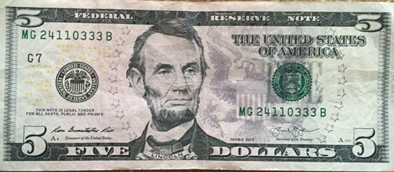
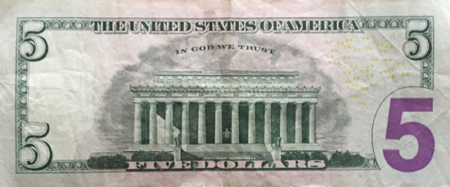
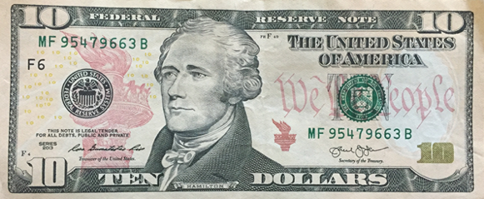
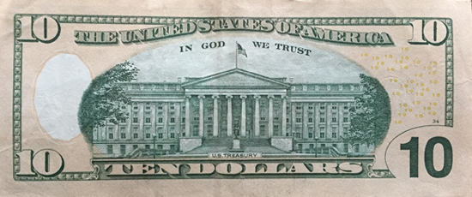
#13
1. What is it?
2. What is it made of?
3. What is it used for?
4. How is it used?
5. What does Ethiopia have that compares to it?
6. How is it made?
7. Do men, women, both, or neither make it?

Slide 17
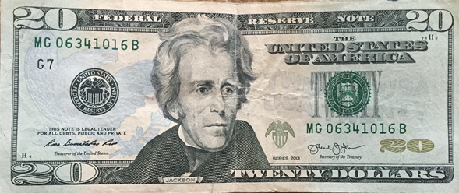
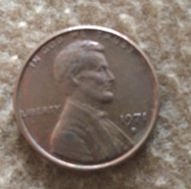
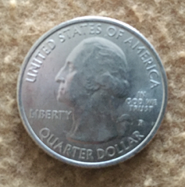
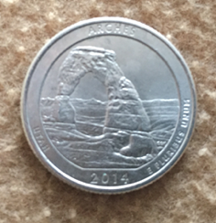
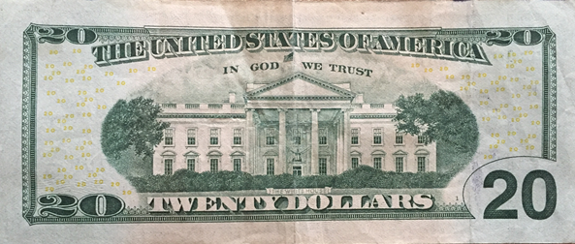
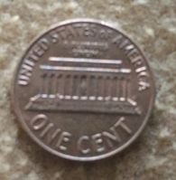
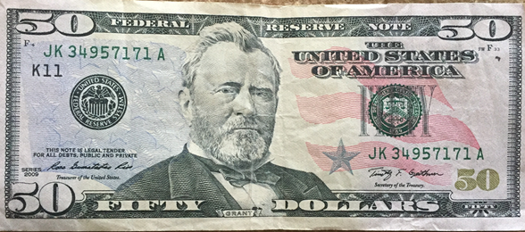
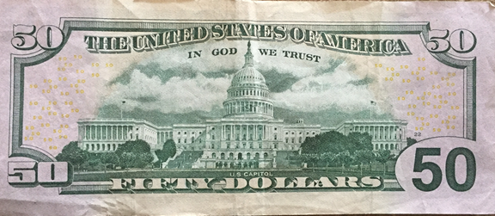
#13 Cont.

Slide 18
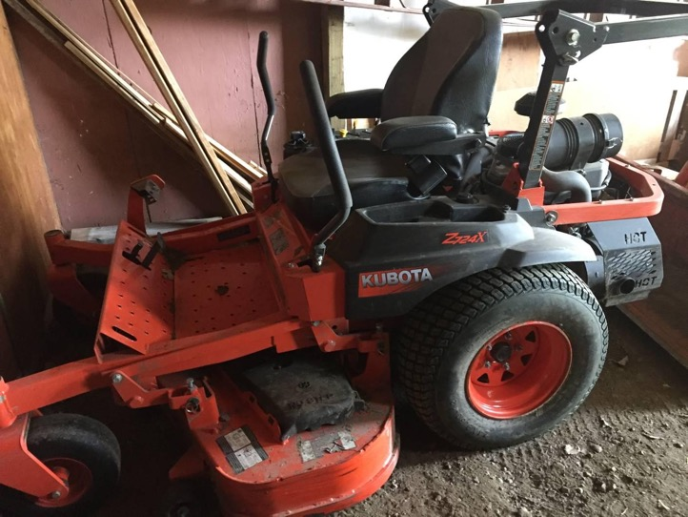
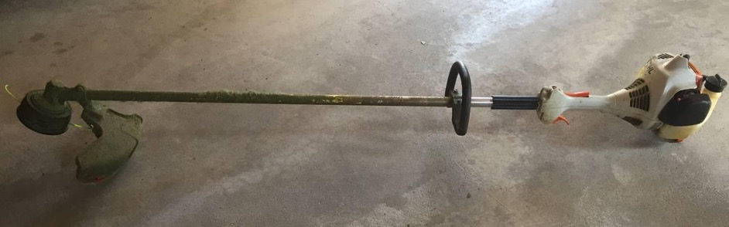
#14
1. What is it?
2. What is it made of?
3. What is it used for?
4. How is it used?
5. What does Ethiopia have that compares to it?
6. How is it made?
7. Do men, women, both, or neither make it?

Slide 19
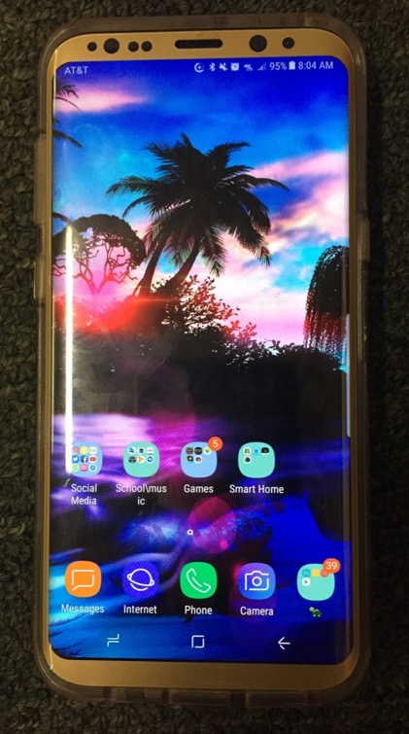
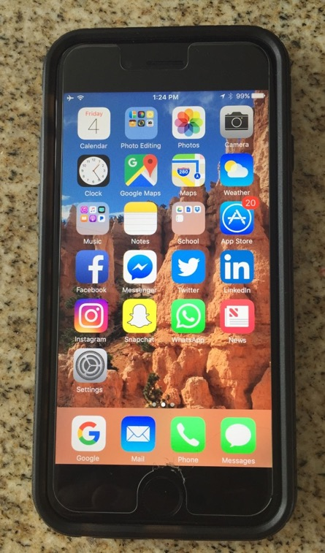
#15
1. What is it?
2. What is it made of?
3. What is it used for?
4. How is it used?
5. What does Ethiopia have that compares to it?
6. How is it made?
7. Do men, women, both, or neither make it?

