Slide 1
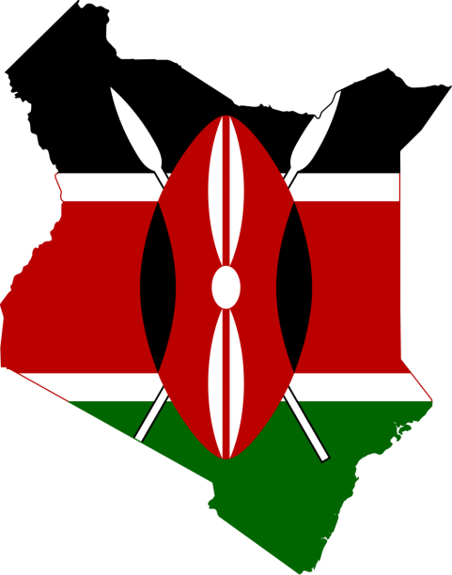
Case Study 1: Kenya
Rebecca Daugherty, Alex Dragon, & Kimberly Safran
Image: Wikimedia Commons User Dariwek, CC 3 License

Slide 2
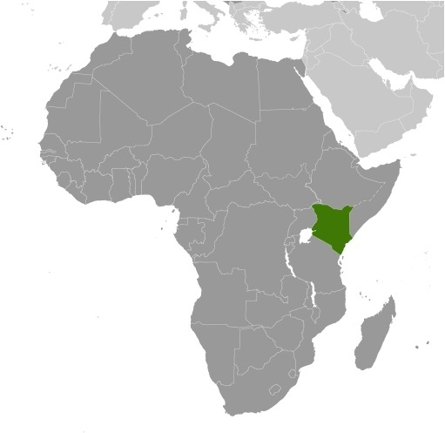
Karibu Kenya! (Welcome to Kenya)
Kenya is a country in East Africa
It is the 7th most populous country in Africa (26th in the world) at 55.1 million people in 2023. ¹
Hominids (prehistoric human relatives) lived in Kenya as far back as 2.5 million years ago, during the Pleistocene Epoch!²
Kenya became an independent Republic in 1964, ending 74 years of British colonial rule. Its current constitution was adopted in 2010 and its form of Government is a Presidential republic.³
Its official languages are Swahili and English, and its people also speak many different native languages or “mother tongues” of their tribes.
Kenya has “42(+)” tribes, depending on what person, census, or other reference you consult–many groups have sub-divisions that have been classified differently in different censuses. Regardless, there are numerous cultural groups all with unique and overlapping languages, cultural traditions, histories, foods, and styles of dress.
https://www.worldometers.info/world-population/population-by-country/
2. Glynn Llywelyn Isaac, Barbara Isaac (1977). Olorgesailie: archeological studies of a Middle Pleistocene lake basin in Kenya. University of Chicago Press. p. Xiii.
https://www.cia.gov/the-world-factbook/countries/kenya/summaries/#geography
Samantha Balaton-Chrimes (2021) Who are Kenya’s 42(+) tribes? The census and the political utility of magical uncertainty, Journal of Eastern African Studies, 15:1, 43-62, DOI: 10.1080/17531055.2020.1863642
Map: By Shosholoza - Own work, CC BY-SA 3.0, https://commons.wikimedia.org/w/index.php?curid=17475554
Notes:
https://www.worldometers.info/world-population/population-by-country/
2. Glynn Llywelyn Isaac, Barbara Isaac (1977). Olorgesailie: archeological studies of a Middle Pleistocene lake basin in Kenya. University of Chicago Press. p. Xiii.
https://www.cia.gov/the-world-factbook/countries/kenya/summaries/#geography
Samantha Balaton-Chrimes (2021) Who are Kenya’s 42(+) tribes? The census and the political utility of magical uncertainty, Journal of Eastern African Studies, 15:1, 43-62, DOI: 10.1080/17531055.2020.1863642
Map: By Shosholoza - Own work, CC BY-SA 3.0, https://commons.wikimedia.org/w/index.php?curid=17475554

Slide 3
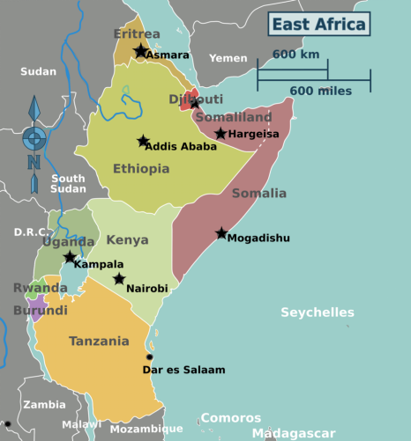
Kenya - Geography - Political
Kenya is situated on the equator and borders South Sudan, Ethiopia, Somalia, Uganda, and Tanzania. It borders the Indian Ocean to the east and borders part of Lake Victoria on the West.
Kenya has 47 counties. It’s capital city, is Nairobi. Other prominent cities by population are Mombasa, on the coast; Nakuru; Eldoret; and Kisumu.
Peter Fitzgerald - Creative Commons Share-Alike 3.0
Notes:
1.https://academic.oup.com/bioscience/article/57/7/573/238419

Slide 4
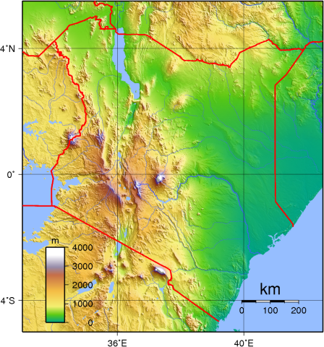
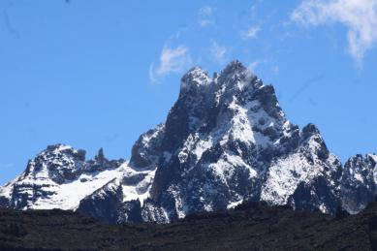
Kenya - Geography - Topography
Kenya’s topography varies in elevation from sea level at its eastern coast to 5,197 m above sea at the Peak of Mount Kenya.
Mt. Kenya is the tallest mountain in Kenya and the second-tallest in Africa, after Mount Kilimanjaro in Tanzania.
Can you find these mountains on the map?
Ngaina, Joshua & Mutai, Bethwel & Ininda, Joseph & Muthama, Nzioka. (2014). Monitoring spatial-temporal variability of aerosol over Kenya. Ethiopian Journal of Environmental Studies & Management. 7. 10.4314/ejesm.v7i3.3.
Mt. Kenya
Mt. Kilimanjaro
Mt. Kenya - photo by Viki Omondi - Creative Commons license
Notes:
Ngaina, Joshua & Mutai, Bethwel & Ininda, Joseph & Muthama, Nzioka. (2014). Monitoring spatial-temporal variability of aerosol over Kenya. Ethiopian Journal of Environmental Studies & Management. 7. 10.4314/ejesm.v7i3.3.

Slide 5
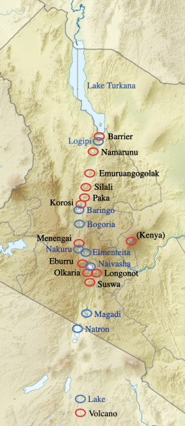
Kenya - Geography
The Kenyan Rift Valley, the Eastern arm of the East African Rift, (colloquially referred to as the “Great Rift Valley”) passes through Kenya. This is a geologically active area where tectonic plates are moving apart, leading to thinning of the earth’s crust and geothermal and volcanic activity.
Some of these volcanoes are still active.
Many lakes in this region are alkaline, also referred to as “soda lakes.” They provide important habitats to many birds like flamingos and white pelicans, and also provide economic resources and opportunities such as mineral resources, geothermal power, and ecotourism.
By Uwe Dedering, modified by Aymatth2 - File:Kenya relief location map.jpg, CC BY 3.0, https://commons.wikimedia.org/w/index.php?curid=17846522
Notes:
Map by Uwe Dedering, modified by Aymatth2 - File:Kenya relief location map.jpg, CC BY 3.0, https://commons.wikimedia.org/w/index.php?curid=17846522

Slide 6
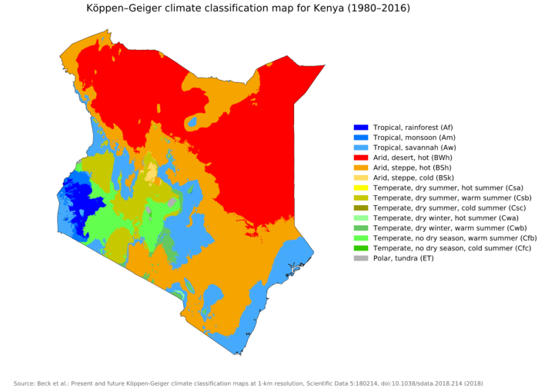
Kenya - Geography - Climate and biomes
Kenya has diverse ecoregions: tropical and subtropical forests; grasslands, savannas, shrublands; deserts; mangroves; lakes; and coral coasts.¹
1.https://academic.oup.com/bioscience/article/57/7/573/238419
Notes:
1.https://academic.oup.com/bioscience/article/57/7/573/238419

Slide 7
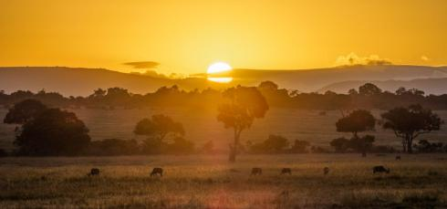
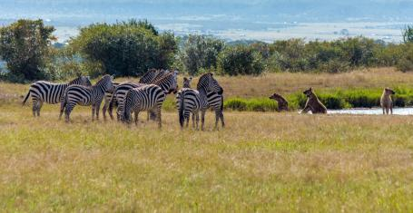
Ecosystems
An ecosystem is a geographic area which includes all of the biotic (living) and abiotic (nonliving) factors in an environment which interact.
By Danijel Mihajlovic - https://thenextcrossing.com/the-ultimate-guide-to-the-masai-mara-safari&quot;, CC BY-SA 4.0, https://commons.wikimedia.org/w/index.php?curid=96024077
Ray Manila, Spotted Hyena vs Grant's Zebra, Maasai Mara, CC BY 2.0
List the of the biotic and abiotic factors you can see in these photos from the Maasai Mara ecosystem in southwest Kenya.
List some others you cannot see pictured, but are likely to be in this ecosystem too.

Slide 8
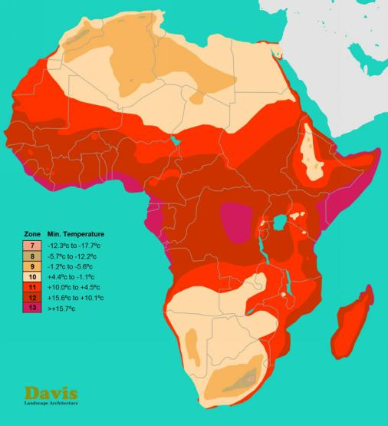
Ecosystems and plant communities
The following factors and more will influence which plants can grow in a particular habitat.
Temperature
Humidity
Elevation
Light levels
Soil type
Soil moisture
Other organisms
This map (from Davis Landscape Architecture firm) displays zones for which plants can survive based on the average lowest temperature.
Image used under fair use.

Slide 9
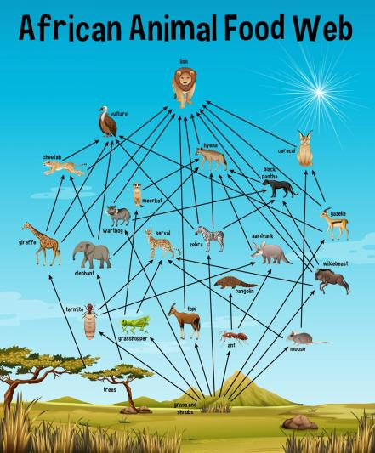
Plants are primary producers in ecosystems
In an ecosystem, we can trace the flow of energy through the system - a food web or trophic web. Plants make their energy using sunlight in the process of photosynthesis. We call them primary producers, because the other organisms in the food web depend on the energy they produce.
How are carnivores like lions dependent on plants?
https://www.freepik.com/free-vector/african-animal-food-web-education_12321489.htm
Image by brgfx on Freepik

Slide 10
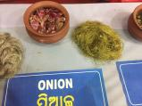
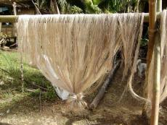
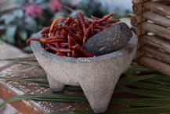

There are other reasons plants are important
List other uses that humans use plants for, other than for food energy.
By Sailesh Patnaik - Own work, CC BY-SA 4.0, https://commons.wikimedia.org/w/index.php?curid=65006416
Medicines
  Could be chewed or made into teas, pastes, ointments and more, depending on the plant type
Construction
  E.g. bamboo poles, grass thatched roofing
Fibers and textiles
  E.g., weaving baskets from grass or bark, linen from flax, cotton
Producing pigments and dyes
Spices
  Used more for their pleasant tastes (and sometimes preservative qualities) than for the calories added.
For aromas
For decoration
Ritual/religious use
More?
We will focus primarily on the medicinal use of plants.
By Jürgen Steger, Sachsenleinen GmbH - Work from Jürgen Steger, Sachsenleinen GmbH, CC BY-SA 3.0, https://commons.wikimedia.org/w/index.php?curid=4400895
By Kostasplus KONSTANTINOS TROVAS - Own work, CC BY-SA 3.0, https://commons.wikimedia.org/w/index.php?curid=14759159
By ਮਨਜੀਤ ਸਿੰਘ - Own work, CC BY-SA 4.0, https://commons.wikimedia.org/w/index.php?curid=53967448
Notes:
Image Credits:
By Sailesh Patnaik - Own work, CC BY-SA 4.0, https://commons.wikimedia.org/w/index.php?curid=65006416
By Jürgen Steger, Sachsenleinen GmbH - Work from Jürgen Steger, Sachsenleinen GmbH, CC BY-SA 3.0, https://commons.wikimedia.org/w/index.php?curid=4400895
By Kostasplus KONSTANTINOS TROVAS - Own work, CC BY-SA 3.0, https://commons.wikimedia.org/w/index.php?curid=14759159
By ਮਨਜੀਤ ਸਿੰਘ - Own work, CC BY-SA 4.0, https://commons.wikimedia.org/w/index.php?curid=53967448

Slide 11
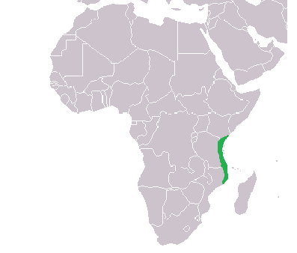
Kenya - cultural background
As far back as the 1st century CE, communities of ironworkers and fisherman were established on the East African Coast.
Arab traders began interacting with the people in this region in the port cities of Mombasa, Zanzibar, and Malindi.
This brought the influence of Islam as well as the Arabic and Persian languages into East Africa. Furthermore, there was influence from India and further societies engaged in this trade network.
The Swahili language was developed as a lingua franca–a common language shared by people with different native languages to communicate. It is still used in this way today across East Africa.
The Swahili Coast Region
By Runehelmet - Own work, CC BY-SA 3.0, https://commons.wikimedia.org/w/index.php?curid=19847485
Notes:
By Runehelmet - Own work, CC BY-SA 3.0, https://commons.wikimedia.org/w/index.php?curid=19847485

Slide 12
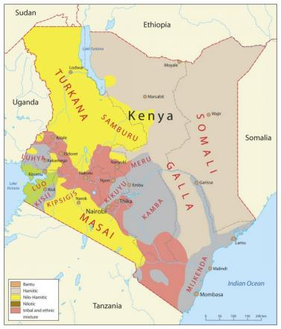
Kenya - cultural background
As previously mentioned, Kenya is ethnically diverse, with 42(+) distinct tribes.
Compare to how Americans may celebrate their ancestry, whether they are indigenous, have ancestors who immigrated here, or are recent immigrants. Kenyans will know their tribe, learn its language (“mother tongue”) and unique customs, histories, foods, musical traditions, art styles, and dances, though they are all still Kenyans.
Copyright Newebcreations https://maps-kenya-ke.com/kenya-tribes-map
Used under fair use.

Slide 13
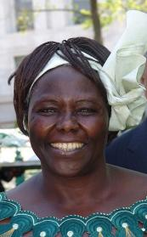
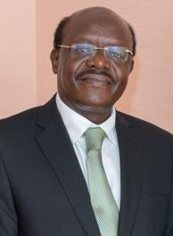
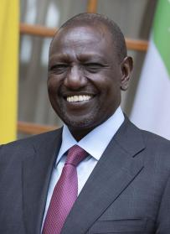
Kenya - cultural background
Per the CIA World Factbook, the most populous tribes in Kenya are (2019 est.):
Kikuyu 17.1%
Luhya 14.3%
Kalenjin 13.4%
Luo 10.7%
Kamba 9.8%
Somali 5.8%
Kisii 5.7%
Mijikenda 5.2%
Meru 4.2%
Maasai 2.5%,
Turkana 2.1%
[non-Kenyan 1%]
other 8.2%
Wangari Maathai, environmental and political activist and the first African woman to win a nobel prize, is from the Kikuyu Tribe.
Mukhisa Kituyi, politician and UN Secretary-General of the UN Conference on Trade and development from 2013-2021, is from the Luhya tribe.
William Ruto, the fifth and current (2023) president of Kenya, is from the Kalenjin tribe.
By Kingkongphoto Wangari Maathai 2004 Nobel Peace prize winner, CC BY-SA 2.0,
By Quirinale.it, Attribution, https://commons.wikimedia.org/w/index.php?curid=129618207
By UNCTAD - https://www.flickr.com/photos/53390373@N06/10995927343/, CC BY-SA 2.0, https://commons.wikimedia.org/w/index.php?curid=58796547
Notes:
By Kingkongphoto &amp; www.celebrity-photos.com from Laurel Maryland, USA - Wangari Maathai 2004 Nobel Peace prize winner, CC BY-SA 2.0, https://commons.wikimedia.org/w/index.php?curid=75053665
By UNCTAD - https://www.flickr.com/photos/53390373@N06/10995927343/, CC BY-SA 2.0, https://commons.wikimedia.org/w/index.php?curid=58796547
By Quirinale.it, Attribution, https://commons.wikimedia.org/w/index.php?curid=129618207

Slide 14
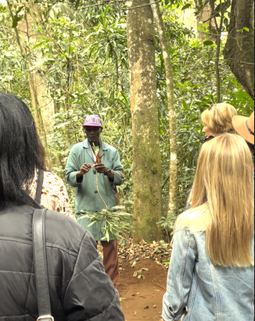
Kenya - cultural knowledge
As with cultures all around the world, some of the knowledge that will be passed down in Kenyan families and tribes is the knowledge of how the plants in their local regions can be used for various purposes.
The knowledge of many tribes will overlap, but they will also have unique information based on their own cultural and geographic histories.
Do you think it is important to continue communicating this type of knowledge to future generations? Why?
Julius Ngila explains some of the uses of the Dracaena plant to tourists in Kiambu County.
Photo by Alex Dragon - may reuse with attribution.

Slide 15
Discussion questions
What similarities do you notice between Kenya and your home? In terms of geography? Ecosystems? Culture?
This was a very brief overview. What else are you curious about now that you have learned a bit about Kenya?
Do people in your family or community use plants for medicine, textiles, construction, pigments, ritual uses, or spices, or anything else besides food? How?
Who in your family or community might know more about traditional uses of plants?
How do the climates and ecosystems of Kenya compare to your region? You can return to slide 8 to review the major climates and ecosystem types in Kenya. Predict what the means for how similar or different the plants will be in your home vs. in Kenya.

