Slide 1
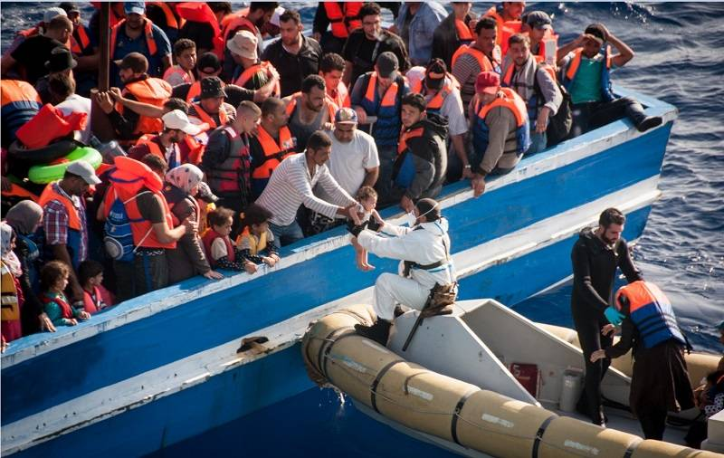
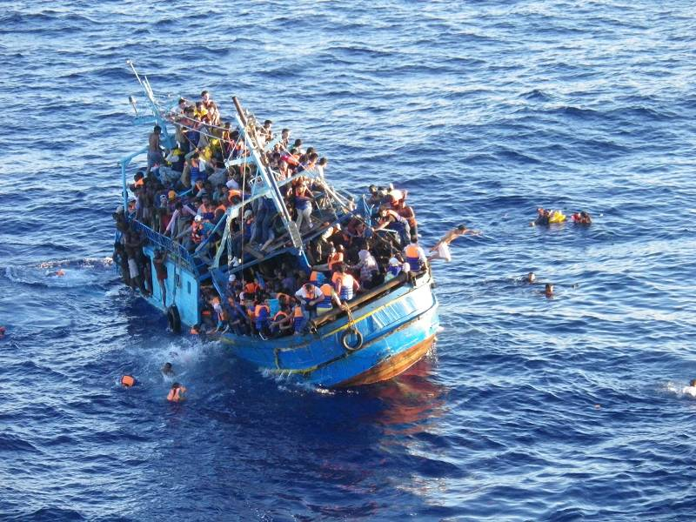
World In Motion: Mediterranean Refugee Crisis
Wednesday
September 23rd
12:30-1:30 PM
4130 Posvar Hall
The Global Studies Center
invites you to join the discussion of the ongoing refugee crisis around the Mediterranean with:
Astrid Ziebarth, Migration Fellow, German Marshall Fund of the United States in Berlin
Professor Heaven Crawley, Chair in International Migration at Coventry University, UK
Our guest experts will speak on the causes of displacement, the European response, and the refugee experience and will take your questions!
Co-sponsored by the European Studies Center
and the Center for Russian and East European Studies

