Slide 1
"Leadership Disincentives: How the promotion process for officials undermines economic and social development in China"
Motivations Main Argument Empirical Strategy Cases Studies Conclusions
Pierre F. Landry Xiaobo Lü
University of Pittsburgh Texas A&M University
Department of Political Science Bush School of Government and Public Service
CHINA TODAY 2013

Slide 2
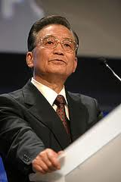
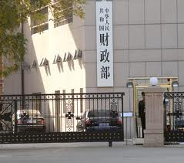
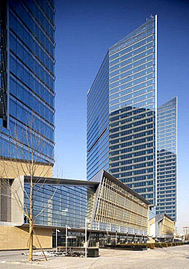
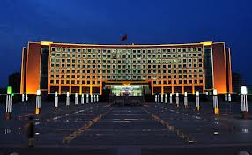
Motivations Main Argument Empirical Strategy Cases Studies Conclusions
What are the political-economic consequences of authoritarian endurance in China?
Interactions between four sets of players
Central leaders--Ministry of finance--CCP Organization--Local Governments
Political Competition and Fiscal Extraction in China USC 2013
CHINA TODAY 2013

Slide 3
China’s Increasing Tax Burden
Motivations Main Argument Empirical Strategy Cases Studies Conclusions
China’s economy grew 738.23% from 1994 to 2010…
  The “M-form” governance structure and “Market-Preserving Federalism” lead to inter-jurisdiction political competition (Montinola, Qian, and Weingast 1995; Qian and Roland 1998; Xu 2011)
  Mixed evidence on the link between GDP growth and political promotion (Li, and Zhou 2005; Chen, Li and Zhou 2005; Shih et al. 2012).
…but budgetary revenues grew by 1492.56% during the same period.
  This is at odds with the “race-to-the-bottom” tax competition in the comparative political economy literature (Oates 1972).
  Standard explanations (1994 Fiscal Reform) fail to explain the very large extent of sub-national variation.
Political Competition and Fiscal Extraction in China USC 2013
Political Competition and Fiscal Extraction in China Brown University, November 1, 2012

Slide 4
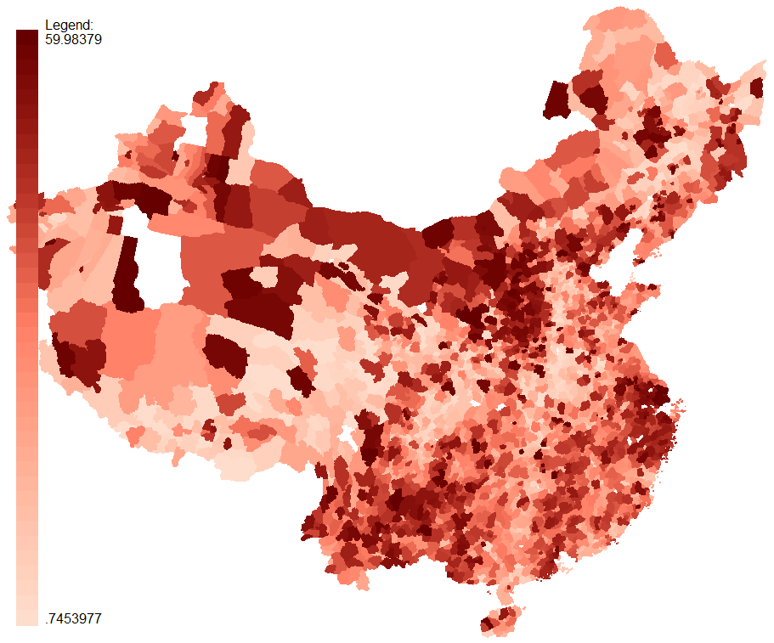
DATA
Motivations Main Argument Empirical Strategy Cases Studies Conclusions
Tax as percent of county GDP, 2005
CHINA TODAY 2013
Political Competition and Fiscal Extraction in China Brown University, November 1, 2012
Political mpetition and Fiscal Extraction in China USC 2013

Slide 5
The Logic of Fiscal Extraction in an Authoritarian Regime
Motivations Main Argument Empirical Strategy Cases Studies Conclusions
The political selection process
Principal: Upper-level CCP Committees & Organization Dpt
  Municipal CCP
Agents: Local government officials
  County officials
Objective functions
Principal:
  Select loyal agents to maintain control.
  Collect revenue for state capacity and regime stability.
Agents:
  Signal loyalty and competence through fiscal extraction.
  Use public expenditures to maintain local control.
  Rent-seeking
➔Inter-jurisdiction political competition leads to greater fiscal extraction.
CHINA TODAY 2013
Political Competition and Fiscal Extraction in China USC 2013

Slide 6
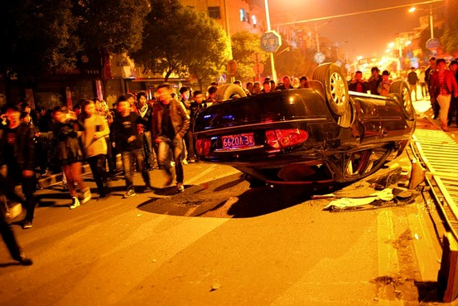
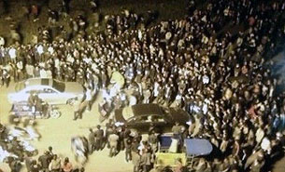
Constraints
Motivations Main Argument Empirical Strategy Cases Studies Conclusions
Zhili town (Wuxing District, Huizhou) tax revolt, October 2011
http://online.wsj.com/article/SB10001424052970204505304577001590489178360.html
http://blogs-images.forbes.com/robertwood/files/2011/10/Zhili.jpg
CHINA TODAY 2013
Political Competition and Fiscal Extraction in China USC 2013

Slide 7
A Wintrobian regime with Chinese characteristics
Motivations Main Argument Empirical Strategy Cases Studies Conclusions
Beijing
Local Officials
Control resources needed for redistribution
Maintain regime stability
Prevent social and political disturbances
Demonstrate competence to their principal(s)
Observables at the local level:
↗ N of competitors ➔ ↗ incentives to signal loyalty and competence ➔ ↗ Fiscal extraction
Subject to the constraint of “political stability”
Political Competition and Fiscal Extraction in China USC 2013
CHINA TODAY 2013

Slide 8
Intensity of Political Competition, Number of Competitors, and Fiscal Extraction
Motivations Main Argument Empirical Strategy Cases Studies Conclusions
Measuring Local Political Competition
  Politicians at a given level of government compete for positions at the next higher level.
  The number of county-level jurisdictions serves as a proxy for the number of political competitors.
Political Competition and Fiscal Extraction in China USC 2013
CHINA TODAY 2013

Slide 9
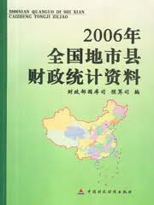
Core Data
Motivations Main Argument Empirical Strategy Cases Studies Conclusions
National Prefecture and County Finance Statistical Yearbooks 1999 – 2006
Cover all county-level jurisdictions
Provide detailed information on local governments budgetary revenues and expenditure
Digitized and geo-referenced by the Barometer on China Development at CUHK.
CHINA TODAY 2013
Political Competition and Fiscal Extraction in China USC 2013

Slide 10
Dependent Variables
Motivations Main Argument Empirical Strategy Cases Studies Conclusions
Fiscal extraction:
All_tax 1 = Local taxes and fees + remitted fiscal revenues
All_tax 2 = Local taxes and fees+ remitted fiscal revenues + government fund
Measured as both the level (log(all_tax i per capita)) and the degree of extraction (all_tax i as % of county GDP)
CHINA TODAY 2013
Political Competition and Fiscal Extraction in China USC 2013

Slide 11
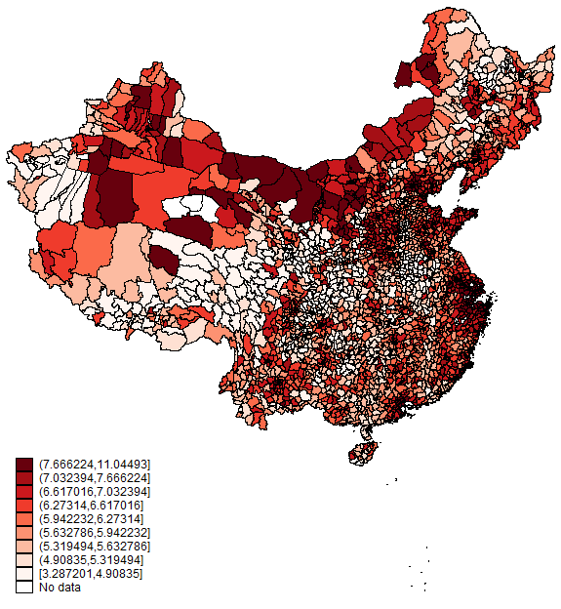
Motivations Main Argument Empirical Strategy Cases Studies Conclusions
Log (tax per capita)
in 2005, by county
CHINA TODAY 2013
Political Competition and Fiscal Extraction in China USC 2013

Slide 12
DATA
Motivations Main Argument Empirical Strategy Cases Studies Conclusions
Tax as percent of county GDP, 2005
CHINA TODAY 2013
Political Competition and Fiscal Extraction in China USC 2013

Slide 13
Key independent variable
Motivations Main Argument Empirical Strategy Cases Studies Conclusions
Pool size as proxy for local political competition
Number of county-level jurisdictions (county, county-level city or urban district) under a municipality or prefecture
Range: 1 to 40 Mean: 10.65 SD: 5.50
CHINA TODAY 2013
Political Competition and Fiscal Extraction in China USC 2013

Slide 14
Motivations Main Argument Empirical Strategy Cases Studies Conclusions
Pool size (2005)
Political Competition and Fiscal Extraction in China Brown University, November 1, 2012

Slide 15
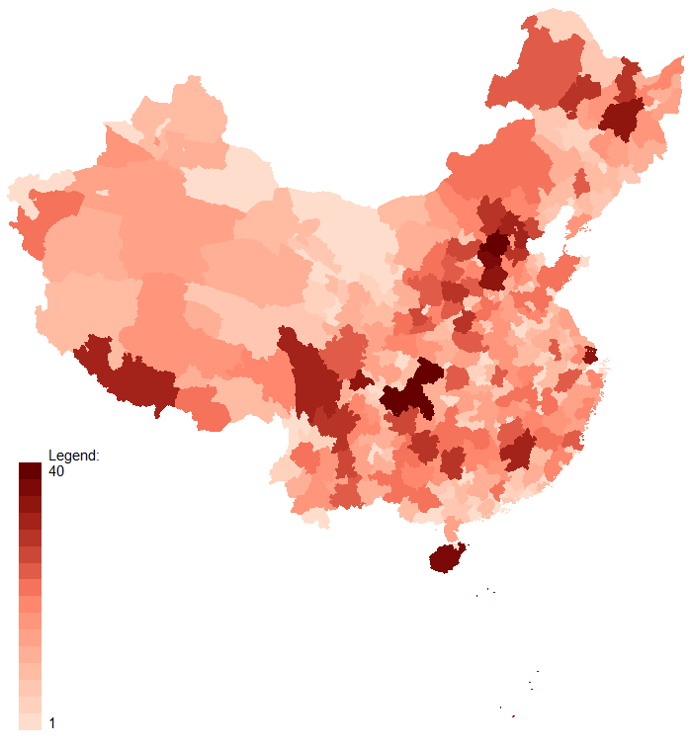
Motivations Main Argument Empirical Strategy Cases Studies Conclusions
Pool size (2005)
CHINA TODAY 2013
Political Competition and Fiscal Extraction in China Brown University, November 1, 2012

Slide 16
Constraints
Motivations Main Argument Empirical Strategy Cases Studies Conclusions
Zhili town (Wuxing District, Huizhou) tax revolt, October 2011
http://online.wsj.com/article/SB10001424052970204505304577001590489178360.html
http://blogs-images.forbes.com/robertwood/files/2011/10/Zhili.jpg
Political Competition and Fiscal Extraction in China USC 2013

Slide 17
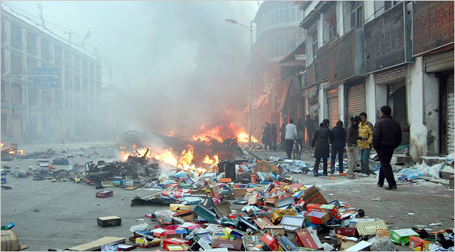
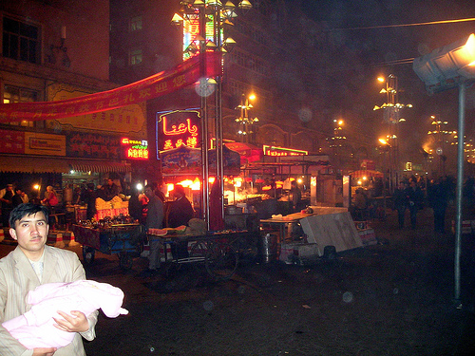
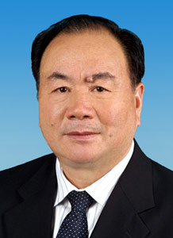
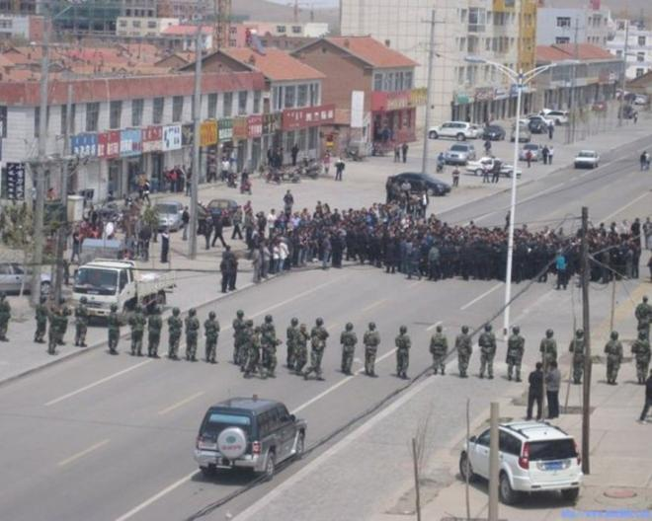
Minority “autonomous regions”
Lhasa (March 2008)
Urumqi (July 2009)
Xilinhot (2011-05-23)
http://www.nytimes.com/2008/03/24/world/asia/24tibet.html
http://www.neweurasia.net/cross-regional-and-blogosphere/riots-in-urumqi/
http://www.ibtimes.com/china-responds-ethnic-riots-inner-mongolia-287983

Slide 18
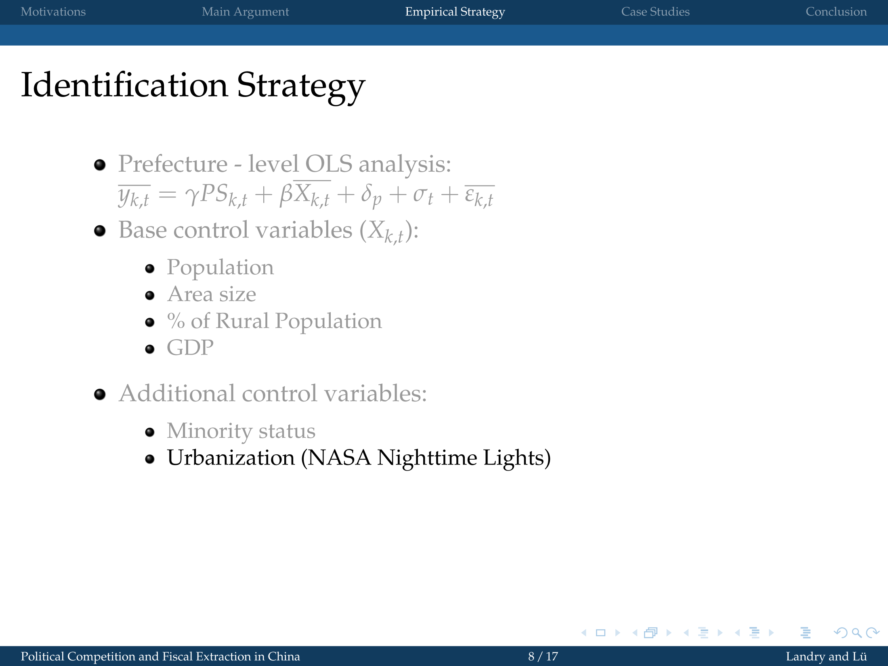
Motivations Main Argument Empirical Strategy Cases Studies Conclusions
CHINA TODAY 2013
Political Competition and Fiscal Extraction in China Brown University, November 1, 2012

Slide 19
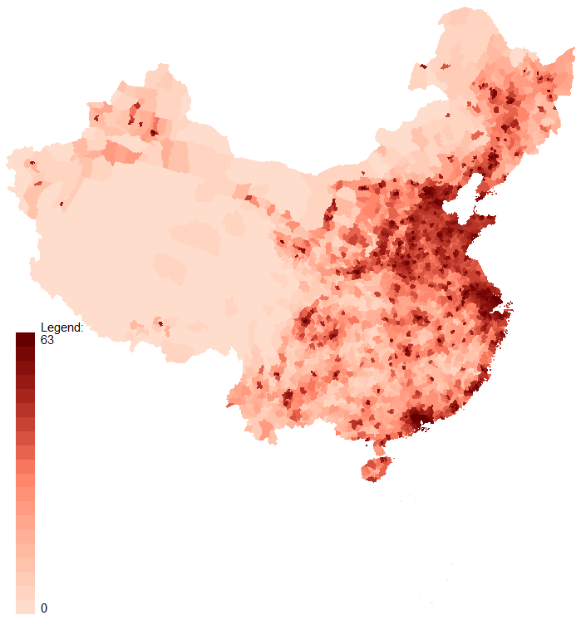
Motivations Main Argument Empirical Strategy Cases Studies Conclusions
NASA Nightlight
(Satellite F15, 2005)
CHINA TODAY 2013
Political Competition and Fiscal Extraction in China Brown University, November 1, 2012

Slide 20
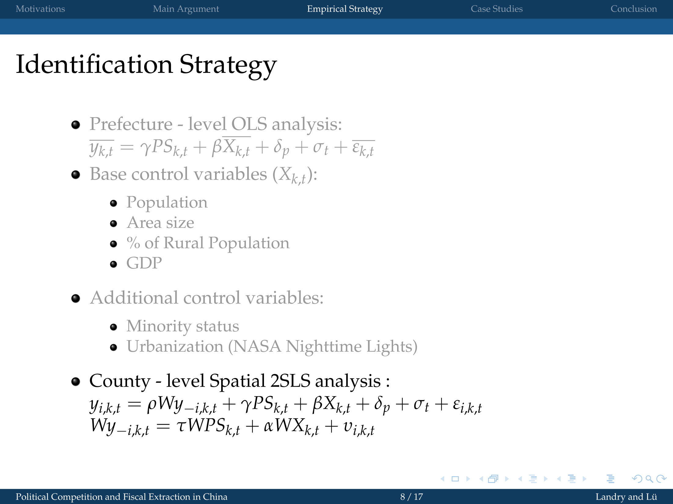
Motivations Main Argument Empirical Strategy Cases Studies Conclusions
CHINA TODAY 2013
Political Competition and Fiscal Extraction in China Brown University, November 1, 2012

Slide 21
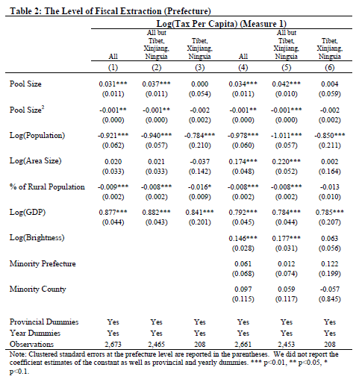
Motivations Main Argument Empirical Strategy Cases Studies Conclusions
CHINA TODAY 2013
Political Competition and Fiscal Extraction in China USC 2013

Slide 22
Competing Explanations and Concerns
Motivations Main Argument Empirical Strategy Cases Studies Conclusions
The post-1994 tax-sharing scheme
Alternative dependent variable that includes part of the extra-budgetary revenue.
Potential omitted variables
The fiscal demand of prefecture-level government.
Disincentives from intergovernmental transfers.
Peer pressure
County-level spatial analysis
CHINA TODAY 2013
Political Competition and Fiscal Extraction in China Brown University, November 1, 2012

Slide 23
Motivations Main Argument Empirical Strategy Cases Studies Conclusions
CHINA TODAY 2013
Political Competition and Fiscal Extraction in China USC 2013

Slide 24
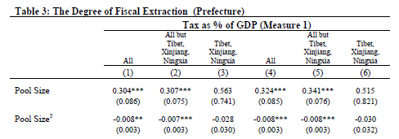
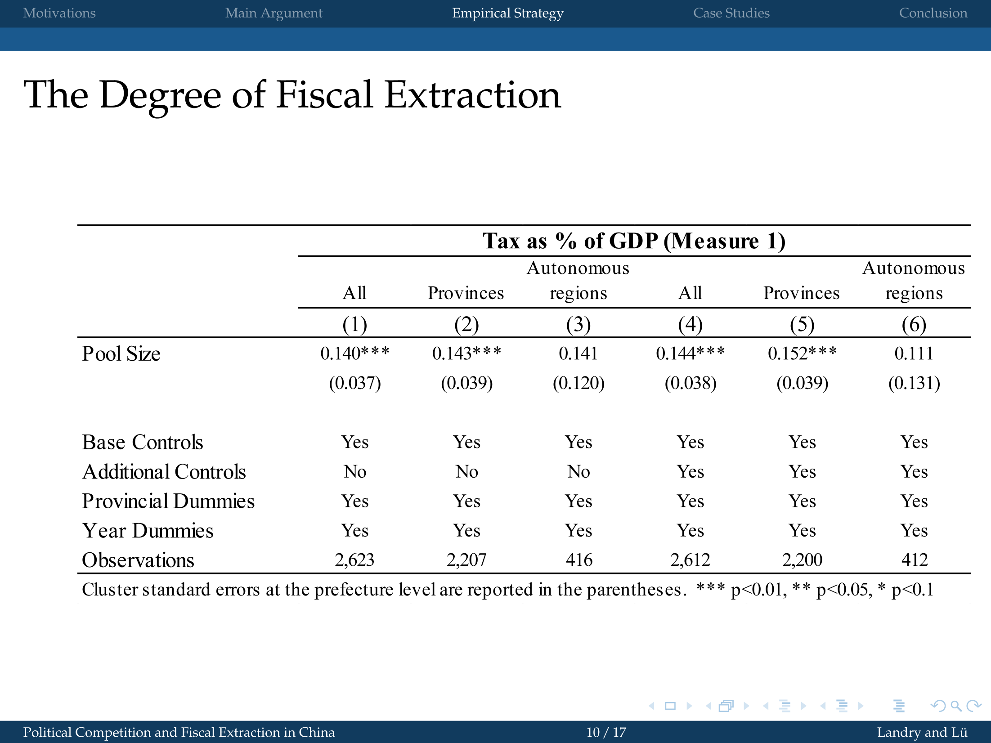
Degree of fiscal extraction (% GDP)
Motivations Main Argument Empirical Strategy Cases Studies Conclusions
CHINA TODAY 2013
Political Competition and Fiscal Extraction in China Brown University, November 1, 2012

Slide 25
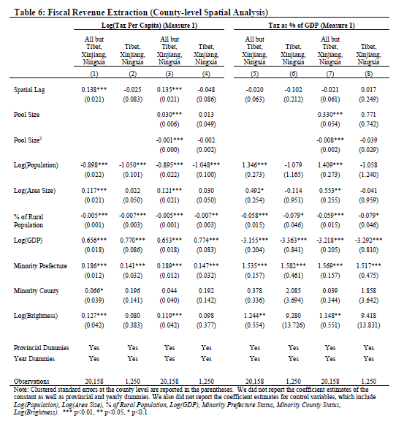
Motivations Main Argument Empirical Strategy Cases Studies Conclusions
CHINA TODAY 2013
Political Competition and Fiscal Extraction in China Brown University, November 1, 2012

Slide 26
Motivations Main Argument Empirical Strategy Cases Studies Conclusions
CHINA TODAY 2013
Political Competition and Fiscal Extraction in China Brown University, November 1, 2012

Slide 27
Conclusions
Motivations Main Argument Empirical Strategy Cases Studies Conclusions
The lines of political accountability of the Chinese political system induce a fiscal ‘race-to-the-top’.
Local heterogeneity is not random, but follows a clear political logic of promotion that compels cadres to signal loyalty by taxing more, so long as they maintain “political stability”.
Fear of political opposition moderates the extent to which local officials overtax their citizens. The credibility of these restraints rests on the willingness of central leaders to systematically demote officials deemed “responsible” for undermining stability.
CHINA TODAY 2013
Political Competition and Fiscal Extraction in China Brown University, November 1, 2012

Slide 28
Case Selection Criteria
Motivations Main Argument Empirical Strategy Cases Studies Conclusions
Treatment Group:
Counties experienced redistricting that significantly changed the number of county-level jurisdictions within a prefecture.
Control Group:
Counties in neighboring prefectures with similar social and economic conditions but without experiencing redistricting.
A case of increased political competition (Chongqing)
  County-level jurisdictions: 21 ➔ 40 after merging with three neighboring prefectures (Wanxian, Fuling, and Qianjiang) in 1997
A case of decreased political competition (Huaiyin)
  County-level jurisdictions: 13 ➔ 5 (Suqian) and 8 (Huai’an)
CHINA TODAY 2013
Political Competition and Fiscal Extraction in China Brown University, November 1, 2012

Slide 29
Contraction
Motivations Main Argument Empirical Strategy Cases Studies Conclusions
Huaiyin Prefecture split into two municipalities: Suqian and Huai’an
Suqian
Huai’an
CHINA TODAY 2013
Political Competition and Fiscal Extraction in China Brown University, November 1, 2012

Slide 30
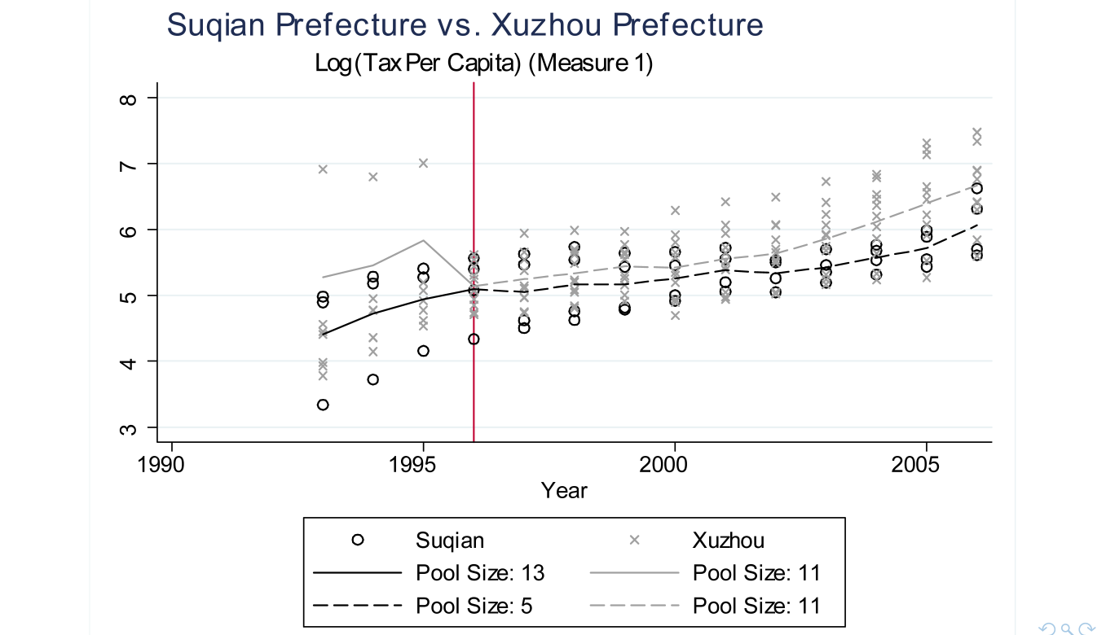
Decreased Political Competition
Motivations Main Argument Empirical Strategy Cases Studies Conclusions
Xuzhou vs. Suqian
Xuzhou
Suqian
CHINA TODAY 2013
Political Competition and Fiscal Extraction in China Brown University, November 1, 2012

Slide 31
Expansion
Motivations Main Argument Empirical Strategy Cases Studies Conclusions
Chongqing in Sichuan (➔ 1996)
Chongqing vs. Sichuan (1997➔)
Sichuan
Sichuan
Wanxian
Chongqing
Fuling
Qianjiang
Chongqing
CHINA TODAY 2013
Political Competition and Fiscal Extraction in China Brown University, November 1, 2012

Slide 32
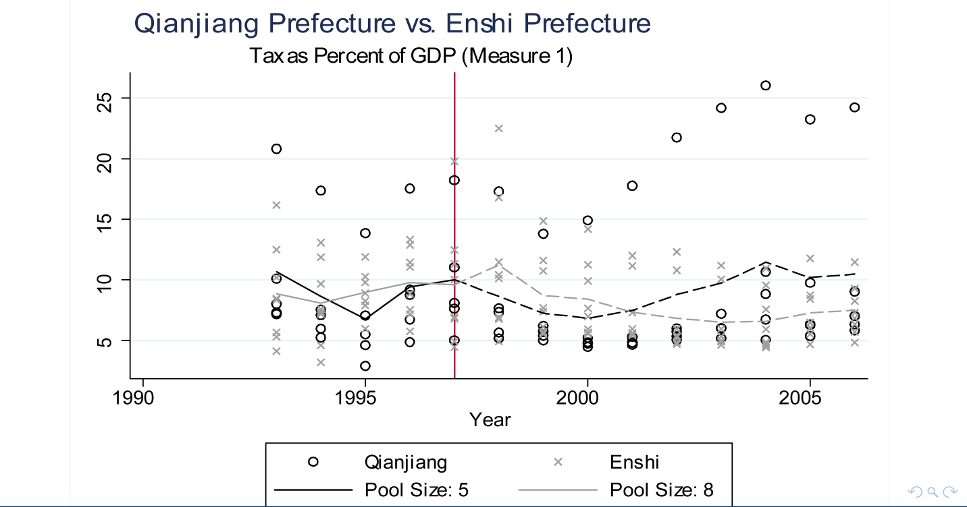
Increased Political Competition
Motivations Main Argument Empirical Strategy Cases Studies Conclusions
Qiangjiang: PS 5➔40
Ex Qianjiang vs Enshi (in Hubei)
Enshi
Qianjiang
CHINA TODAY 2013
Political Competition and Fiscal Extraction in China Brown University, November 1, 2012

Slide 33
Increased Political Competition
Motivations Main Argument Empirical Strategy Cases Studies Conclusions
Qiangjiang: PS 5➔40
Ex Qianjiang vs Enshi (in Hubei)
Enshi
Qianjiang
CHINA TODAY 2013
Political Competition and Fiscal Extraction in China Brown University, November 1, 2012

Slide 34
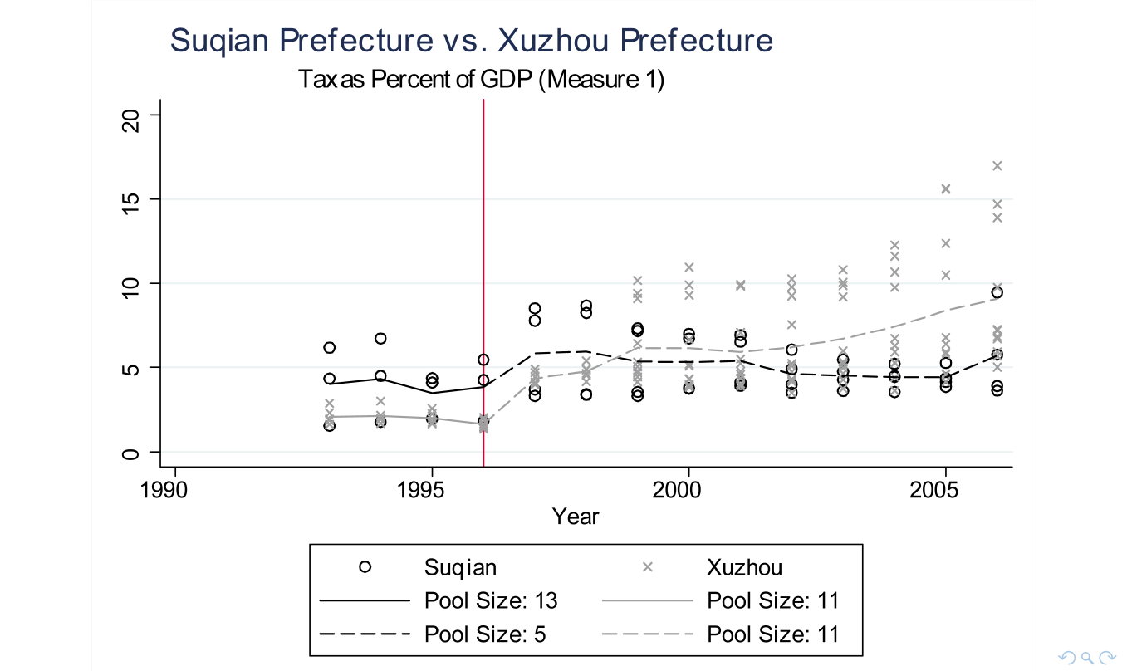
Decreased Political Competition
Motivations Main Argument Empirical Strategy Cases Studies Conclusions
Xuzhou vs. Suqian
Xuzhou
Suqian
CHINA TODAY 2013
Political Competition and Fiscal Extraction in China Brown University, November 1, 2012

