Slide 1
Central Asia and Its Neighbors
Central Asia Mini-Course
Jennifer Murtazashvili
Assistant Professor
Graduate School of Public and International Affairs
University of Pittsburgh
jmurtaz@pitt.edu

Slide 2
Overview
Regional multi-polarity → No single powerful influence
  Has raised the costs for the United States
China has emerged as the economic power in the region
Russia has sought to maintain its influence
US/European strategy driven by Afghan War

Slide 3
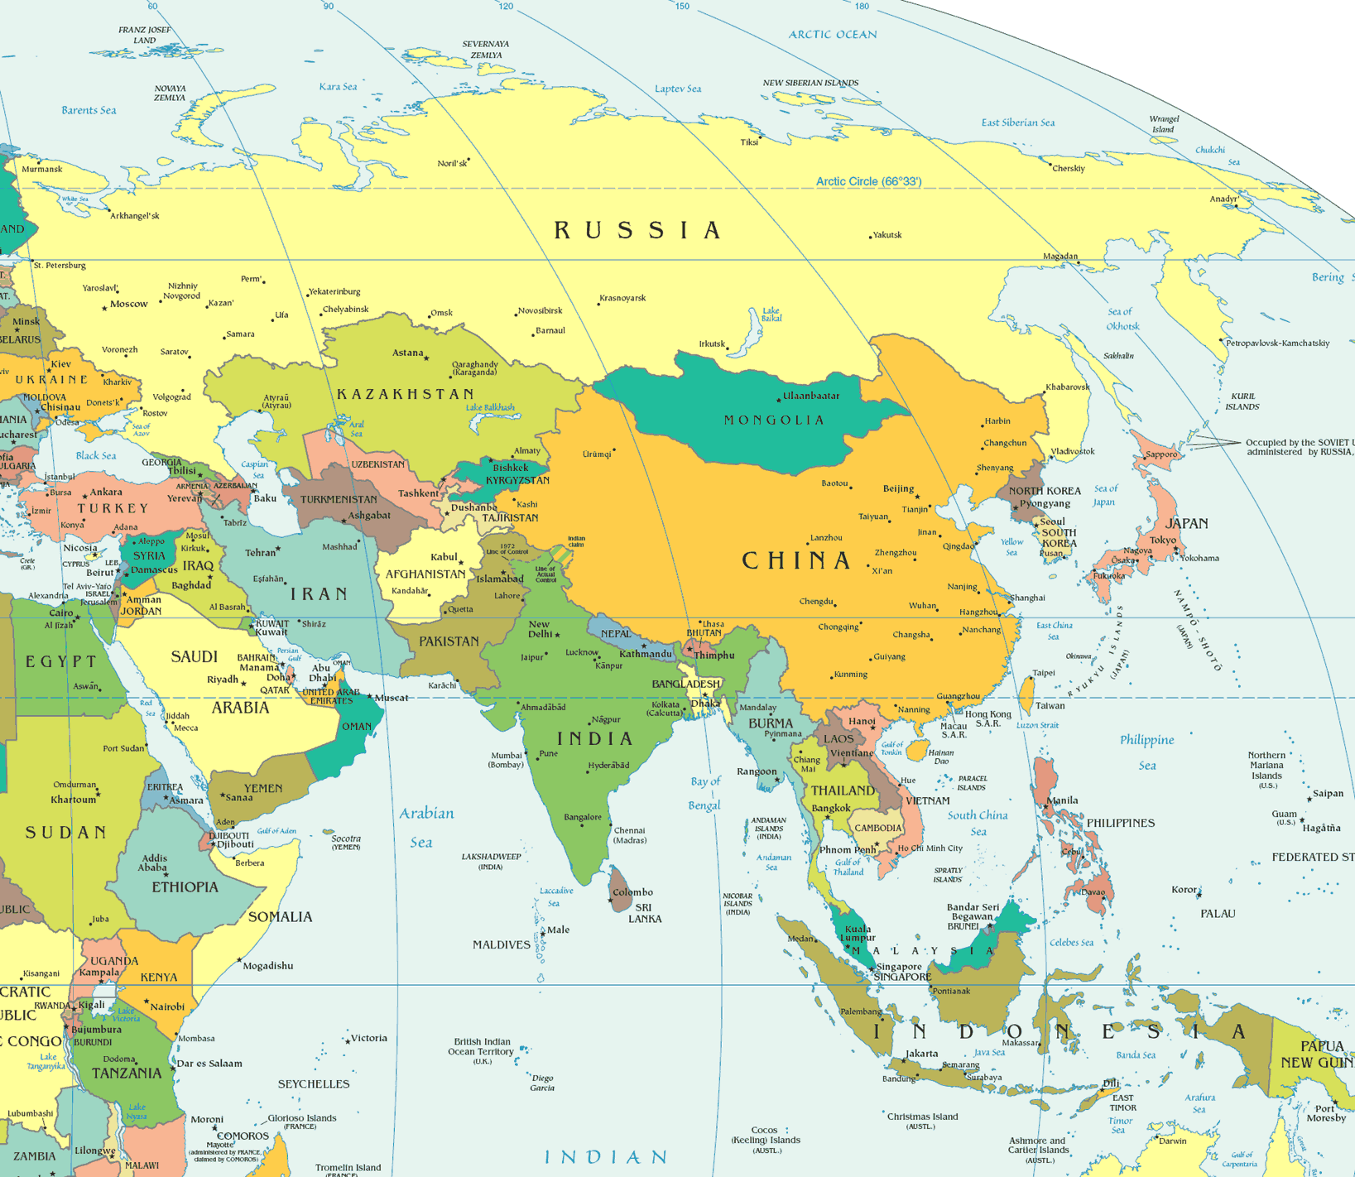
Where is Central Asia?

Slide 4
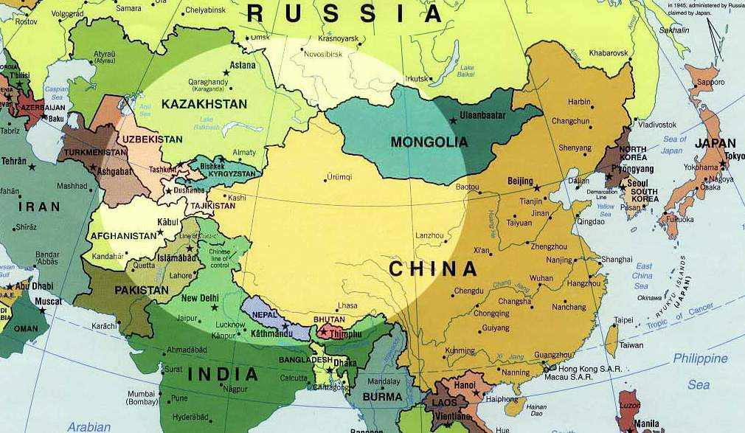
Where is Central Asia?

Slide 5
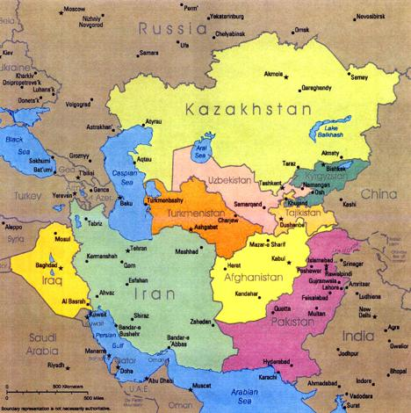
Where is Central Asia?

Slide 6
Questions
How to define Central Asia?
  Levi – Nau Roz
  Roy/Barfield – area of Turco-Persian civilization
  Heathershaw and Megoran – Place of Danger?
    Obscure, Oriental, Fractious
Definition matters: Which bureau is responsible for Central Asia in the U.S. Department of State?

Slide 7
Region of Contrasts
  Mountains vs. valleys
  Egalitarian vs. hierarchical
  Turkic vs. Persian
  Urban vs. Rural
  Settled vs. nomadic
  Sunni vs. Shia
  Rainfed vs. irrigated
  Tribal vs. non-Tribal
  Desert vs. sedentary

Slide 8
Languages and Population
Before the 1920s the region never had a state created that was associated with a linguistic or ethnic group
  Place of dynasties
Important role of Persian language
  Turkic/Pashto and other languages were vernacular, Persian was written
  Samarkand, Bukhara
  Chitral maintained Persian until 1962
Bolshevik rise -> Persian decline

Slide 9
Confluence of Empires
Empires not an expression of ethnic identity
Persian speakers have been in the region longer than any group
Slow expansion of different groups
Turkic and Mongol Tribes
  5th Century
Russia
  1480 Ivan III freed Russia from Mongol Yoke
  1868 conquered Samarkand
  1920s – Establishment of Soviet authority

Slide 10
Former Soviet Central Asia
Kazakhstan, Kyrgyzstan, Uzbekistan, Tajikistan, Turkmenistan
Soviet and Russian legacy
Recently independent
Defined by titular ethnic group
Soviets established strong administrative presence in each republic

Slide 11
How Does Central Asia Matter to Its Neighbors?
Gains
  Trade and commerce
  Energy
Potential dangers posed by
  Conflict
  Refugee flows
  Crime/narcotics
  Terrorism
Potential sources of rivalry involving the West, Russian, and China
Absence of a regional hegemon

Slide 12
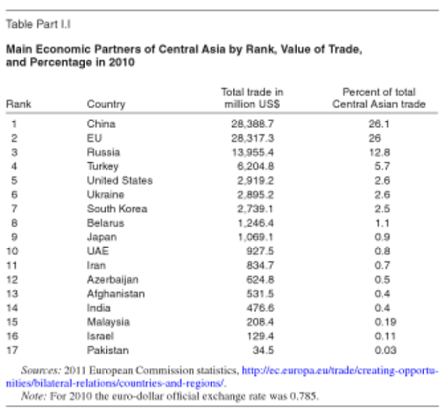
Dimensions of Trade

Slide 13
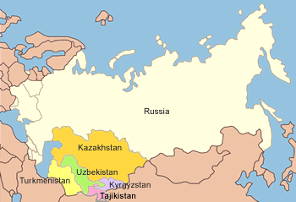
Russian-Central Asian Relations

Slide 14
Russia
1990s – Russian CA policy in disarray
  Russian influence remained weak
  A spoiler?
Western, Chinese, Iranian investment in CA also upset Russian monopoly
1999 – Putin - development of the Commonwealth of Independent States a foreign policy priority
Trade relations skyrocketed since 2003

Slide 15
Russia
Perceptions of Russia in region mixed
  A necessary evil?
Russia approved establishment of US airbases in the region – initially
  Used 9/11 as a reason to increase its own influence
Fear of Islamic radicalism brought CA back into Russian sphere of influence
Domestic crises in CA have strengthened Russia
  Uzbekistan and Turkmenistan remain suspicious
Cultural influence
Labor migration

Slide 16
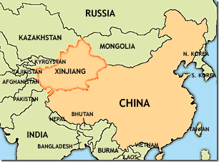
China-Central Asia Relations

Slide 17
China
China has emerged as the leading economic power in the region
Influence not easy to characterize
  Private investment, government assistance
  Wide range of economic instruments: loans
China single largest creditor to Tajikistan
Building infrastructure in the region to promote trade
Outstanding territorial disputes

Slide 18
China
Interest in CA focused on:
Security interests
  Uyghur separatism
Trade and investment
  Extractive industries, telecom, infrastructure
Hydrocarbon supplies
  Increased imports
Central Asian leaders admire Chinese model

Slide 19
Shanghai Cooperation Organization (SCO)
Began as Shanghai Group in 1996
Members include Russia, China, Kazakhstan, Kyrgyzstan, Uzbekistan, Tajikistan
Anti-Western bloc?
Based on common security concerns
Divergent national interests raise challenges
CA and Russia fear Chinese domination
Russian interests still dominate the region

Slide 20
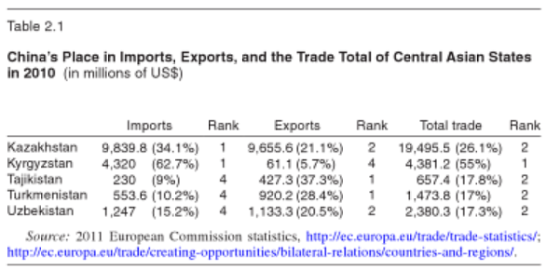
Central Asia-China Trade

Slide 21
US-Central Asian Relations
Post-USSR collapse, relations focused on:
  Market reform (“shock therapy”)
  Democracy promotion
Sought to orient CA republics towards US
  Move them away from Russia
Kyrgyzstan was an earlier reformer
  “Island of democracy”
  Received vast assistance; US happy to take credit
  US assistance backfired when political instability rocked the country

Slide 22
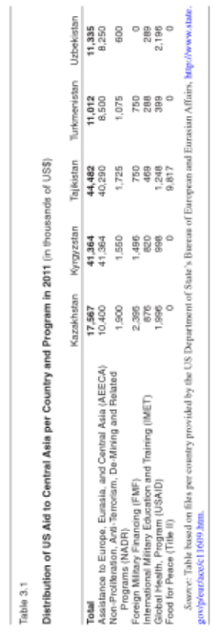
Distribution of US Assistance to CA

Slide 23
United States
US does not seem to have a post-2014 strategy in Central Asia
The region will not be a priority
Prior to 9/11 – US sought to limit/balance Chinese and Russian interests in the region
  China and Russia integrate CA into the global economy

Slide 24
United States/NATO Post 2001
Relations with Central Asia have revolved around Afghanistan
  Karshi-Khanabad (K2) in Uzbekistan
  Manas Airfield in Kyrgyzstan
  German air contingent in Termez, Uzbekistan
  French air contingent in Dushanbe, Tajikistan
Transport route in an out of Afghanistan
Little focus by the US on indigenous issues
Northern Distribution Network (2009)
  Alternative to Pakistan

Slide 25
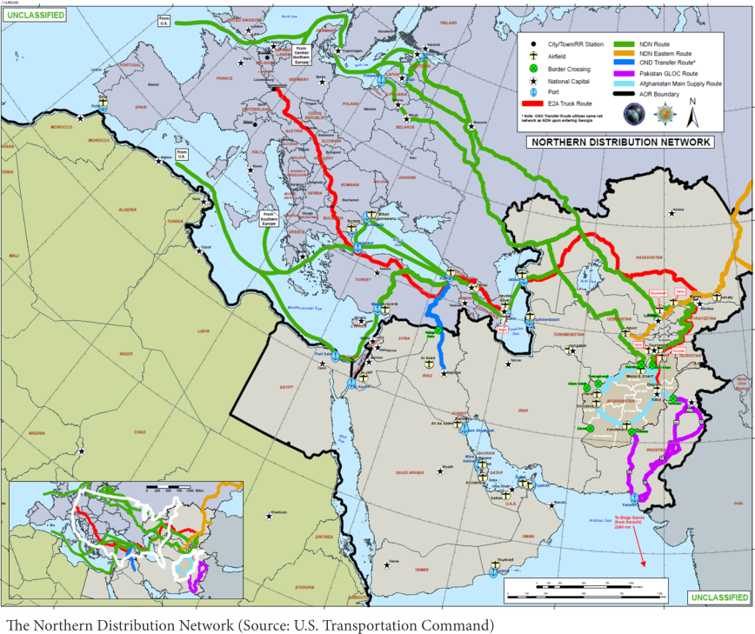

Slide 26
Northern Distribution Network
Pakistan shut off Torkham route into Afghanistan for US supplies for seven months
  Pakistan flirted with China
Increased urgency for NDN
Each container costs ISAF/NATO $17,500 to transit through NDN
  Only $7,500 through Pakistan
Collectively, four CA countries receive $500 million annually in transit fees
2012 signed reverse route agreement

Slide 27
From CA to Afghanistan
Five CA republics have participated in development projects in Afghanistan
  Kazakhs have actually contributed its own funds
  $8 million in bilateral assistance; student training
Uzbekistan
  Uzbek state railway constructed line from Hairaton to Mazar-e Sharif
    Gives Afghanistan its only rail line to the outside world
    Uzbekistan would like to boost this rail line across Afghanistan to boost exports to South Asia

Slide 28
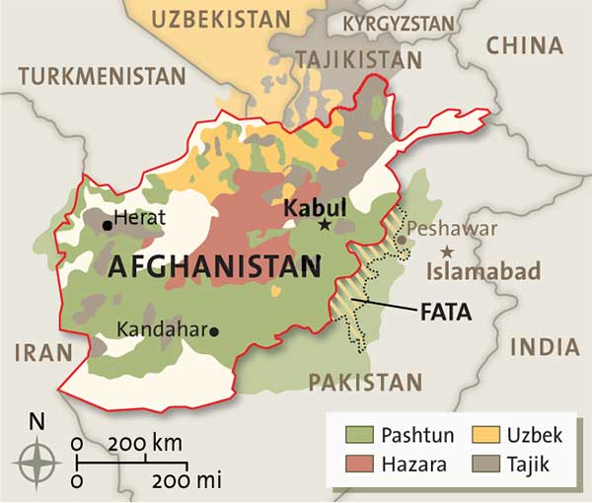
Ethnic Groups in Afghanistan

Slide 29
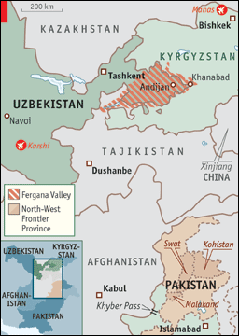
Pakistan
Dual strategy in Pakistan
Anti-terrorism
  Uzbekistan
Energy
  Tajikistan
  Kyrgyzstan

Slide 30
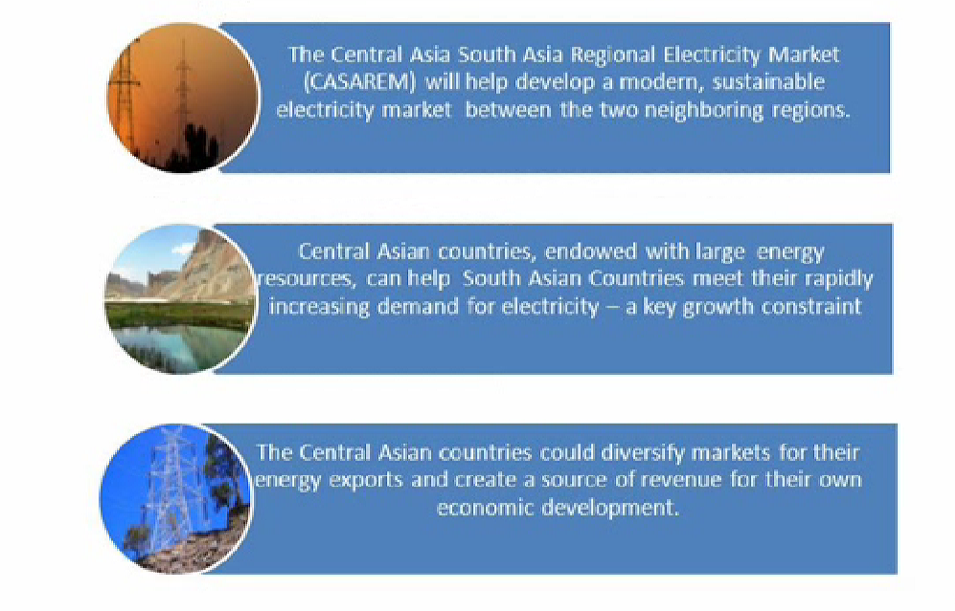
CASA-1000

Slide 31
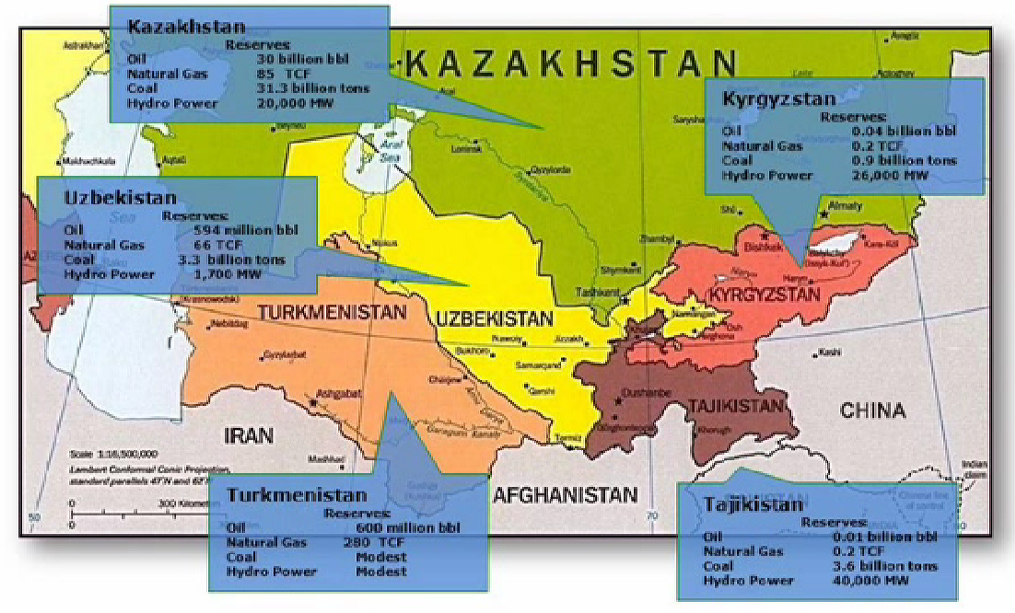

Slide 32
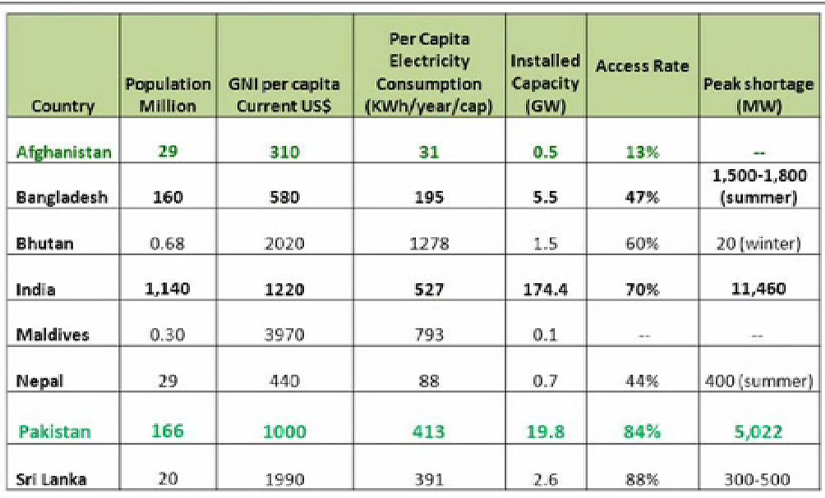
Electricity Demand Exceeds Capacity in South Asia

Slide 33
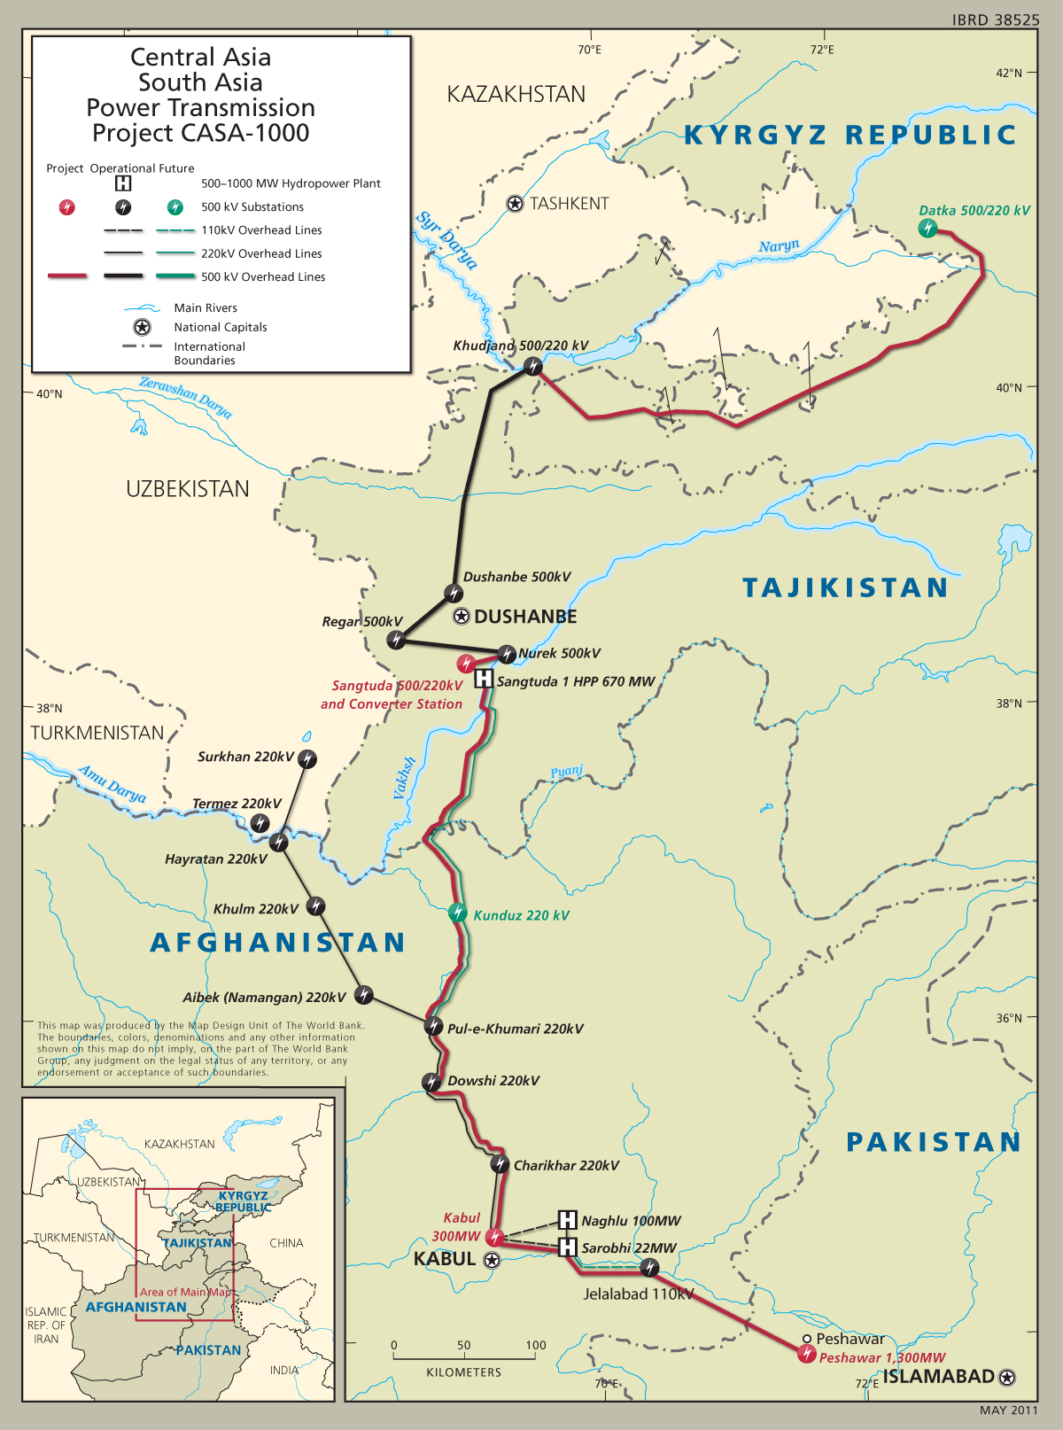

Slide 34
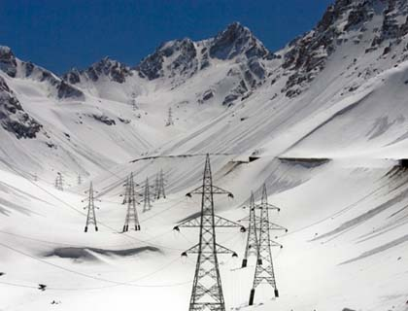
Uzbek Electricity Supplies Kabul

Slide 35
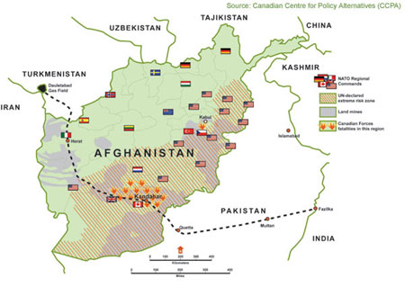
TAPI

Slide 36
Other Players
Turkey
Iran
United Arab Emirates
Israel

Slide 37
Attitudes of Leaders
Romance with the West has ended
CA political leaders and other elites have grown tired of US norms promotion
  Pointed out US double standards
After “colored revolutions” such attitudes solidified→activities of foreign NGOs curtailed
Russia and China send election observers to the region to “approve” flawed elections
No country has well-defined strategy towards Central Asia

