Slide 1
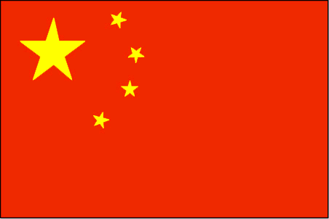
CONTEMPORARY CHINA IN
HISTORICAL PERSPECTIVE

Slide 3
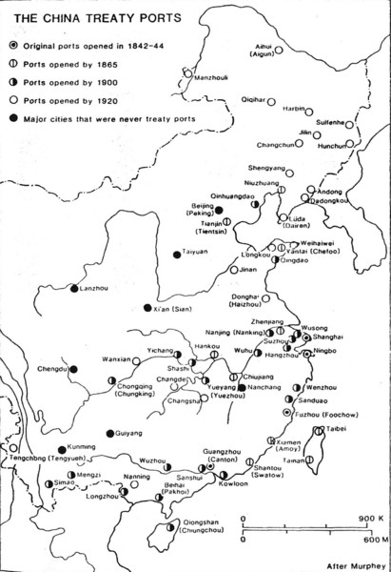
IMPERIALISM
*Opium War, Treaty of Nanjing
*Unequal Treaties, 1842-
*Treaty Ports
*Embassies,/Missions 1860-
*Foreign Factories, 1895-
*Reform, 1860s, 1870s, 1880s, 1890s
*Revolution of 1911
*Republican era, 1912-1949

Slide 4
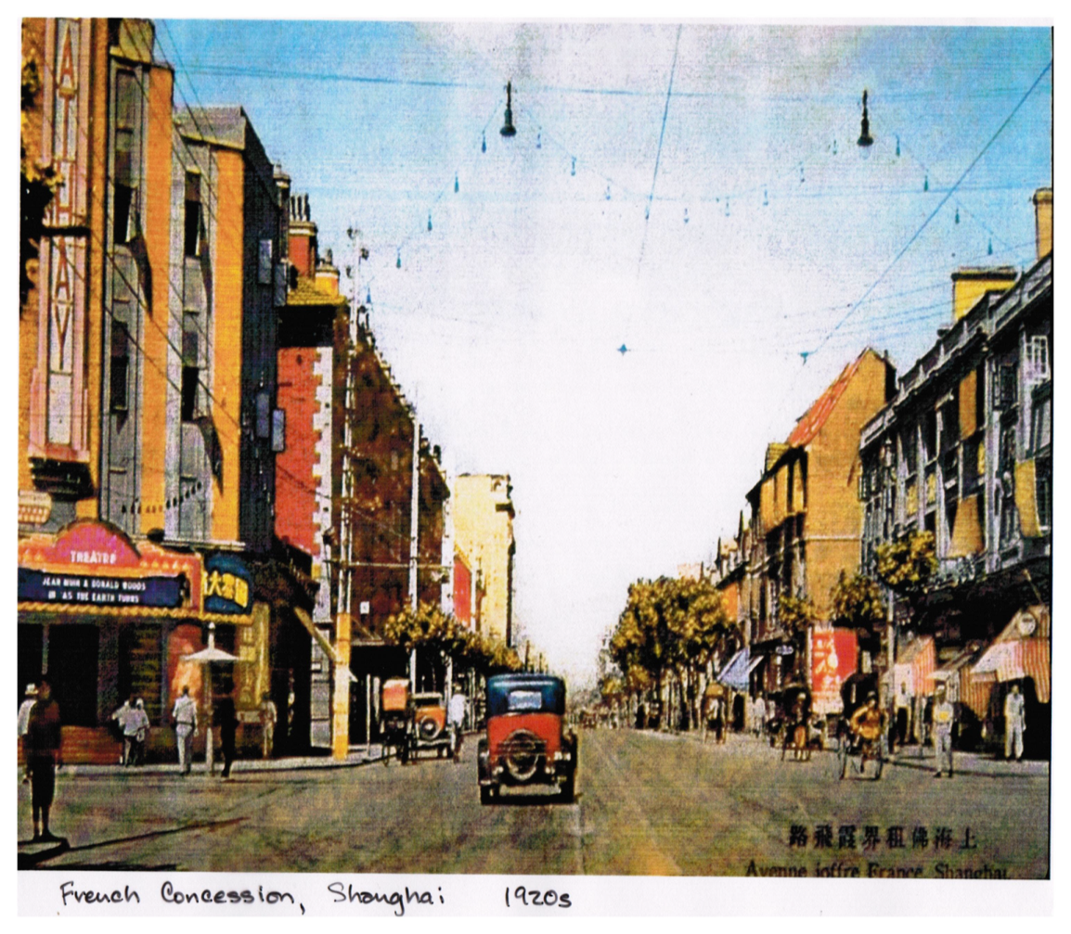
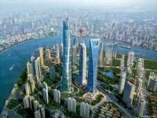
SHANGHAI

Slide 6
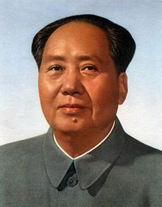
MAO ZEDONG,1893-1976
*A student in New Culture
*Li Dazhao and CCP, 1920-21
* United Front work
*In the wilderness, 1927-31
*Long March, 1934-35
*Fighting the Japanese, 1937-45
*Civil war, 1945-49
*Building socialism, 1949-

Slide 7
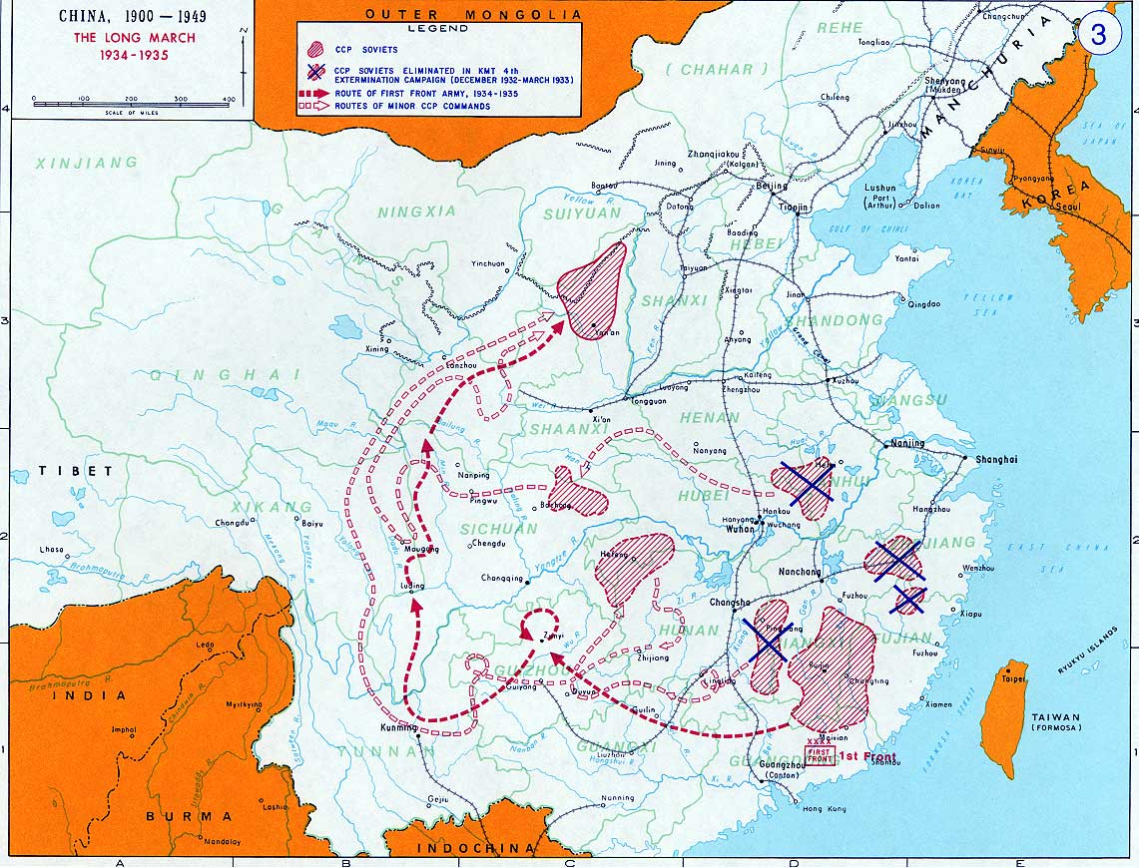

Slide 8
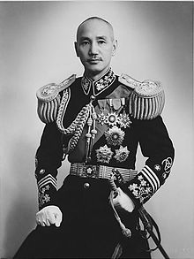
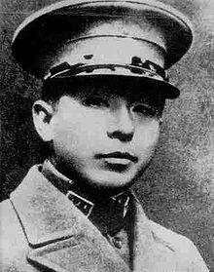
XI’AN INCIDENT, DEC. 1936
Zhang Xueliang
Chiang Kai-shek

Slide 9
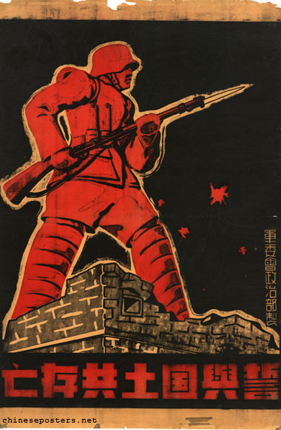
2nd Sino-Japanese War, 1937-45
*United Front with Guomindang
*Nationalist credentials
*Organizational achievements

Slide 10
HOW DID THE CCP WIN CHINA?
Nationalist appeal: end disunity, build a strong nation
Ideological appeal to social justice and egalitarianism
3. External forces: Western imperialism, Japanese imperialism
4. Strong leadership

