Slide 1
Islam in Indonesia: A Global Religion in a Modern Nation-State

Slide 2
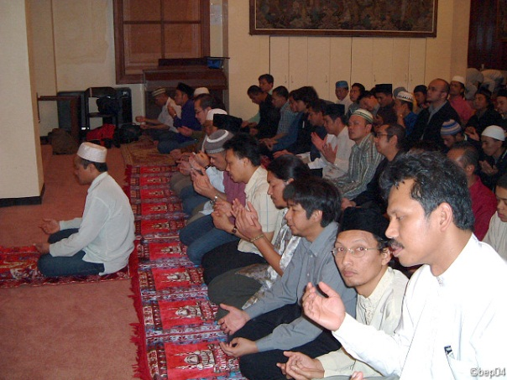
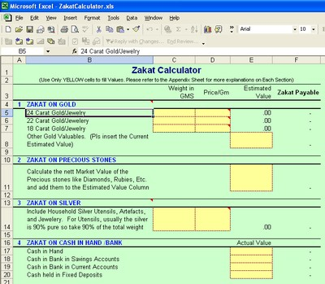
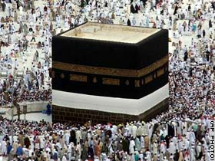
Normative Islam (Five Pillars)
Shahada (confession of faith)
Salat (5 required prayers, 2 optional daily)
Zakat (almsgiving)
Saum (Ramadan fast)
Hajj (Pilgrimage to Mecca)

Slide 3
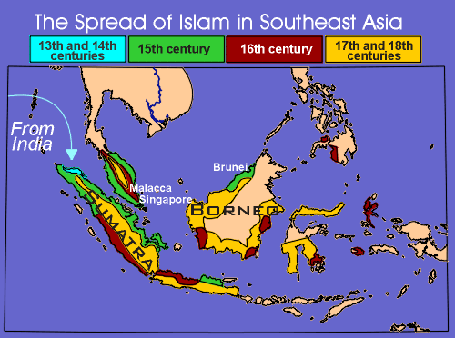

Slide 4
Islam, Colonialism, Nation-States
Homo Islamicus?
Diverse experiences, views in SE Asia
Islamic fundamentalism as modern
Islam & Democracy
Islamic Education & Social Welfare
Western interests & fears
SE Asia’s diverse interests and fears
‘Command Good, Forbid Evil’
Ethics viewed as public issue, not private

Slide 5
Islam in SE Asia
60% of Muslims = South and Southeast Asia
Indonesia = Most Populous Muslim Country
Key 19th Century Muslim Leaders in Mecca
How to explain Islam in Indonesia?:
Snouck H.; Geertz (Ch. 1)
Wahid; Madjid (Ch. 2); Azra (Ch 4)…

Slide 6
Spread of Islam
Political-Economic Factors
Malacca turned to Islamic states for political support Vs. Buddhist Siam and Hindu Majapahit
Provided a state supporting ideology
connection with Islamized trading centers in India.
after 1511, an ideological tool to oppose Christian colonizers.

Slide 7
Spread of Islam
Religious Appeal
egalitarian approach: all true believers equal before God.
a dynamic, monotheistic faith bridging over many of the normal aspects of life
Sufism
Markets & Mosques
Ethnic Commonality
Elite-brokered conversion

Slide 8
Walisonggo
Nine Saints
Great Mystical Feats
Cultural Dynamism
Wayang, Gamelan
Balance Normative and Mystical

Slide 9
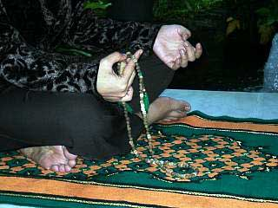
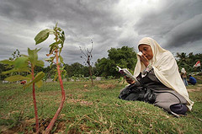
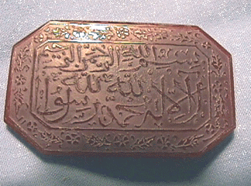
Mystical Islam
Zikir
Baraka
Ziarah (grave visitation)
Kenduren/slametan (ritual meals)
Amulets

Slide 10
Islam in SE Asia Today
Country % Muslims
Brunei 60
Burma 4
Indonesia 90
Malaysia
mainland 53
Sabah 38
Sarawak 23
Philippines 4
Singapore 15
Thailand 4

Slide 11
Indonesian Islam
Two major organizations
Nadhlatul Ulama -- Classicalists or “Traditionalists” (Abdurrahman Wahid)
Strongly Pluralist
Focus on personal piety
Muhammadiyya – Modernists (Madjid)
Do not follow madhab
Founded in 1912
Some Islamist Organization
Dewan Dakwah Islam Indonesia (DDII)
Political Parties (unsuccessful in elections)
A Few Jihadist Groups

Slide 12
Terms
Modernists – I. Khalifiyya -- those favoring ijtihad (personal interpretation) over intellectual genealogy
Instead, Reformists
Traditionalist – I. Salafiyya-- those working with in the traditions of maddhab; A. those basing faith on the Quran and the early community of believers.
Instead, Classicalists

Slide 13
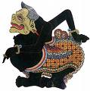
Indigenous Islam? Smiling Islam?
Horse Trance
Wayang (Characters)
Bull Races, Madura
Muslim Matriarchs

Slide 14
Traditionalist vs. Modernist (Ch 2)
Abdurrahman Wahid (NU)
Making Islam Indigenous; inferiority complex
1) Tradition – local orthodoxy; Sunan Kalijaga
2) Politics – fiqh; Islam not political ideology
3) Law – Islam/adat; as long as Islam covered…
N. Madjid (Muhammadiyah/ Paramadina)
1) Political integration, not culture ala Wahid
2) Accept nationalism; Pancasila = tawhid
3) ‘umma’ as nation-state→ Madina Charter
* “Islam Yes, Islamic political parties, NO”

Slide 15
“Indonesia in Global Scheme of Islamic Things” (Hefner 2013)
1) Religious Education
“…among the most forward-looking and dynamic in the world” – vs fiqh focus in Mid-East
Modern Islamic reform; anti-colonialist movement
gender; secular topics; higher educ.
2) Associational Life; Social Welfare
3) Islam & Democracy? (pg. 60)
80% do NOT vote for Islamist parties
80% believe democracy best form of gov’t
But… 82.8% want state based on sharia

Slide 16
Challenges for Indonesia…
Religious Freedom & Minority Rights
* Intra-Islam: shi’a, Ahmadiyah
* Inter-faith: fear of Christianization
2) Islamist militias; Rule of Law
* Islamic Defenders Front
* amar maruf nahi munkar
* “… from the perspective of the broader Muslim world – the greatest achievement of Indonesia’s Muslim citizenry is to have struck the balance between shari’a ethics and constitutional democracy” (Hefner pg. 62)

Slide 17
Indo/West: “Shared Hopes, Separate Fears”
HOW DOES US VIEW INDONESIA?
HOW DOES INDO VIEW USA?
Dutch: Javanese smile
Most can’t place Ind. on map
Do not know history, U.S. connection
Post-Arab Spring hopes
“Moderate Islam”
Obama at UI (You Tube)
Political-Economic interests
Emerging Markets, but… rampant probs w/ bribery
* Ambivalent, depends on…
Admire US, but…
“Seks bebas”, Britney Spears
Wonder how Muslims treated
Anxious to clarify that Islam doesn’t preach terrorism
U.S. role in Iraq, Palestine
(Ayat-Ayat Cinta - YouTube)
Aa Gym, letter to George Bush; meeting with Powell

Slide 18
Islam in Everyday Life

