Slide 1
China’s Health Transitions
Diseases of poverty and affluence
Tina Phillips Johnson, PhD
Saint Vincent College
October 27, 2013

Slide 2
Health transitions
Medical transitions are changes in the field of medicine.
Health transitions are changes in the health of populations.
Comprised of:
Demographic transition: patterns of fertility and mortality
Epidemiologic transition: patterns of disease

Slide 3
Health transitions shaped by:
Direct health action
Traditional and modern medicine
Medical systems
Social determinants of health
Political stability
Economic growth
Literacy
Education

Slide 4
Problems with data
Data sources are variable by time and place
Insufficient transparency
National-level focus
Skewed data
Disease epidemics
Invasion, war, conflict
Famine

Slide 5
China’s 20th-century demographic transition
Population tripled in 20th century
Estimated 430 million 1900; 1.3 billion 2000
Birth and death rates dropped 1950-2000
Population policy 1970-79:
Voluntary “late, long, few” policy
Fertility rate halved from 5.2 to 2.9
Due to:
Universal education
Improved child survival
Greater gender equality
Wang 2011

Slide 6
Demographics (cont.)
Skewed sex ratio
1.06 in 1979
1.11 in 1988
1.17 in 2001
Problems?
Trafficking of girls
Commercial sex work industry
STDs
Davin 2007

Slide 7
Demographics, cont.
Aging population
5% >65 years in 1982
7.5% >65 years in 2012
>65 expected to rise to more than 15% by 2025
Rural-urban migration
12% urban in 1950
50% urban in 2012
Davin, 2007

Slide 8
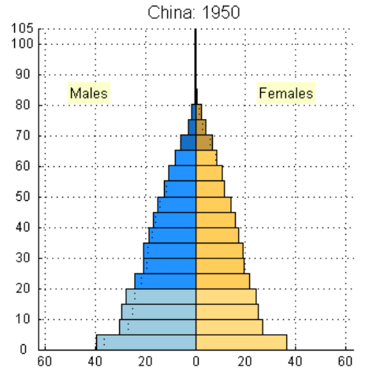
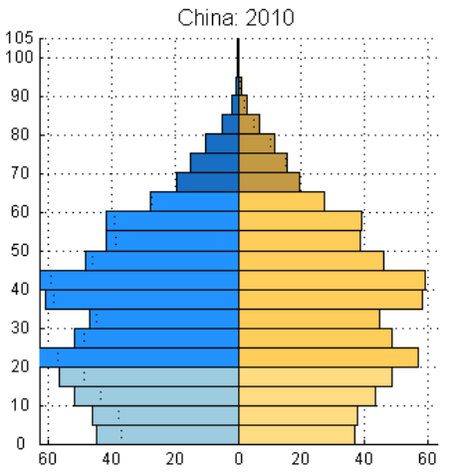
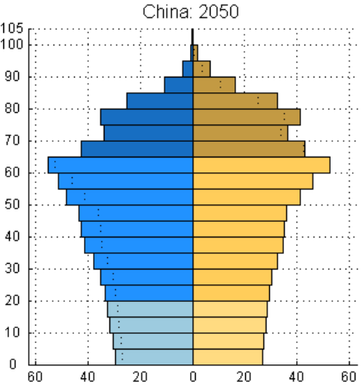
Figure 3 – Age structure of China (1950, 2010, 2050)
Source:(United Nations 2011)

Slide 9
Epidemiologic Transition
Shifts in burden of disease
High fertility, high mortality (pre-transition)
Characterized by infectious disease
High fertility, low mortality (transition)
Medical advances prolong life expectancy
Low fertility, low mortality (post-transition)
Increased life expectancy, medical advances, chronic disease
Omran 1970

Slide 10
Crude birth rate (‰), crude death rate (‰) and % urban population
Chen 2013

Slide 12
Burden of Disease (DALYs) in world regions, 2004
(Low- and middle- income countries grouped by WHO region, 2004)
DALY: Disease-adjusted life year; The overall disease burden, expressed as the number of years lost due to ill-health, disability or early death.

Slide 13
China’s double burden of disease
Infectious diseases and epidemics
Chronic and man-made non-communicable diseases

Slide 14
Questions?

Slide 15
Works Cited
Chen L. China’s Exceptional Health Transitions: Overcoming the Four Horsemen of Apocalypse. 2011.
Davin D. Marriage Migration in China and East Asia. J Contemp China. 2007;16(50):83–95.
Ho CS, Gostin LO. The Social Face of Economic Growth: China’s Health System in Transition. JAMA. 2009;301(17):1809–11.
Liu Y, Yang G, Zeng Y, Horton R, Chen L. Policy dialogue on China’s changing burden of disease. The Lancet. 2013;381:1961–62.
Omran, AR. The epidemiologic transition. A theory of the epidemiology of population change. Milbank Memorial Fund Quarterly. 1970; 49.4:509-38.
Wang F. The Future of a Demographic Overachiever: Long-Term Implications of the Demographic Transition in China. Popul Dev Rev. 2011;37 (Supplement):173–90.
Yang G, Zeng Y, Gao GF, et al. Rapid health transition in China, 1990-2010: findings from the Global Burden of Disease Study 2010. The Lancet. 2013;381:1987–2015.

