Slide 1
Ethnicity and the Decentralization of Terrorism in Southeast Asia
By Alphonse La Porta Ambassador ret.

Slide 2
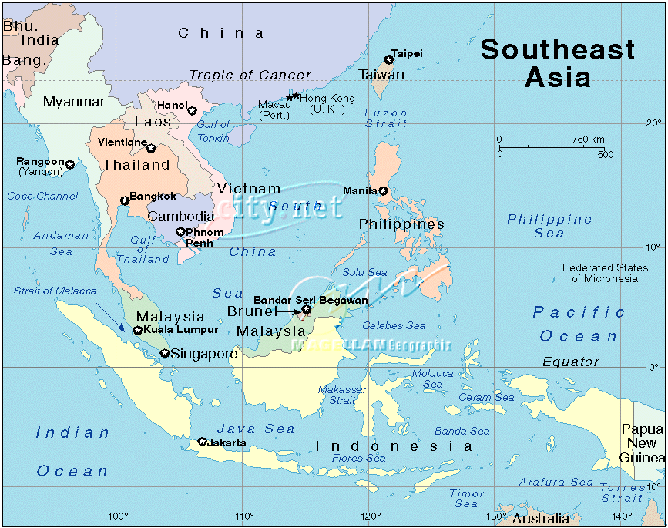
Map of Southeast Asia

