Slide 1
Muslim Majority and Minority Politics:
Indonesia and Burma

Slide 2
Public Opinion
What do Indonesian Muslims Want?
Five priority issues:
Economic growth
national prosperity
national unity
education
the rule of law

Slide 4
Indonesia’s Election Results: The People’s Representative Assembly
Party | Votes 1999 | Seats 1999 | Votes 2004 | Seats 2004 | Votes 2009 | Seats 2009 | Pancasila/ Islamist
Indonesian Democratic Party-Struggle (PDI-P) | 33.73 | 153 | 18.53 | 109 | 14.0 | 93 | PS
Golkar | 22.46 | 120 | 21.58 | 128 | 14.5 | 106 | PS
Democrat Party (PD) | -------** | ----- | 7.45 | 57 | 20.85 | 150 | PS
National Awakening Party (PKB) | 12.66 | 51 | 10.57 | 52 | 4.94 | 28 | PS
National Mandate Party (PAN) | 7.12 | 45 | 6.44 | 52 | 6.01 | 48 | PS
Prosperous Justice Party (PKS) | 1.52 | 7 | 7.34 | 45 | 7.88 | 57 | IS
United Development Party (PPP) | 10.72 | 58 | 8.15 | 58 | 5.32 | 38 | IS
Reform Star Party (PBR) | --------- | ---- | 2.4 | 13 | 1.2 | ----* | IS
Star and Crescent Party (PBB) | 1.94 | 13 | 2.62 | 11 | 1.8 | ----* | IS
Other parties | 9.85 |  | 14.92 |  | 15.28 | ----*
Total | 100 |  | 100 |  | 84.72

Slide 5
Islamist Party Performance in Indonesia’s Elections
Why has the vote for Islamically oriented parties declined over the last three election cycles?
Beliefs about the parties themselves
Mainstreaming of political Islam
Fracturing of Islamist parties

Slide 6
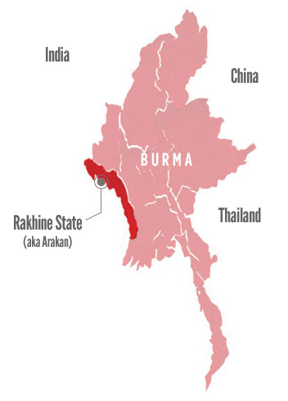
The Rakhine State (Arakan)

Slide 7
The Rohingya in Burma
What are the roots of the current conflict?
How did the Rohingya become stateless?
Colonial roots
Citizenship laws
Impact of Burmese reforms

