Slide 1
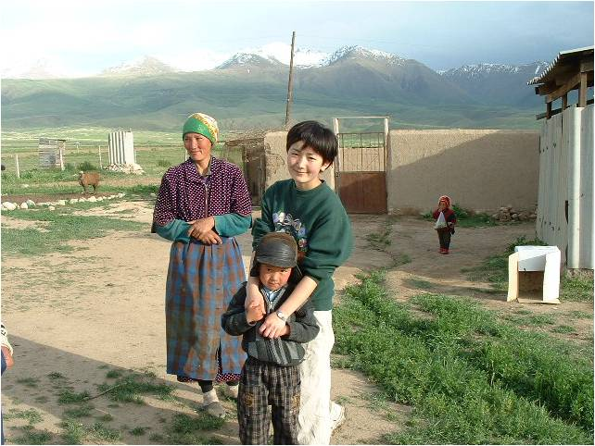
Noor O’Neill Borbieva borbievn@ipfw.edu
March 23, 2014
Gender and social change in Central Asia:
Women encounter development

Slide 2
How has Central Asia’s participation in transnational political and economic networks expanded opportunity for women in the region?

Slide 3
Lecture outline
Historical perspectives on gender in CA
Economic context
Anthropological reflections on women’s new opportunities

Slide 4
I. Historical perspectives on gender in CA

Slide 5
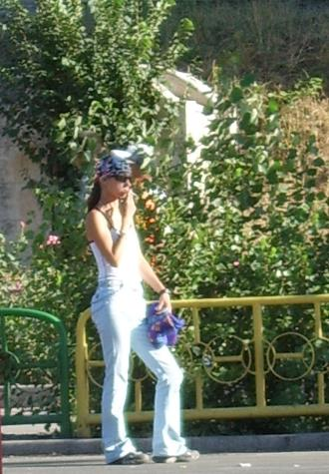
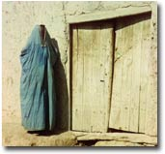
Some things have changed

Slide 6
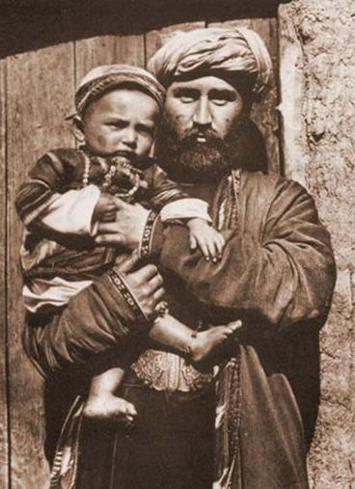
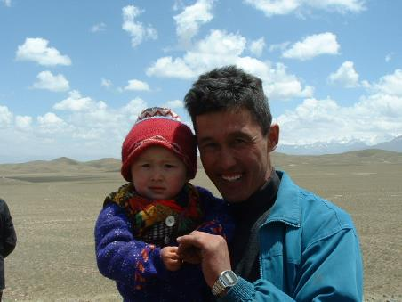
Some things remain the same

Slide 7
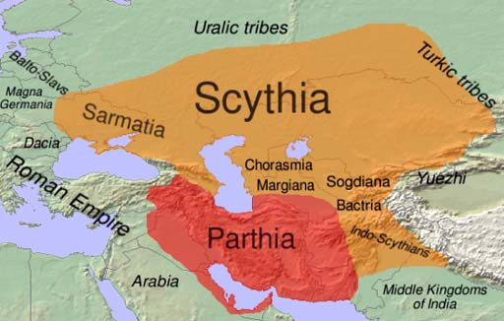
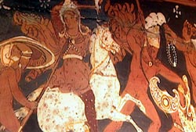
Hildinger, Erik. 1997. Warriors of the steppe: A military history of Central Asia 500 B.C. to 1700 A.D. Cambridge, MA: Da Capo.

Slide 8
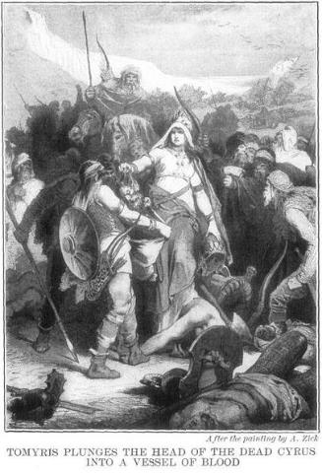
Tomyris
Herodotus, The History, George Rawlinson, trans., (New York: Dutton & Co., 1862), http://www.fordham.edu/halsall/ancient/tomyris.asp.

Slide 9
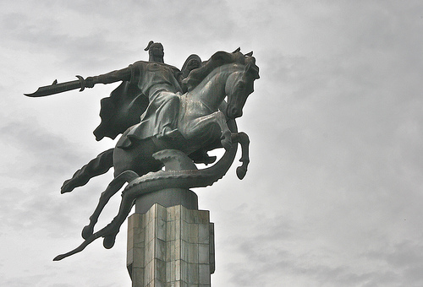
Kanikei

Slide 10
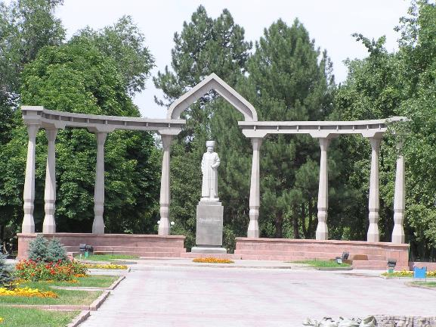
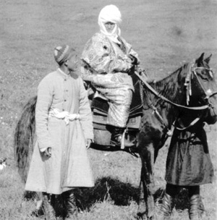
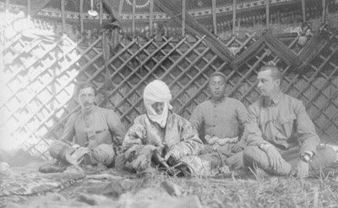
Kurmanjan Datka (1811-1907)

Slide 11
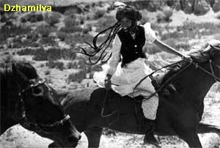
Jamiliya

Slide 12
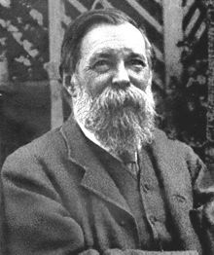
Friedrich Engels
“The first class antagonism which appears in history coincides with the development of the antagonism between man and woman in monogamous marriage, and the first class oppression with that of the female sex by the male” (The Origin of the Family, Private Property, and the State, 1884).

Slide 13
EARLY SOVIET POLICIES
Byt crimes
Hujum (1927-1928)
Suffrage (1918)

Slide 14
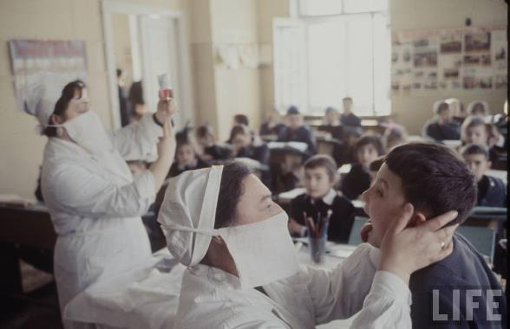
Soviet era

Slide 15

After?

Slide 16
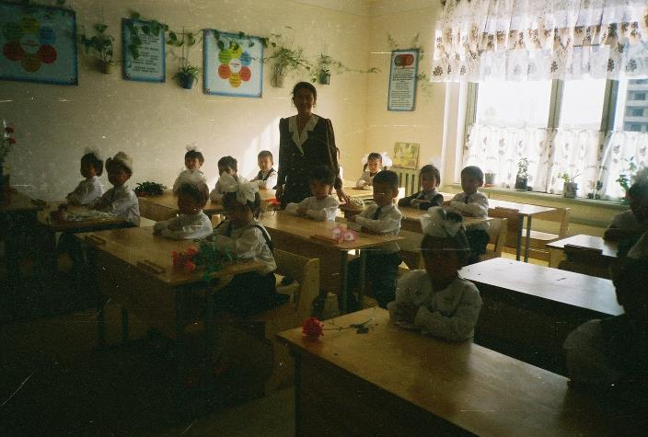
Do women really have more opportunity now?

Slide 17
II. Economic context: transnational involvements
Migrant work/remittances
Trade
Development sector

Slide 18
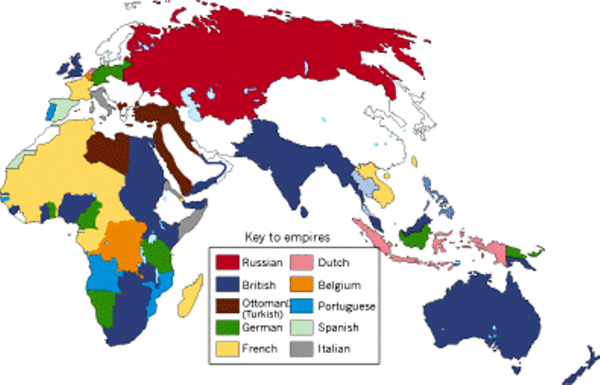
Colonialism/imperialism

Slide 19

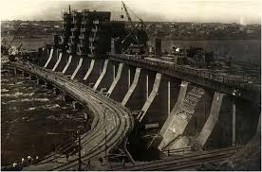
Communism!

Slide 20
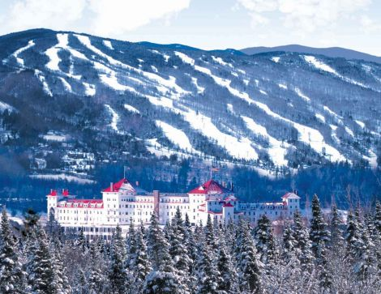
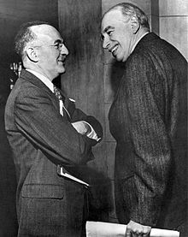
1944: Bretton Woods

Slide 21


IFIs

Slide 22
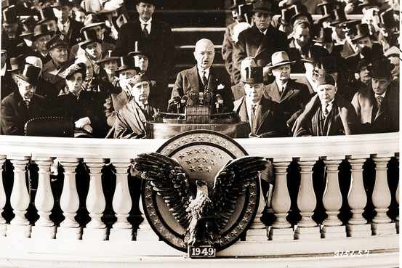
1949: Truman’s Point Four

Slide 23
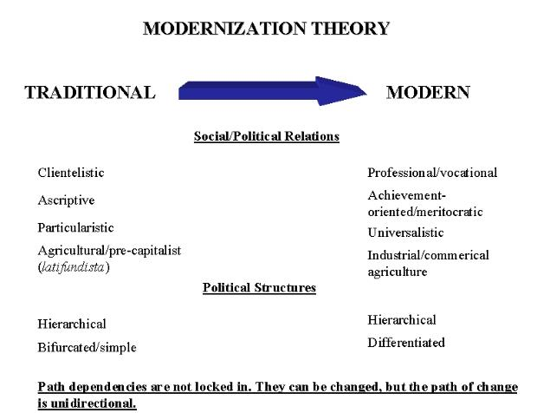
http://filasociology.blogspot.com/2013/05/chapter-18-social-change-and.html

Slide 24
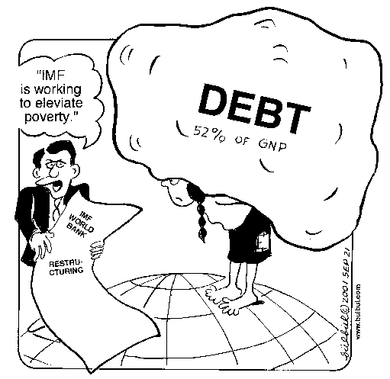
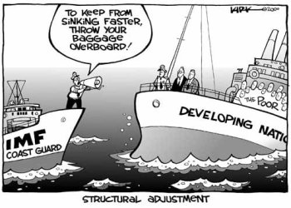
Structural adjustment

Slide 25


Slide 26

Social capital

Slide 27
RESULTS OF DEVELOPMENT
Drastic increase in economic hardship and poverty.
Statistical fact that amount of aid is inversely correlated with rate of development.

Slide 28
REMITTANCES
48% of GDP in Tajikistan
31% of GDP in Kyrgyzstan
Cieslewska: Markets make up 27% of GDP

Slide 29
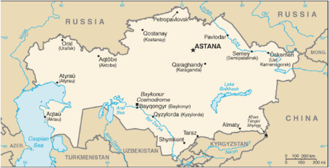

Republic of Kazakhstan
Қазақстан Республикасы
Республика Казахстан
Size: 2.7M km² (1st)
Population: 17.7M (2nd)
Per capita GDP: $14,100 (1st)
Stable and growing economy, in part thanks to high oil prices.
High levels of foreign investment.
Some structural adjustment: privatization nearly complete.
So prosperous, it has become a destination for labor migrants from other CARs.

Slide 30

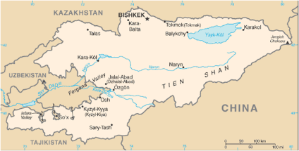
Kyrgyz Republic
Кыргыз Республикасы
Кыргызская Республика
Size: 198K km² (4th)
Population: 5.5 million (4th)
Per capita GDP: $2,500 (4th)
Agreed to most extreme form of structural adjustment, which has hurt economy.
Second most development aid per capita, largest foreign debt per capita.
31% of GDP is foreign remittances.
Foreign investment minimal except in gold mining.
Important source of water and electricity for entire region.

Slide 31

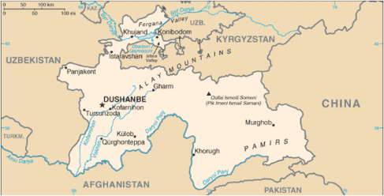
Republic of Tajikistan
Ҷумҳурии Тоҷикистон
Jumhurii Tojikiston
Size: 143K km² (5th)
Population: 7.9M (3rd)
Per capita GDP: $2,300 (5th)
Economy expanded during Soviet era.
Economy devastated by civil war (1992-1997)
Today, stagnating. Three sources of revenue: remittances (48% of GDP), drug trade (40% of GDP?), NGOs
Half of all laboring men are migrant workers
Very little foreign investment, except futile attempts to stem drug trade.

Slide 32

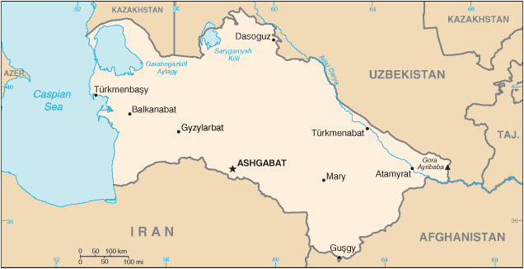
Republic of Turkmenistan Türkmenistan Respublikasy
Size: 488K km² (2nd)
Population: 5.1M (5th)
Per capita GDP: $9,700 (2nd)
Huge oil and natural gas reserves, but lack of transparency and good pipelines means little economic benefit
Minimal international involvement.
Rejected structural adjustment. Instead, modest free market reforms.
State supplies water, electricity, and gas to all citizens, but living standards are low.

Slide 33

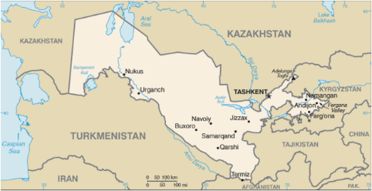
Republic of Uzbekistan
O‘zbekiston Respublikasi
Ўзбекистон Республикаси
Size: 447K km² (3rd)
Population: 28.7M (1st)
Per capita GDP: $3,800 (3rd)
Rejected structural adjustment reforms. Instead, modest free market reforms.
Cotton monoculture enriches the government but not the populace. Government is wealthy, people are poor.
Environmental devastation.

Slide 34
Country Data
Country | Kazakhstan | Kyrgyzstan | Tajikistan | Turkmenistan | Uzbekistan
2013 Population (rank) | 17.7M (2) | 5.5M (4) | 7.9M (3) | 5.1M (5) | 28.7M (1)
2013 Population growth rate | 1.2% | 1% | 1.8% | 1.2% | 0.9%
Total Size (rank) | 2.7 M km² (1) | 198K km² (4) | 143K km² (5) | 488K km² (2) | 447K km² (3)
2013 GDP | $224.9B | $7.2B | $8.5B | $40.6B | $55.2B
2013 GDP Real Growth Rate | 5% | 7.4% | 6.8% | 12.2% | 7%
2013 GDP per Capita (rank) | $14,100 (1) | $2,500 (4) | $2,300 (5) | $9,700 (2) | $3,800 (3)
Poverty Rate | 5.3% (2011) | 33.7% (2011) | 39.6% (2012) | 30% (2004) | 17% (2004)
GINI index (higher=unequal) | 28.9 (2011) | 33.4 (2007) | 32.6 (2006) | 40.8 (1998) | 36.8 (2003)
2013 Debt--external | $131.3B | $3.9B | $3.6B | $428.9M | $8.8B
2013 Inflation | 5.8% | 6.8% | 5.6% | 9% | 10.1%

Slide 35
III. Anthropological reflections

Slide 36
What is “ethnography”?
  The first-hand observation of a society.
  The text which is produced by analyzing these observations.

Slide 37
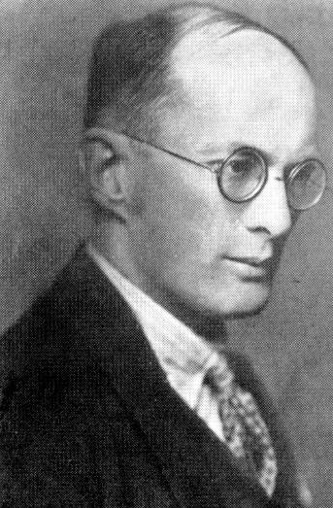
“To grasp the native’s point of view, his relation to life, to realize his vision of his world. We have to study man, and we must study what concerns him most intimately, that is, the hold which life has on him” (Argonauts of the Western Pacific, pg. 25).
Bronislaw Malinowski (1884-1942)

Slide 38
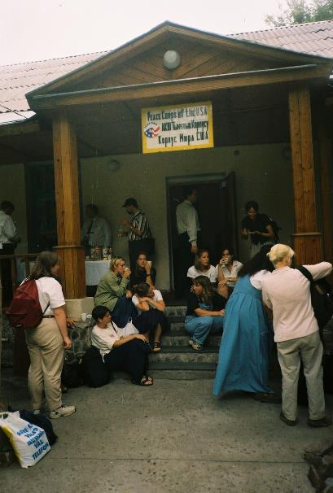
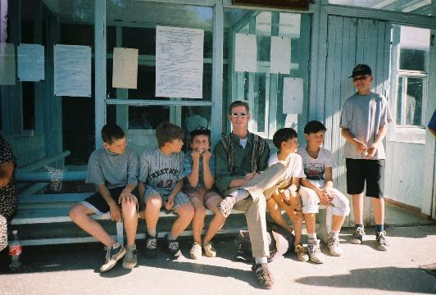

Slide 39
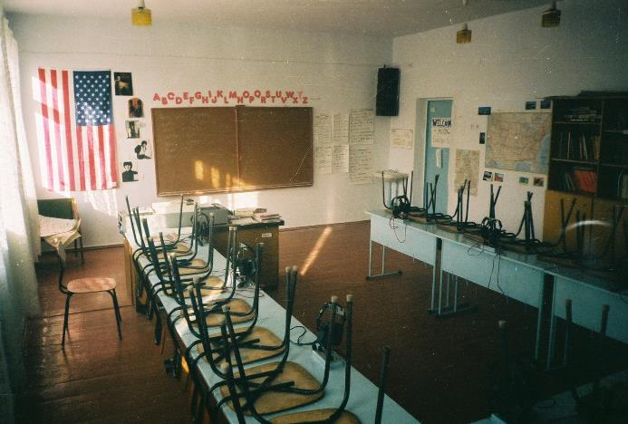
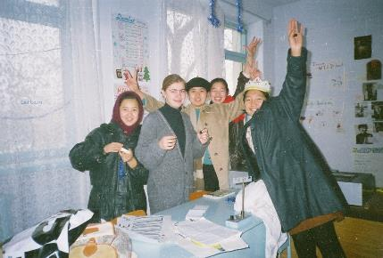
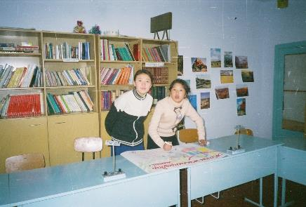

Slide 40
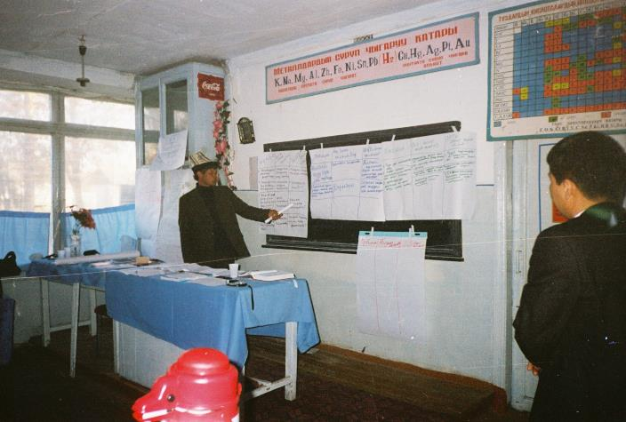

Slide 41
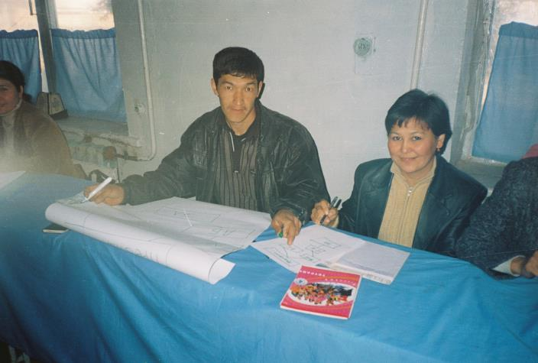

Slide 42
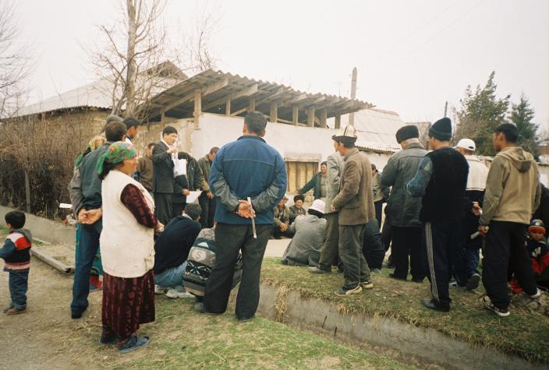

Slide 43
CHARACTERS FROM READINGS
Aida
  Born in mid-1970s. Came of age during the Soviet Union, but embraces new ideals of market capitalism
  Studies in Bishkek and works in a kiosk
  Hopes to succeed as an entrepreneurial business owner. . She also worked in a kiosk, and viewed the entrepreneurial market as a place she could prosper.
Prostitutes in Bishkek
  Dissatisfied with salary as a preschool teacher
  Did not want to rely on parents
  Got “addicted” to the lifestyle

Slide 44
  Olga/Altinai: successful chelnoki
  Tamara Sadikova
  Highly educated
  Successful NGO leader, women’s empowerment programs
  Participated in FSA exchange program
  Moral epiphany
  Works at periphery of development economy
  OTHERS?

Slide 45
Lessons learned
Development organizations are involved with women’s issues, but their ideology is western
Development funding has empowered a modest number of creative, ambitious, educated women, particularly through job stability and a living wage.
Women who work in development struggle to achieve respect in Kyrgyz society.
The negative effects of the new economy outweigh the benefits of development money

Slide 46
Bibliography
Deaton, Angus. 2013. The Great Escape: Health, Wealth, and the Origins of Inequality. Princeton: Princeton University Press.
Gleason, Gregory. 2003. Markets and politics in Central Asia: Structural reform and political change. London: Routledge.
Ikramova, Ula, and Kathryn McConnell. 1999. "Women's Ngos in Central Asia's Evolving Societies." In Civil Society in Central Asia, edited by M. Holt Ruffin and Daniel Waugh, 198-213. Seattle and London: University of Washington Press.
Kamp, Marianne. 2006. The new woman in Uzbekistan: Islam, modernity, and unveiling under communism. Seattle: University of Washington Press.
Massell, Gregory J. 1974. The Surrogate Proletariat: Moslem Women and Revolutionary Strategies in Soviet Central Asia, 1919-1929. Princeton: Princeton University Press.
Northrop, Douglas. 2004. Veiled empire: Gender and power in Stalinist Central Asia. Ithaca and London: Cornell University Press.
Olcott, Martha Brill. 2005. Central Asia's Second Chance. Washington, DC: Carnegie Endowment for International Peace.
Putnam, Robert D. 2000. Bowling Alone: The Collapse and Revival of American Community. New York: Simon and Schuster.
Sievers, Eric W. 2003. The Post-Soviet Decline of Central Asia: Sustainable Development and Comprehensive Capital. London: Routledge.

Slide 47
How has Central Asia’s participation in transnational political and economic networks expanded opportunity for women in the region?

