Slide 1
Building Understanding about Refugees
2025

Slide 2
Four Key Categories

Slide 3
Ask these 3 Questions:

Slide 4
Refugees
Where- Refugees live outside of their own country, they have crossed one international border
Why?- Refugees have moved because they were in danger as a result of war, violence or persecution. Refugees are forcibly displaced. This means they had no choice but to leave, otherwise they would continue to be exposed to danger. RIGHTS?
International law says that refugees cannot be sent back to their own country if this puts them at risk war, violence or persecution. They have a right to remain in the host country. They also have a right to work in the host country, to health care, to education, they have the right to rent or acquire a place to live and they have other fundamental rights such as freedom of expression and religion.

Slide 5
Migrants
WHERE? Migrants are per definition outside their own country. They have crossed at least one international border. Migrants can only be found outside their own country, just like refugees
WHY? Migrants have moved because of other reasons than war, violence or persecution. This is where they differ fundamentally from refugees. Migrants, could in principle return to their own countries without being in immediate danger. However, they may have very good reasons to leave. Some migrants may move to work legally in another country, because they want to join family or get an education. More compelling and precarious reasons like poverty, natural disasters, food shortages or other reasons may drive many to leave as well.
RIGHTS? Most places have migration laws. Some countries, for example, offer opportunities for people to migrate legally to work or study or for family members or spouses to join one another in another country. These arrangements differ from the international laws protecting refugees.

Slide 6
Internally Displaced People (IDPs)
WHERE? They are still inside their own country.
WHY? IDPs were in danger as a result of war, violence or persecution. Like refugees, this means they had no choice but to leave, otherwise they would continue to be exposed to danger.
RIGHTS? IDPs stay within their own country and remain under the protection and laws of their country’s government even if that government is the reason for their displacement, for example because the government is persecuting certain groups in the country. UNHCR agencies are difficult to get to, so vulnerable people have trouble accessing resources.

Slide 7
Asylum-Seekers
WHERE? They live outside their own country. They have crossed at least one international border. Asylum- seekers can therefore only be found outside their country.
WHY? They claim asylum, meaning you are asking another country for international protection from dangers such as war, violence and persecution.
Want to be recognized as refugees because they are 1. Outside of their country 2. They fled because of danger 3. They would be in danger if they would be sent back- see the definition of refugees
RIGHTS? Claiming asylum in another country is a human right. Most countries in the world have asylum procedures in place to determine if persons arriving from other countries, and who are claiming danger can be recognized as refugees. In many cases asylum- seekers are interviewed extensively to determine if they have a ‘well-founded fear of being persecuted’ and if they would be in danger if they return to their country.

Slide 8
Key Terms
Persecution- if he or she has a 'well- founded fear of being persecuted for reasons of race, religion, nationality, membership of a particular social group or political opinion, is outside the country of his nationality and is unable or, owing to such fear, is unwilling to avail himself of the protection of that country'.
Examples: To name a few examples of what persecution means in this context, people may be jailed, mistreated, hurt or worse just because of their race, religion, nationality, political opinions or belonging to a certain group of people. When this is the case, and the person has crossed at least one border, this person is a refugee according to the criteria in international law
International Protection- When you start searching for documentation about refugees and asylum, you will often come across the legal term 'international protection'. This term is derived from the international laws on refugees. Protection in this case simply means that people fleeing danger in their own country, can stay in safety and enjoy fundamental rights in another country and that they cannot be sent back if this puts them at risk. Keep this simple principle in mind if you come across the term 'international protection'.

Slide 9
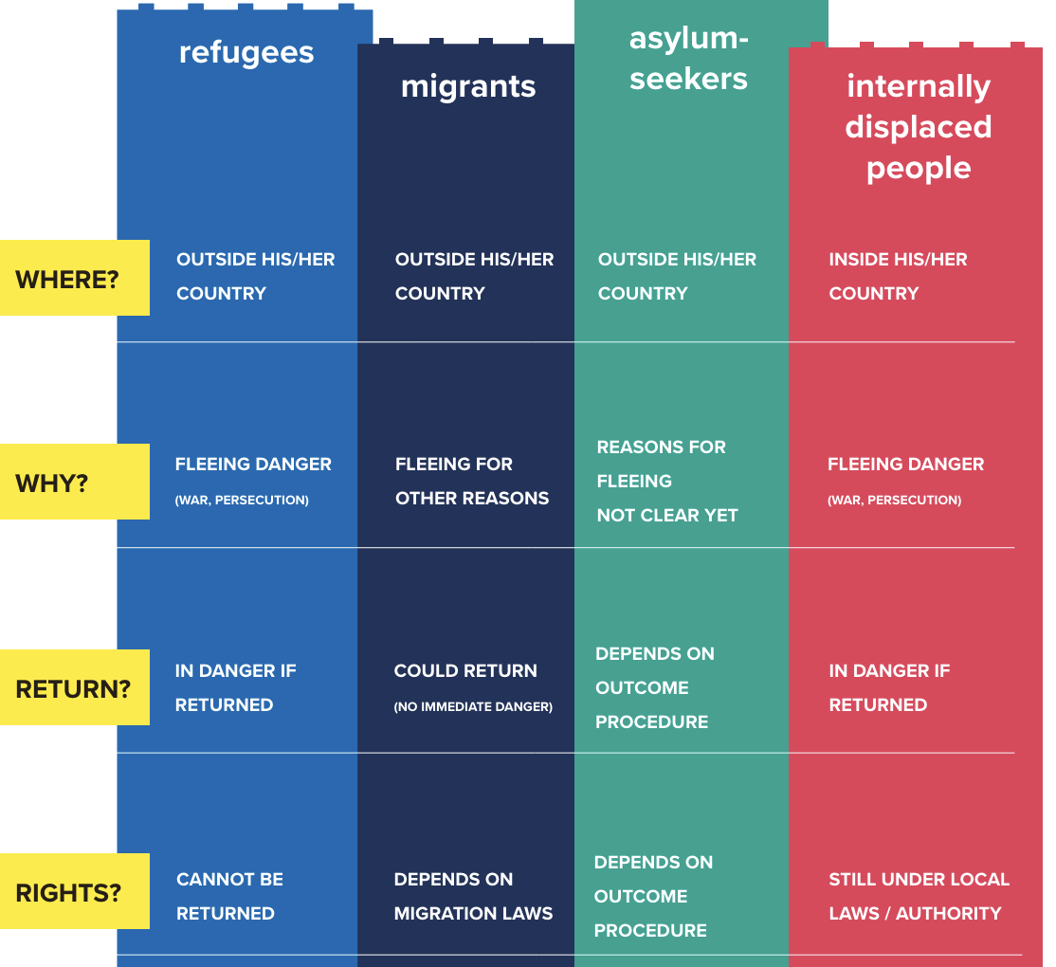

Slide 10
The Numbers
The number of people affected by forced displacement (refugees, asylum-seekers and internally displaced persons) globally has doubled from around 41 million in 2011 to over 82 million in 2020.
In the second decade of the 21st century, a majority of the world's refugees have consistently originated from a relatively small number of countries that have been affected by conflict or violence for years or even decades, such as Afghanistan, Central African Republic, Democratic Republic of Congo, Iraq, Syria, Somalia, South Sudan and Yemen. The top five countries of origin accounted for roughly two thirds of the world's refugees in recent years.

Slide 11
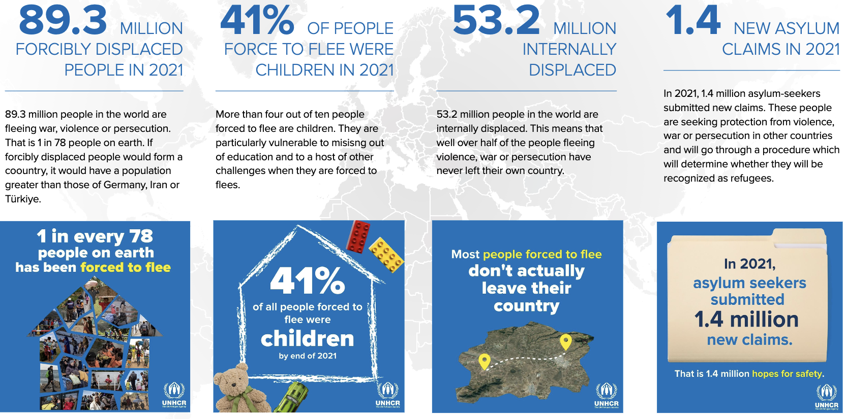

Slide 13
Source Credit: https://www.unhcr.org/sites/default/files/legacy-pdf/618bc1d64.pdf

