Slide 1
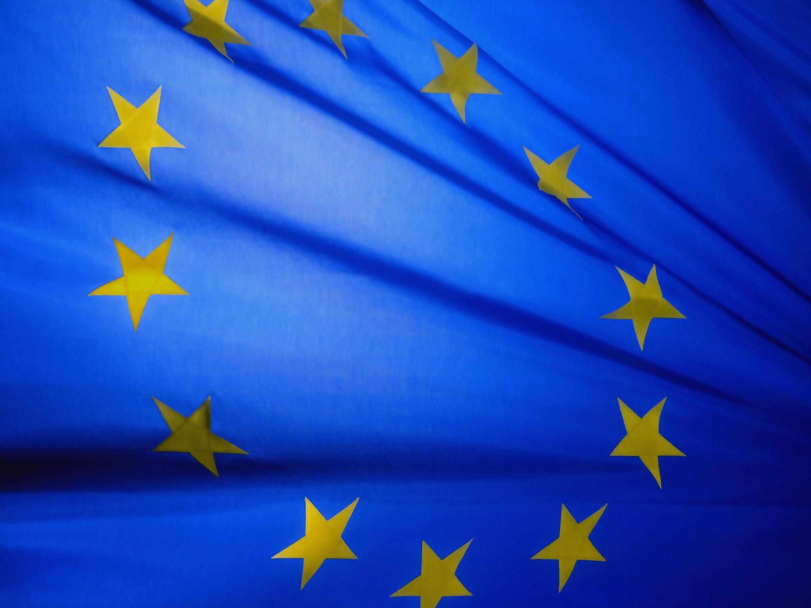
THE EUROPEAN UNION
“Nothing is possible without men; nothing
is lasting without institutions” – Jean Monnet
Notes:
All graphics and information directly from the EU’s website: https://europa.eu/european-union/documents-publications/slide-presentations_en#the-basis-for-a-union

Slide 2
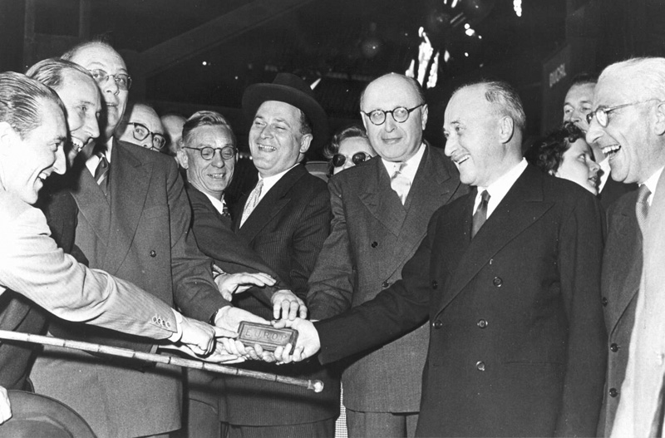
1951:
European Coal & Steel Community
In the aftermath of World War II, the aim was to secure peace among Europe through the cooperation of shared institutions.
Based on a plan by French Foreign Minister Robert Schuman.
Six founding countries signed a treaty to run heavy industries (coal and steel) under common management:
Belgium
Federal Republic of Germany
France
Italy
Luxembourg
The Netherlands
Jean Monnet and other leaders with
the first “European” ingot of steel

Slide 3
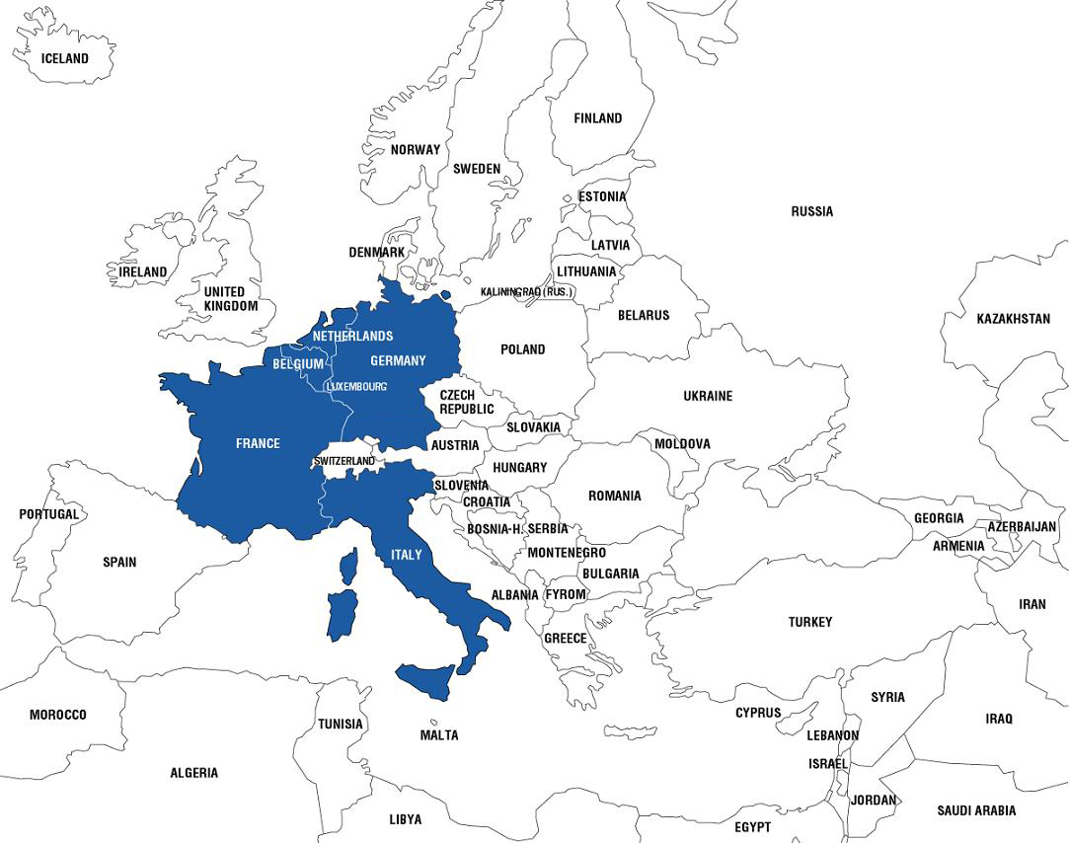
1952
Founding Members
Belgium
France
Germany
Italy
Luxembourg
Netherlands

Slide 4
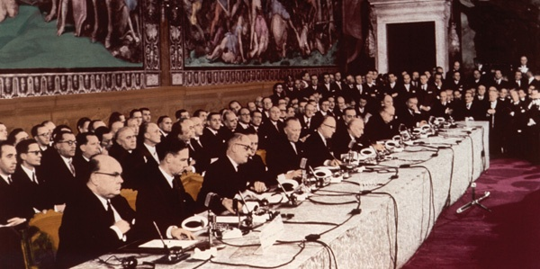
Treaty of Rome
1958:
The EEC is Created
The six founding countries expanded cooperation to other economic sectors, creating the European Economic Community (EEC) – or “common market.”
As a result, people, goods, services, and capital today move freely across the Union.
Signing of the Treaty of Rome, 1957

Slide 5
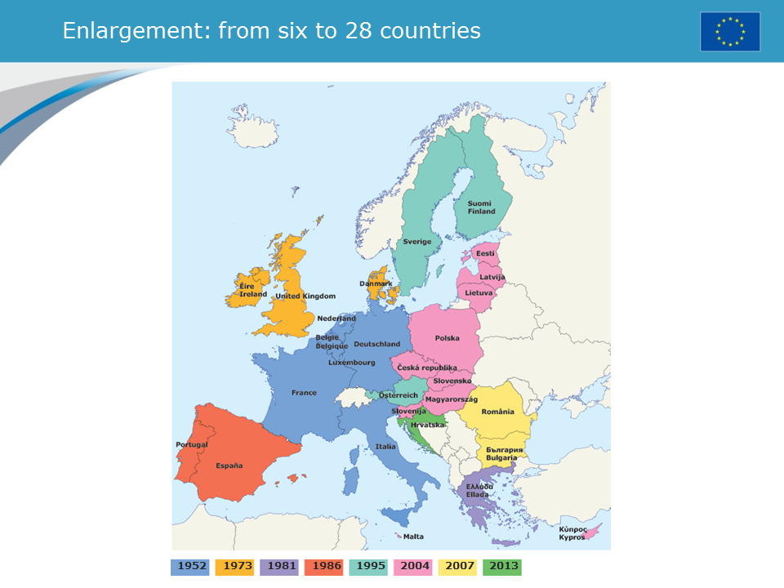

Slide 6
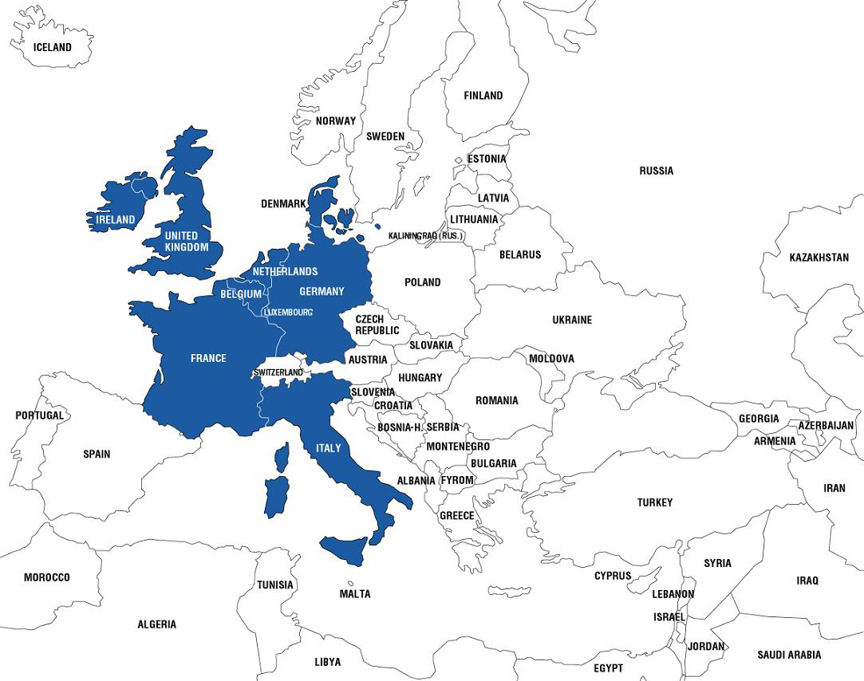
1973
Denmark
Ireland
United Kingdom

Slide 7
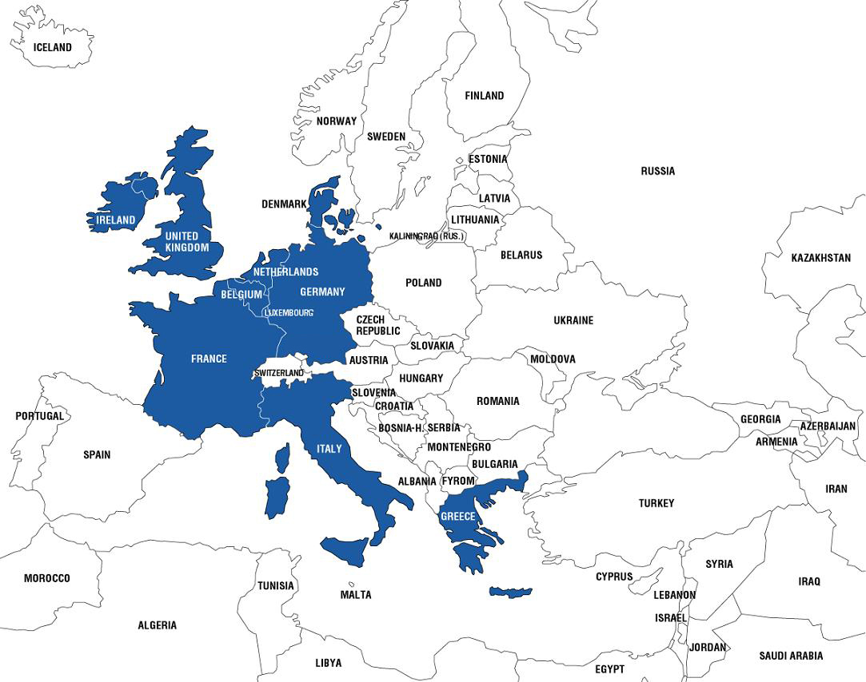
1981
Greece

Slide 8
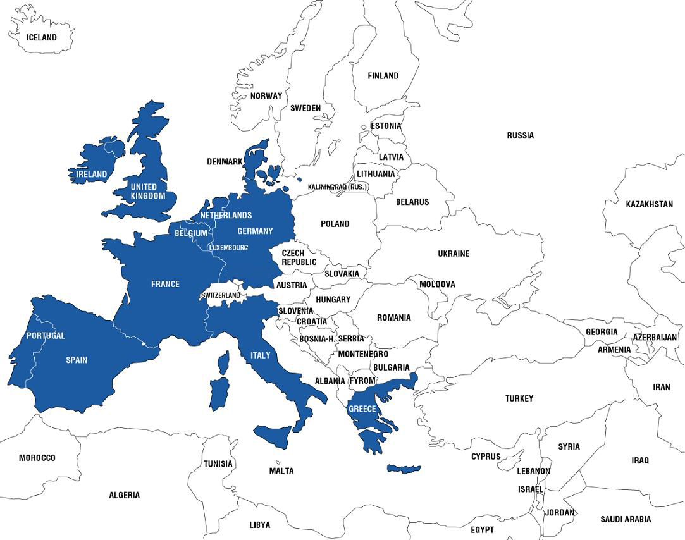
1986
Portugal
Spain

Slide 9
1989
What happened in 1989-1991 that changed the EU?

Slide 10
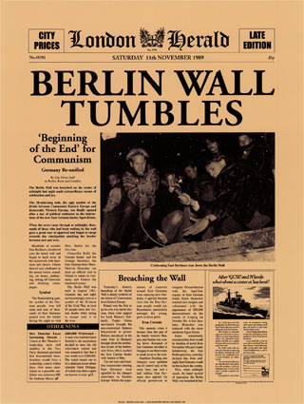
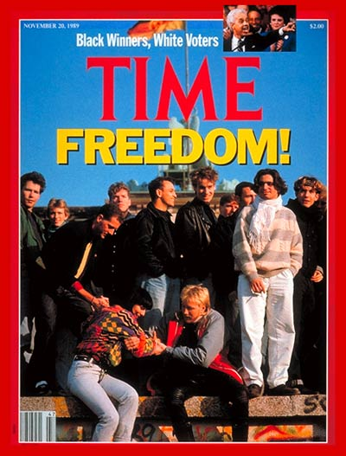
Fall of the Berlin Wall sets the stage for unifying Europe and EU enlargement

Slide 11
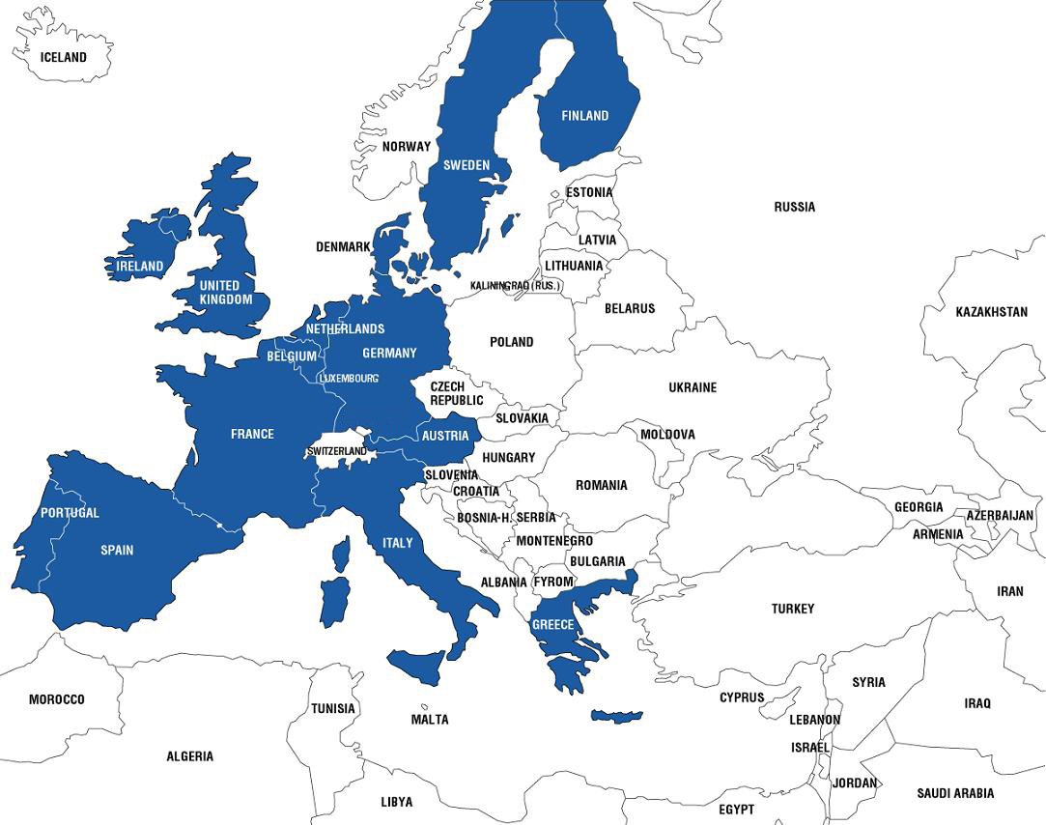
1995
Austria
Finland
Sweden

Slide 12
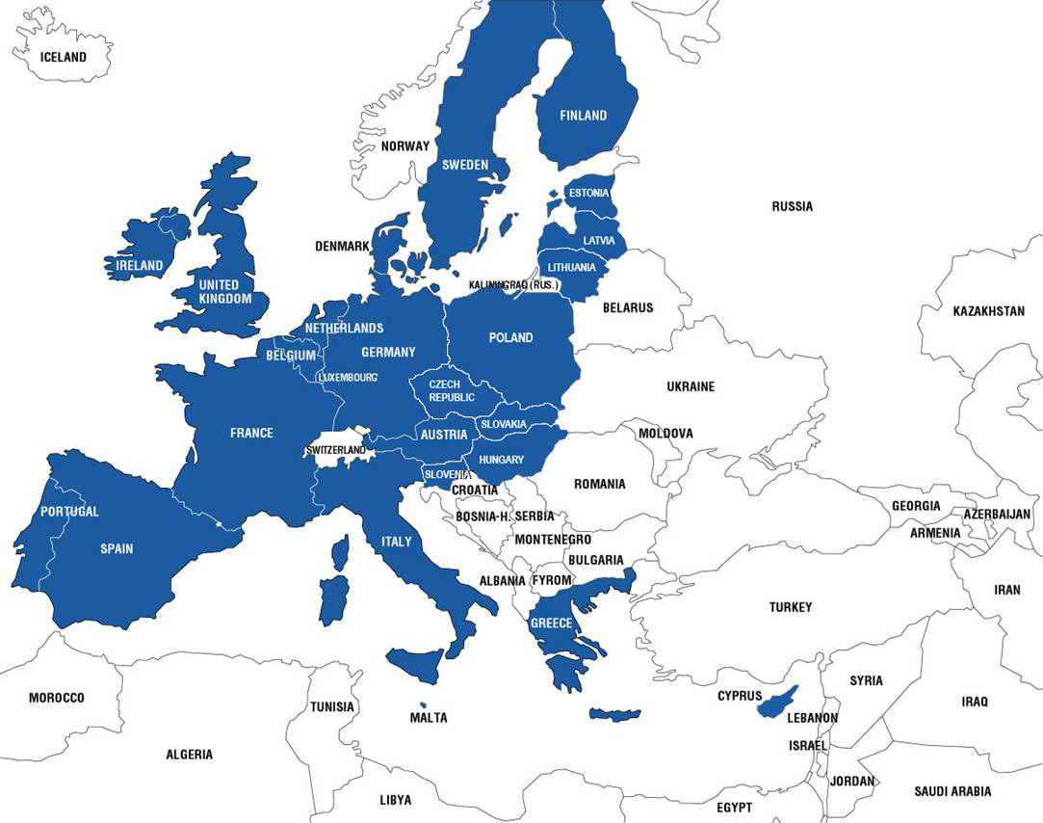
2004
Cyprus
Czech Republic
Estonia
Hungary
Latvia
Lithuania
Malta
Poland
Slovakia
Slovenia

Slide 13
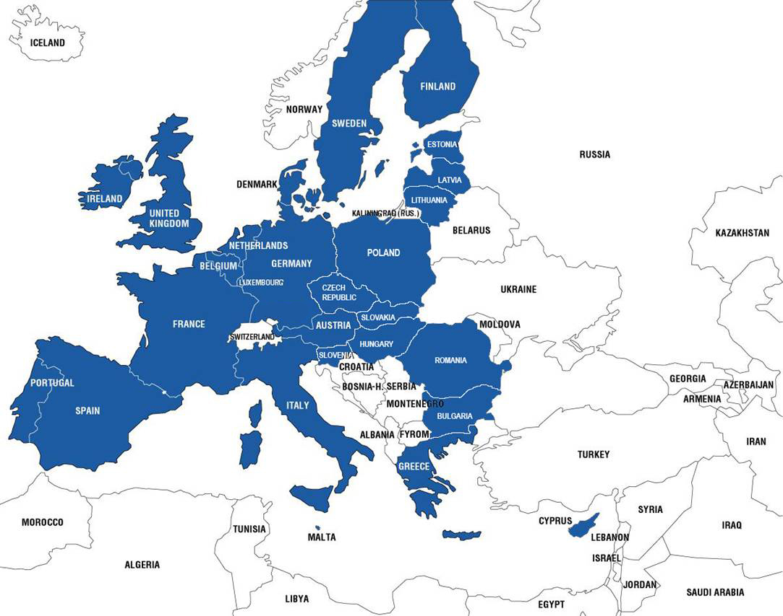
2007
Bulgaria
Romania

Slide 14
2016
Brexit
Britain votes to Exit the EU
(the only country to ever leave)

Slide 15
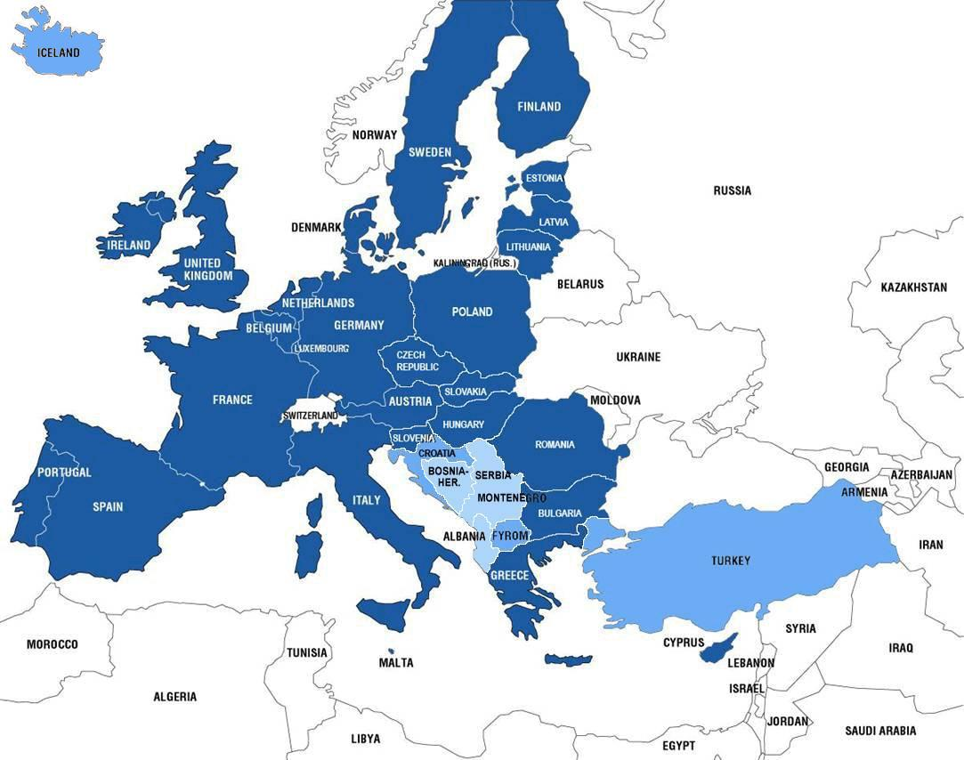
Candidate Countries
Croatia
former Yugoslav Republic of Macedonia
Iceland
Turkey
Potential
Candidate Countries
Albania
Bosnia & Herzegovina
Kosovo
Montenegro
Serbia

Slide 16
Other Key Points…
Before becoming a member of the European Union, what must a government have/do?
Have a strong economy
Be democratic
Respects human rights

Slide 17
THE EUROPEAN UNION
“United in Diversity”
The EU has united the citizens of Europe – while preserving Europe’s diversity.
Many ethnicities
24 languages
The euro (Even though many countries share the same currency, each country has its own design on the back.)

Slide 19
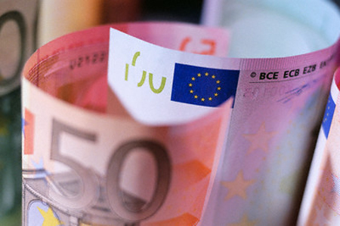
The €uro
€
€
In 1999, the Euro Zone was established as a currency in eleven of the then fifteen EU Member States.
Of the 28 EU Member States today, 15 have adopted the euro.

Slide 21
United in Diversity - The €uro

Slide 22
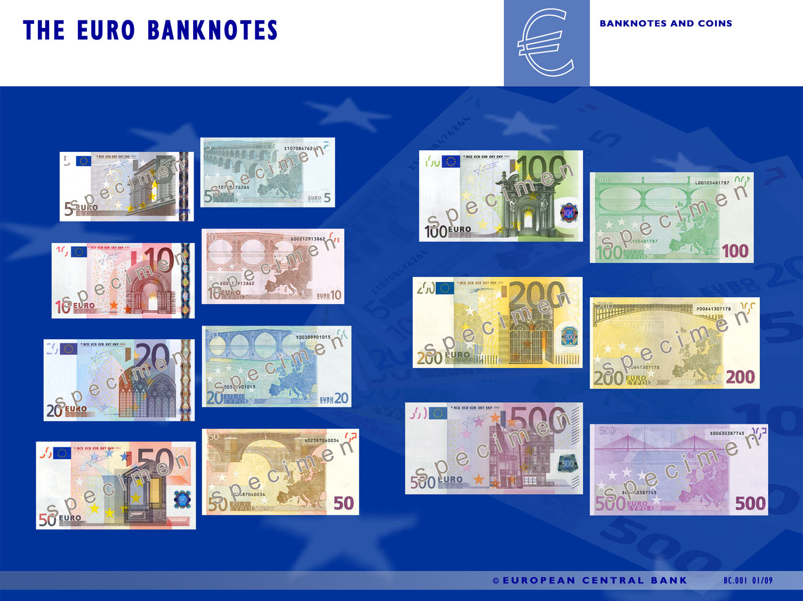
Windows, Doorways and Bridges on EU Notes symbolize connectedness and openness.

Slide 23
THE EUROPEAN UNION
The Benefits of the EU

Slide 24
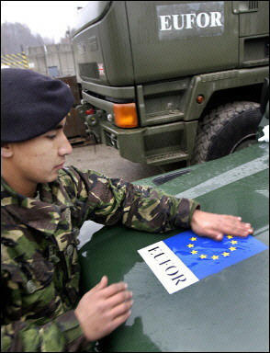
What else does the EU do?
1. Peace & Security
Works for global peace and security
Undertakes humanitarian and peacekeeping missions
Provides military forces for crisis management around the globe
2. Counterterrorism & Homeland Security
Improved intelligence sharing, enhanced law enforcement and judicial cooperation, curtailed terrorist financing.
Supports the struggle against terrorism.

Slide 25
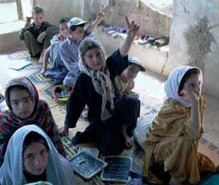
What else does the EU do?
3. Democracy & Human Rights
Works globally for free elections and open democratic processes
Fights racism and intolerance at home and abroad.
Campaigns globally against capital punishment (the death penalty)
4. Development Assistance & Humanitarian Relief
Provides billions of dollars in humanitarian aid to more than 100 countries in response to crises and natural disasters

Slide 26
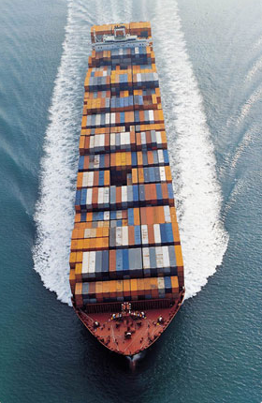
What else does the EU do?
5. Trade
Supports free trade and open markets
Promote growth and jobs in both industrialized and developing countries

Slide 27
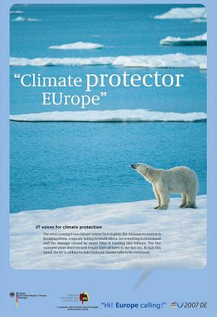
What else does the EU do?
6. Environmental Protection
Leader in protecting the environment
Fights against global warming with the adoption of binding energy targets (cutting 20% of the EU’s greenhouse gas emissions by 2020)
Source: German Information Center USA

Slide 28
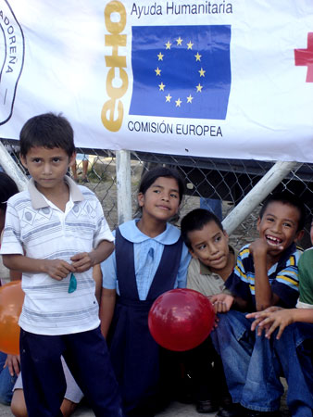
Shared Values and Responsibilities
7. Freedom & Democracy
Supports free elections, good governance, human rights, and the rule of law around the world.
8. Security
Cooperate to fight terrorism, limit the spread of nuclear weapons, and work for global peace.
9. Development
Together, EU and U.S. provide 80% of global development assistance and an even larger share of global humanitarian aid in times of disaster and conflict.

Slide 29
THE EUROPEAN UNION
Structure & Function

Slide 30
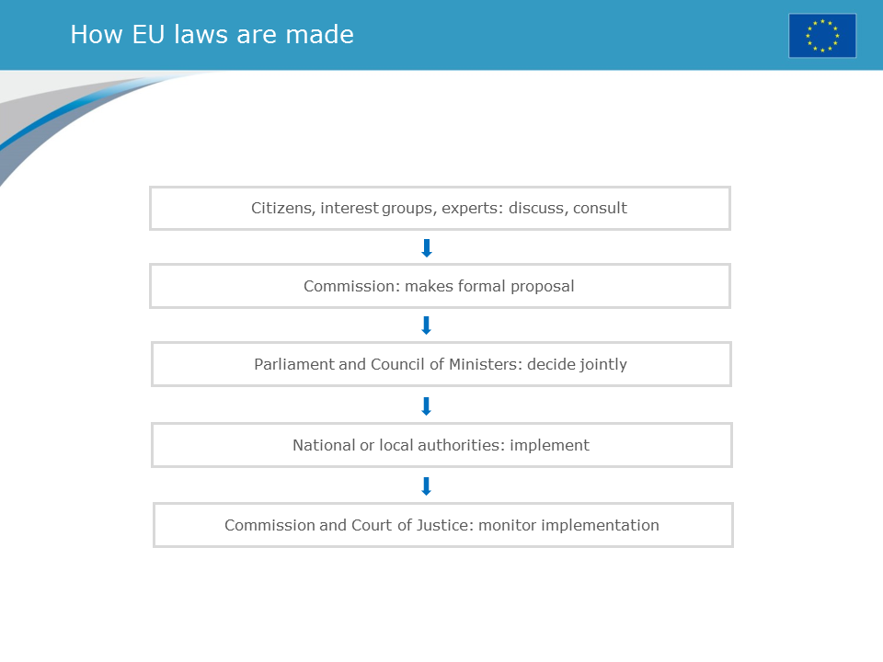

Slide 32
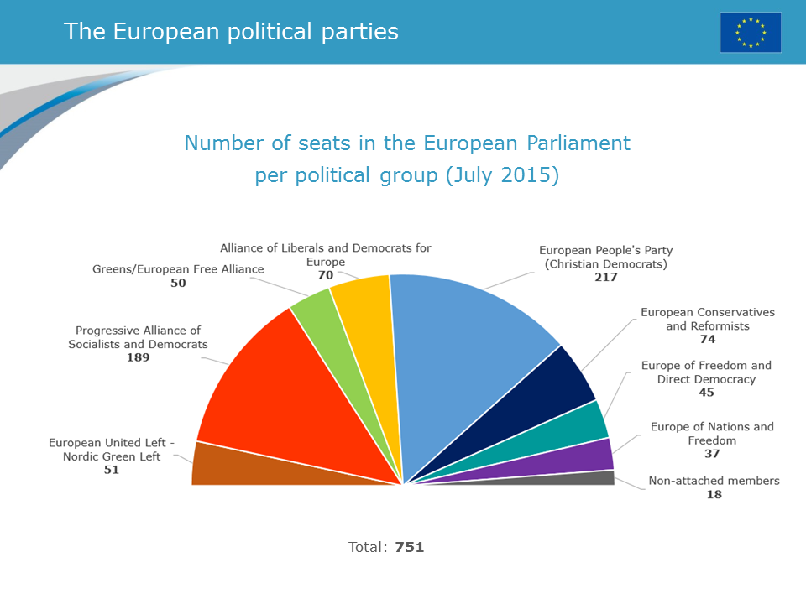

Slide 34
Why do you think they require a double majority?

Slide 37
THE EUROPEAN UNION
Unit Debriefing

Slide 38
Let’s talk…
What questions do you still have about the EU?
What did you learn about the EU?
What is your opinion of it? (Remember, please have facts to support your opinion.)
What do you think lays in store for the EU, considering all that you’ve learned about it? Why?
Did you find this simulation worthwhile? Why or why not?
What was challenging about it? Do you think these were challenges real political figures face?
What did you excel at during our mini-EU?
Did you develop any skills during this simulation? If so, what are they?
Finally, should we conduct this again next year?
If so, how could we improve it?

