Slide 1
EU MEMBER STATES AND CANDIDATE STATES EUROZONE SCHENGEN AREA

Slide 2
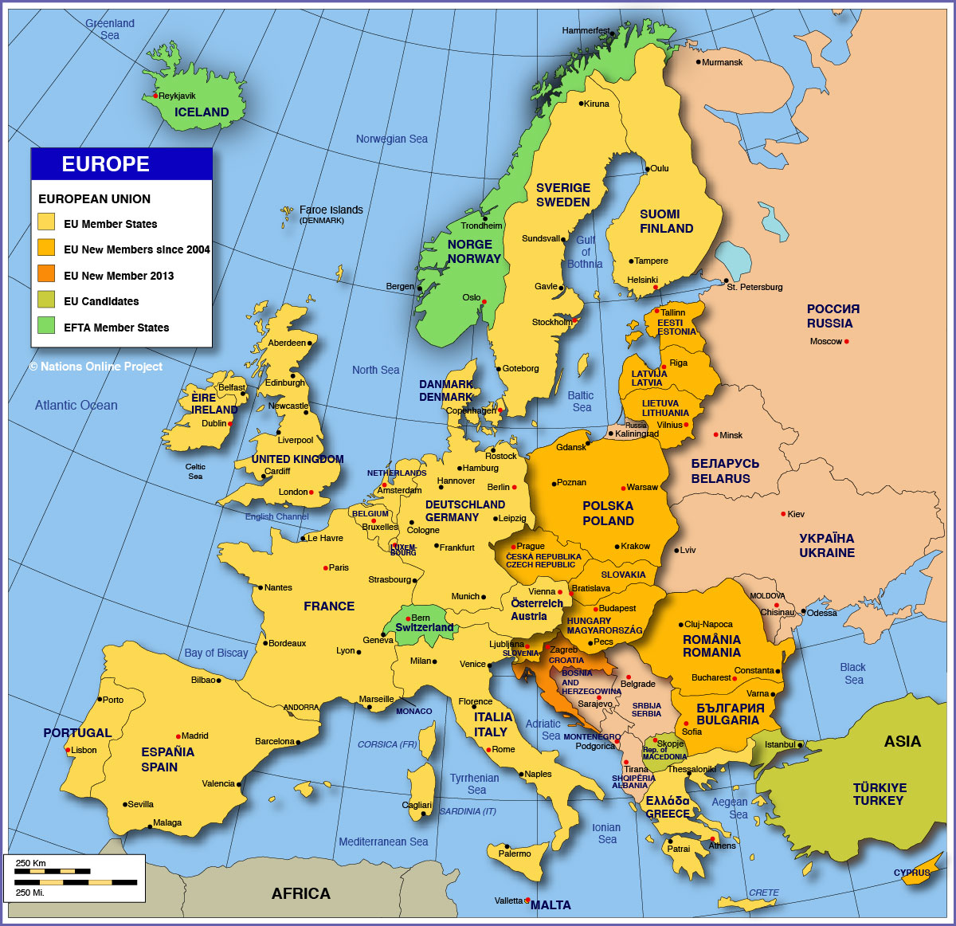

Slide 3
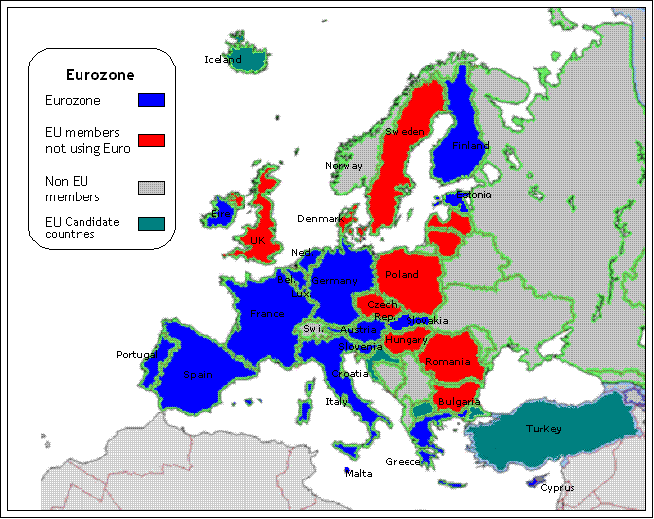

Slide 4
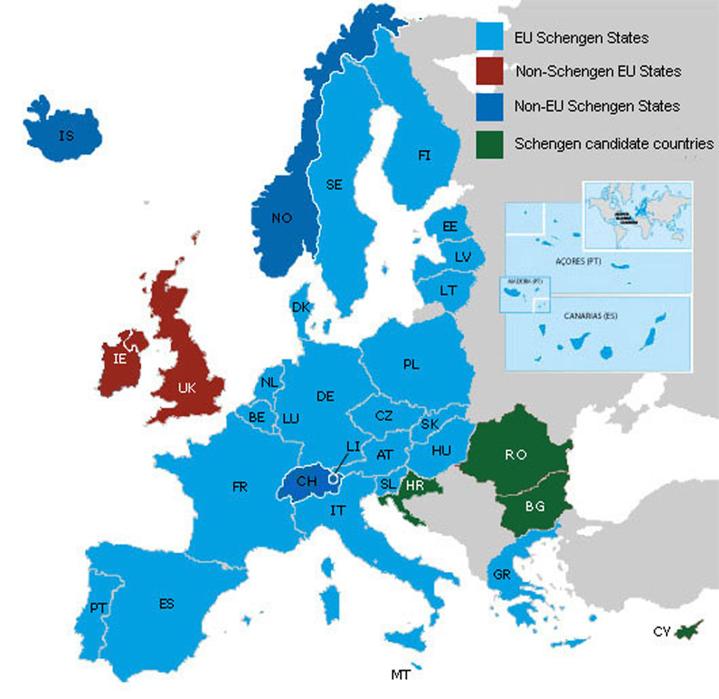

Slide 5
INTERACTIVE CHART OF EU ENLARGEMENT OVER 40 years
http://www.europarl.europa.eu/external/html/euenlargement/default_en.htm#accession2004

