Slide 1
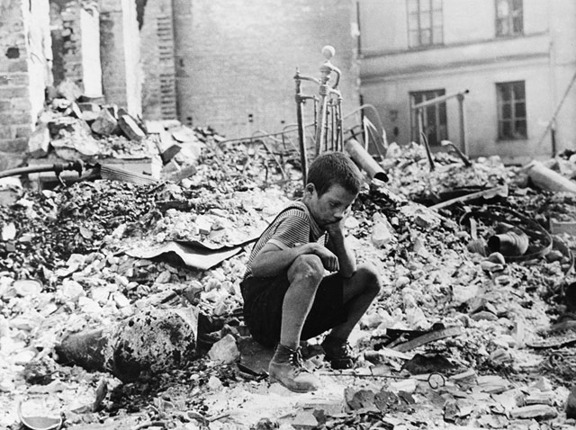
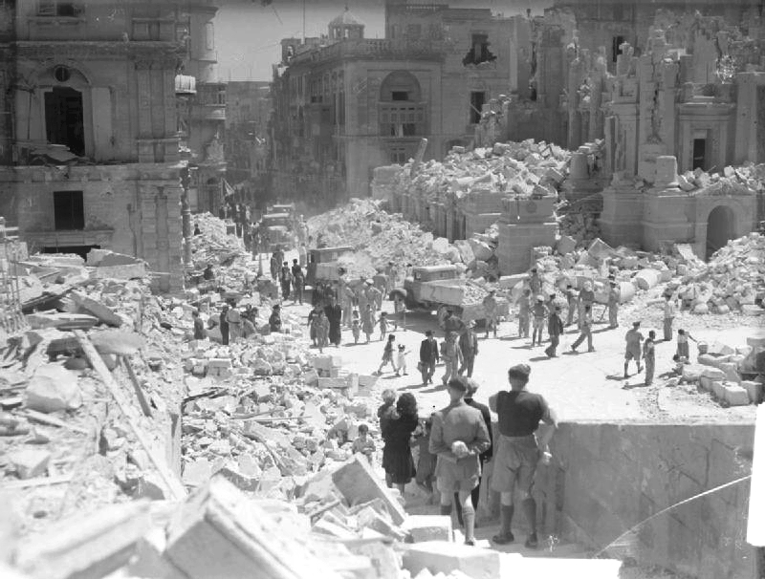
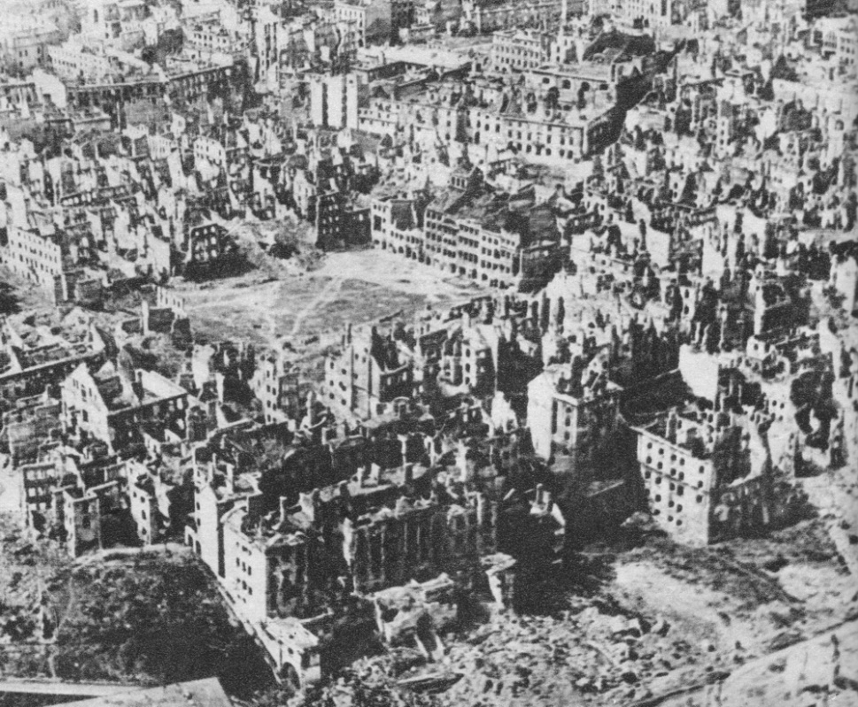
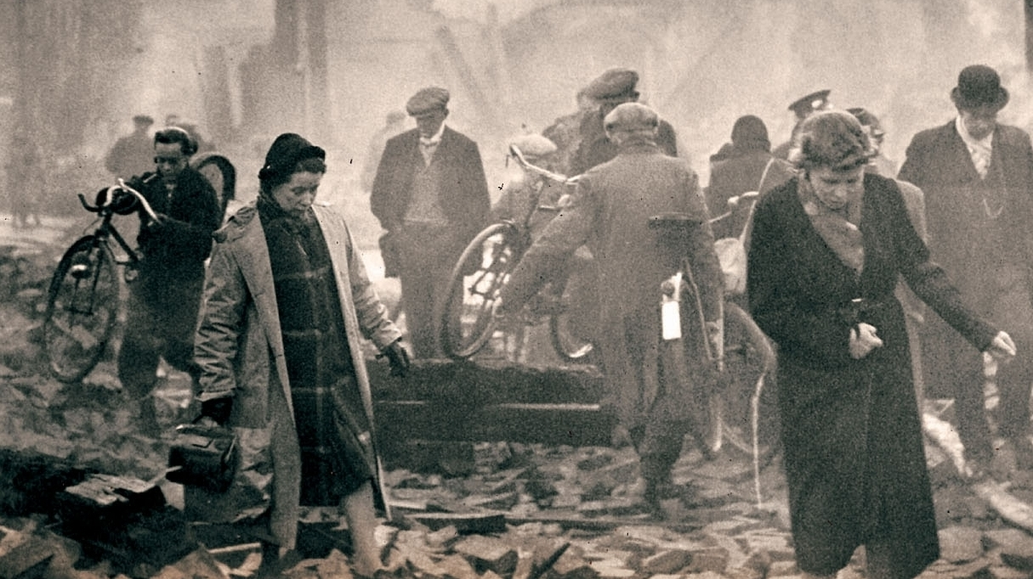
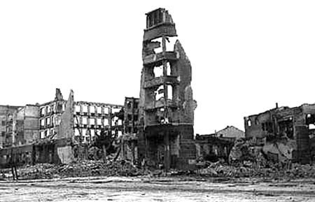
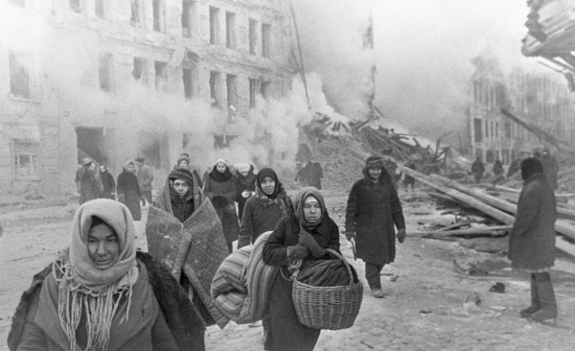
Welcome to Europe 1945

Slide 2
Please read “May 8, 1945: Peace in Europe” (PAGE 1 ONLY!)
Before you turn it over and read the back, does anyone have any ideas to share?
How can Europe prevent this kind of tragedy from happening a third time?

Slide 3
Unifying EUrope
Instead of studying how this happened, we’re going to live it!
Each Geography class will be assigned a country.
Yours will be: _________________________________
For tomorrow:
Read up on your nation (both the Nationality Sheet you each received but also check out the website if you are able).
Read the proposal for tomorrow & jot down answer to the questions.
Remember, to read carefully, think deeply, ask questions, and come prepared.
This is all new and will seem challenging at first, but no one said saving Europe from disaster would be easy!
Notes:
The hyperlink on the website is for the If It Were My Home website the students are encourage to use to research tonight.

Slide 4
Getting to Know you
Share the following information about your country:
What did you learn about it’s economy (how it makes money and gets the things it needs)?
What did you learn about it’s government (the people in charge)?
What strengths does your nation have?
What are its weaknesses?
What issues are going to be the most important for your nation during this simulation?
Any questions before we begin?

Slide 5
EU Simulation
In class you will learn about the proposals, debate the issues, and prepare for our European Union Parliament plenary sessions (during AM homeroom).
You will have homework (20-30 minutes) most nights. It is essential you do this, so you can take part the next day!
During the plenary sessions, we will have 5 minutes to form into parties (sit with party members not your countrymen) and 5 more minutes to determine speakers from each party.
Each party will have 2-3 minutes to make their case.
Each of the other parties will then have 1-2 minutes (combined) to ask questions of that speaker.
Finally, we will hold a vote on the proposal.
If time permits, we will discuss the outcome.

Slide 6
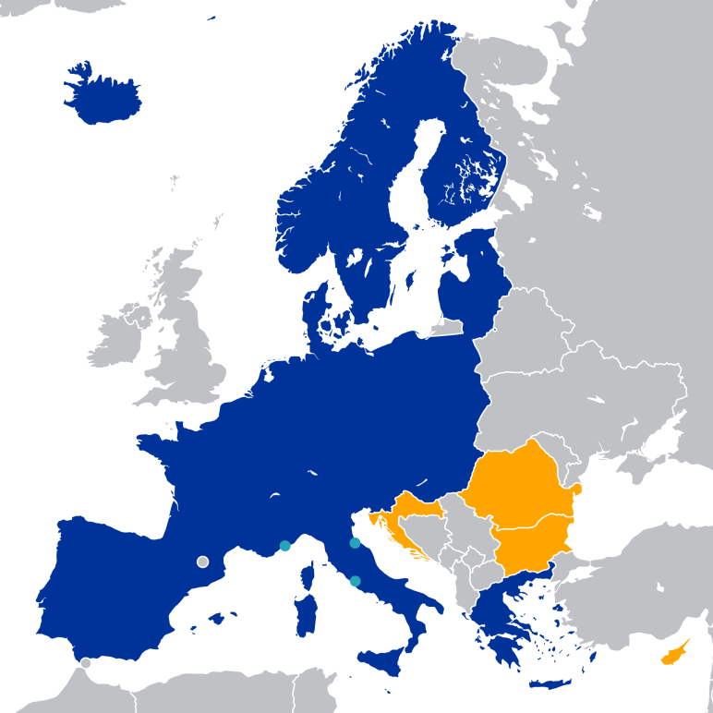
The Schengen Area
What is it?

Slide 7
Schengen Area
Pros?
Cons?

Slide 8
Schengen Area
What is the best thing for your country to do?
Join?
Opt out?
Why? (Defend your choice with facts!)
Once you have decided, join up with your countrymen who share your opinion and begin to develop your argument. (Remember, you must have facts to justify your opinion!)
We’ll be debating and voting on this issue during homeroom tomorrow morning.
Homework: Prepare for debate & vote. If you finish early, read and answer questions for tomorrow’s proposal.

Slide 9
Schengen: DeBriefing
Did our EU form the Schengen Area?
Will our nation join it? For: _____________ Against:________________
Let’s see who joined in “real life.”
Let’s hear the state of the Schengen Area over 30 years later.
Closing Thoughts on the Issue?
Notes:
The first hyperlink is to the EU website where there is an interactive map the kids can scroll over on the SmartBoard to see if there country joined.
The second hyperlink is to an NPR news clip (approx. 3:23 min.) about the Schengen Area from 2016.

Slide 10
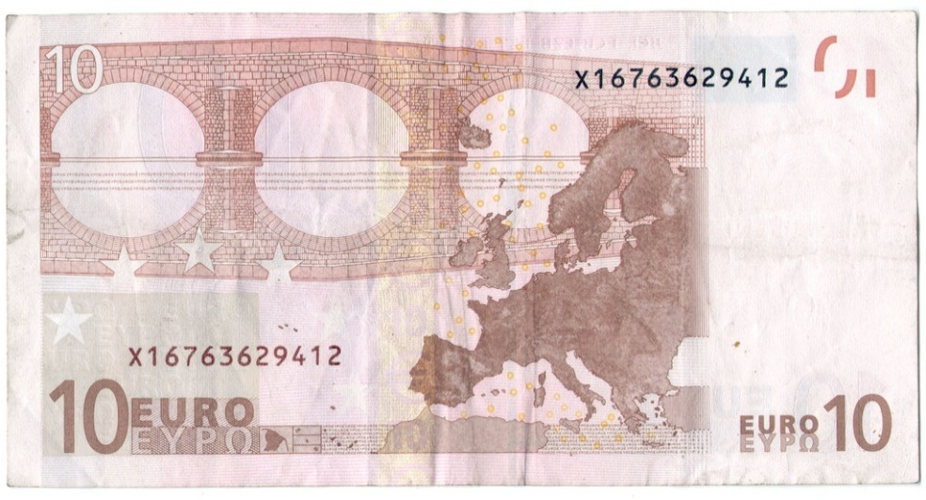
The Euro Zone
Proposal #2

Slide 11
The Euro Zone
What is it?
Can anyone explain the big boat vs. little boat analogy from your reading?

Slide 12
Euro ZOne
Pros?
Cons?

Slide 13
EURO Zone
Should we form a Euro Zone?
Why or why not?
Should our country join it?
Why or why not?
Join with your like-minded countrymen and prepare to debate and vote tomorrow.
Homework: Prepare for the debate on the Euro Zone.

Slide 14
The Euro Zone: Debriefing
Did our EU form a Euro Zone?
Will our nation begin using the Euro? For: ____ Against: ______
Why or why not?
How did the euro idea come about?
What happened in the “real world”?
Notes:
The first hyperlink is of a 2 minute synopsis of the Euro Area forming.
The second is of a PDF of the Euro Zone so they can see if their country joined.

Slide 15
The Debt Crisis
We’re going to watch a video to get started, but before we do, we’ll need to jot down a few key terms on your sheets:
Interest Rate--the percentage of the money loaned that you pay to the lender as a fee; it is set based upon how big of a risk it is
Inflation--the increase in the amount of money and the decrease in the value of money
Monetary (how much money is in the economy) vs. Fiscal (how much they tax and spend)
Deficit Spending--Spending more than you make; creates debt
Default--failure to fulfill an obligation, like paying back a loan

Slide 16
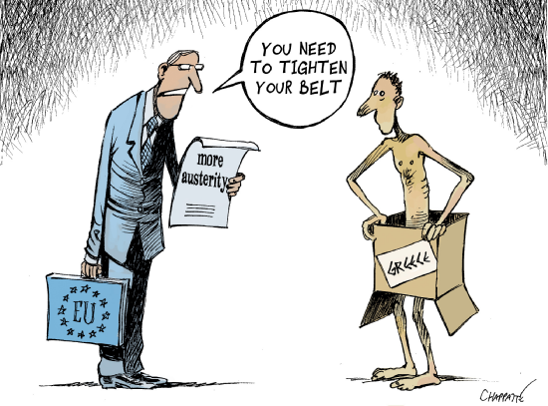
The European Debt Crisis
Let’s learn about it!
Discussion Questions:
Why would richer countries be able to get “cheaper loans”? Why can’t poorer countries do the same? How did the the Euro Zone change this?
What happened in 2008?
What is austerity?
Why do some believe that austerity will fail to balance a budget?
Notes:
If time doesn’t permit the longer video and discussion, we can use this one: https://www.youtube.com/watch?v=ULQiCN0YNmw
Answers:
2. The U.S. Housing Crisis collapsed and the lending became difficult. Greece--and the other debtor nations--couldn’t get loans and it made their cycle of deficit spending collapse.
3. taxing more, cutting spending/services to pay back loans
4. people have less money, they spend less, which results in less tax collect-->makes the debt crisis worse

Slide 17
The Debt Crisis
Homework: Read Proposal #3—The Debt Crisis and the article on Greece. DO NOT answer the questions yet!
We’ll discuss in class tomorrow and then you can answer the questions.
The debate/vote will take place the following morning.

Slide 18
The Debt Crisis
Can someone explain the analogy of a house on fire from your reading last night?
What are our thoughts on the different solutions:
Austerity?
Bail-Out?
Leave the Euro Zone/EU?
Strengthen the Euro Zone/EU?

Slide 19
The Debt Crisis
Any Questions?
Join with your countrymen who agree with your approach to this crisis. Develop your argument:
What should we do?
Why? (Use facts)
Prepare to answer questions from the opposition.
Homework: If you get done early, please Proposal #4—Migration Crisis. You DO NOT need to answer the questions yet though.

Slide 20
Debt Crisis: Debriefing
What should we do about the Debt Crisis:
Make the debtor nations institute austerity?
Give them a bail-out?
Kick them out of the EU?
Strengthen the rules of the EU?
How does our country feel about using the Euro now? Why?
Do we still want to take part? Why or why not?
What happened in the real world?
Notes:
Answer to the final question: The Greeks stayed, they have gotten 3 bail-outs but have also had to impose austerity measures that have been very unpopular. Things are not as bad as they were but they are still fairly devastating to the Greeks. (see more detailed print-out if need be).

Slide 21
A Migration Crisis
Let’s review the two introductory articles together & discuss them:
Why is this happening?
What exactly is happening?
Begin to brainstorm what we should do.
Homework for Tomorrow:
Finish brainstorming (write down your ideas)
Check out the two link about migrants for more information.
We’ll discuss tomorrow.
The debate and vote will not be until the following morning.

Slide 22
The Migration Crisis
You have 15 minutes to meet with classmates, discuss ideas, and form parties on this issue.
Our vote will be tomorrow morning, so prepare to debate.

Slide 23
Exit from the EU
For the second half of class we will begin discussing our final proposal, which involves Britain’s referendum on exiting the EU.
Let’s hear the arguments for both sides—Leave & Remain:
The Debate
Leave Commercial
Remain Commercial
While we watch, make sure to jot down notes in your chart.
Homework: Read the proposal and brainstorm.
Notes:
During the debate only watch the following clips:
4:00-5:15
5:30-6:51
7:35-9:05
40:18-42:59
1:11:41-1:13:18

Slide 24
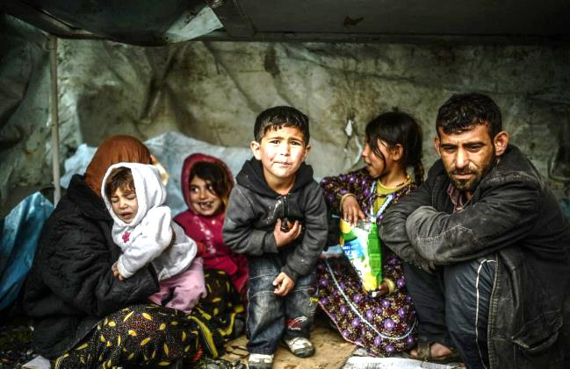
The Migration Crisis: Debriefing
What did we decide to do?
Do we think it will help? Why or why not?
What did Europe decide to do?
Well, they’re still trying to figure it out.
Some countries have agreed to take more immigrants.
Others have closed their borders.
More aid has been sent.
But, no major solution has been found unfortunately.

Slide 25
Exit from the EU
UK→ Do we want o stay or go? Why?
Other nations→What happens if the UK decides to leave?
How should we handle it?
Does this raise other concerns moving forward?
UK→What do we do if we vote to leave?
Other nations→Do we want to remain in the EU?

Slide 26
Exit from the EU: Debriefing
Which countries decided to leave? Why?
Which countries decided to go? Why?
How should the EU deal with this moving forward?
What happened in the real world? Well, your homework has the answer…
Homework: Read the article on Brexit. Begin to review this unit.

Slide 27
Job Well Done!
Our simulation is over. Let’s see what we’ve learned.

