Slide 1

The Vietnam WAR and Inside Out & Back Again
EXPLORING THE
ASIAN DIASPORA
October 2, 2019
K-16 Curriculum Workshop

Slide 2
Vietnam terms for educators
French Indochina
Ho Chi Minh
Vietminh
Hanoi
Vietcong
Saigon
Domino effect
Battle of Dien bien Phu
Geneva Conference
John F. Kennedy
Lyndon B. Johnson
Napalm
Agent Orange
Tet Offensive
Richard Nixon
Vietnamization
Ho Chi Minh Trail
Fall of Saigon
Vietnamese Boat People
Operation New Life

Slide 3
Vietnam War: context & synopsis
In the late19th century, the present-day countries of Vietnam, Laos, and Cambodia made up the French colony of Indochina.
These lands were desirable to the French because of their fertile rice lands (Mekong and Red River deltas and coastal lowlands) and natural resources of rubber, silk, and spices.
Under French colonial rule, Indochina suffered greatly: high illiteracy rates, religious persecution, poor healthcare and infrastructure, corrupt governance.

Slide 4
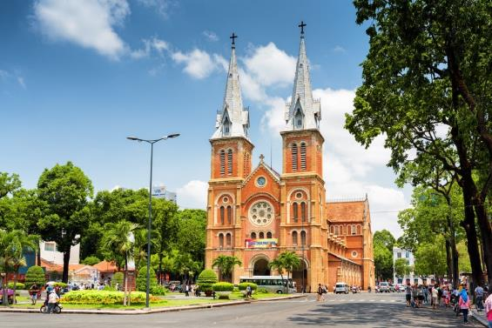
French imperialism in Indochina
French colonial administrator is pulled by a Vietnamese rickshaw driver.
Notre Dame Cathedral Basilica of Saigon

Slide 5
Ho Chi Minh
Ho was a nationalist and a communist, whose name means “He Who Enlightens.”
His appeals for Indochina’s sovereignty were rejected by President Wilson at post-World War I Paris Peace Conference.
He lived in China and the Soviet Union where he was influenced by communist doctrine.
He formed the League for the Independence of Vietnam, or the Vietminh, which became the military power of communist north Vietnam, whose capital was Hanoi.
Both US presidents Truman and Eisenhower saw Ho as a threat to U.S. Cold War goals and sought to topple him, however unsuccessfully.

Slide 6
Indochina War
The domino effect, or Cold War fear that if one region (Indochina) became communist, others surrounding it would as well, justified Presidents Truman and Eisenhower’s decision to support and aid the French quest to maintain Indochina as its colony after World War II ended.
In the Indochina War, the French forces were defeated at the (in)famous Battle of Dien bien Phu, and Indochina was seemingly freed of its French colonial masters.
However, the Geneva Conference, organized by the western nations as overseers of Indochina’s transition from colony to sovereign nation, convened in 1955, and divided Vietnam in half at the 17th parallel for what they claimed would be two years, after which time democratic elections would be held to re-unify Vietnam.

Slide 7
The Unwinnable War in Vietnam
Vietnam remained divided, and in 1962, the new U.S. president John F. Kennedy, sought to bolster his Cold War foreign policy credentials and legitimacy by increasing U.S. military advisors in Vietnam more than ten-fold, and authorizing U.S. forces to engage in direct combat there.
After President Kennedy’s assassination, his successor, Lyndon B. Johnson, escalated U.S. involvement in the war with massive bombing campaigns in Vietnam and the use of chemical weapons in the form of Napalm, a chemical gel that burned its victims, and Agent Orange, which was sprayed over jungle foliage to de-nude the dense ground cover in which the Vietminh and their south Vietnamese compatriots, the Vietcong, were hiding and waging guerilla warfare against U.S. soldiers.
By the end of Johnson’s presidency in 1967, however, victory in Vietnam seemed no closer than it did in 1963 when Kennedy was assassinated.
U.S. popular opinion turned against the war in 1968 during the Tet Offensive, when the Vietminh and Vietcong coordinated massive strikes during the Vietnamese Tet New Year against countless South Vietnamese villages, more than 100 cities, 12 U.S. military bases, and the U.S. embassy in South Vietnam’s capital, Saigon.

Slide 8
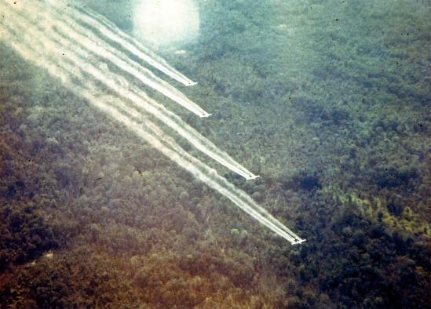
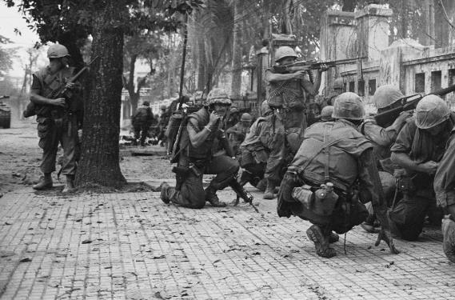
The Unwinnable War in Vietnam
American military airplanes spray Agent Orange defoliant over Vietnamese jungles.
American forces defend U.S. military headquarters in Saigon during the Tet Offensive.

Slide 9
America loses Vietnam
When Richard M. Nixon was elected in 1968, he promised to secure U.S. withdrawal from Vietnam in what he called “peace with honor” through Vietnamization, or incrementally turning Vietnam back to the responsibility of the Vietnamese.
However, first Nixon secretly bombed neighboring Cambodia due to evidence that they were supplying the Vietminh and Vietcong with weapons via the Ho Chi Minh Trail, or underground communist networks and supply lines.
Most U.S. forces, now demoralized and even vilified back in the U.S., withdrew from Vietnam by 1973.
Two years later, in April, 1975, Vietminh and Vietcong troops overran South Vietnam, which surrendered unconditionally in the Fall of Saigon.
The more than two million Vietnamese refugees, including the family of Thanhha Lai, who fled their country between 1975-1995 were known as the Vietnamese boat people or Thuyền nhân Việt Nam.
Under the U.S. government program, Operation New Life, more than 100,000 Vietnamese refugees were transported to the island of Guam, where they were housed in tent cities for several weeks and then processed for re-settlement, mostly to the United States.

Slide 10
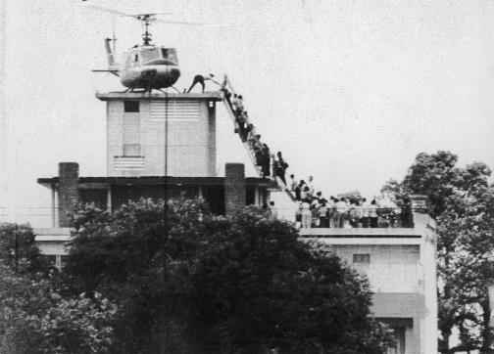
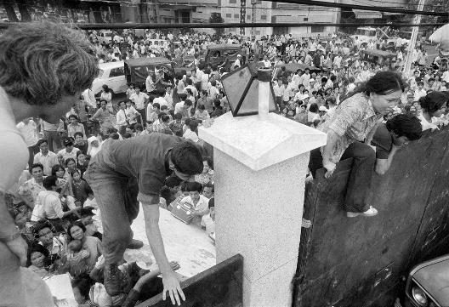
The Fall of Saigon

Slide 11
Components of this workshop:
Grades K-8 mini-lesson on being “other”
Grades 9-16 mini-lesson on different perspectives on Vietnam
Grades 9-16 analysis of poems through themes, terms, and quotes

Slide 12
K-8 mini-lesson on being “other”
Tell students that they are going to listen to some poems about a girl named Ha who came to the United States to escape a war.
Use the map on the left to generate discussion about why why this might be difficult for Ha or for anyone.

Slide 13
Why Might This Change be Difficult?
Why might Ha be treated unkindly?
Ha looks different than her classmates
Ha speaks a different language
Ha lives far away in a country that looks different and lives in a different way from Americans.

Slide 14
Pre-reading questions for Feel Dumb
Ask
Ask students to think about the poem’s title and why the author made this the title of the poem.
Tell
Tell the students to listen for the ways that the English language is a barrier or obstacle for Ha, what she does about it, and how it makes her feel.
Wonder
Ask the students to put themselves in Ha’s shoes and think about how they would feel in this situation.

Slide 15

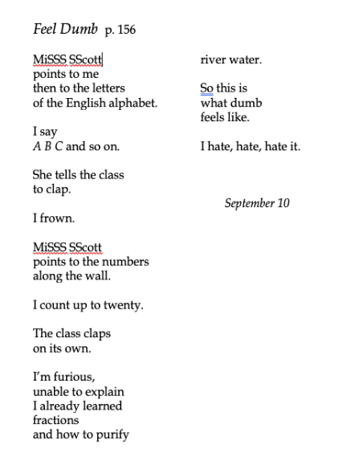
Feel Dumb p. 156

Slide 16
Vietnamese Alphabet
“Put yourself in Ha’s shoes”
Which letters are the same as the English alphabet and which are different?
Would learning this new language be easy or difficult?
Listen here

Slide 17
Excerpt from the film“Foreign Letters”
Foreign Letters excerpt from 10:35-13:58
Here

Slide 18
Grades 9-16 mini-lesson on different perspectives on Vietnam
The two poems, War & Peace and MiSSSisss WaSShington’s Response, present an opportunity for educators to explore with students how one’s experiences with place can shape their perspectives and opinions.
Vietnam is interpreted in extremely different ways in the two poems, and students can ask how Vietnam is interpreted in each poem, why it might be interpreted in this way, and what the effects of these contrasting perspectives lead to.

Slide 19
Poem Analysis Worksheet
Poem | War & Peace | MiSSSisss WaSShington’s Response
How is Vietnam interpreted?
Why might it be interpreted in this way?
What effect does this interpretation have?

Slide 20
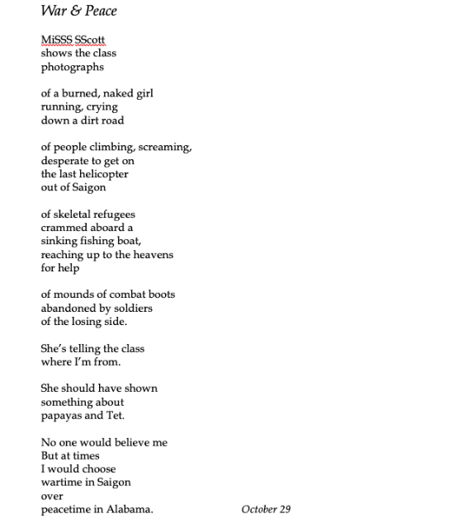
War & Peace p. 194

Slide 21
“Napalm Girl”
“Of a burned, naked girl running, crying, down a dirt road.”

Slide 22
The Fall of Saigon
“Of people climbing, screaming, desperate to get on the last helicopter out of Saigon.”

Slide 23
Vietnamese Boat People
“Of skeletal refugees crammed aboard a sinking fishing boat, reaching up to the heavens for help.”

Slide 24
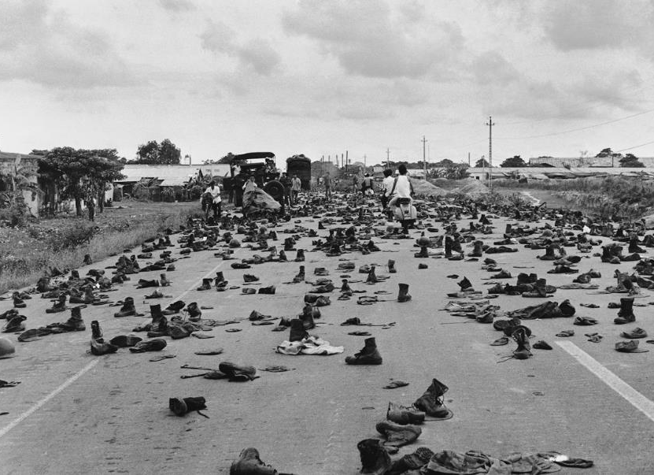
Combat boots abandoned by South Vietnamese soldiers outside of Saigon.
“Of mounds of combat boots abandoned by soldiers of the losing side.”

Slide 25
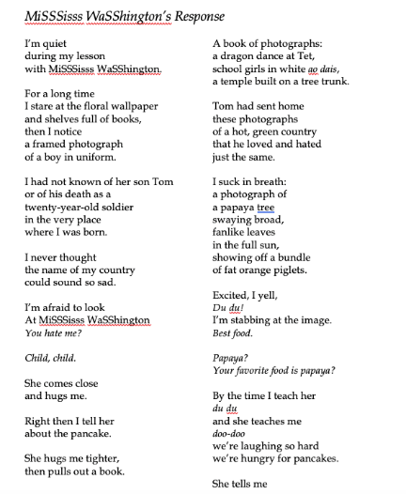

MiSSSisss WaSShington’s Response, p. 200

Slide 26
“A Dragon dance at Tet”

Slide 27
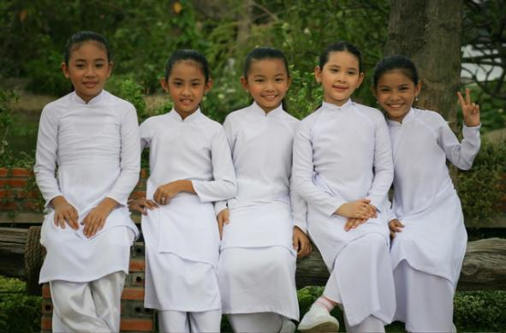
“school girls in white ao dais”

Slide 28
“A Temple built on A tree trunk”

Slide 29

Papaya Tree, Vietnam

Slide 30
Dear America: Letters Home from Vietnam
(at 23 minutes): https://www.dailymotion.com/video/x6hhhme

Slide 31
Grades 9-16 analysis of poems through themes, main ideas, terms, and quotes: Poetry Analysis Worksheet
Poem | Bridge to the Sea | Quiet Decision | Saigon is Gone | Tent City | Choose | Alabama | English Above All
Why is this the title?
Theme(s) |  |  | Displacement, Vietnam War, Refugees, Loss |  | Diaspora
Main idea |  | Ha’s family decides to leave Vietnam.
Applicable terms |  |  |  |  |  | Operation New Life
Quotes | “I will not risk fleeing with my children on a rickety boat.”; “when the time comes, this house is our bridge to the sea.” |  |  | “We have landed on an island called Guam”; “Many others arrived before us and are living in green tents and sleeping on cots.” |  |  | “Until you children master English, you must think, do, wish for nothing else.”
What do you want to know more about?

Slide 32
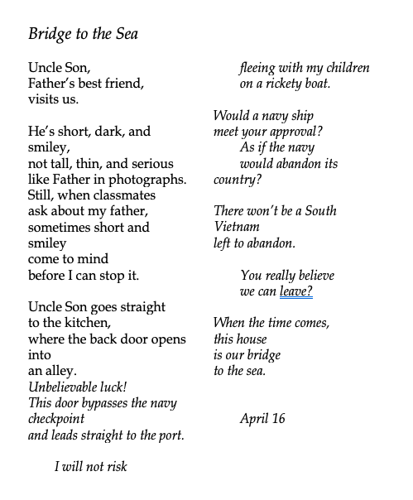
Bridge to the Sea p. 42

Slide 33
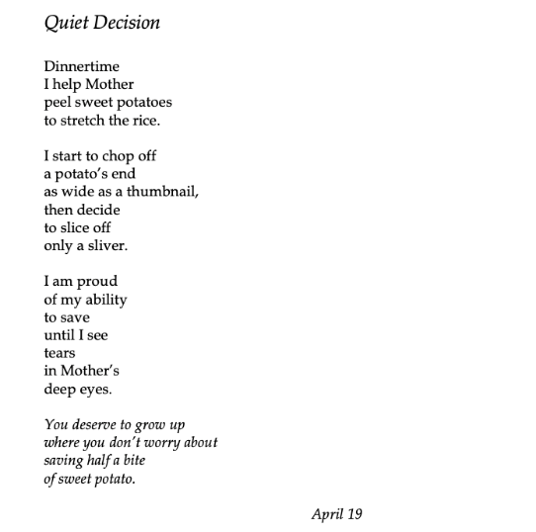
Quiet Decision p. 47

Slide 34
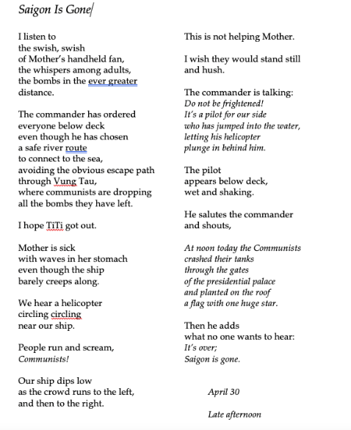
Saigon is Gone p. 67

Slide 35
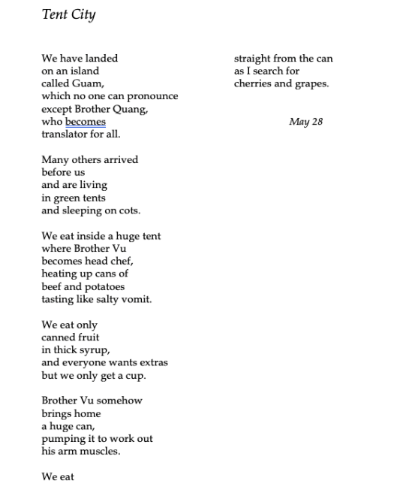
Tent City p. 96

Slide 36
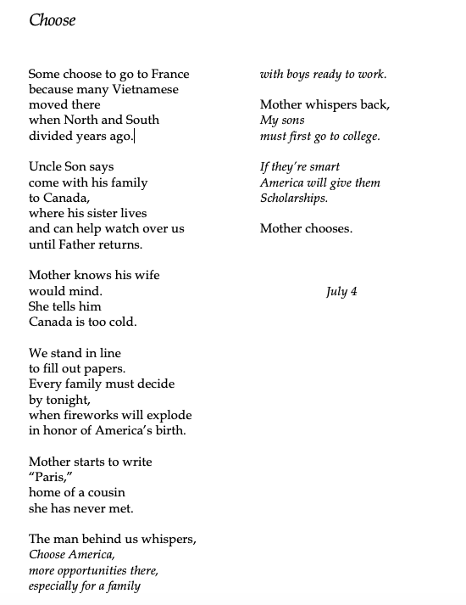
Choose p. 105

Slide 37
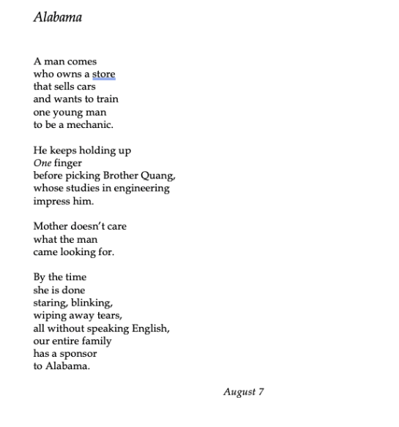
Alabama p. 109

Slide 38

English Above All p.116

Slide 39
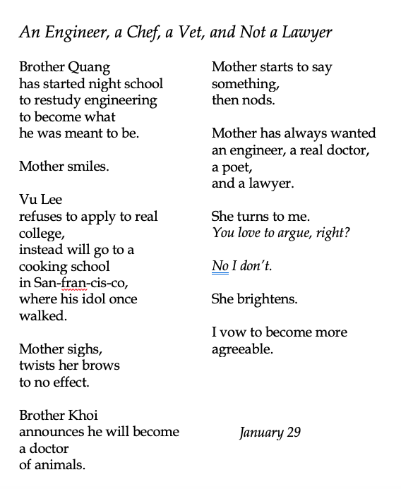
THE FRUITS OF DIASPORA: An Engineer, a Chef, a Vet, and Not a Lawyer

