Slide 1
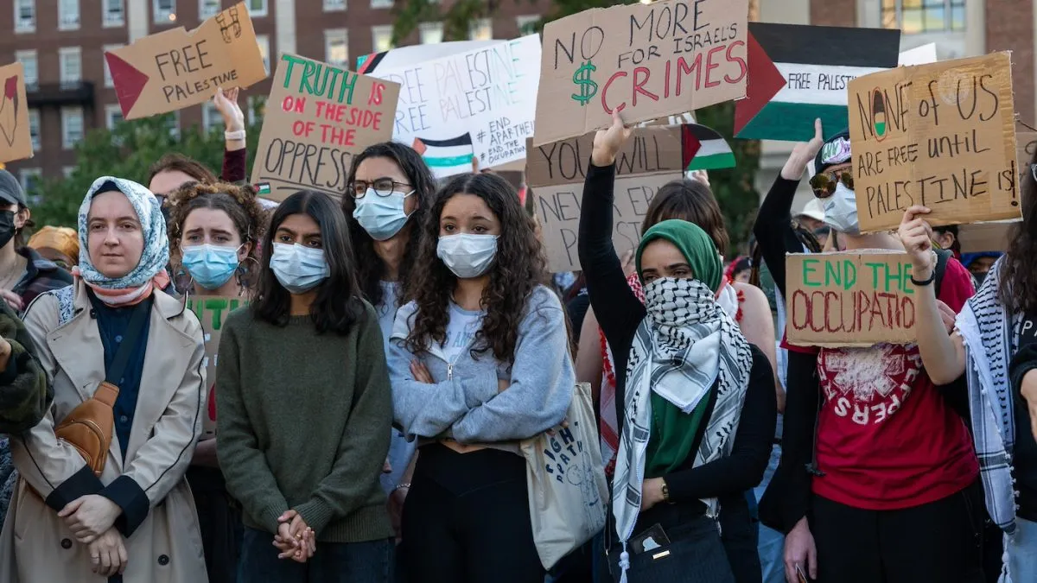

Slide 2
culmination
noun
The highest point or final stage of development, often reached after a long process or series of events.
escalating
verb
To increase or become more intense, especially in a way that is dangerous or harmful.
condone
verb
To accept or allow something that is wrong or morally unacceptable.
animosity
noun
Strong hostility or dislike, often accompanied by a feeling of hatred.
equivocating
verb
To use ambiguous language to avoid giving a clear or direct answer.

Slide 3
The text describes the controversy that erupted on American college campuses in the wake of the 2023 Gaza War, with students on both sides of the Israeli-Palestinian conflict engaging in heated protests and debates.
The center of the bubble map has a main idea from the reading to help get you started. Fill in the connecting bubbles with terms, concepts, and two visuals that connect to the reading. Explain the connections you made below. “_____ connects to the reading because_____”
Explain the connections you made above in your own words.

Slide 4
The conflict over the conflict led to accusations of anti-Semitism on campuses, with Jewish students feeling unsafe and targeted.
The center of the bubble map has a main idea from the reading to help get you started. Fill in the connecting bubbles with terms, concepts, and two visuals that connect to the reading. Explain the connections you made below. “_____ connects to the reading because_____”
Explain the connections you made above in your own words.

Slide 5
NEWS REPORT: We begin with breaking news. The Israeli military is warning that a number of militants have infiltrated Israeli territory from Gaza.
NEWS REPORT: A barrage of rockets being fired from Gaza, reaching as far as Tel Aviv and West Jerusalem. They’ve never seen such an amount of rockets at the same time.
SHABBOS KESTENBAUM (HARVARD DIVINITY SCHOOL STUDENT): October 7th was the Jewish joyous holiday of Simchat Torah. I’m an orthodox Jew, meaning on the Sabbath, on Jewish holidays, I don’t use electronics, including my phone. Rumors began circulating that there was a terror attack in Israel. I lived in Israel.
I have four siblings who currently live in Israel. My grandparents, aunts, uncles. So, I, I break the Sabbath for the first time in my life on the night of October 7, frantically trying to locate my siblings, seeing if, if they’re alive or not. I was not alone. There were dozens of other Jewish students at Harvard doing the exact same thing, frantically locating their, their loved ones.
NEWS REPORT: Hamas has launched a surprise attack within Israel’s borders.
NEWS REPORT: Palestinian gunmen are inside Israeli cities and towns.
NEWS REPORT: …the death toll in Gaza spiral as Israel continues to retaliate. So far, at least 198 Palestinians have been killed…
NARRATION: In those very first hours, at Harvard, a group of Palestinian student activists began discussing how to respond.
LEA KAYALI (HARVARD LAW SCHOOL STUDENT): I had a conversation with my dad that day, and he was like, 50,000 Palestinians will be killed because of what happened on October 7th. And I remember at the time being like, Baba, you’re crazy. Like, that’s not going to happen because we hadn’t seen anything like that in our lifetime.
NARRATION: They were members of a group called Harvard Law School Justice for Palestine, and for years they had been protesting Israel’s treatment of Palestinians.
ISRAA ALZAMLI (HARVARD LAW SCHOOL STUDENT): So we felt like it was necessary to get out some sort of statement, like, immediately, because we saw what was happening and we felt like there were two, like, really urgent needs. One was to, like, contextualize what’s happening. And two, we were scared and we felt like there was a real urgent need to warn people to, um, stand in unwavering, you know, solidarity against retaliation that was going to kill thousands of people.
NARRATION: The statement, signed by a coalition of more than 30 student groups at Harvard, began with the line “We, the undersigned student organizations, hold the Israeli regime entirely responsible for all unfolding violence.”
There was no mention of Hamas.
ISRAA ALZAMLI: It’s this idea of, like, if something horrific happens, why and what are the circumstances that lead someone to do something like this? And where does that responsibility lie? And when we’re talking about Palestine and the circumstances in which Palestinians are living, it’s, it’s, they are living under Israeli oppression. And what is happening, um, is they’re, they’re in a pressure cooker, and you think: what is a response that could occur in this pressure cooker?
JAMES JACOBY: Did you contemplate whether to mention Hamas at all?
TALA ALFOQAHA (HARVARD LAW SCHOOL STUDENT): It just didn’t really seem like the purpose of our statement. Like, I think, again, we wanted to contextualize it in a broader structure. I think Hamas is a, like, manifestation of the structure.
MALE VOICE: I was appalled when I saw that letter. The absolute last thing you do is blame the victim.

Slide 6
NARRATION: How the university would respond would set the stage for the months of turmoil to come.
NEWS REPORT: The statement was met with outcry from several alumni, including Texas Senator Ted Cruz, who tweeted, “What the hell is wrong with Harvard?”
NARRATION: Almost immediately, there were calls for Harvard to condemn the student groups’ statement.
RABBI DAVID WOLPE: I thought that any responsible institution would immediately say, we condemn this letter. We want to meet with the students who wrote this letter. We want to make clear to them that this is not acceptable at an institution of higher education.
NARRATION: Rabbi David Wolpe, a visiting scholar at Harvard Divinity School and one of the most influential rabbis in America, thought the student statement amounted to anti-Semitism.
RABBI DAVID WOLPE: I don’t think there’s any question that the letter was anti-Semitic because it is inconceivable to me that any other group of people in the world could have gone through the brutality that the Israelis endured and have had people say, well, it’s their fault. I was appalled and shocked, but not entirely surprised because I had seen this ideology before, I knew it existed. I’m referring to the problem of deep animosity towards Israel and derivative animosity towards Jews.
NARRATION: Harvard’s newly appointed president, Claudine Gay, initially made no public comment.
Then, a major escalation.
On October 9th, one of Gay’s predecessors, the former treasury secretary Larry Summers, launched an attack on social media. He wrote: I am sickened. I cannot fathom the administration’s failure to disassociate the university and condemn this statement.
NEWS REPORT: He’s saying he’s never felt more alienated and disillusioned by what is happening now.
NARRATION: The posts made Claudine Gay and Harvard headline news.
NEWS REPORT: Good for Larry Summers, incidentally, who immediately came out strongly in support of common sense.
KHALIL MUHAMMED (HARVARD KENNEDY SCHOOL OF GOVERNMENT): Here he was turning to social media to shame and embarrass and pressure the current president who, who had literally been in office doing that job for a few months.
NARRATION: At Harvard’s Kennedy School of Government, Professor Khalil Gibran Muhammed thought the students’ statement was an inappropriate way to make their point.
But he was troubled by Summers’ attack.
KHALIL MUHAMMED: Larry Summers had a huge bully pulpit. He was spending as much of his political capital as possible to say that what’s happening at Harvard University is unacceptable. This university cannot continue down this path. And, uh, ultimately, that Claudine Gay was doing a terrible job.
NARRATION: Later that day, Claudine Gay – who declined our requests for an interview – released Harvard’s first public statement.
It didn’t condemn the students as Summers was demanding. Instead, it called for “dialogue and empathy” … “at a time of unimaginable loss.”
KHALIL MUHAMMAD: It was a general expression of concern about what had happened in the Middle East and an affirmation that in this moment people will have different points of view, um, that we have to respect each other’s different points of view.
NARRATION: The statement did little to calm the situation at Harvard.

Slide 7
PROTESTOR: Terrorists! You guys are terrorists!
NARRATION: Yasmeen Ohebsion, a Tulane student, was there.
PROTESTOR: You guys are terrorists!
YASMEEN OHEBSION: Students on the other side were flipping us off, telling us that we smelled and we should go back to the showers. People saying [BLLEP] Israel, a woman who did not seem to look like a student at all approached me and looked at me as I was holding an Israeli flag, um, and have my Magen David necklace on, and she said, “[BLEEP] you, Jew.”
NARRATION: By this point in the Gaza War, Israel’s military had killed thousands of Palestinians.
NEWS REPORT: More than 9,000 Palestinians have been killed.
NARRATION: Harvard students were ramping up their anti-war efforts.
LEA KAYALI (AT BUS STATION): Right now we have hundreds of people who have come out to get on buses to go join the national march on Washington. We’ll be taking to the streets and sending a very clear message that we demand a ceasefire, we demand an end to the siege on Gaza.
STUDENT (TAKING PHOTO OF FELLOW STUDENTS): 3,2,1. Cheese.
NEWS REPORT: Thousands are flooding D.C. right now, marching against the war in Gaza. Organizers are expecting up to 30,000 people or so, from all across the country.
PROTESTORS: Guilty! Guilty!
NARRATION: The Harvard students joined thousands of other students and protestors, demanding a ceasefire and protesting America’s longstanding economic and military support for Israel.
PROTESTOR: You’re buying the guns that childrens are dying from, the rockets where families are burning under the rubble.
PROTESTOR: Guys, make some space! Make some space!
NARRATION: The growing protest movement was appealing to students who saw the war in Gaza as a struggle for liberation linked to other American social justice causes.
PROTESTOR: As a Black person in America we understand that these struggles are intertwined.
PROTESTORS: Not another nickel, not another dime!
PROTESTOR: You can’t free Black people until you free Palestine.
PROTESTORS: Israel bombs, U.S.A. pays. How many kids did you kill today?
DOUGLAS BELKIN: They see children being um, maimed and, and buildings exploding. And that’s the single largest marching against the war in Gaza. Organizers are expecting up to 30,000 people or so, from all across the country.

Slide 8
1. What was the initial response of Harvard University President Claudine Gay to the student statement blaming Israel for the violence on October 7th?
A) She immediately condemned the statement and called for a meeting with the students.
B) She issued a statement calling for dialogue and empathy, but did not condemn the students.
C) She publicly denounced the statement as anti-Semitic and called for the students to be punished.
D) She remained silent and did not make any public comment for several days.
2. What was the main argument made by billionaire investor Leon Cooperman regarding the student protests at Columbia University?
A) He believed the protests were a legitimate expression of student activism and supported their right to free speech.
B) He argued that the protests were a sign of a broader problem of anti-Semitism on college campuses.
C) He felt the protests were a distraction from more important issues and should be ignored.
D) He believed the protests were justified because of the Israeli government's actions in Gaza.
3. What was the outcome of the congressional hearings with the presidents of Harvard, MIT, and the University of Pennsylvania?
A) The presidents were praised for their handling of the protests and their commitment to free speech.
B) The presidents were criticized for their responses to questions about anti-Semitism and their handling of the protests.
C) The presidents were commended for their willingness to condemn anti-Semitism and support Israel's right to exist.
D) The presidents were asked to resign from their positions due to their failure to adequately address the issue of anti-Semitism on their campuses.

