Slide 1
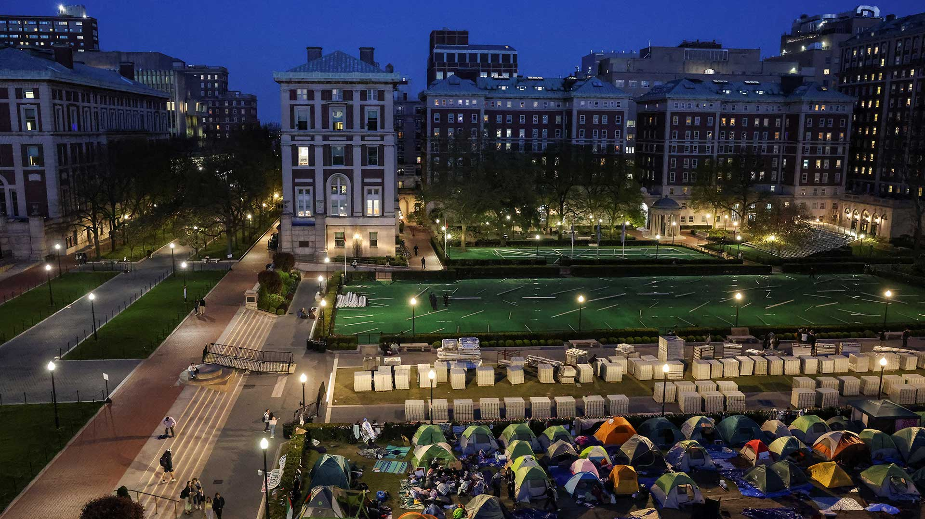
Image: Notice and Wonder
Instructions: Look at the image and write down 2-3 things you notice (key details, main ideas, themes) and then write down 2-3 things you wonder (questions you have because of the image, things you are curious about when you look at the image.)

Slide 2
Review Vocabulary
culmination
The highest point or final stage of development, often reached after a long process or series of events.
The graduation ceremony was the culmination of four years of hard work and dedication.
escalating
To increase or become more intense, especially in a way that is dangerous or harmful.
The escalating tensions between the two countries led to a full-blown war.
condone
To accept or allow something that is wrong or morally unacceptable.
The government cannot condone violence against its citizens.
animosity
Strong hostility or dislike, often accompanied by a feeling of hatred.
The animosity between the two families stemmed from a long-standing feud.
equivocating
To use ambiguous language to avoid giving a clear or direct answer.
The politician's response to the question was evasive and equivocating.

Slide 3
ACE Short Answer Question
1. What was the main argument made by Rabbi David Wolpe regarding the student statement at Harvard University?

Slide 4
ACE Short Answer Question
2. What was the main reason for the crackdown on protests at Columbia University?

Slide 5
Open Ended Question
Write your answer below. Then, when instructed, discuss your answers with your partner or group. Use the second box to take notes on what their answers were in the space provided.
1. The text explores the complex and often heated debate surrounding the Israeli-Palestinian conflict on American college campuses. How do you think this debate might manifest itself in your own school or community? What are some ways that you can engage in these conversations respectfully and constructively?

Slide 6
Open Ended Question
Write your answer below. Then, when instructed, discuss your answers with your partner or group. Use the second box to take notes on what their answers were in the space provided.
2. The text highlights the challenges of balancing free speech with the need to prevent harassment and discrimination on college campuses. How do you think this balance should be struck? What are some examples of speech that you think should be protected, and what are some examples of speech that you think should be restricted?

Slide 7
Open Ended Question
Write your answer below. Then, when instructed, discuss your answers with your partner or group. Use the second box to take notes on what their answers were in the space provided.
3. The text discusses the role of powerful interests, such as donors and alumni, in shaping the discourse on college campuses. How do you think these external pressures influence the way that issues are debated and discussed? Do you think that these pressures are a positive or negative force in higher education?

