Slide 1
Summer Screenshots: Hot Nights and Cold War
Teaching the History of Cambodia through the film, The Missing Picture
A K-14 Curriculum component

Slide 2
Terms for classroom use
Khmer
Angkor Kingdom
Yasodharapura
Hinduism
Buddhism
Angkor Wat
Phnom Penh
Imperialism
Colonialism
French coloniall Indochina
Vietnam War
Ho Chi Minh Trail
President Richard Nixon
Operation Menu
Kent State protest & shooting
communism
Pol Pot
Khmer Rouge
Peap pray
Anka
Rithy Panh

Slide 3
Historical Timeline of Cambodia
4th c. CE Earliest written records in Cambodian script
15th c. CE Buddhism becomes main religion; Phom Penh becomes capital
1953, Cambodian gains independence from France and enters into short-lived golden age.
1975, Communist forces known as Khmer Rouge seize power
9th c. CE Establishment of kingdom of Ankgor
1863, French invited as protectors, develops into full-scale colonial control
Late 1960s, Cambodia is drawn into the Vietnam War.
1979, Vietnamese forces invade Cambodia and overthrow the Khmer Rouge

Slide 4
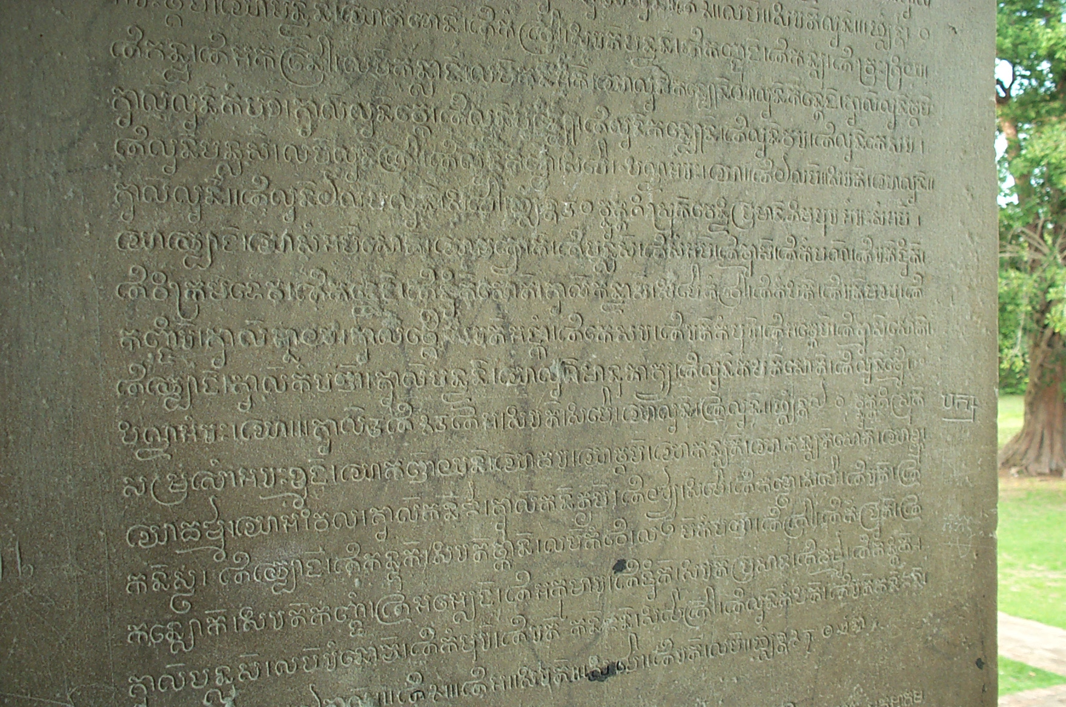
Ancient Cambodia
In ancient times, Cambodia was heavily influenced by Chinese and Indian traders who interacted with its coastal populations well before the common era.
The earliest dated inscriptions that survive are from massive stone sculptures were written in the 4th c. CE in Hindu Sanskrit and Cambodian, or Khmer.
Ancient Khmer script

Slide 5
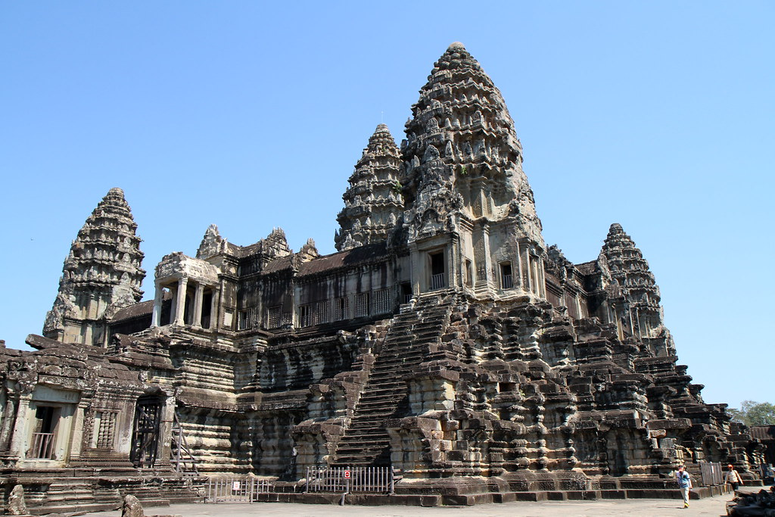
Cambodia’s Golden Age
For about seven centuries, from the 9th through 16th century, Cambodia enjoyed a golden age as the kingdom of Angkor. Its capital at Yasodharapura bustled with an agriculture-based population of nearly one million people. The capital's temples, dedicated to Hindu gods or The Buddha, include the famous Hindu temple of Angkor Wat, which is the largest religious monument in the world.
Five Towers of Ankgor Wat

Slide 6
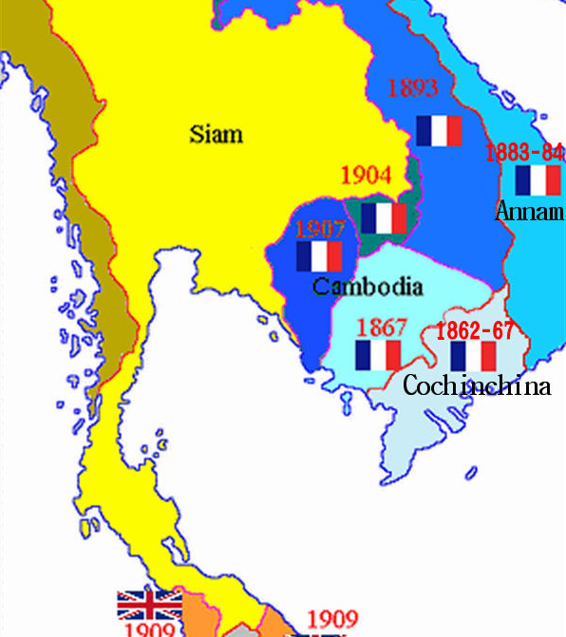
French colonialism in Cambodia
The decline of the Angkor kingdom after the 16th c. was marked by conflicts with Thailand at its borders. In 1863, Cambodia asked the French (who had already begun their imperialist incursion in the region) for protection against Thailand, and soon found themselves under complete French colonial rule.
Cambodia, along with Vietnam and Laos, became part of the French colonial empire in the late 19th c. and were known as Indochine or Indochina.

Slide 7
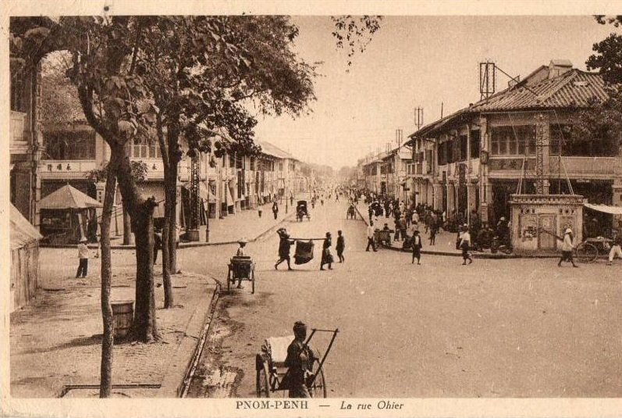
Life under French colonial rule
Despite the many damaging impacts of French colonial rule in Southeast Asia, the Khmer elite of Cambodia fared quite well under the system, making advancements in both their educational and professional attainment.
French colonial policies had a much lighter impact on Cambodia than Vietnam, and modernizations made to the physical infrastructure strengthened the Cambodian economy.
The French also regarded Cambodia's architectural history with respect and restored many religious temples at Yasodharapura.
La rue Ohier in Phnom Penh, which became the capital of Cambodia in the 15th c. As it modernized and developed, it became known as the “Pearl of South Asia”

Slide 8
Cambodian Independence
After Cambodia gained its independence from France in 1953, it entered another golden age, although sadly short-lived. Western fashion and musical tastes became very popular with Cambodian youth, and a liberal optimism prevailed in the decade or so between independence and the Vietnam War.
"Don't Think I've Forgotten: Cambodia's Lost Rock and Roll"

Slide 9
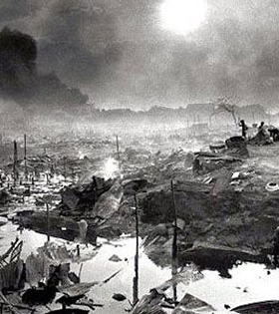
The Vietnam War and Operation Menu
The US military's covert bombing campaign in 1969 decimated the Cambodian countryside.
The Vietnam War, the conflict between the communist North and American-backed democratic South, unavoidably bled into Cambodia by the late 1960s. The Ho Chi Minh Trail (nicknamed for the communist leader of North Vietnam, Ho Chi Minh), provided an underground supply chain from communist North Vietnam to their compatriots in the South. Part of these supply lines were fed from Cambodia.
The United States military, under the presidencies of both Lyndon Johnson and Richard Nixon, sought to blunt these supply lines. Without authorization from Congress or the knowledge of the American people, Nixon ordered the secret bombing of Cambodia in March of 1969, known an "Operation Menu."
After the New York Times revealed the bombings several months later, Nixon openly ordered U.S. ground troops to Cambodia, setting off major protests in the U.S. such as the Kent State protest in 1970 that led to death of several students.

Slide 10
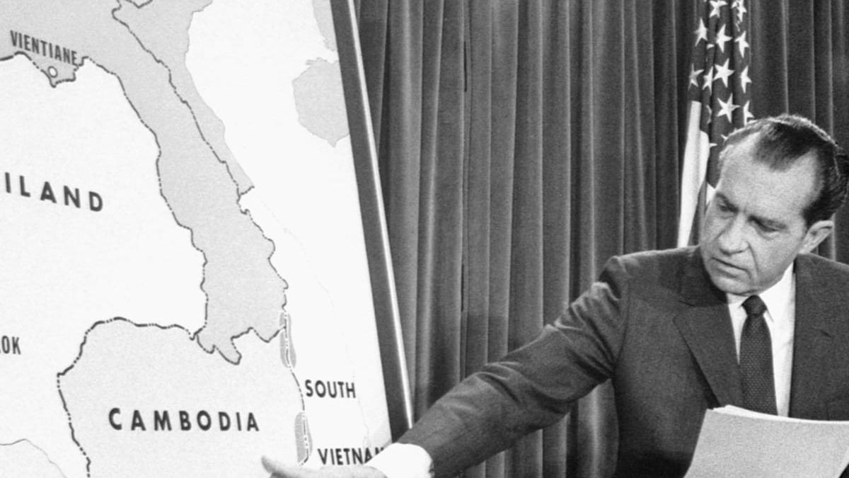
Civil War, further U.S. bombings and the Khmer Rouge
By 1970, Cambodia had descended into civil war. The ruling Khmer prince Norodom Sihanouk decided to cast his fate with the communists, supporting Pol Pot and the Khmer Rouge and received financial support from communist China’s Mao Zedong, as a result. The U.S. government backed the pro-democracy military leader, Lon Nol, who ousted Prince Sihanouk in 1972 with U.S. support.
Further U.S. military bombings were order by Nixon in 1973 after the Khmer Rouge, a fanatical communist revolutionary force known by Cambodians as peap pray, or the forest army, began to strengthen their campaign of terror in the rural villages of Cambodia.
Stories emerged of forced re-locations of entire villages by the Khmer Rouge, immediate executions of any who questioned or disobeyed, banning of religious practices, murder of monks, and the forced separation of families.
However, the U.S. military bombings (2.7 million tons of explosives were dropped on Cambodia between 1965 and 1973 by the U.S.) and class antagonisms exploited by the Khmer Rouge created enemies of the United States within the Cambodian population.
Image: President Richard Nixon discusses plans for U.S. military operations in Cambodia

Slide 11
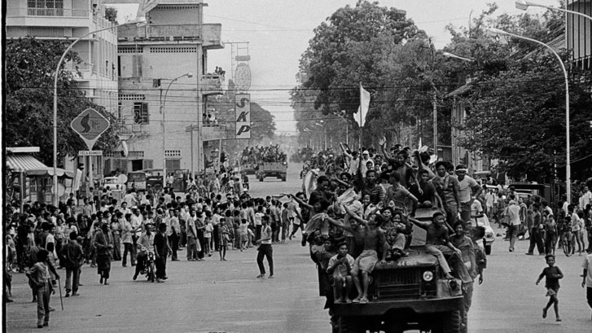
The Khmer Rouge takes over
By 1973, the communist party of Cambodia had further radicalized under the control of its most fanatical members, Pol Pot and Son Sen, who believed that Cambodia needed to go through a social revolution that destroyed all traces of its past.
To that end, the Khmer Rouge tortured and murdered untold numbers of civilians, destroyed Buddhist and Hindu temples, tortured and murdered monks, practiced infanticide, abducted and assassinated journalists, and shelled the capital of Phnom Penh for more than a year until U.S. forces pulled out of Cambodia in April, 1975. Shortly after, Phnom Penh fell to the Khmer Rouge.
The fall of Phnom Penh, 1975.

Slide 12
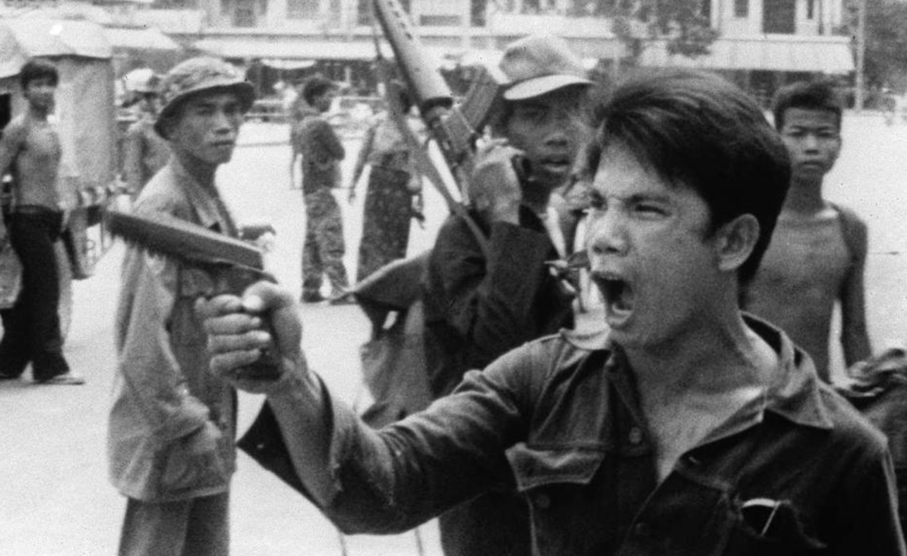
Reign of Terror
The Khmer Rouge ruled over the Cambodian people with a reign of terror.
Families were separated, forced to wear black uniforms, cut their hair, change their names, and give up all personal possessions. Children were indoctrinated and forced to become child soldiers, and informed on their parents and sibling to survive. Girls and women were raped and brutalized and forced into Khmer Rouge marriages. People were starved and overworked to death in the re-education camps—all ultimately dehumanized by the Khmer Rouge.
The Khmer Rouge’s goal was to erase the past. To that end, the day that the capital city of Phnom Penh fell—April 17, 1975—was “Zero Hour” or Day 1 on the Khmer Rouge calendar.
The inner circle of Pol Pot’s regime was called the “Anka” or “center,” and they tortured and murdered so-called enemies of their new state with impunity.
The Khmer Rouge’s reign of terror lasted for 4 years, only ending when Vietnamese forces invaded Cambodia in 1979 and overthrew them.

Slide 13
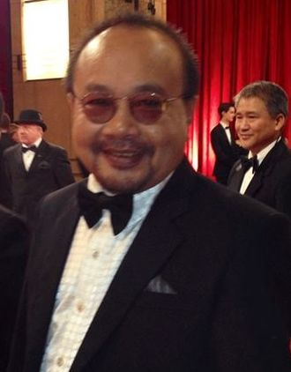
Context for The Missing Picture: Rithy Panh
Rithy Panh, the director of The Missing Picture, was 11 years old when Phnom Penh fell to the Khmer Rouge.
Panh’s father was a high official in the Ministry of Education and a member of the Cambodian Senate, and therefore, the Panh family was specifically targeted by the Khmer Rouge as enemies of the revolution.
Panh’s parents, siblings, and other relatives died of overwork or malnutrition in the Khmer Rouge labor camps, but Panh himself escaped to Thailand in 1979 where he was given refugee status.
Panh eventually setttled in Paris, where he began to train as a carpenter until he was handed a video camera at a party and became interested in film-making.
He graduated in cinematographic studies in Paris, and returned to Cambodia in 1990 while still splitting his time in Paris.
Director Rithy Panh in Hollywood

Slide 14

Teaching The Missing Picture
Rithy Panh narrates his film in first person and uses clay figures to help him to remember and process the trauma he and his family experienced during the Khmer Rouge’s brutal reign of terror in Cambodia.
After the Powerpoint presentation and notes, but before viewing parts or all of the film, teachers may want to provide students with the graphic organizer on right to help them prepare themselves for the viewing.
Under the “I Think” and “I’m Curious About” columns, ask students to work in pairs to discuss 1.) why they think the film is called The Missing Picture 2.) why they think Panh used clay figures to depict his story 3.) what they think of the history of Cambodia so far 4.) what they are curious to know more about

Slide 15
Quotes from The Missing Picture: before the fall of Pnomh Penh
THEMES: INNOCENCE, PEACE
“I seek my childhood like a lost picture or rather it seeks me.”
“His suit is white. His tie is dark. I want to hold him close. He is my father.”
“I remember how sweet life was. Then came the war.”
Suggested Activities:
Have students come up with the themes based on the quotes and discuss as a class.
Have students consider how they would remember their childhood if it was represented as a single picture.
Have students consider what they would miss most about their lives if they were interrupted and impacted by war.

Slide 16
Quotes from the Fall of Phnom Penh
THEMES: DEHUMANIZATION, FEAR, LOSS
“They entered the capital on April, 17, 1975. There were no cries of joy, only sign of the expectancy. I was there. I remember the look in the eyes of the young soldiers as if we had not been there.”
“The city is impure. The city is corrupt. It is emptied within hours. Two million people are thrown onto the roads. They leave behind their homes, their loved ones, their memories. In fact, their former worlds.”
Suggested Activities:
Have students come up with themes for the quotes.
Have students do a bit of research on the Fall of Phnom Penh and create a Storymap of the events leading up to it.
Discuss with students the role of “young soldiers” in the Khmer Rouge. Why were the young recruited in the Khmer Rouge’s armies? Have the students do research on the use of child soldiers in other world conflicts and/or civil wars.
Ask students why they think the Khmer Rouge wanted to empty Phnom Penh of its inhabitants.

Slide 17
Quotes from The Missing Picture: the takeover
THEMES: DEHUMANIZATION, LOSS, FEAR
“Immediately the Khmer Rouge counted then separated women and men, adults and children. Souvenirs were forbidden. All personal effects. Suddenly there were no individuals. Only numbers.”
“They cut our hair. They take our watches, glasses, toys, books. They dye our clothes black, they change our first names. We are the new people-bourgeoisie, intellectuals and capitalsts to be eradicated and destroyed.”
“Soon there will be no more faces, no more friends, no more love, no more father and mother. Soon there will be no more emotion and even the words will be transformed. Each being will be a revolutionary, a fertilizer for the rice fields.”
“To hang on you must hide within yourself, a strain, a memory, an idea that no one can take from you. For a picture can be stolen. A thought cannot.”
Suggested Activities:
Have students suggest themes for the quotes and explain why they have chosen them.
Discuss the term “class warfare” with students to help them to better understand quote #2. Ask students to research other revolutions in world history (French, Russian, Chinese) that were based on class warfare. Have students compare and contrast those revolutions with Cambodia’s.
Ask students to consider how dehumanization is, in particular, emphasized as a goal of the Khmer Rouge. Why would they do this? What was their strategy?

Slide 18
Quotes from The Missing Picture: the use of propaganda
THEMES: MANIPULATION, PROPAGANDA
“The Anka: Long life to a new society devoid of rich and poor.”
“Comrade, you are so very free, from now you must obey. Dig ceaselessly, move earth, move rock.”
“The spade in your pen. The rice field is your paper.”
Suggested Activities:
Have students come up with the themes for these quotes.
Discuss the “Anka.” What was its role, what did it mean? Do more research as a class for a better understanding of this term.
Ask students to compare the strategies of the Khmer Rouge with the Nazis during the Holocaust. Consider the fact that the words, “Work will set you free.” were displayed over the entrances of the concentration camps at Dachau and Auschwitz.
What is the meaning of the 3rd quote? Discuss in particular its reference to class warfare.

Slide 19
Quotes from The Missing Picture: attacks on capitalism
THEMES: INDOCTRINATION, PROPAGANDA, TERROR
“There is no more selling, no more trading. The new people are to be re-educated in the rice fields.”
“The Anka never use an object from imperialist or feudal society.”
“Our only belonging is our spoon.”
“How do you revolt when all you have are your black clothes and a spoon.”
“They turn the high school into a torture center. They turn Phnom Penh into an execution center.”
Suggested Activities:
Have students come up with themes for quotes.
Make sure students understand what the term propaganda means by having them provide examples of it.
Discuss the irony of the Khmer Rouge using the capital city and its high school as execution and torture centers.
Have students conduct research on the Khmer Rouge’s leader, Pol Pot? Was he a revolutionary peasant in the fashion on Mao Zedong or an educated intellectual in the style of Maximilian Robespiere or Vladimir Lenin? How did his background and tactics compare and contrast with his predecessors?

Slide 20
“Now I Understand”
When you have completed viewing the film (or parts of it), have discussed the quotes, and completed some of the suggested activities, have students reflect by completing the final portion of their graphic organizer, “Now I understand.” What didn’t they know or understand before viewing the film, that they now know or understand and how?
Share with your students the saying, “Those who cannot remember the past are condemned to repeat it.” Ask students to reflect on this statement in regards to The Missing Picture.

