Slide 1
The Day of the Pelican
by Katherine Paterson
Karen Gaul, Winchester Thurston School

Slide 2
Overview
Welcome and Introductions
A Brief History of Kosovo
Reflections on Day of the Pelican - Time and Place
Example Curricular Use for the Middle Years Learner
Break (Examine related books and curricular materials)
Reflections on Day of the Pelican - Story Events
Sharing of Important Points to Take Away from Our Conversation

Slide 3
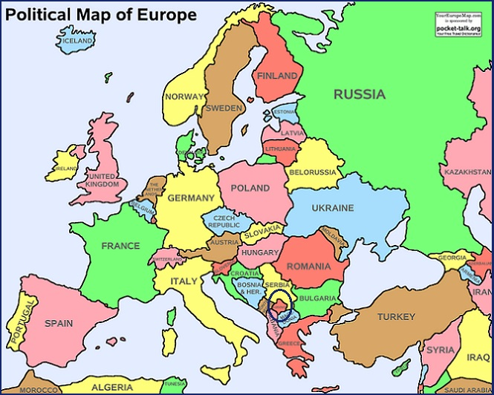
Notes:
Discuss location of Kosovo within Europe. Next slide is Kosovo map with demographics.

Slide 4
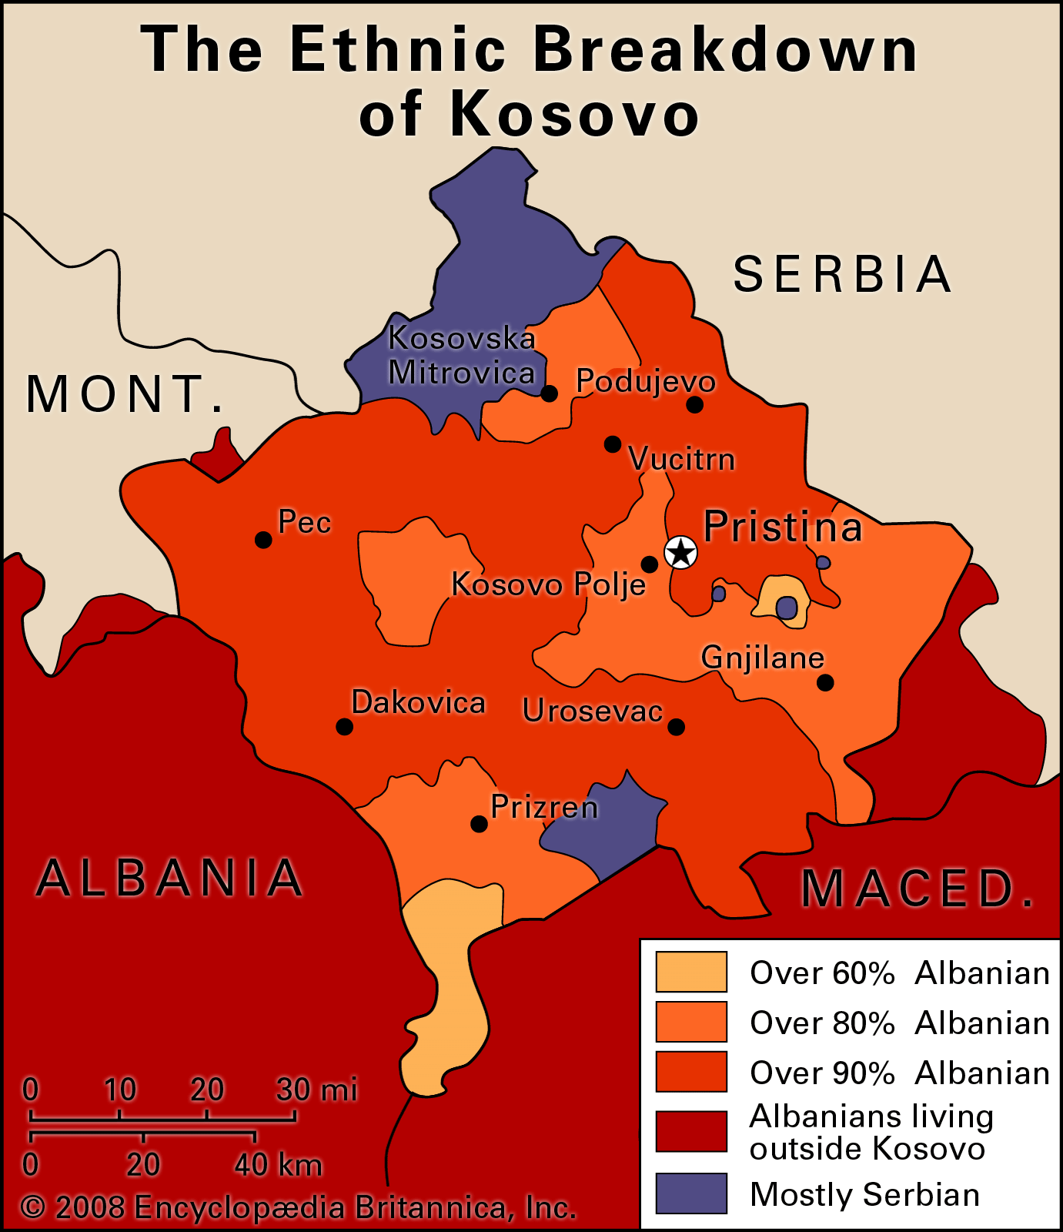

Slide 5
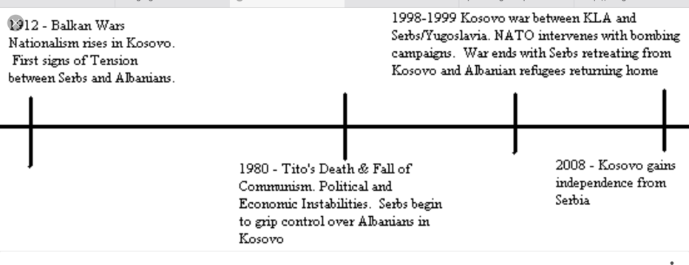
Timeline of Event Leading to Independence
Notes:
1912 is first date. Part of Ottoman Empire for 500 years before that. In 1918 Kosovo is part of Yugoslavia.

Slide 6
Notes:
https://youtu.be/rusF4OJzGbo

Slide 7
Broad Topics - Time and Place
NATO
Nationalism
Slobodan Milošević
Kosovo Liberation Army
Welcoming Refugees
Recognition as a Country
UN Declaration of Human Rights
Notes:
move forward to next slide (airlift 1999) and then back again.

Slide 8
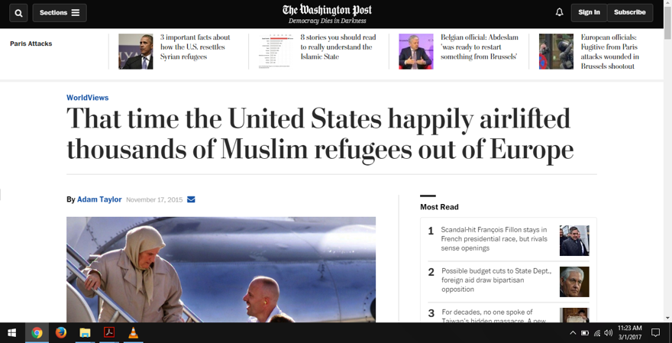
May 6, 1999

Slide 9
Broad Topics - Time and Place
NATO
Nationalism
Slobodan Milošević
Kosovo Liberation Army
Welcoming Refugees
Recognition as a Country
UN Declaration of Human Rights

Slide 10
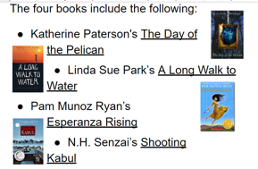
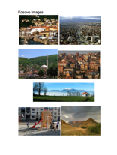
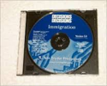
Fifth Grade Book Club Unit
Connection to contemporary immigration topics
Small groups of students assigned to one of several novels, each with a refugee theme
Book Club work complemented with Decisions, Decisions (Tom Synder/Scholastic) refugee study unit in social studies class
Pelican used with my top readers, typically a group of three or four students

Slide 11
The Journey by Francesca Sanna

Slide 12
Break
Coming up after break...
Reflections on Day of the Pelican - Story Events
Sharing of Important Points to Take Away from Our Conversation

Slide 13
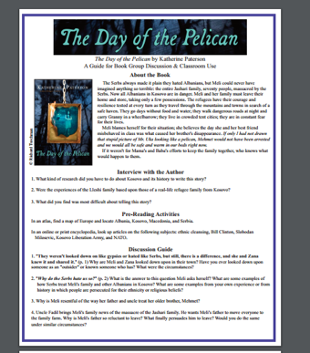
Reflections on Day of the Pelican - Story Events

Slide 14
January 2017
Notes:
remember take aways

Slide 15
The Day of the Pelican
by Katherine Paterson
Karen Gaul, Winchester Thurston School
gaulk@winchesterthurston.org

